Slide 1

Welcome to Year 4

Slide 2
The Team
Mrs Winster, Mrs Eastham and Mrs Martin

Slide 3
How do we learn in Year 4?
By:
Listening attentively
Sharing ideas with others
Working in pairs
Working individually
Working towards targets
Recording ideas and work
Using a range of resources

Slide 4

Year 4
Curriculum
English
Maths
Science
History
Geography
Computing
Art
Design and Technology
PE
RE
PSHE (Personal, Social, Health Education)
Music
French

Slide 5
Assessment
At the start of the year, we carry out a spelling assessment and a writing assessment.
We assess the children’s knowledge at the start of each Maths unit.
We carry out ongoing assessments in all subjects.
At the end if each term we have an NFER assessment test in reading and maths.
During the summer term, we carry out a timetables assessment.

Slide 6
Additional Support
There may be some skills gaps, which we identify during our assessments. We will be aware of possible gaps in teaching and learning when we start a new unit.
Some individual children may have addition support to help plug the gaps. This may be 1:1 support or a small group.

Slide 7
Maths
We use WhiteRose Maths scheme in school.
At the end of Year 4, children should take part in a statutory Multiplication Tables Check. They are expected to know all their times tables up to 12x12.
If you are looking for further information please visit the website below: https://www.theschoolrun.com/primary-school-times-tables-tests-explained
We will be working hard in class but would appreciate if you could practise at home too. There will be weekly times tables activities set on Purple Mash by your child’s teacher.

Slide 8
English and Reading
Home reading books will be sent home every Monday. It would be useful if you child’s book is in school each day.
It is important that you read the home reader with your child as the Teacher’s focus will be on guided reading.
Please read with your child at home for 20 minutes each evening and ask questions about what your child has read, the characters, the meanings of words and what they think might happen next.
We will have high expectations of handwriting and it will be taught as a weekly lesson.
To start, we will recap Year 3 Key words for our Spellings.
There are a variety of strategies to learn spellings which are on the next slide.

Slide 9
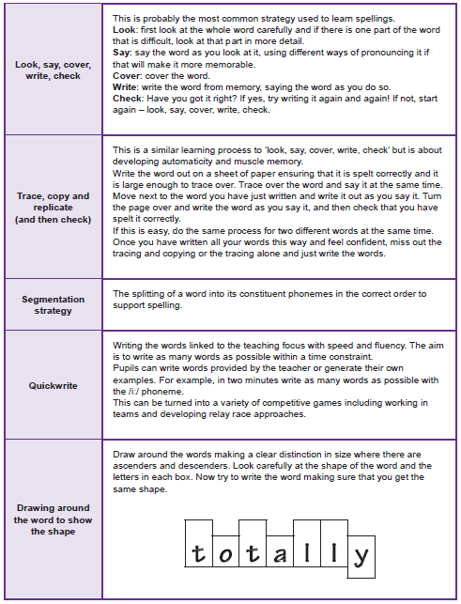

Slide 10
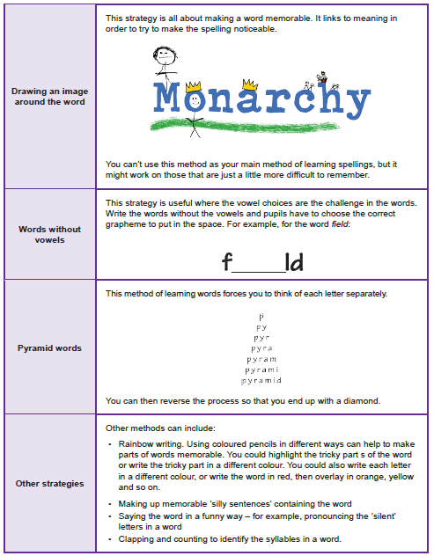

Slide 11
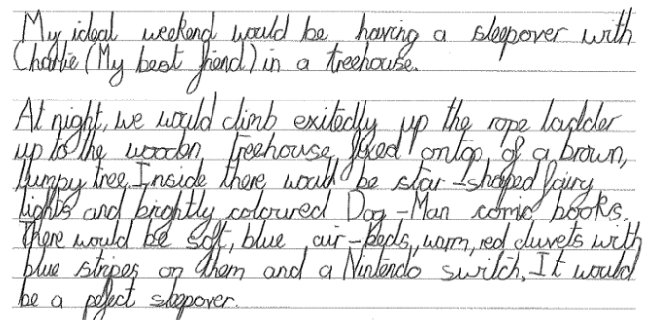
Year 4 Writing Skills

Slide 12
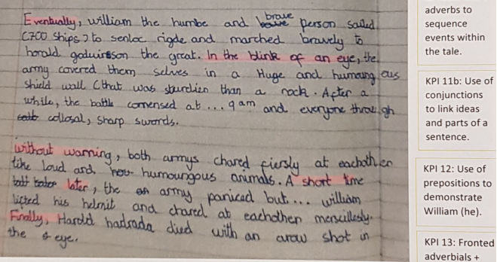

Slide 13
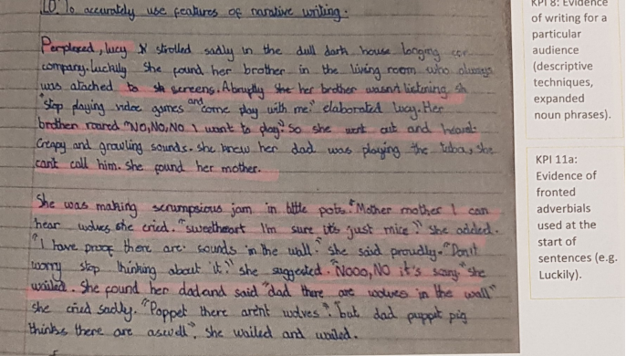

Slide 14
Composition |  | Transcription
Vocabulary, grammar and punctuation | Composition | Spelling | Handwriting
As above and: Create complex sentences with adverb starters e.g. Silently trudging through the snow, Sam made his way up the mountain. Use commas to mark clauses in complex sentences. Create sentences with fronted adverbials for when e.g. As the clock struck twelve, the soldiers sprang into action. Create sentences with fronted adverbials for where e.g. In the distance, a lone wolf howled. Use commas after fronted adverbials. Identify, select and use determiners including: - articles: a/an, the - demonstratives : this/that; these/those - possessives: my/your/his/her/its/our/their - quantifiers: some, any, no, many, much, every Use inverted commas and other punctuation to indicate direct speech e.g. The tour guide announced, “Be back here at four o’ clock.” Identify, select and effectively use pronouns. Use nouns for precision, e.g. burglar rather than man, bungalow rather than house. Explore, identify, collect and use noun phrases e.g. the crumbly cookie with tasty marshmallow pieces. Explore, identify and use Standard English verb inflections for writing e.g. We were instead of we was. I was instead of I were, I did instead of I done. She saw it instead of she seen it. Use apostrophes for singular and plural possession e.g. the dog’s bone and the dogs’ bones. | As above and: Planning Read and analyse narrative, non-fiction and poetry in order to plan their own versions. Identify and discuss the purpose, audience, structure, vocabulary and grammar of narrative, non-fiction and poetry. Discuss and record ideas for planning e.g. story mountain, text map, non-fiction bridge, story board, boxing-up text types to create a plan. Drafting and Writing Develop settings and characterisation using vocabulary to create emphasis, humour, atmosphere, suspense. Plan and write an opening paragraph which combines setting and character/s. Improvise and compose dialogue, demonstrating their understanding of Standard and non-Standard English. Generate and select from vocabulary banks e.g. adverbial phrases, technical language, persuasive phrases, alliteration. Use different sentence structures (see VGP). Use paragraphs to organise writing in fiction and non-fiction texts. Use organisational devices in non-fiction writing, e.g. captions, text boxes, diagram, lists. Link ideas across paragraphs using fronted adverbials for when and where e.g. Several hours later…, Back at home… Evaluating and Editing Proofread to check for errors in spelling, grammar and punctuation. Discuss and propose changes to own and others’ writing with partners/small groups. Improve writing in light of evaluation. Performing Use appropriate intonation, tone and volume to present their writing to a range of audiences. | As above and: Use further prefixes, e.g. in- , im- ir–, sub–, inter–, super–, anti–, auto–. Use further suffixes, e.g. –ation, - tion, –ssion, –cian. Investigate what happens to words ending in f when suffixes are added, e.g. calf/calves. Identify and spell words with the /k/ sound spelt ch (Greek in origin), e.g. scheme, chorus. Identify and spell words with the /ʃ/ sound spelt ch (mostly French in origin), e.g. chef, chalet, machine. Identify and spell words ending with the /g/ sound spelt –gue and the /k/ sound spelt –que (French in origin), e.g. tongue, antique. Identify and spell words with the /s/ sound spelt sc (Latin in origin), e.g. science, scene. Understand how diminutives are formed using e.g. suffix - ette and prefix mini-. Investigate ways in which nouns and adjectives can be made into verbs by the use of suffixes e.g. pollen (noun) and –ate = pollinate (verb). The /ɪ/ sound spelt y elsewhere than at the end of words, e.g. myth, gym, Egypt. Use the first three letters of a word to check its spelling in a dictionary. Write from memory simple sentences, dictated by the teacher, that include words and punctuation taught so far. Explore and use the possessive apostrophe, e.g. boy’s books (books belonging to a boy) and boys’ books (books belonging to more than one boy). Spell words from the Year 4 list (selected from the statutory Year 3/4 word list) - see below. | As above and: Use a joined style throughout their independent writing. Write with consistency in size and proportion of letters, e.g. by ensuring that the downstrokes of letters are parallel and equidistant; that lines of writing are spaced sufficiently so that the ascenders and descenders of letters do not touch.

Slide 15
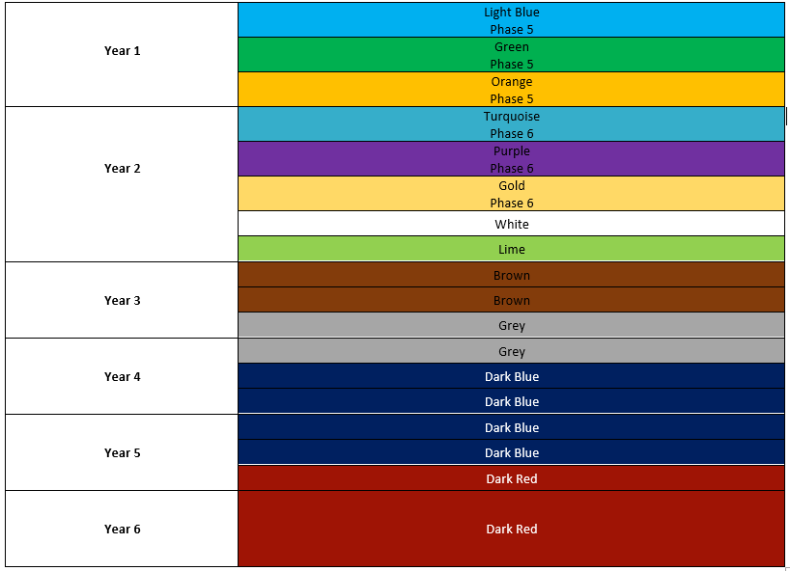
Book Bands

Slide 16

RE
Autumn Term
People
Called
Gift
Spring Term
Community
Giving and receiving
Self-Discipline
Summer Term
New life
Building bridges
God’s People

Slide 17
Useful information
For Year 4:
a water bottle filled with water (not juice)
a healthy snack for break time
PE kit- PE will take place on Tuesday and Wednesday.
Correct uniform
Please do not bring in any other items or bags from home other than your lunch bag.
Watches are allowed to be worn but please be mindful that they can be a distraction.

Slide 18
Earrings
Safe Practice in PE states that, ‘The Association for Physical Education strongly recommends the practice of removing all personal effects at the commencement of every lesson to establish a safe working environment. This applies to all ear and body piercings.’
The teacher has duty of care for the safety of children.
Staff can not remove or tape (cover) earrings.
Many children can not remove earrings themselves.
Children can only participate in parts of the lesson if earrings are worn.
School can not be held responsible for losses of removed earrings.
The earrings worn in the past were becoming more and more unsuitable and unsafe as people deviated away from the single plain stud.
For these reasons, earrings are not allowed in school.

Slide 19
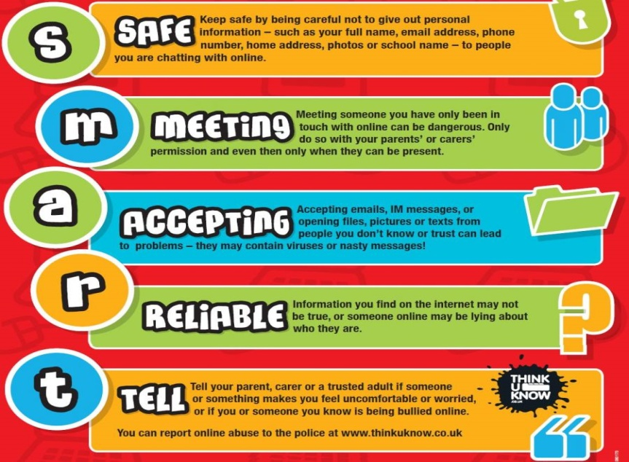
Online Safety
We follow the SMART e-safety rules.
In Year 4 our lessons will cover:
what it means to be responsible and respectful offline and online
the importance of their online identity
what to do if something worries or upsets them online

Slide 20
Behaviour Charter
Pupils are expected to follow
Our Behaviour Charter
This is a whole school approach.
We aim to promote a positive atmosphere in the classroom and in our school.
We encourage the children to…
Be Safe
Be a Learner
Be Kind and Respectful

Slide 21
Behaviour Charter
To achieve this we might use ….
A positive approach
Praise/Praise Assembly
Class Dojos
Rewards
Certificates

Slide 22
Working together
We would like to thank you for your continued support of the education of your child during this unique time.
If you wish to contact us please don’t hesitate to Dojo us.
Don’t forget to check the school website for class pages, curriculum, class photos etc.

