Slide 1
Welcome to Year 5
Class Teachers
Mrs Pilkington & Mrs Eccles Teaching Assistant
Mrs Brown

Slide 2
Vision for the Year
For EVERYONE to:
Be the best learners that they can be with increasing independence
Secure key skills within a broad and rich curriculum
Grow spiritually, physically, morally and intellectually.

Slide 3
Year 5J Class Page
https://www.ourlady-st-gerards.lancs.sch.uk/year-5-johnson-class-2/
Information regarding the Curriculum will also be available on there, such as curriculum maps and homework links.

Slide 4
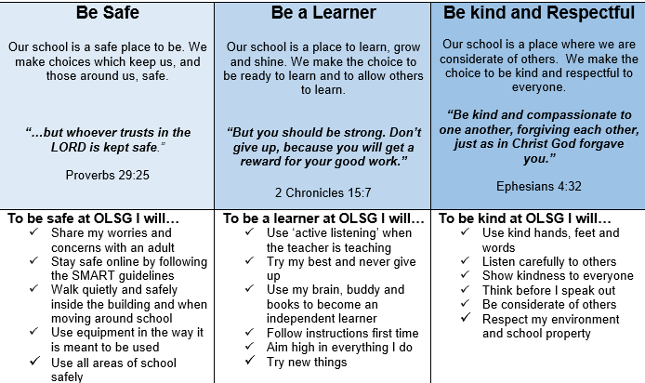
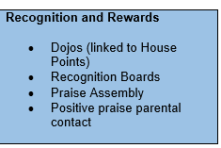
Our Behaviour Charter
Relentless Routines (Every day, with pride!)
1. We wear full school uniform
2. We walk calmly and quietly when moving around school and respect all areas of school
3. We follow instructions first time
4. We allow teachers to teach and learners to learn
5. We are kind and respectful to everyone

Slide 5
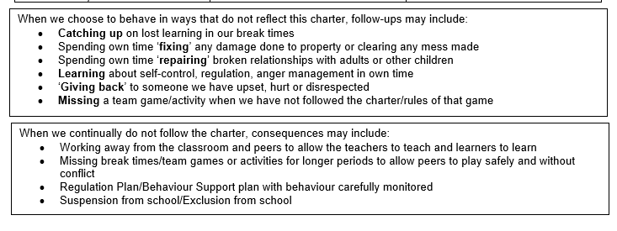

Slide 6
Year 5 curriculum in brief
English / Maths – Daily, Monday to Friday
Science x 1 a week / Computing x 1 a week / P.E x 2 lessons a week / Geography half termly / Art half termly / History half termly / Design Technology half termly / French x1 a week
Religious Education – timetabled for two and half hours every week.
Physical Education – children must have their correct P.E kit in school every day. PE is on a Tuesday and Thursday this half term and may change throughout the year.

Slide 7
Earrings
Safe Practice in PE states that, ‘The Association for Physical Education strongly recommends the practice of removing all personal effects at the commencement of every lesson to establish a safe working environment. This applies to all ear and body piercings.’
The teacher has duty of care for the safety of children.
Staff can not remove or tape (cover) earrings.
Many children can not remove earrings themselves.
Children can only participate in parts of the lesson if earrings are worn.
School can not be held responsible for losses of removed earrings.
The earrings worn in the past were becoming more and more unsuitable and unsafe as people deviated away from the single plain stud.
For these reasons, earrings are not allowed in school.

Slide 8
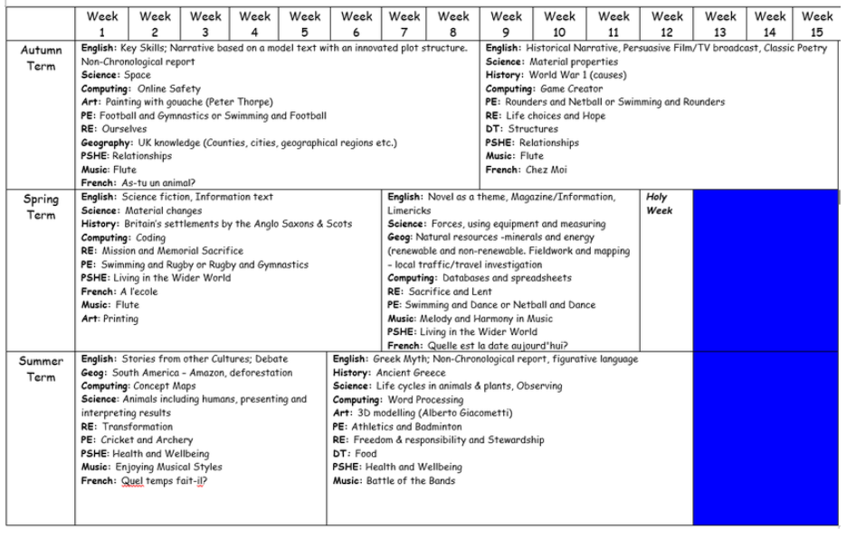

Slide 9
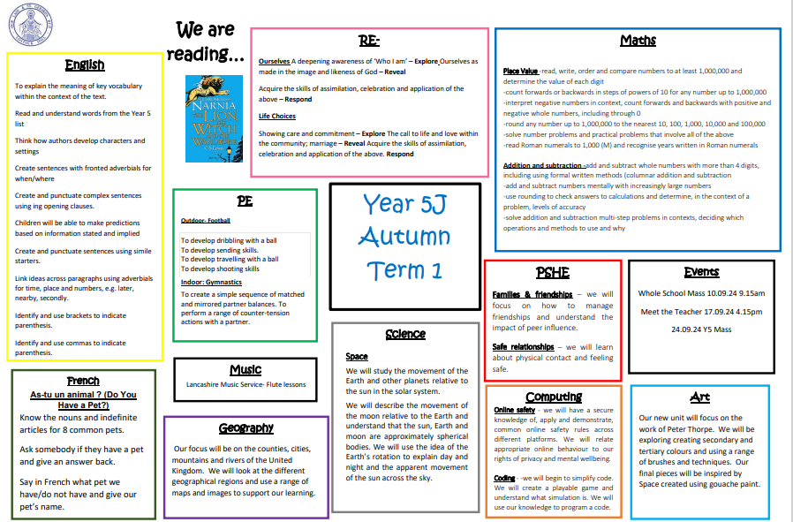

Slide 10
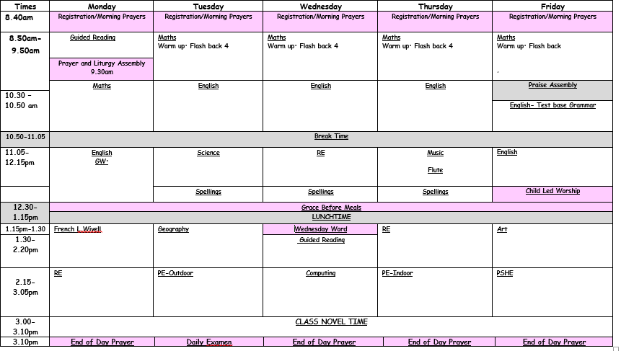

Slide 11






English Curriculum
We are really proud of our English curriculum. We use a range of texts, both fiction, non-fiction and poetry within our units. Our chosen texts are age-appropriate, exciting and diverse.
More information about the key skills that we cover within our lessons can be found on our curriculum map each half term.

Slide 12

Reading
There are many reading opportunities every day in Year 5 which include:
  Home reading
  Guided reading (Whole class/small groups)
  1:1 Reading
  Peer Reading
  Independent Reading
  Class novel
  In Year 5 we are developing stamina as a reader and accessing a wide range of authors and texts.
  Regular reading helps to develop vocabulary, improve spellings and the ability to read at pace and with understanding.

Slide 13
Home Reading books
Please make sure your child reads daily.
This doesn’t always have to be their home reading book, it can be newspapers, magazines etc. We expect a minimum of 3 times a week on their school book. These are important as they are pitched at the level your child is working at and exposes them to our key vocabulary.
Finished book will be placed in a basket ready to be changed.

Slide 14
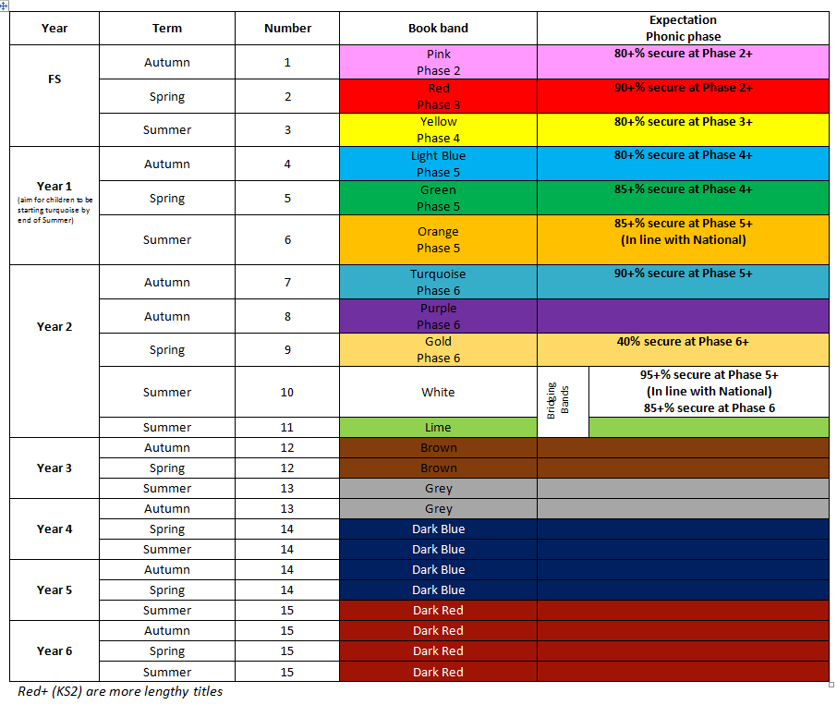

Slide 15
Writing
In Year 5, we write every day :
  In English, we teach:
    A range of genres (fiction / non-fiction)
    Grammar (SPaG)
    Handwriting
  Writing across the curriculum
    Science, Geography, RE, History
  Handwriting – all handwriting should be joined and legible

Slide 16
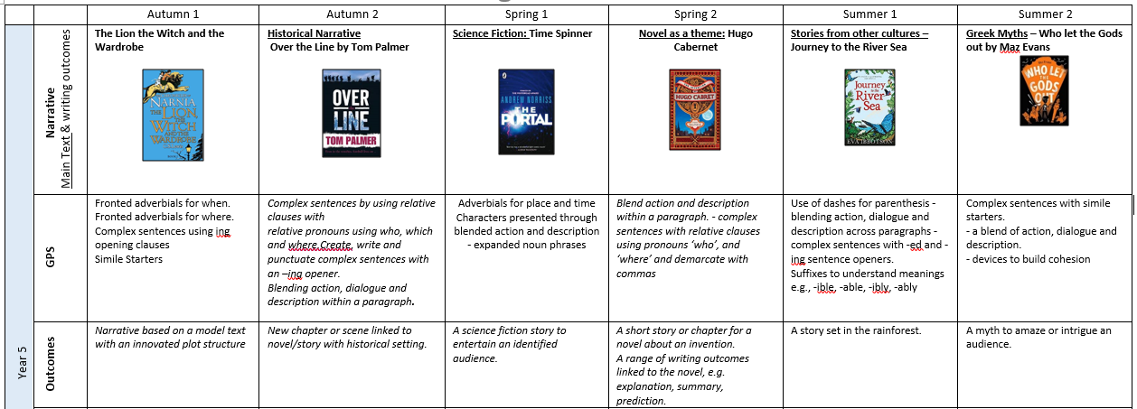

Slide 17
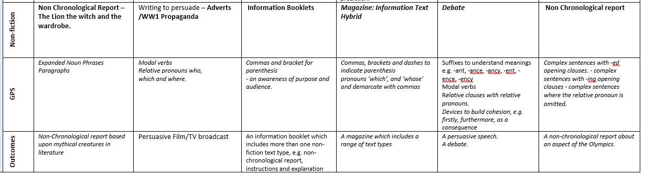

Slide 18
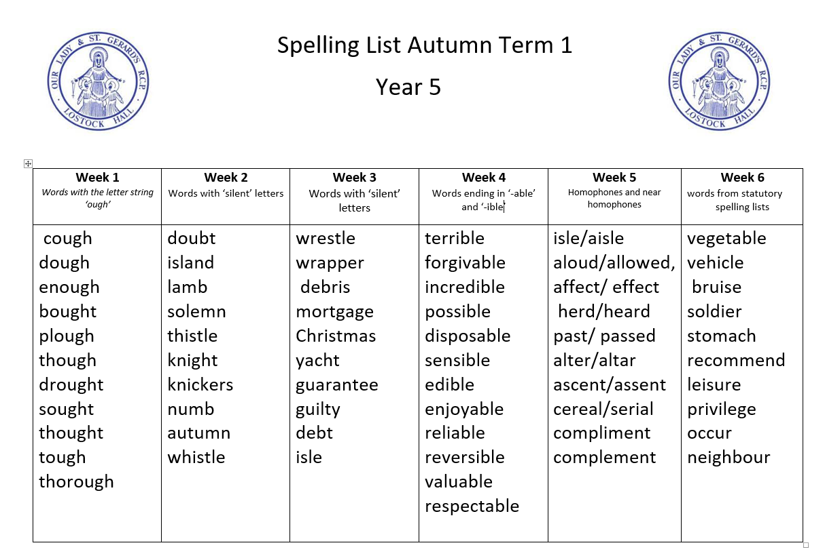
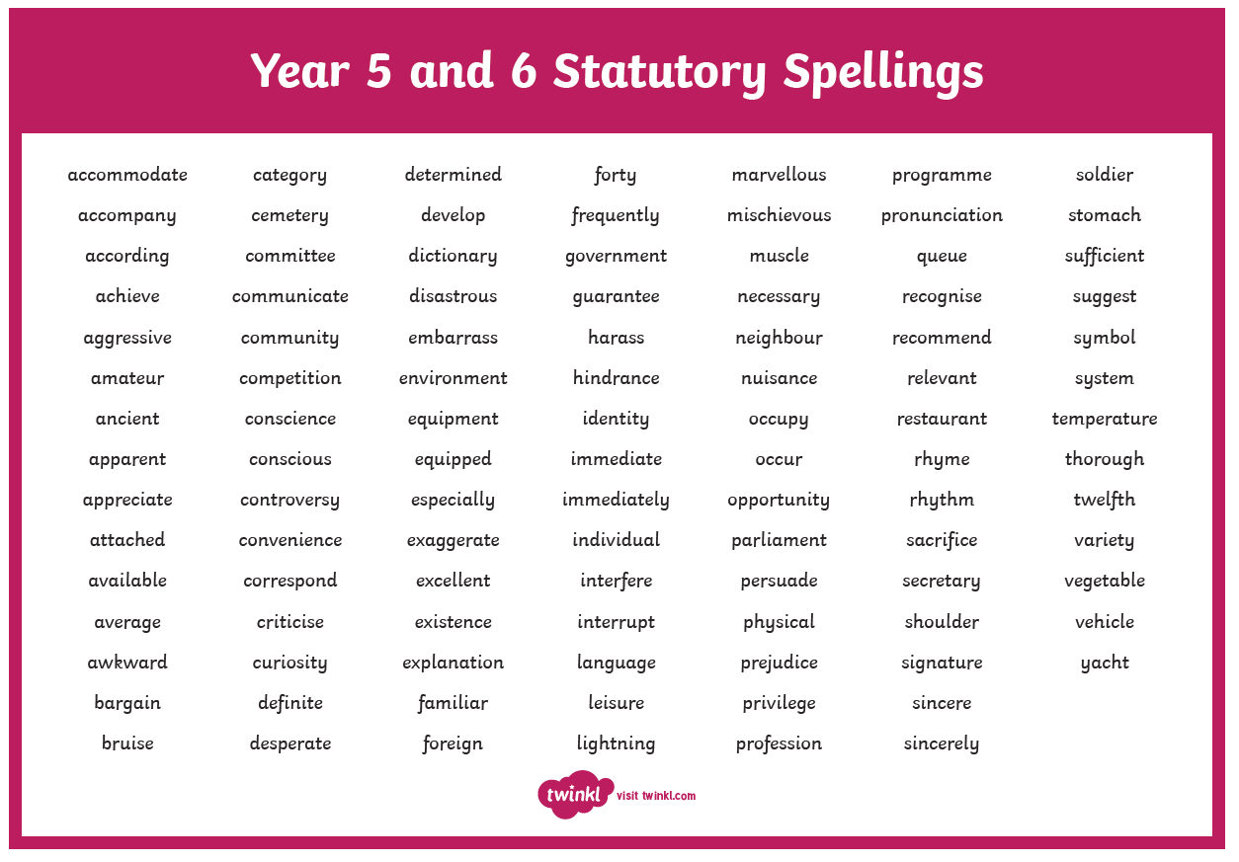
Spelling
We focus on a different spelling rule each week, following the No Nonsense Spelling scheme
Children should learn the Year 5/6 spelling list at home.
Spellings lists will be shared on class dojo at the beginning of each term. This is for your reference and the children will NOT be tested weekly.

Slide 19

Maths
We follow the White Rose scheme of work which uses a range of strategies in Year 5:
  Mental methods – the ability to recall and calculate at pace
  Written methods – we practise the formal written methods followed in our Calculations Policy
  Problem solving / Reasoning – the children will be challenged in every lesson to use their Maths skills and apply them to a range of contexts
Times tables facts- It is important that everyone knows their times table facts up to 12 x 12. (Please note that by the end of year 4, children should know their multiplication and associated division facts up to 12x12. )
  The children have the White Rose work books in school and use jotters alongside these for any working out or extra calculations.

Slide 20

White Rose have also produced Practice Journals which are fully aligned to the curriculum we follow in school. These may be useful as an additional resource to use at home – these are not compulsory but are great for extra consolidation. They can be purchased from Amazon for £4.99

Slide 21

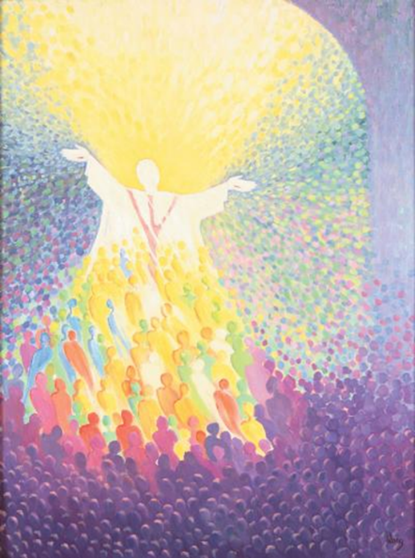
RE
Autumn Term
    Ourselves
    Life choices
    Hope
Spring Term
    Mission
    Memorial sacrifice
    Sacrifice
Summer Term
    Transformation
    Freedom and responsibility
    Stewardship

Slide 22
How can you help?
Listen to your child read often (it is still important for them to develop expression, understanding and discussion of new vocabulary)
Help them to learn their year 5/6 spellings (little and often works best)
Keep practising number bonds and times tables
Use the parent overviews sent out each half term to ask your child questions about their learning.

Slide 23

Homework
Reading
At least 3 times a week on their school book
Maths/English
These will be set on purple mash every Friday and be due in the following Thursday.
Occasionally, class teachers may ask children to complete a research piece of homework or a creative activity linked to the wider curriculum.

Slide 24
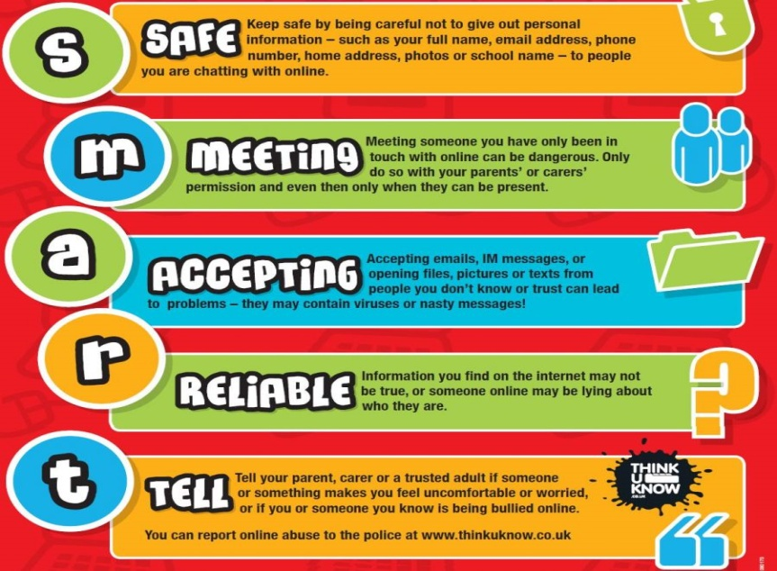
Online Safety
Taught in the Autumn term and revisited regularly
throughout the year.
We follow the SMART e-safety rules.
In Year 5, our focus is on:
the use of age appropriate websites including social media;
not sharing personal information online;
knowing what to do if something worries or upsets them online.
As a school, we teach our children how to use the internet responsibly.

Slide 25


Slide 26

Year 5 School Trip
On Tuesday 12th November at 5pm there will be a parents meeting about the upcoming residential.
Our residential is booked for Monday 25th November- Wednesday 27th November.

Slide 27


Working Together
  If you have any queries regarding your child, please do not hesitate to contact us on class dojo (Mrs Eccles – Mon/Tues, Mrs Pilkington – Weds/Thurs/Fri)or make an appointment through the office.
  Any important messages please pass to the school office as we often do not get to this messages during the school day as we are working hard to ensure quality education is being given to your child. Attendance and appointment messages must be given to the school office.
  We would like to thank you for your continued support and we are looking forward to a successful school year.

Slide 28

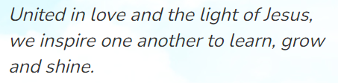
Any Questions?

