Slide 1
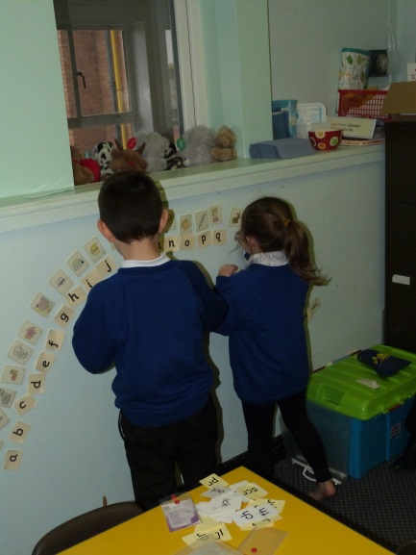
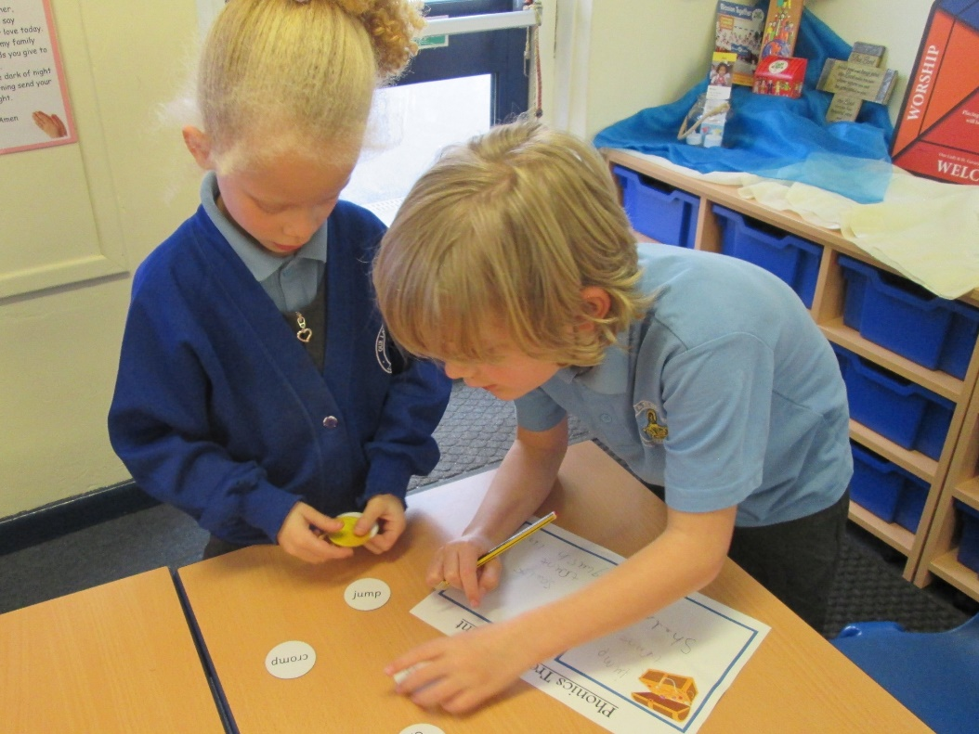
Phonics: a workshop for parents and carers
Notes:
This workshop can be delivered as a whole session or in 2 or 3 shorter sessions depending on numbers of parents.

Slide 2
Aims of this session
To learn the basics of phonics and some useful phonics terms
To develop your confidence in helping your children with phonics and reading
To share how phonics is taught at Our Lady & St Gerard’s
To show examples of activities and resources that schools use to teach phonics
To outline the different stages in phonic development
To share websites which you can use to support your children
To give you an opportunity to ask questions
Notes:
Share aims and highlight the importance of asking questions, seeking clarification throughout the session.
It’s always good to identify the probable length of the session – approx. 90 minutes as a whole session

Slide 3
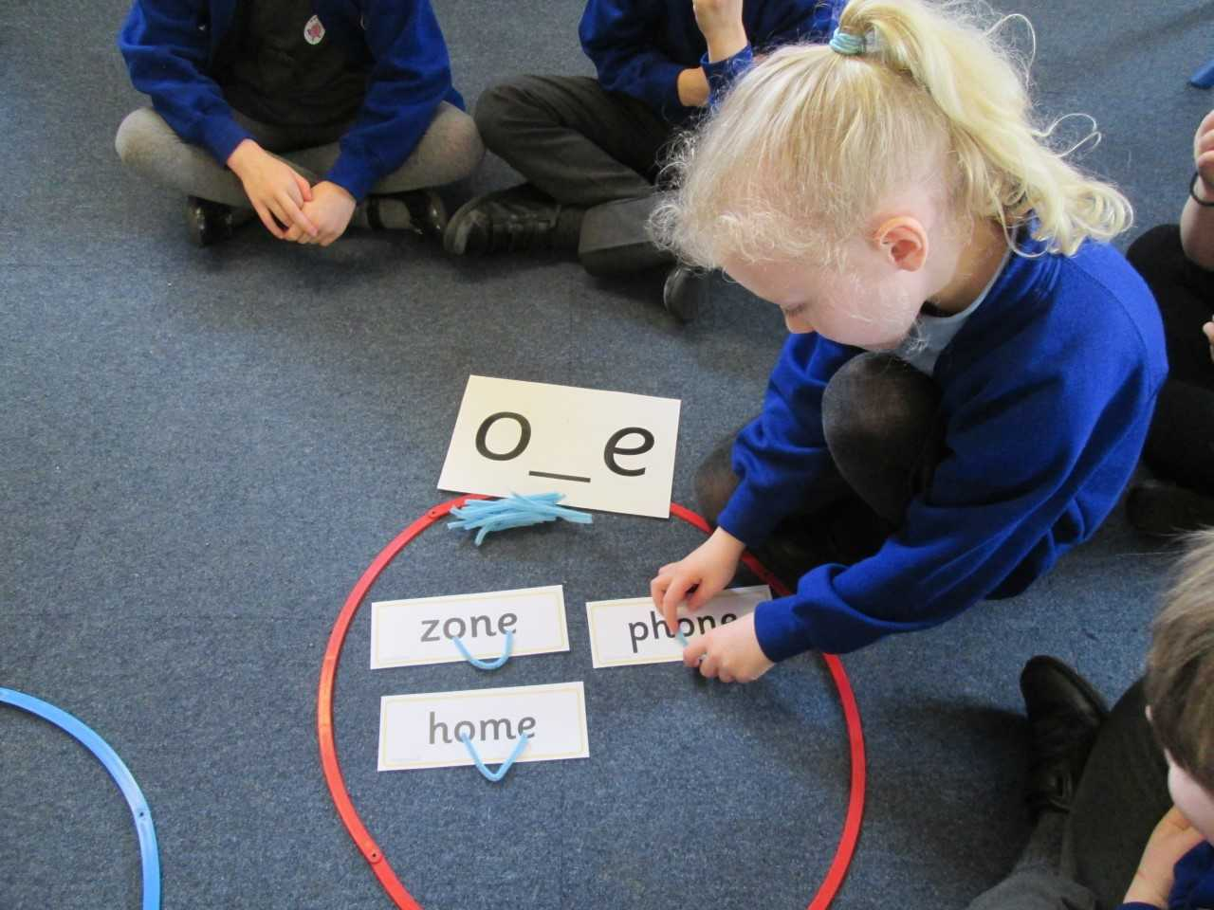
What is phonics and how can I help my child at home?
Notes:
We can’t assume that parents in attendance know nothing about phonics. Like any classroom there will be different abilities and experiences. It’s important to make parents feel like they are free to ask questions, that no question is silly and that everyone in the room is ‘in the same boat’.

Slide 4
Phonics is all about using …
skills for reading and spelling
knowledge of the alphabetic code
+
Learning phonics will help your child to become a good reader and writer.
Notes:
This is some basic background knowledge that everyone supporting phonics needs to know.

Slide 5
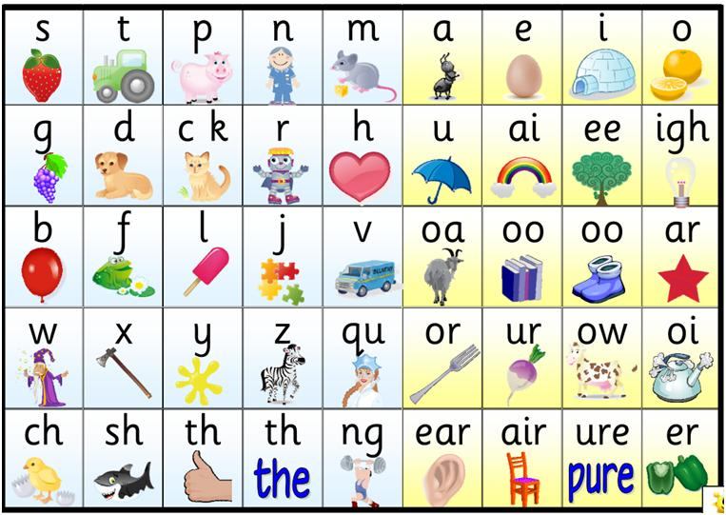

Slide 6
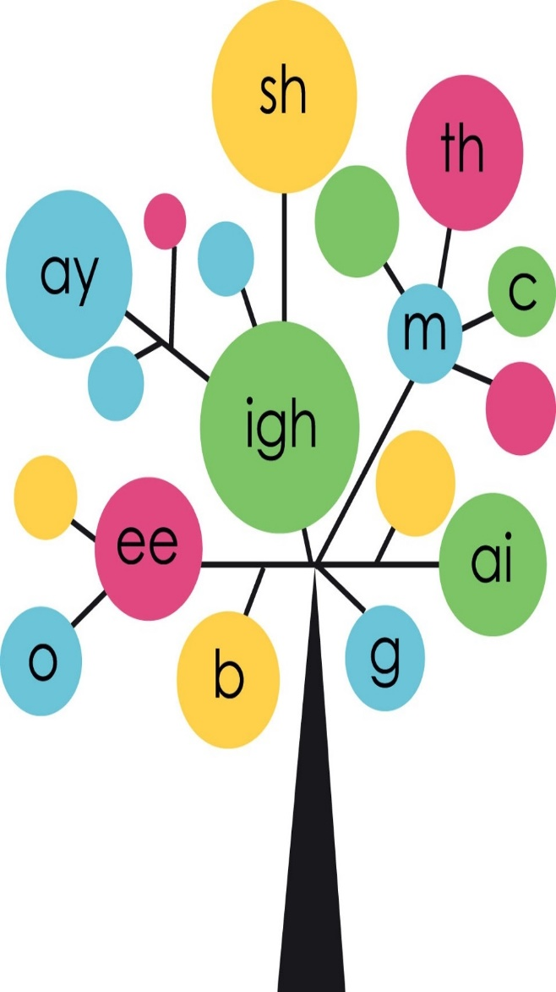
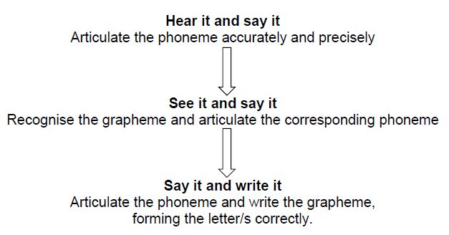

Slide 7
Daily Phonics for Foundation Stage and Key Stage 1
This school uses Phonics Bug Phonics to support the teaching of phonics
20 minute session
Fast paced approach
Includes games, songs and rhymes
There are 6 phonics phases/units which children work through.
Notes:
Inform parents that we will have a look at some of the games such as Phoneme frames, sound buttons, full circle, countdown, flashcards, buried treasure etc. later in session in order to show how they can support their children at home.

Slide 8
A Phonics Lesson
Phonics is fast, fun and multisensory and each session follows a clear sequence.
Recap: Each phonics lesson begins with a recap of the different diagraphs and tricky words that have been learnt so far.
Teach: The children will then be exposed to a new sound that they will see and become familiar with.
Practice: The children will play fast, fun games to practice what they have learnt.
Apply: The children will then have the opportunity to apply this learning by writing or reading words. There are lots of fun games that we use to support this.

Slide 9
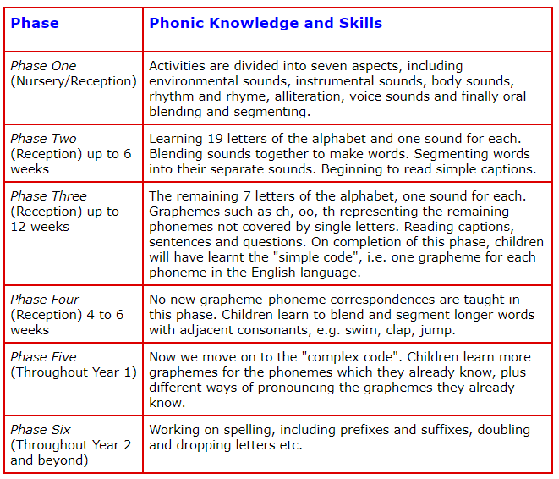


Slide 10

Think about how you are doing this...
What skills do you need to have to read a word using phonics?
spointering
What skills do you need to spell a word using phonics?
What are the actual processes?
Notes:
Ask parents to write hippopotamus

Slide 11
Glossary
Phonemes: the smallest units of sound that are found within a word
Grapheme: the spelling of the sound
Digraph: two letters that make one sound when read
Trigraph: three letters that make one sound
CVC: stands for consonant, vowel, consonant
Segmenting: breaking up a word into its sounds
Blending : putting the sounds together to read a word
Tricky words: words that cannot easily be decoded
Pseudo words: Nonsense words
Notes:
Explain each term and give examples for each one.

Slide 12
Blending
Children need to be able to say the separate sounds in a word and then blend them together to say the whole word .
Notes:
Tell parents that you will now go through all the technical terms and give examples so that parents can use them at home.
This is the skill of hearing separate sounds and putting them together to make a word.

Slide 13
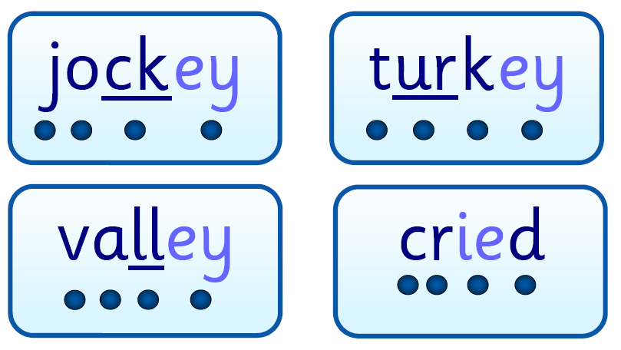
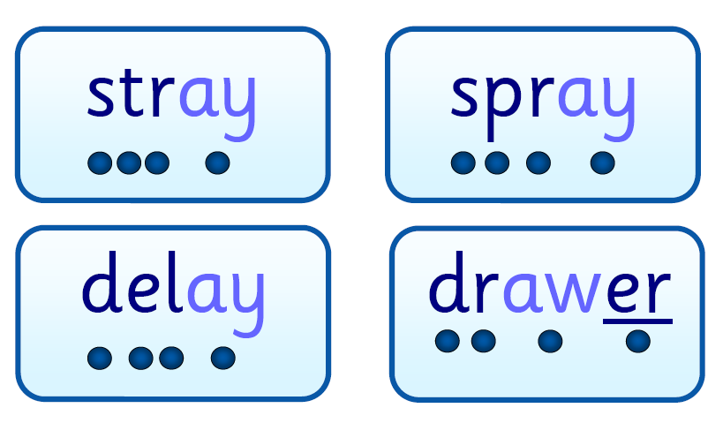
Blending
/b/ /e/ /d/ = bed
/t/ /i/ /n/ = tin
/m/ /u/ /g/ = mug
Notes:
Model for the parents how this works

Slide 14
Segmenting
Children need to be able to hear a whole word and say every sound that they hear. Then they need to know how to write the corresponding graphemes.
Notes:
Breaking up the words into different sounds. Hearing the whole word first and deciding which graphemes match the phonemes.

Slide 15
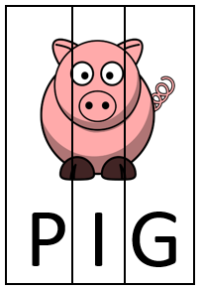
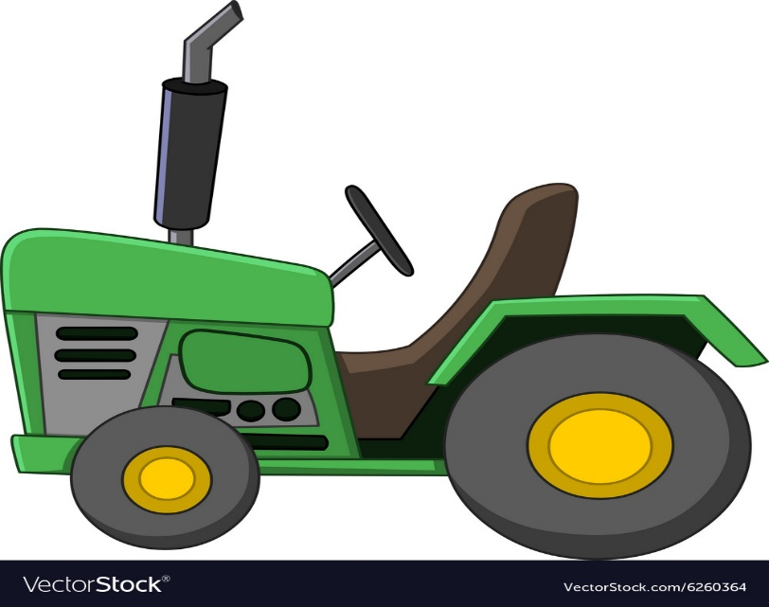
Segmenting
bed = /b/ /e/ /d/
tin = /t/ /i/ /n/
mug = /m/ /u/ /g/
Notes:
Example

Slide 16
Articulation
https://www.youtube.com/watch?v=BqhXUW_v-1s

Slide 17
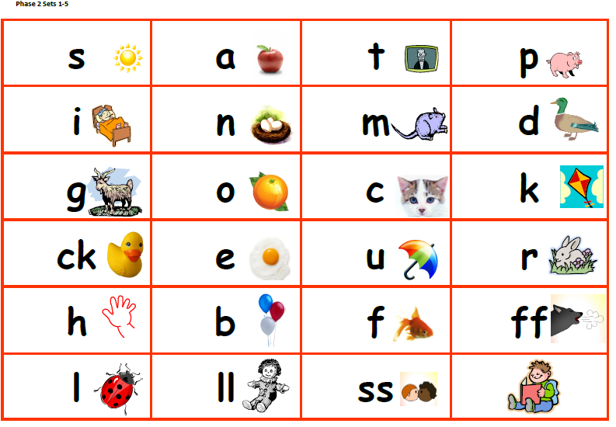
Phase 2

Slide 18
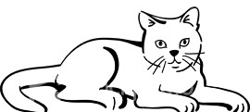
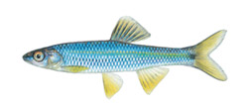
Phonics words
Phoneme frame and sound buttons
c | a | t
. . .
f | i | sh
. . _
Notes:
Give out some phoneme frames for parents to look at or refer to.
Also a blank one for them to take home.
Model how to use frame and pushing the sound buttons.

Slide 19
Phoneme frames game
How would you write the following words in phoneme frames?
log duck fill
Notes:
Give parents the chance to have a go at using the frame and the buttons.
Discuss use of magnetic letters (lots of parents already use these at home) or just cut out letters.

Slide 20
Answers
l | o | g
d | u | ck
. . .
. . _
f | i | ll
. . _
Notes:
Get parents to give you answers.

Slide 21
Tricky Words
There are many words that cannot be blended or segmented because they are irregular.
For example:
the was said you some
Notes:
Discuss how schools teach tricky words and high frequency words – e.g magic words, pull them out of a hat etc. Add strategies that you use in your school specifically.

Slide 22
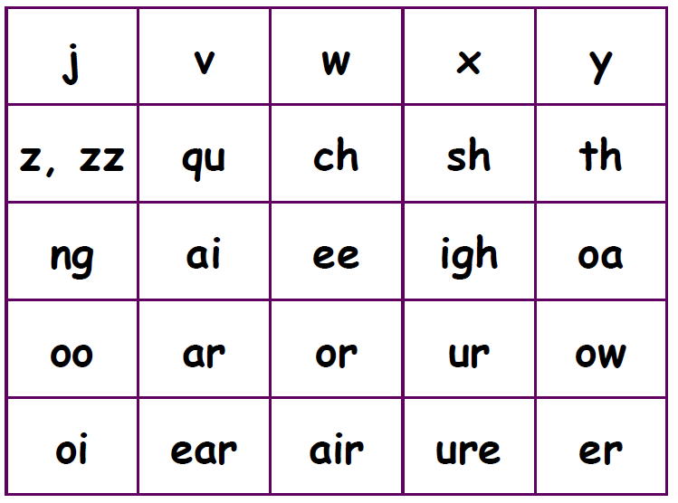
Phase 3

Slide 23
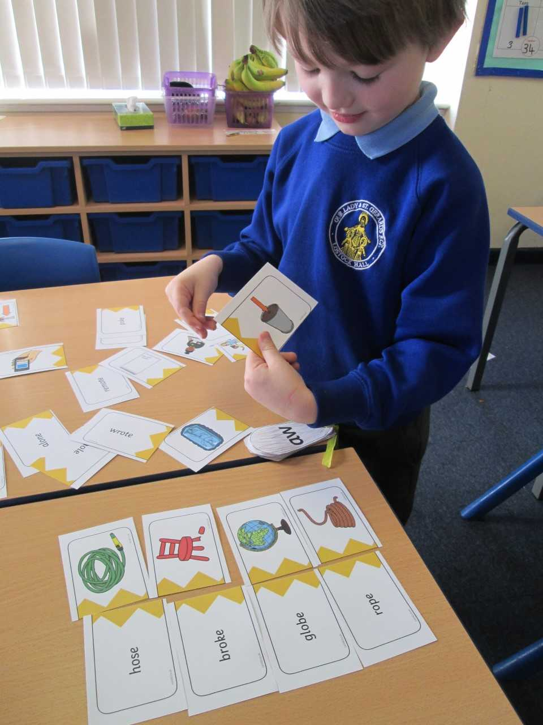
Using your phoneme frame, write these words:
ring chick
night
Notes:
Play phoneme frame game with parents again focusing on the more difficult phonemes. Help parents to hear the ‘ng’ as one sound.

Slide 24
Answers
ch | i | ck
r | i | ng
. . _
_ . _
n | igh | t
. _ .
Notes:
Show Sound buttons and listen to sounds. You may get some confusion with the ‘ng’ sound as one. This could depend on accents. It’s important to stress that we need to make it as simple for chn as possible.

Slide 25
Phase 4:
Introducing consonant clusters: reading and spelling words with four or more phonemes
This phase doesn’t introduce any new phonemes.
It focuses on reading and spelling longer words with the phonemes children already know.
These words contain consonant clusters
  at the beginning: spot, trip, clap, green, clown
  or at the end: tent, mend, damp, burnt
  or at the beginning and end! trust, spend, twist
Notes:
Discuss words that contain adjacent consonants and that children are taught that these are still separate sounds.

Slide 26
Phase 5: introducing more graphemes
Teach new graphemes for reading:
Learn different ways to say the same grapheme:
fin/find hot/cold cat/cent got/giant,
but/put cow/blow tie/field eat/bread
ay | ou | ie | ea | oy | ir | ue
aw | wh | ph | ew | oe | au
a-e | e-e | i-e | o-e | e-e

Slide 27
Learning all the variations!
Learning that the same phoneme can be represented in more than one way:
  burn first term
  heard work
Notes:
Ask parents to identify which letters ‘sound’ the same and point out the differences in spelling that phoneme.

Slide 28
Learning all the variations!
Learning that a grapheme can represent more than one phoneme:
meat bread
he bed
bear hear
cow low
Notes:
Go through slide and discuss the complexities of our language.

Slide 29
A Real Treat
Tom was very happy. It was the weekend and he was off to the beach with his mum and dad, his puppy and baby Pete.
‘Help me pack the green bag,’ said mum. ‘We need sun cream and lots to eat.’
Tom got into his seat in the back of the car and the puppy got on his knee. Pete held his toy sheep. Off they went. Beep! Beep!
At the end of the street there was a big truck. It had lost a wheel.
‘Oh, no,’ said Tom. ‘We’ll be here for a week!’
Dad went to speak to the driver to see if he could help.
Notes:
Discuss that this is the type of activity that teachers use to show the different graphemes that can be made for the same sound.
Some of your audience may not be able to read this very well so best to just read it out to them and ask them to play along.
Play the Real Treat.
Thumbs up when hear long /ee/
Pick up regional dialect. Go with what the children hear. The phonemes are generally consistent within the speech of an individual. If your own accent is so very different, when teaching a sound try to say it like the children. Be honest, discuss how you say it differently.
Highlight /ee/ words and then sort according to the grapheme on the flip chart ‘e’, ‘y’, ‘ee’, ‘ea’, ’e-e’

Slide 30
A Real Treat
Tom was very happy. It was the weekend and he was off to the beach with his mum and dad, his puppy and baby Pete.
‘Help me pack the green bag,’ said mum. ‘We need sun cream and lots to eat.’
Tom got into his seat in the back of the car and the puppy got on his knee. Pete held his toy sheep. Off they went. Beep! Beep!
At the end of the street there was a big truck. It had lost a wheel.
‘Oh, no,’ said Tom. ‘We’ll be here for a week!’
Dad went to speak to the driver to see if he could help.
Notes:
Show answers.
Pick up regional dialect. (e.g. ‘puppy’ and ‘baby’ in Burnley where the ‘y’ might say /i/ or even /e/) Go with what the children hear. The phonemes are generally consistent within the speech of an individual. If your own accent is so very different, when teaching a sound try to say it like the children. Be honest, discuss how you say it differently.
Highlight /ee/ words and then sort according to the grapheme on the flip chart ‘e’, ‘y’, ‘ee’, ‘ea’, ’e-e’

Slide 31
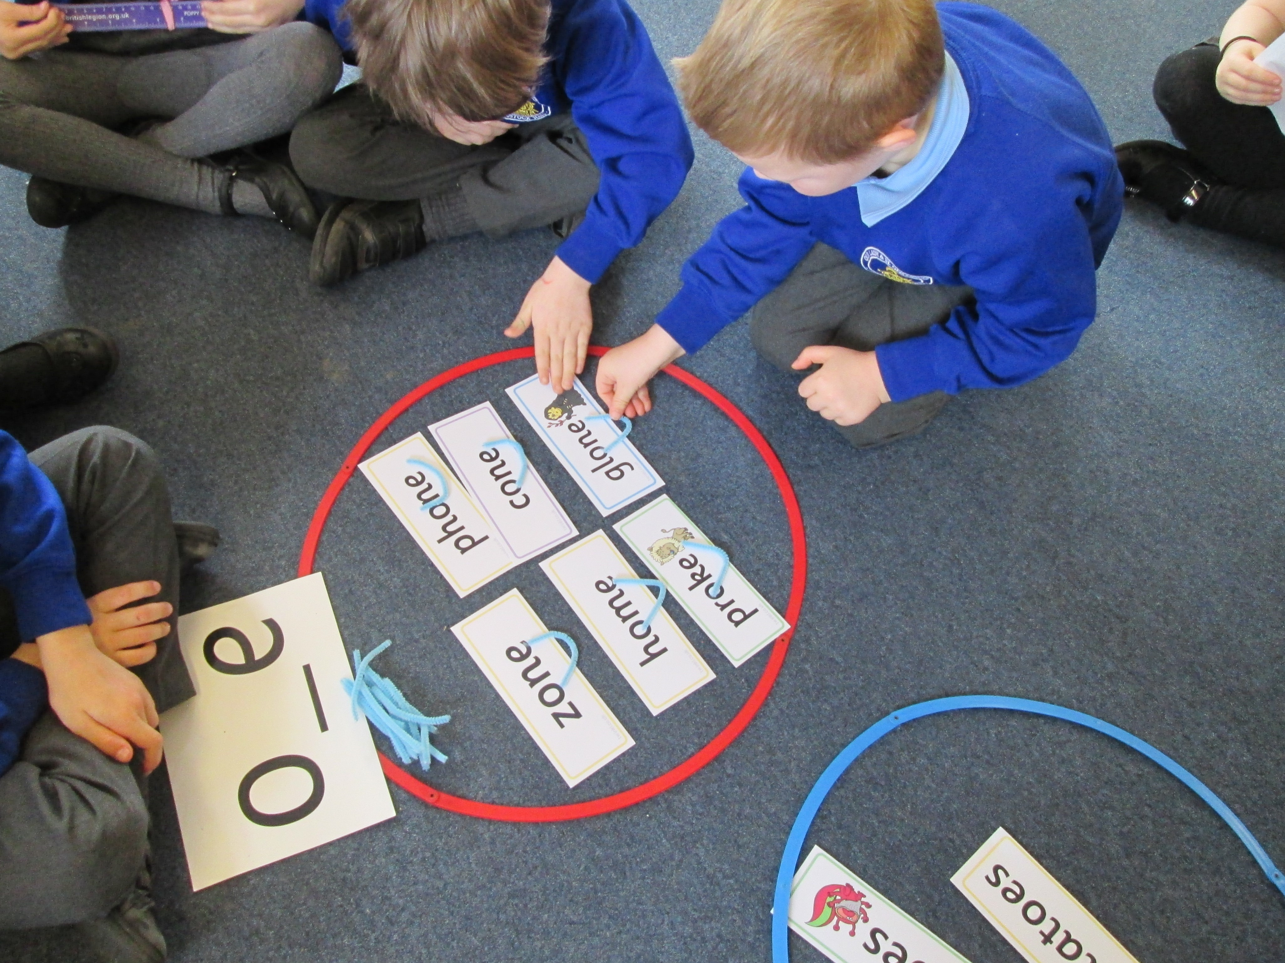
Teaching the Split Digraph
tie time
toe tone
cue cube
pie pine
Notes:
Cut this if running out of time – may be too much info for parents.
Discuss the old ‘silent e’ or ‘magic e’ as many parents will know it as.
Discuss how the e affects the sound of the word – listen to the change in the vowel in the word – p/i/e to pine

Slide 32
Phase 6
Focuses on spellings, including prefixes and suffixes, doubling and dropping letters etc.
Learning about the past tense
Reading and spelling irregular high frequency words
39
Notes:
Parents will be naturally concerned about this check. It is important to inform them that is not done in test conditions and that every child will be made to feel as relaxed as possible when doing it.
It is important to tell parents that it is a fair and straightforward way to check phonic understanding.
Some of your audience may not have y1 children, but tell them that it is important to know what has gone before and what is coming next.

Slide 33
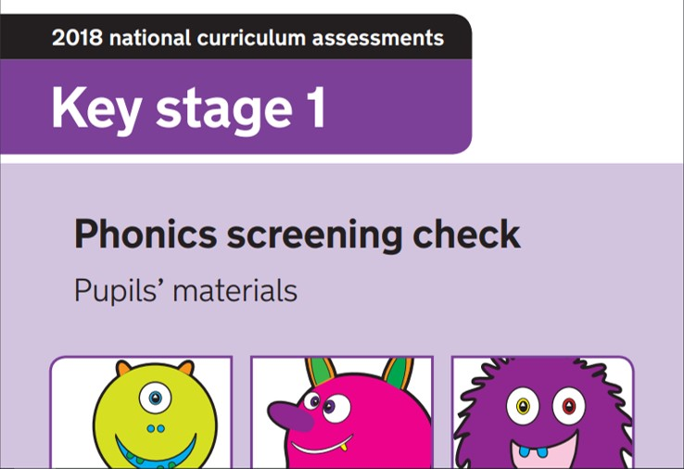
The phonics screening check at the end of
Year 1
A quick check to see if your child has made the expected progress
A child will sit with a teacher he or she knows and be asked to read 40 words aloud
The child may have read some of the words before, while others will be completely new
The check normally takes just a few minutes to complete and there is no time limit
If a child is struggling, the teacher will stop the check
The check is carefully designed not to be stressful for children
Notes:
Screening materials on the tables

Slide 34
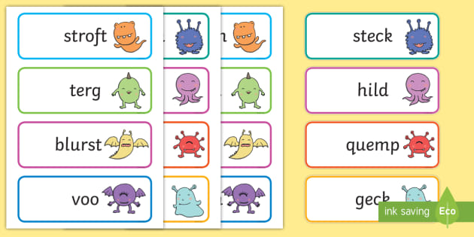
What are ‘non-words’?

Slide 35
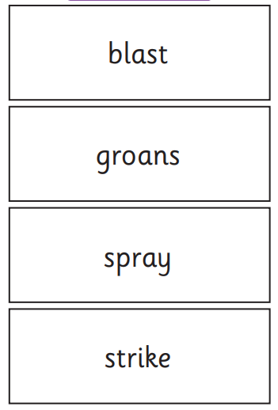
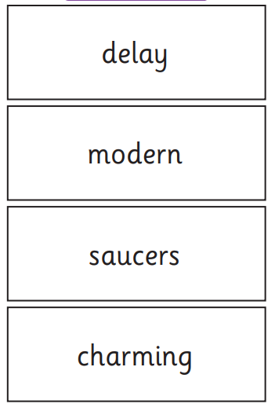
https://www.youtube.com/watch?v=IPJ_ZEBh1Bk

Slide 36
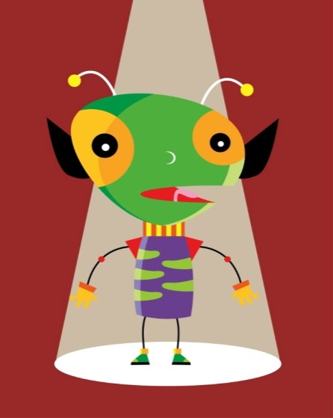
How can I help at home?
Point out obvious alternative spellings that you see around.
Develop ‘I spy’ to include more tricky words.
Think of made-up words for different sounding phonemes.
Make up names for imaginary aliens and ask your child to decode them.
Here is an alien from Mars. His name is Snork. How do you think we spell Snork?
Notes:
Look at imaginary alien game and ask parents to decode their names e.g.
Snork
Flidge.

Slide 37
How can I help at home?
When spelling, encourage your child to think about what “looks right”
Try out spellings using wipe clean whiteboards
tray trai
rain rayn
boil boyl
boy boi
throat throwt
snow snoa
Notes:
Discuss playing ‘best bet’ for spellings, what looks right etc.
Have a go with the parents if time.

Slide 38
Useful websites
BBC www.bbc.co.uk/schools/wordsandpictures
The School Run www.theschoolrun.com/what-magic-e
Primary Tools http://primarytools.co.uk/pages/phonics.html
Phonics Play www.phonicsplay.co.uk/
Letters and Sounds www.letters-and-sounds.com/phase-2-games.html
Family Learning www.familylearning.org.uk/phonics_games.html
Phonics Bloom https://www.phonicsbloom.com/
Notes:
Give time for questions.
Remember to keep referring back to points raised earlier at start of day, things colleagues wanted to be covered.

