Slide 1
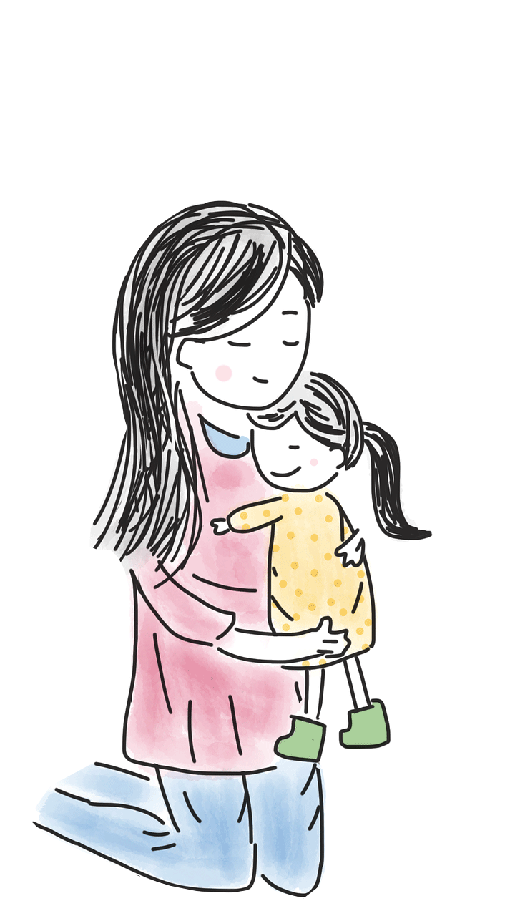

Early Years
The wonder of being special and unique
1. A Journey in Love
– Early Years –

Slide 2

IMPORTANT
Copyright and Terms and Conditions of use
By using this Powerpoint CD presentation you are agreeing to the following terms and conditions.
All images and text are copyright to the respective owners and can only be used and shown as a presentation within a classroom or other room or area within an educational or religious establishment.
– All the files and images contained within this PowerPoint presentation are subject to copyright restrictions and cannot be duplicated, copied or shared as detailed on the CD and CD packaging (Unlawful duplication is prohibited by law).
– You must NOT share this Powerpoint presentation or any of the text and images by uploading them to a website on the Internet.
If you have purchased a Network Licence you may store the Powerpoint presentation on your Intranet.
– You must not change/alter or recreate the files in any way or form.
– If you do not comply with the terms of this licence you could be liable to legal action against you by the copyright holder and/or the agency that acts on their behalf.
This Powerpoint presentation is a simplified form of the
A Journey in Love book and should be used in conjunction with
this publication.
The book is available from www.mccrimmons.com
Published in United Kingdom in 2020 by
McCrimmon Publishing Co. Ltd
Revised 2021
sales@mccrimmons.com / www.mccrimmons.com
McCrimmon order ref: MB7863CD
Text © 2005/2006/2020 Sr Jude Groden and the following contributors.
﻿Dr Sathi Aiya / Ilse Brockling / Fr David Clemens
Sarah Feist / Shaun Kelliher / Patrick Harrison.
Narrative text: Sr Jude Groden.
Powerpoint construction and design by Éanna McAteer
I have read the Terms and Conditions above…
Acknowledgements
Most of the mages used in this Powerpoint presentation are from www.pixabay.com Pixabay are an online (free to use for commercial use) image library.
Other image credits
Slide 3 (right) www.pngtosvg.com
Slide 5 netclipart.com
Slide 6 maxpixel.net
CONTINUE

Slide 3

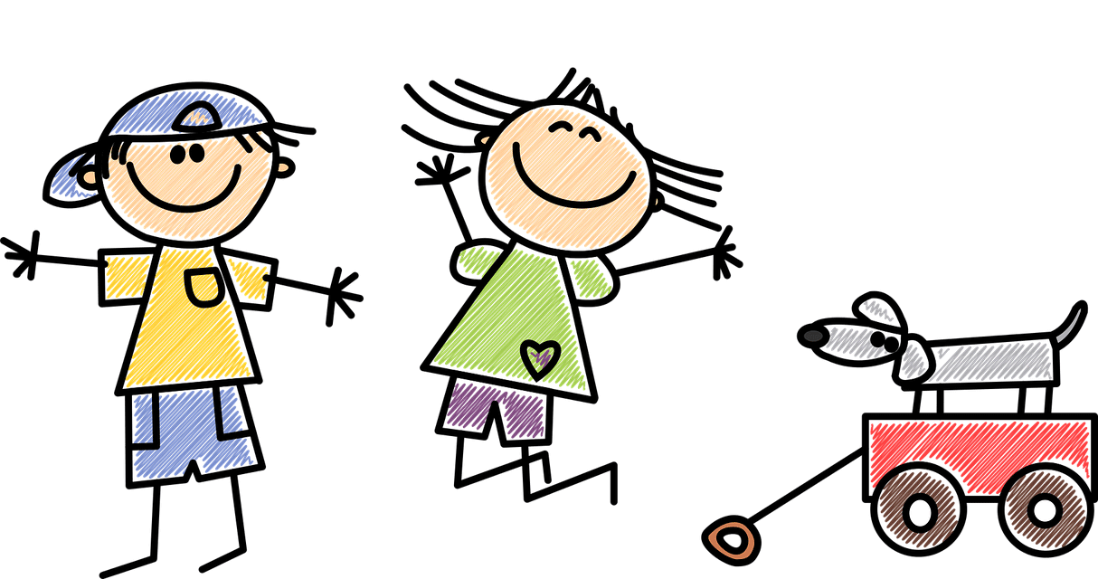

Aim
To explore the wonder of being special and unique
3. A Journey in Love
– Early Years –

Slide 4
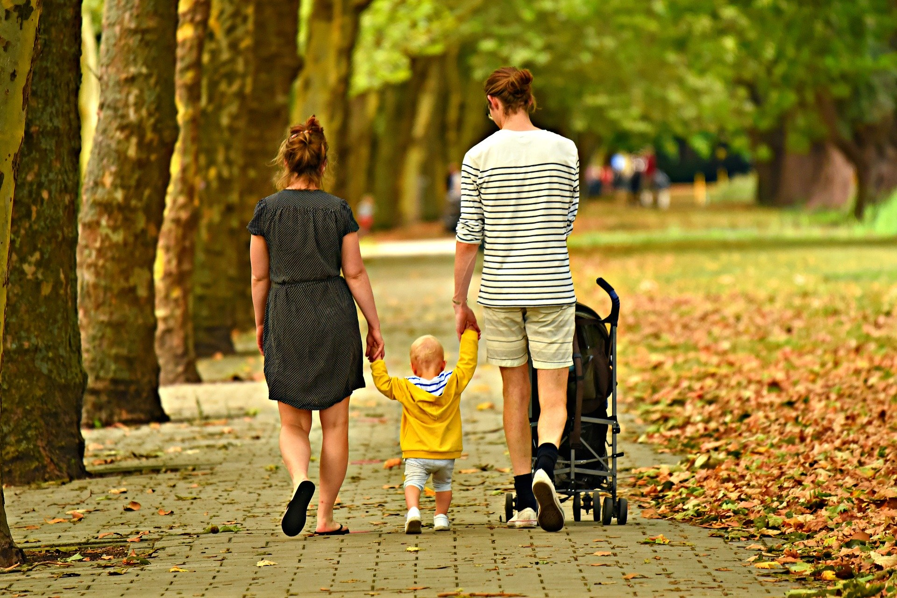
Social and Emotional
Learning intention
To recognise the joy of being a special person in my family
4. A Journey in Love
– Early Years –

Slide 5


God
wonder
love
hands
fingers
faces
nails
noses
lips
belonging
ears
different
special
hair
womb
features
baptism
colour
describe
shape
friends
size
generous
unique
worried
5. A Journey in Love
– Early Years –

Slide 6

listening
creating
sharing
Skills
observing
speaking
celebrating
respecting
praying
relaxing
6. A Journey in Love
– Early Years –

Slide 7
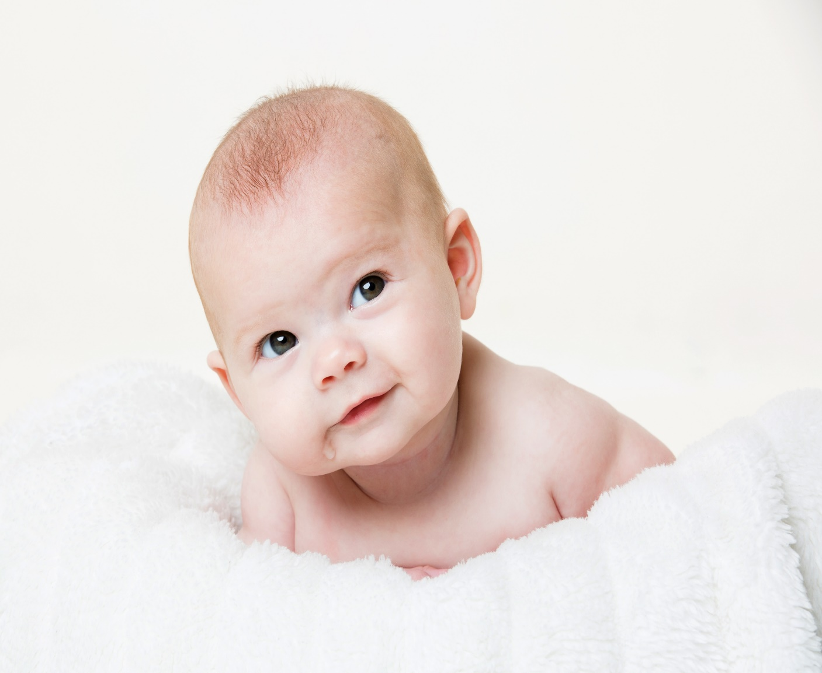
Questions
Why are you special to your family?
How do you know that you are special?
What do you love and enjoy about belonging to your family?
Who would you go to if you felt worried or needed help?
How does God show love to you and your family?
7. A Journey in Love
– Early Years –

Slide 8

Pause and reflect
Loving Father,
Thank you for joy of being a special person in my family. Bless all who love and care for me.
Thought from St Teresa of Calcutta:
“Let us always meet each other with a smile, for the smile is the beginning of love.”

Slide 9
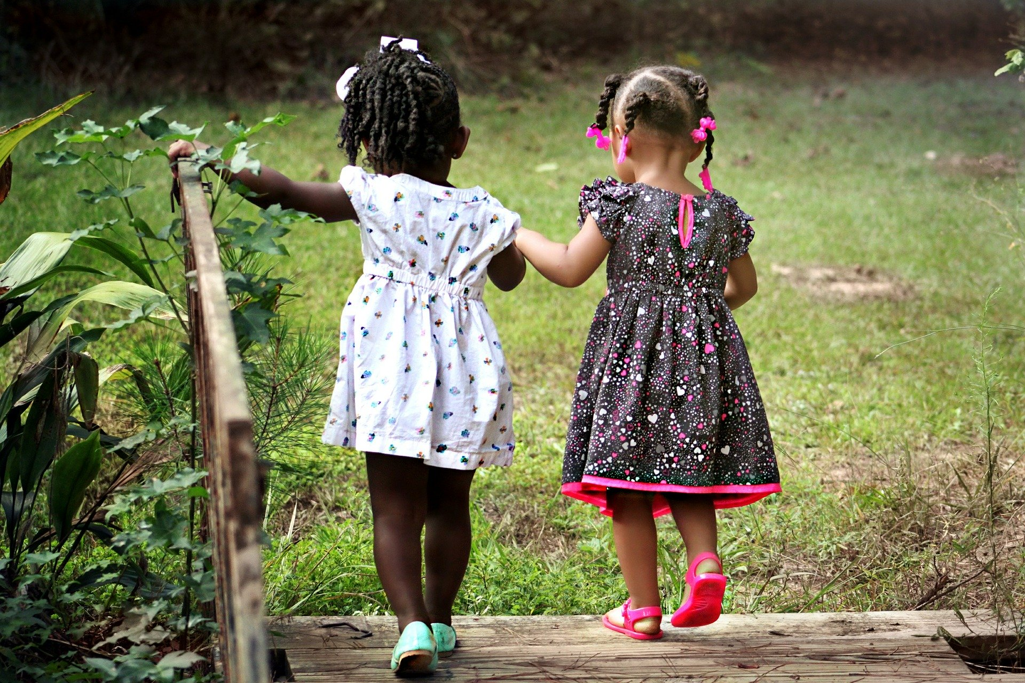
Physical
Learning intention
To recognise that we are all different and unique
9. A Journey in Love
– Early Years –

Slide 10
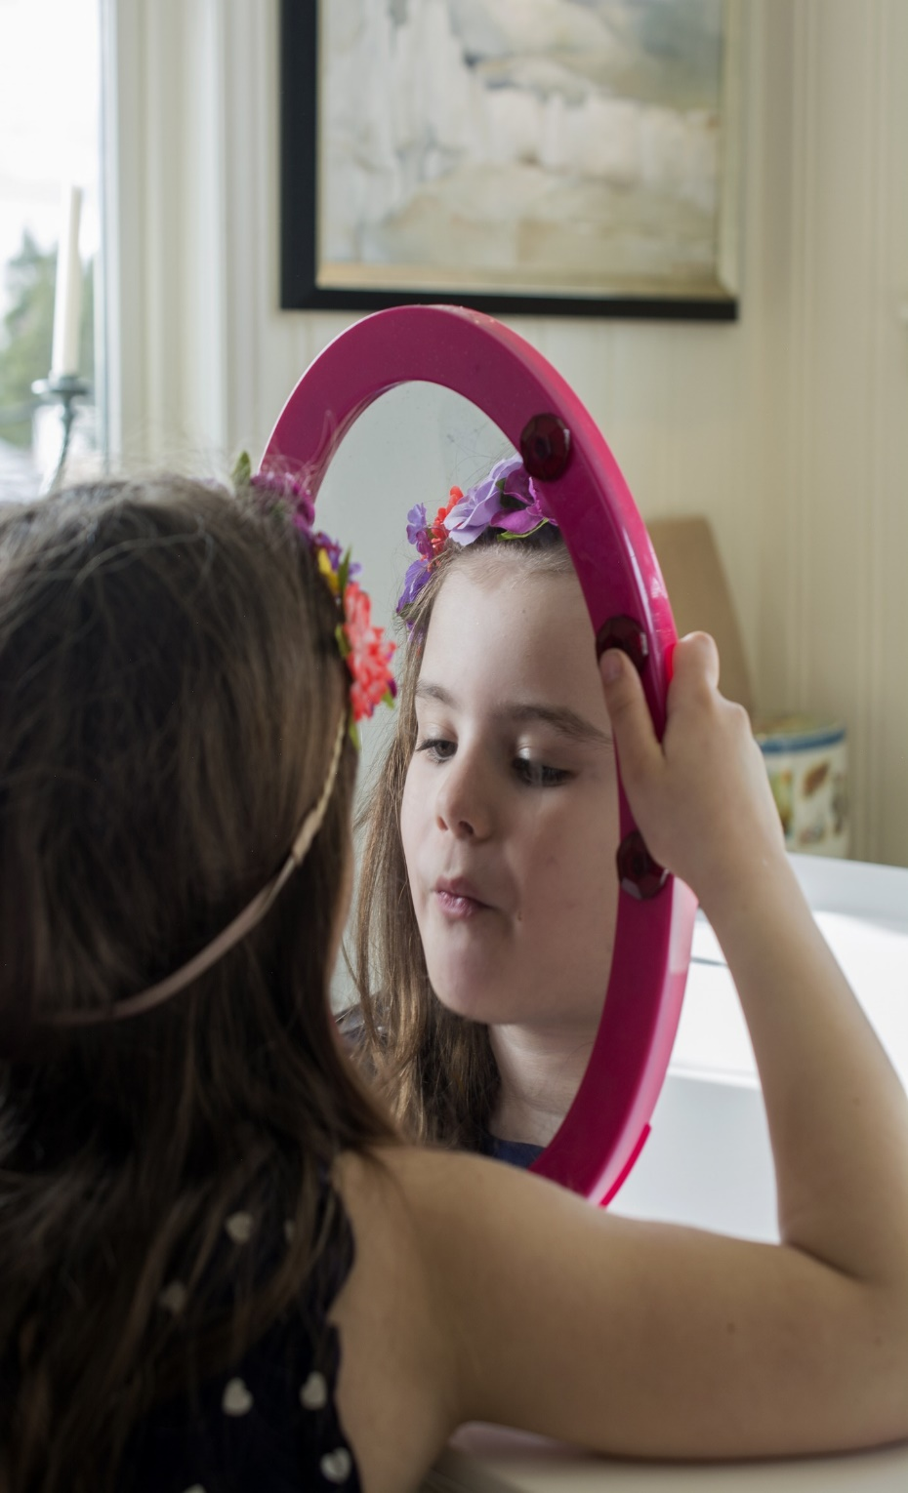
Questions
Look at me – how am I different from you?
Look at you – how are you different from me?
What is it that makes us all different?
Why has God made us all different and special to Him?
How can we be friendly to others, make and keep friends, showing care and being generous when we are together?
10. A Journey in Love
– Early Years –

Slide 11
Pause and reflect
Loving God,
Thank you for making me special and unique, with my own name.
Bless my family and friends.
Amen
“God loves each of us as if there were only one of us.”
St Augustine

Slide 12
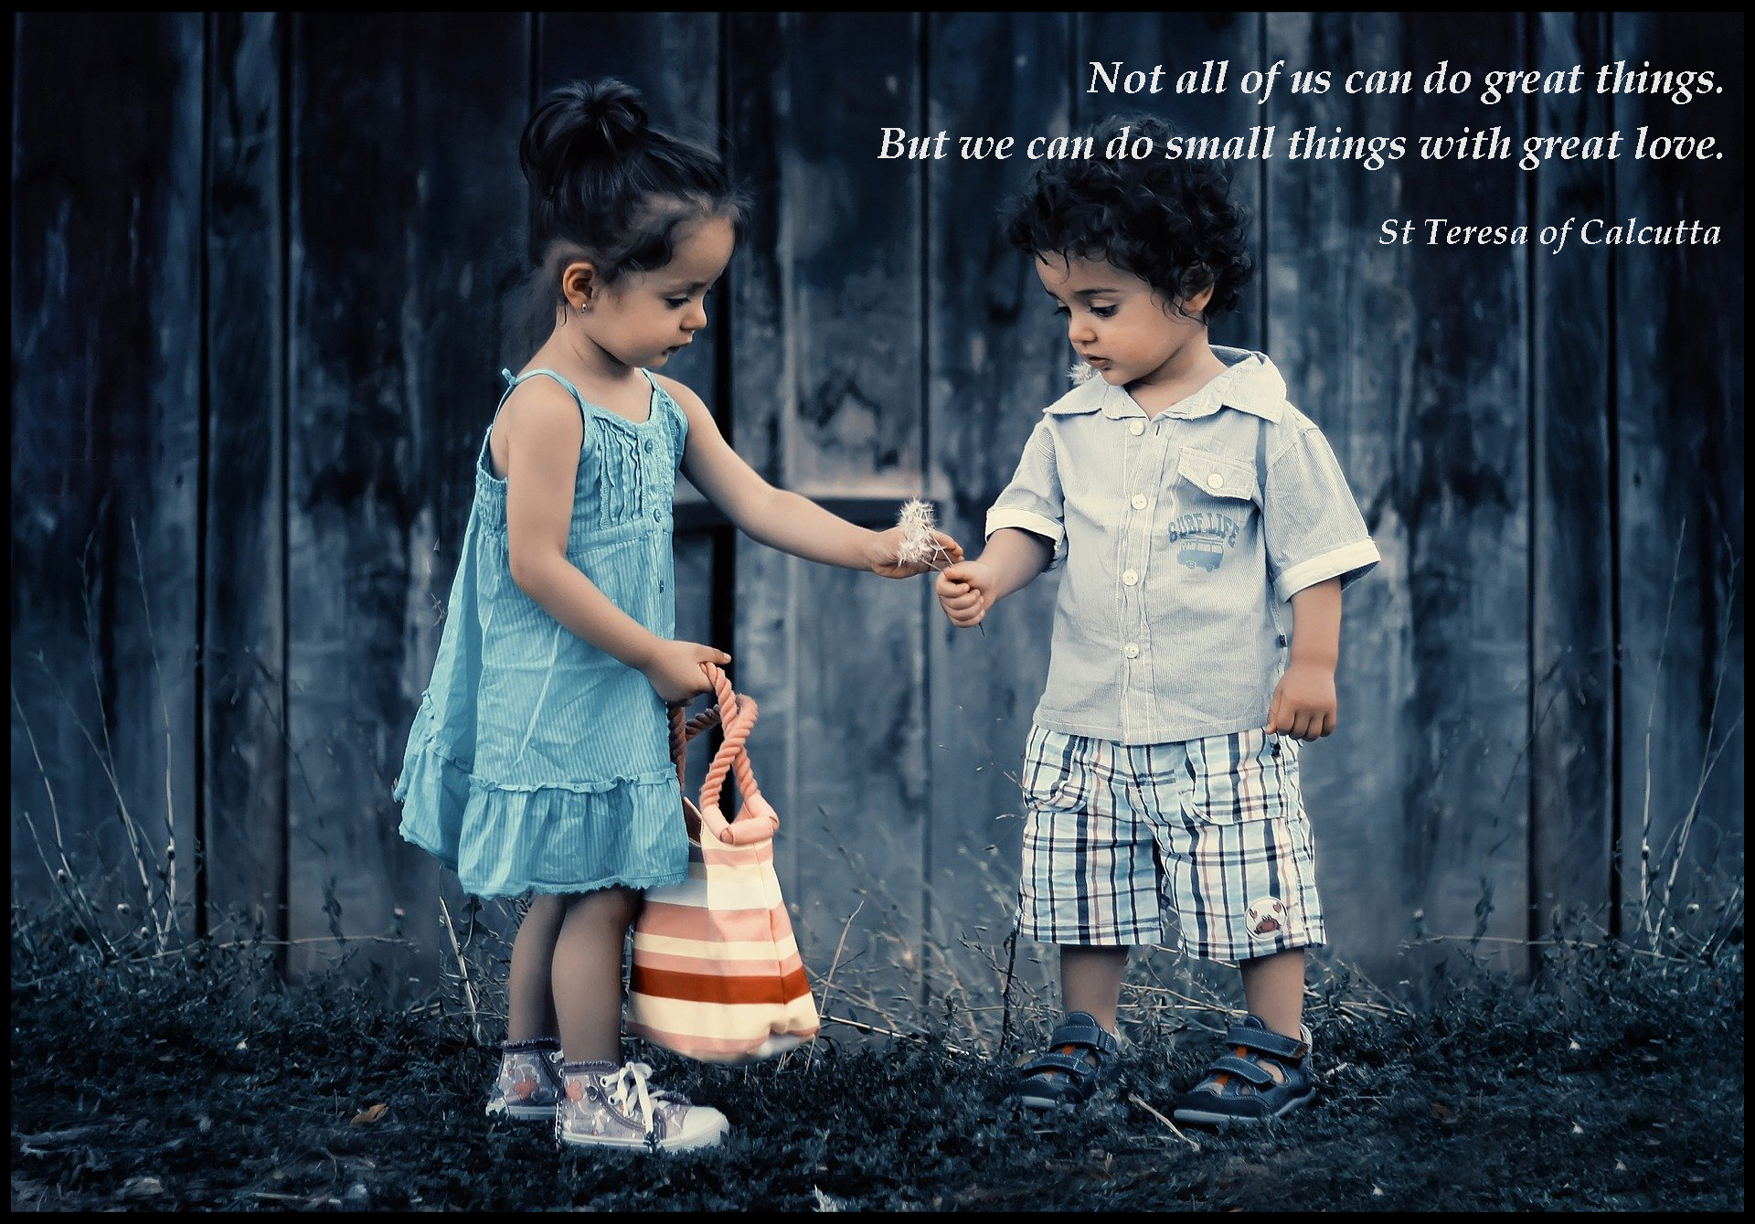

Slide 13
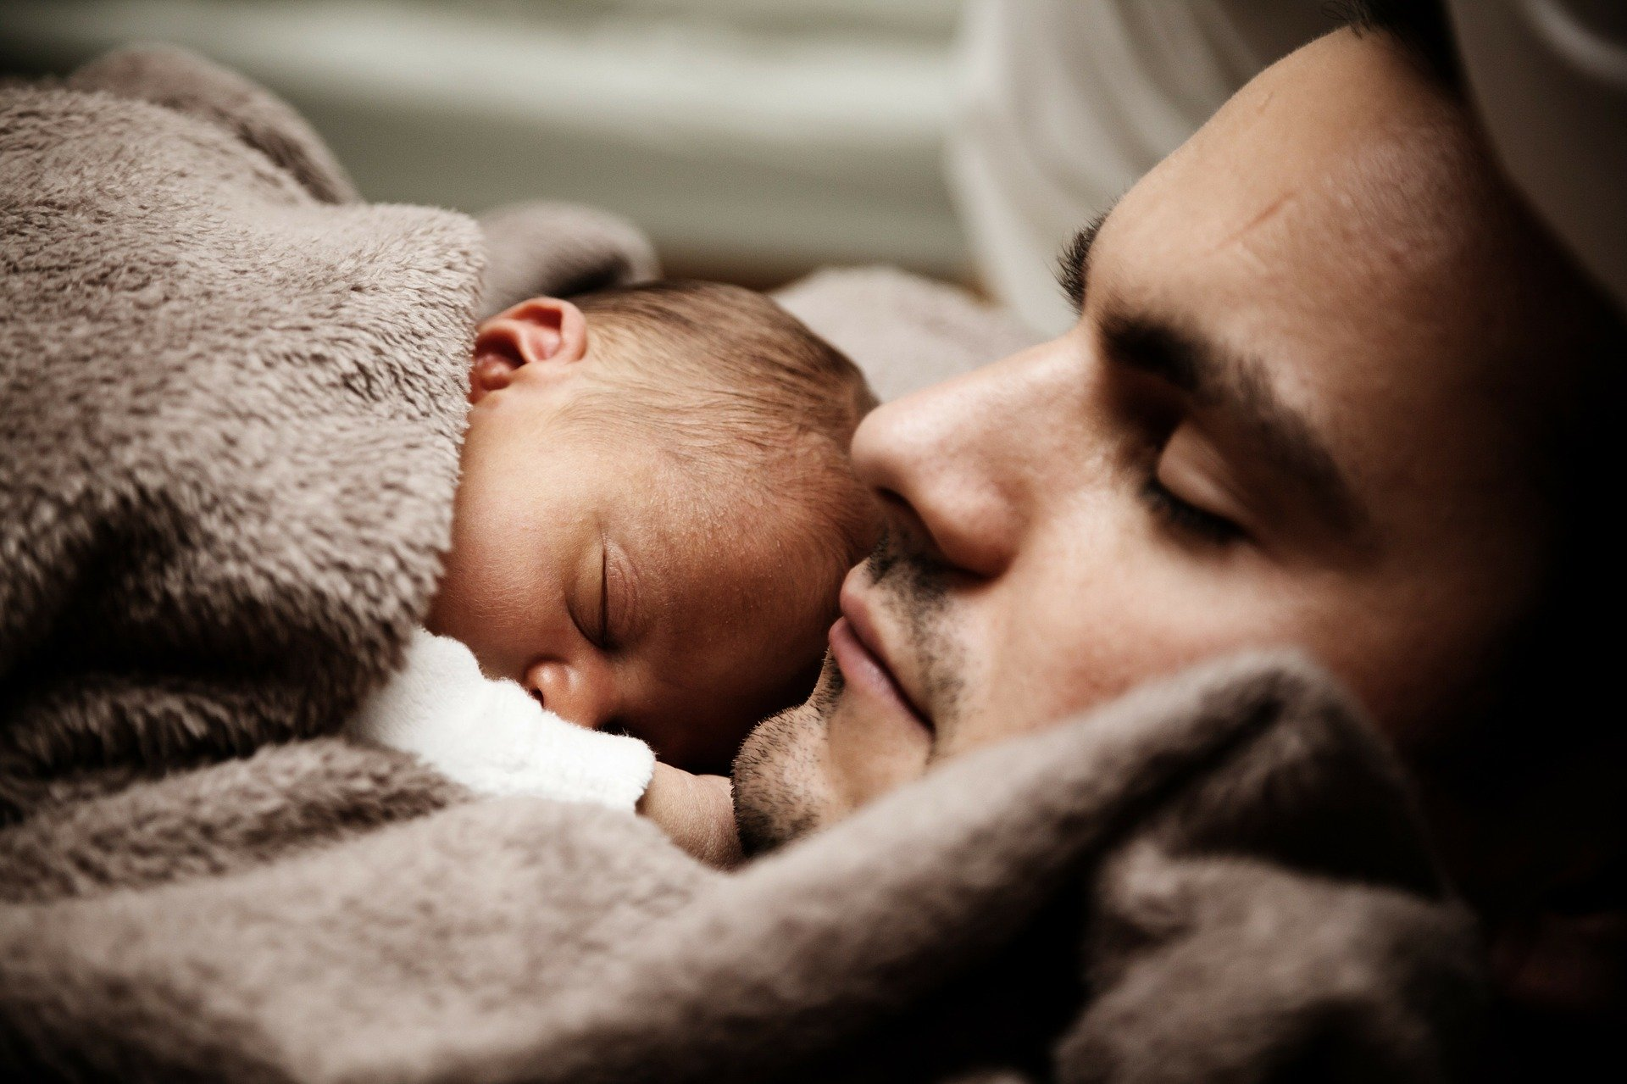
Spiritual
Learning intention
To celebrate the joy of being a special person in God’s family.
13. A Journey in Love
– Early Years –

Slide 14
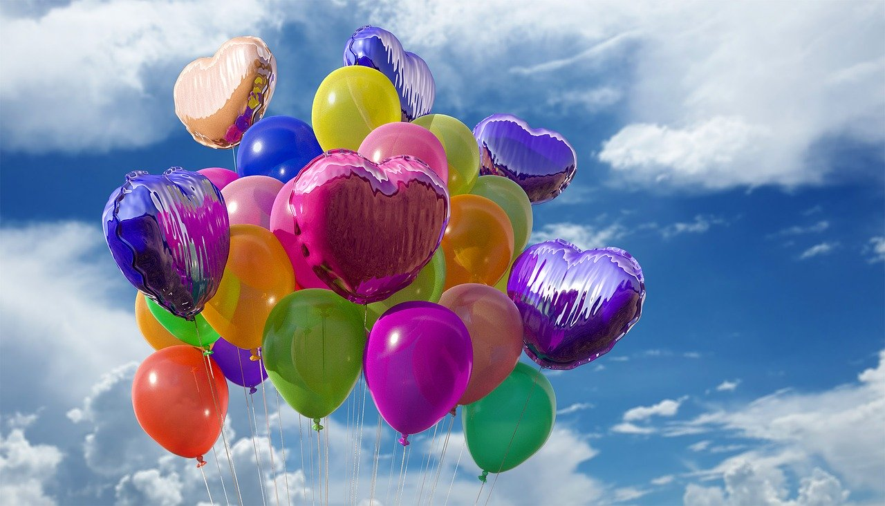
Questions
How do we ‘celebrate’ with each other?
What can we remember about happy celebrations in our families?
What celebrations do we enjoy and look forward to?
14. A Journey in Love
– Early Years –

Slide 15
Pause and reflect
Loving Father,
Thank you for each member of my family
and for all my friends.
Thank you for making each of us special and uniquely loved by you.
Amen

Slide 16
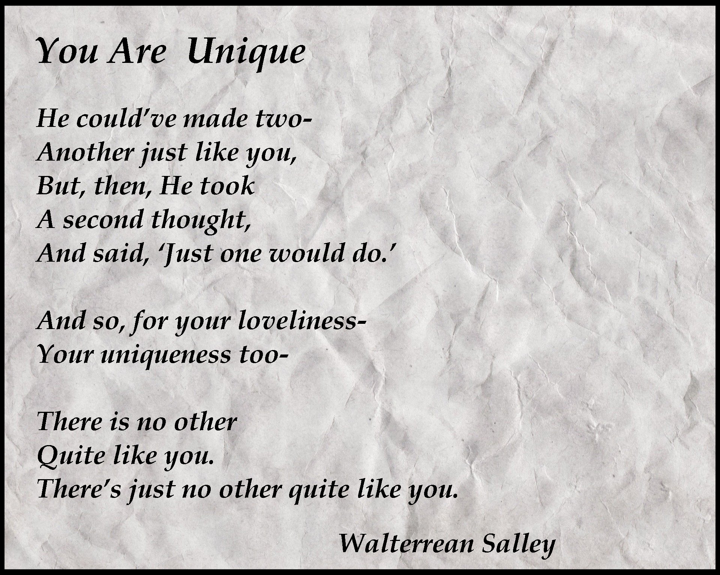
16. A Journey in Love
– Early Years –

Slide 17
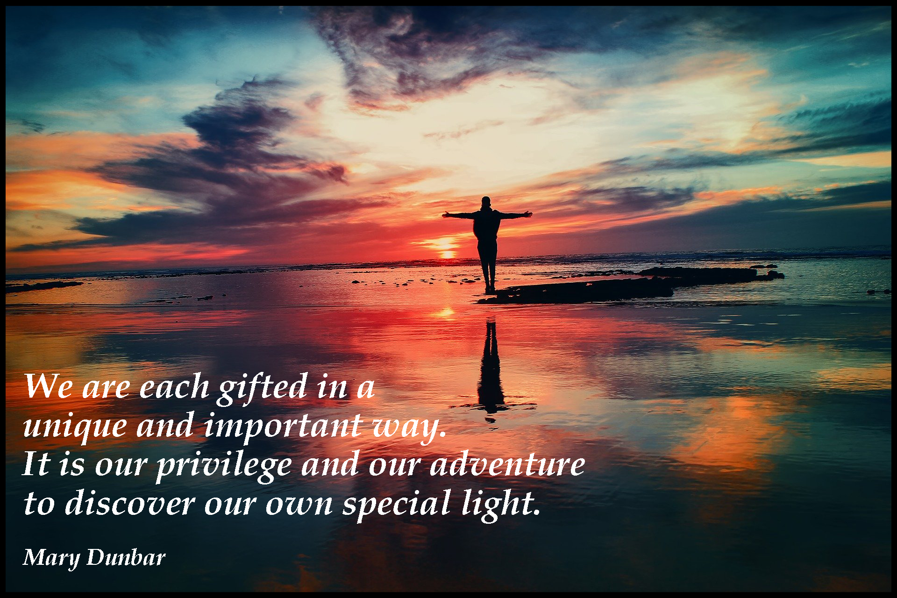
17. A Journey in Love
– Early Years –

