Slide 1
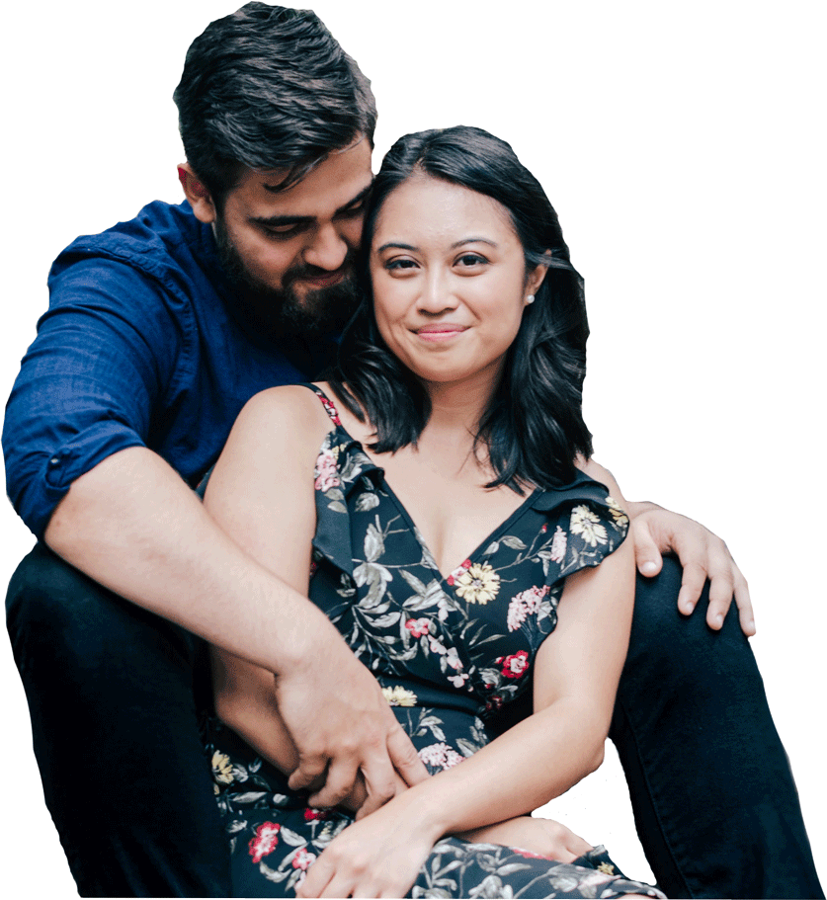

Year 6
The wonder of God’s love in creating new life.
1. A Journey in Love
– Year 6 –

Slide 2

IMPORTANT
Copyright and Terms and Conditions of use
By using this Powerpoint CD presentation you are agreeing to the following terms and conditions.
All images and text are copyright to the respective owners and can only be used and shown as a presentation within a classroom or other room or area within an educational establishment.
– All the files and images contained within this PowerPoint presentation are subject to copyright restrictions and cannot be duplicated, copied or shared as detailed on the CD and CD packaging (Unlawful duplication is prohibited by law).
– You must NOT share this Powerpoint presentation or any of the text and images by uploading them to a website on the Internet.
If you have purchased a Network Licence you may store the Powerpoint presentation on your Intranet.
– You must not change/alter or recreate the files in any way or form.
– If you do not comply with the terms of this licence you could be liable to legal action against you by the copyright holder and/or the agency that acts on their behalf.
This Powerpoint presentation is a simplified form of the
A Journey in Love book and should be used in conjunction with
this publication.
The book is available from www.mccrimmons.com
Published in United Kingdom in 2020 by
McCrimmon Publishing Co. Ltd.
sales@mccrimmons.com / www.mccrimmons.com
McCrimmon order ref: MB7863CD
Text © 2005/2006/2020 Sr Jude Groden and the following contributors.
﻿Dr Sathi Aiya / Ilse Brockling / Fr David Clemens
Sarah Feist / Shaun Kelliher / Patrick Harrison.
Narrative text: Sr Jude Groden.
Powerpoint construction and design by Éanna McAteer
Acknowledgements
Most of the mages used in this Powerpoint presentation are from www.pixabay.com Pixabay are an online (free to use for commercial use) image library.
Other image credits
Slide 1 unsplash (Kelly Sikkema)
Slide 3 Pexels (Georgia Maciel)
Slide 4 netclipart.com
Slide 5 maxpixel.net
Slide 6 Pexels (Chermiti Mohamed)
Slide 11 Pexels (Rushay Booysen)
Slide 13 Pexels (Andre Furtado)
Slide15 –19 www.vecteezy.com
I have read the Terms and Conditions above…
CONTINUE

Slide 3
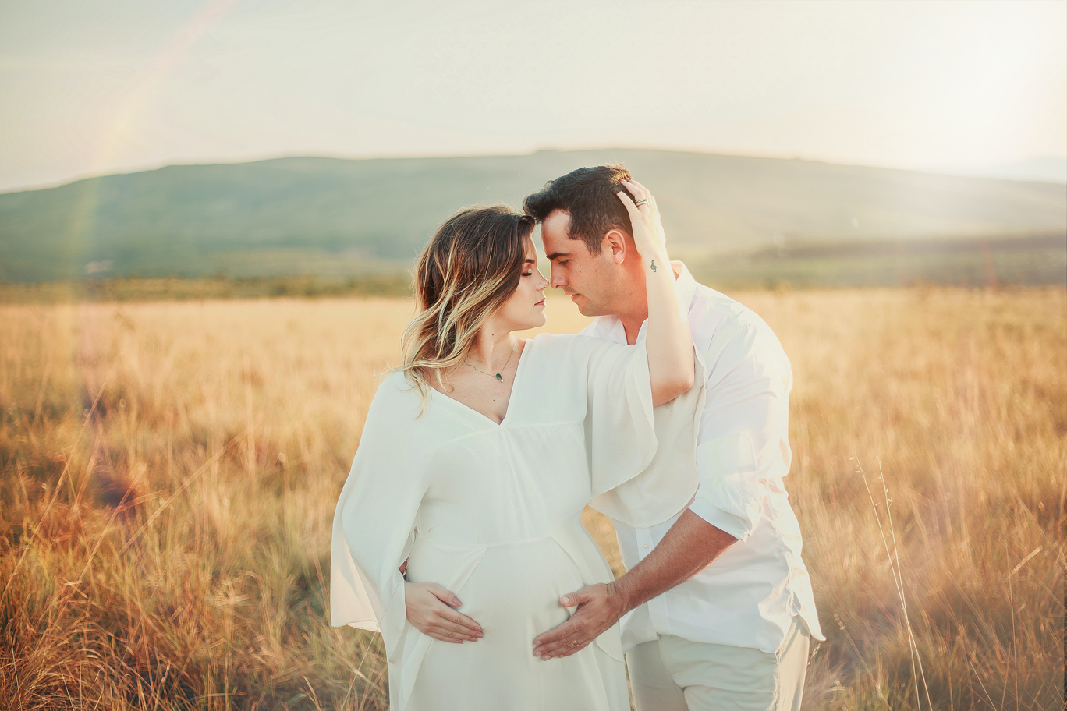
Aim
To develop a secure understanding of what stable, caring relationships are and the different kinds there may be. Focusing on Catholic teaching, children will also know and understand about the conception of a child within marriage.
3. A Journey in Love
– Year 6 –

Slide 4


God
Christian
Appropriate
Sexuality
Dignity
Fallopian
Intercourse
Relationship
Conceive
Cervix
Uterus
Fiancé
Fiancée
4. A Journey in Love
– Year 6 –

Slide 5

categorising
observing
classifying
listening
questioning
speaking
Skills
relating
respecting
reflecting
thinking
identifying
accepting
empathising
understanding
communicating
presenting
evaluating
researching

Slide 6
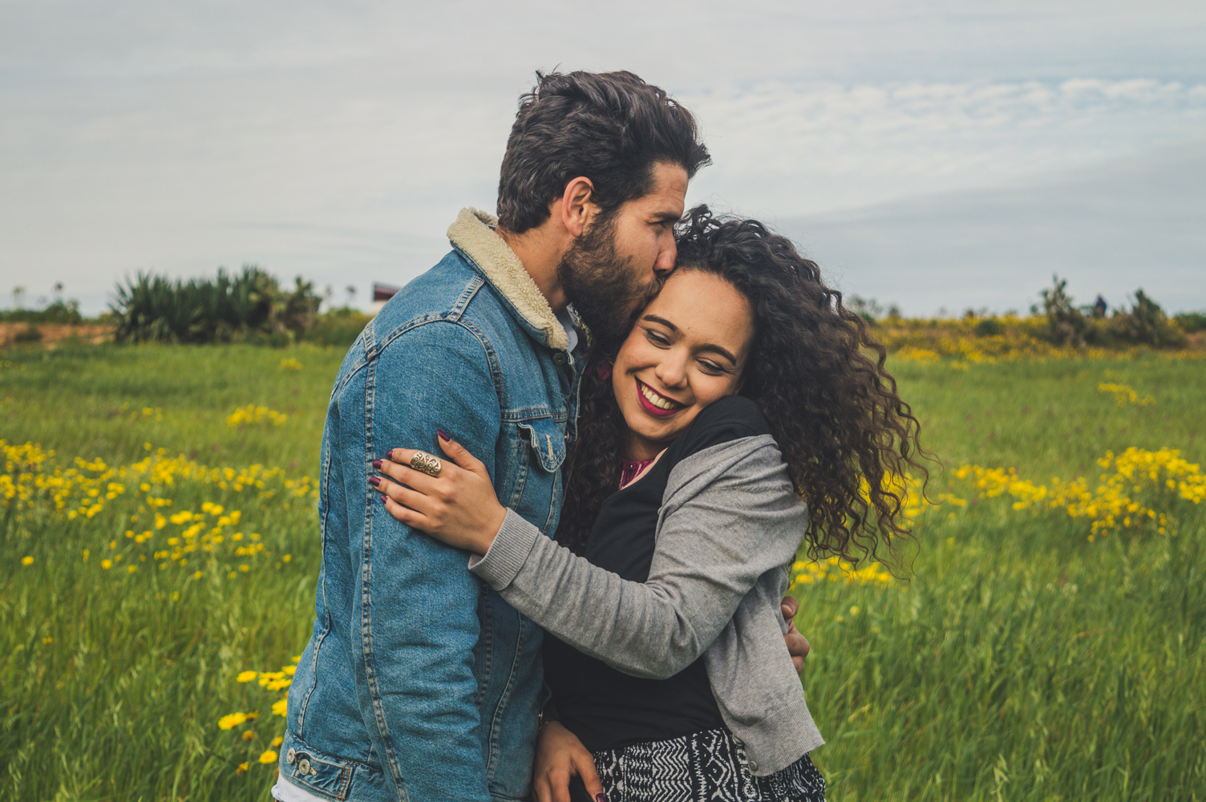
Social and Emotional
Learning intention
To develop a secure understanding that stable and caring relationships, which may be of different types, are at the heart of happy families.
6. A Journey in Love
– Year 6 –

Slide 7
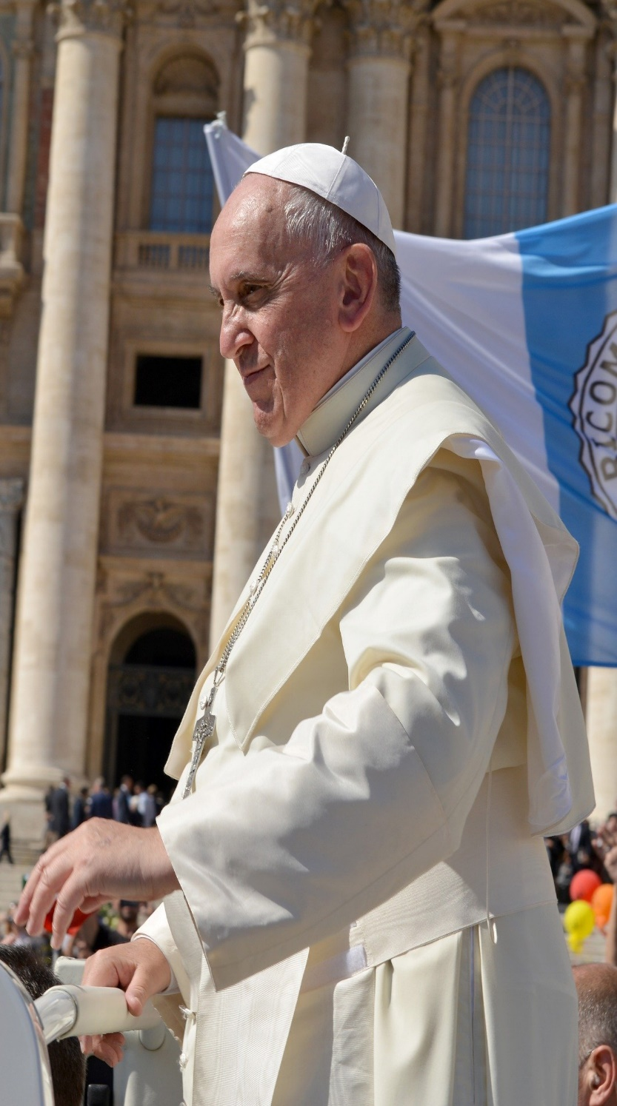
Lovers do not see their relationship as merely temporary.
Those who marry do not expect their excitement to fade.
Those who witness the celebration of a loving union, however fragile, trust that it will pass the test of time.
Children not only want their parents to love one another, but also to be faithful and remain together.
These and similar signs show that it is in the very nature of conjugal love to be definitive.
The lasting union expressed by the marriage vows is more than a formality or a traditional formula;
it is rooted in the natural inclinations of the human person.
Pope Francis
7. A Journey in Love
– Year 6 –

Slide 8
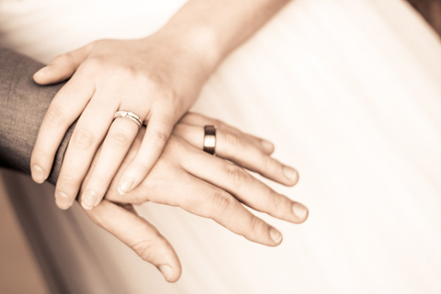
Questions
What is your understanding of love?
St Paul tells us:
Love is always patient and kind;
love is never jealous;
love is not boastful or conceited,
it is never rude and never seeks its own advantage,
it does not take offence or store up grievances.
Love does not rejoice at wrongdoing,
but finds its joy in the truth.
It is always ready to make allowances,
to trust, to hope and to endure whatever comes.
Love never comes to an end.
As it is, these three remain: faith, hope and love
and the greatest of them is love.
Questions continued on next page >>>
8. A Journey in Love
– Year 6 –

Slide 9
Questions (continued)
What does it mean to be patient, kind and never jealous?
What does it mean not to be boastful, conceited, and to never seek advantage?
What does it mean to not take offence, store up grievances or rejoice at wrongdoing?
Explain what it means that love finds its joy in the truth, is always ready to make allowances, endure whatever comes and never comes to an end?
9. A Journey in Love
– Year 6 –

Slide 10
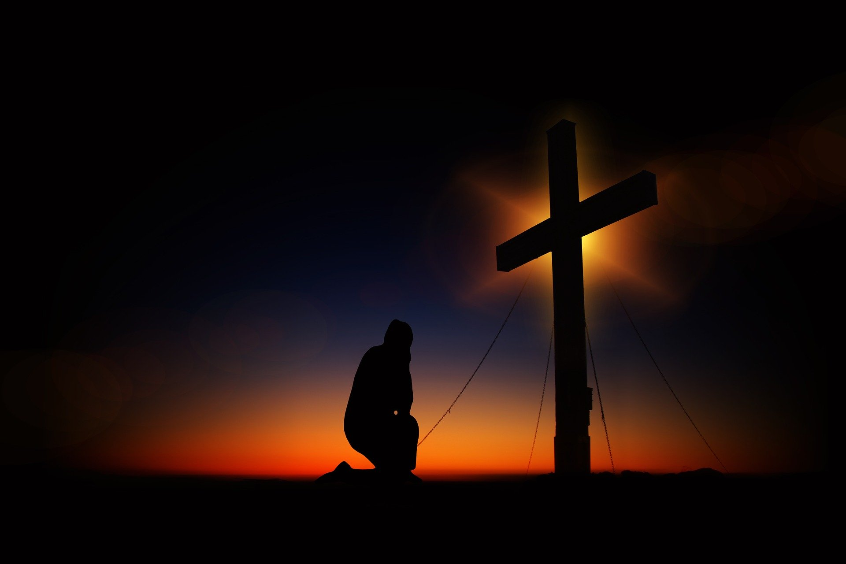
Pause and reflect
Small things, done in great love,
Bring joy and peace.
St Teresa of Calcutta

Slide 11
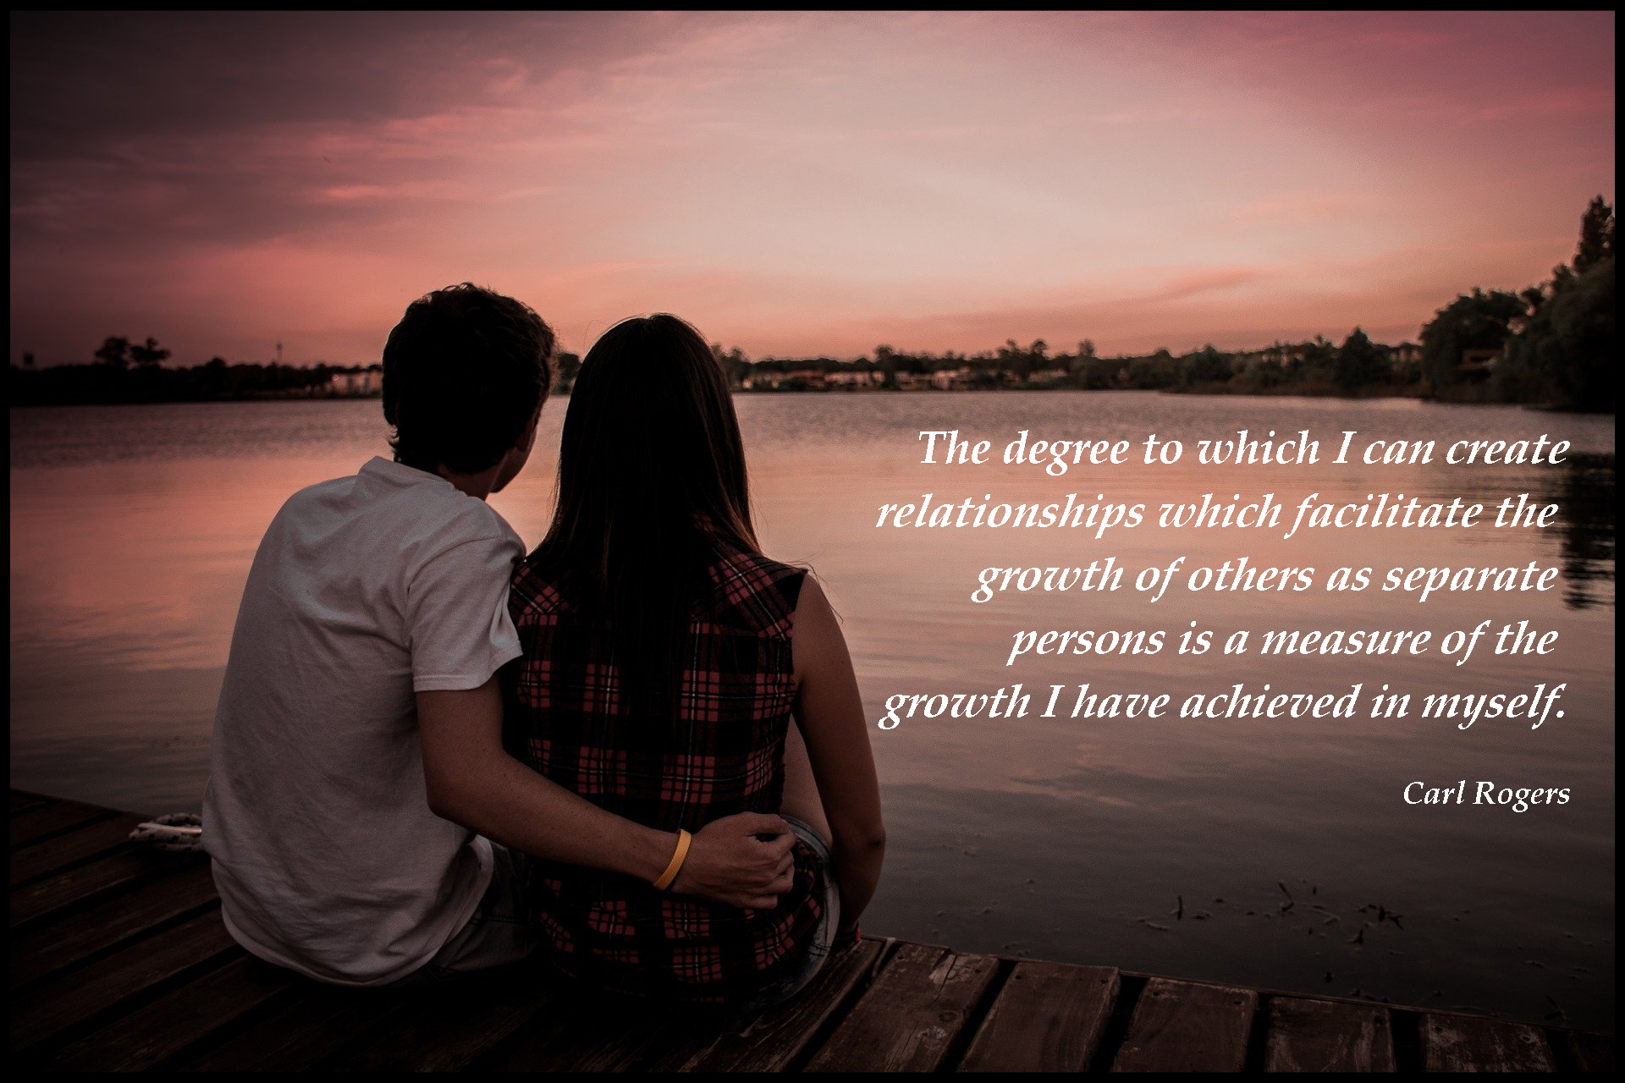

Slide 12
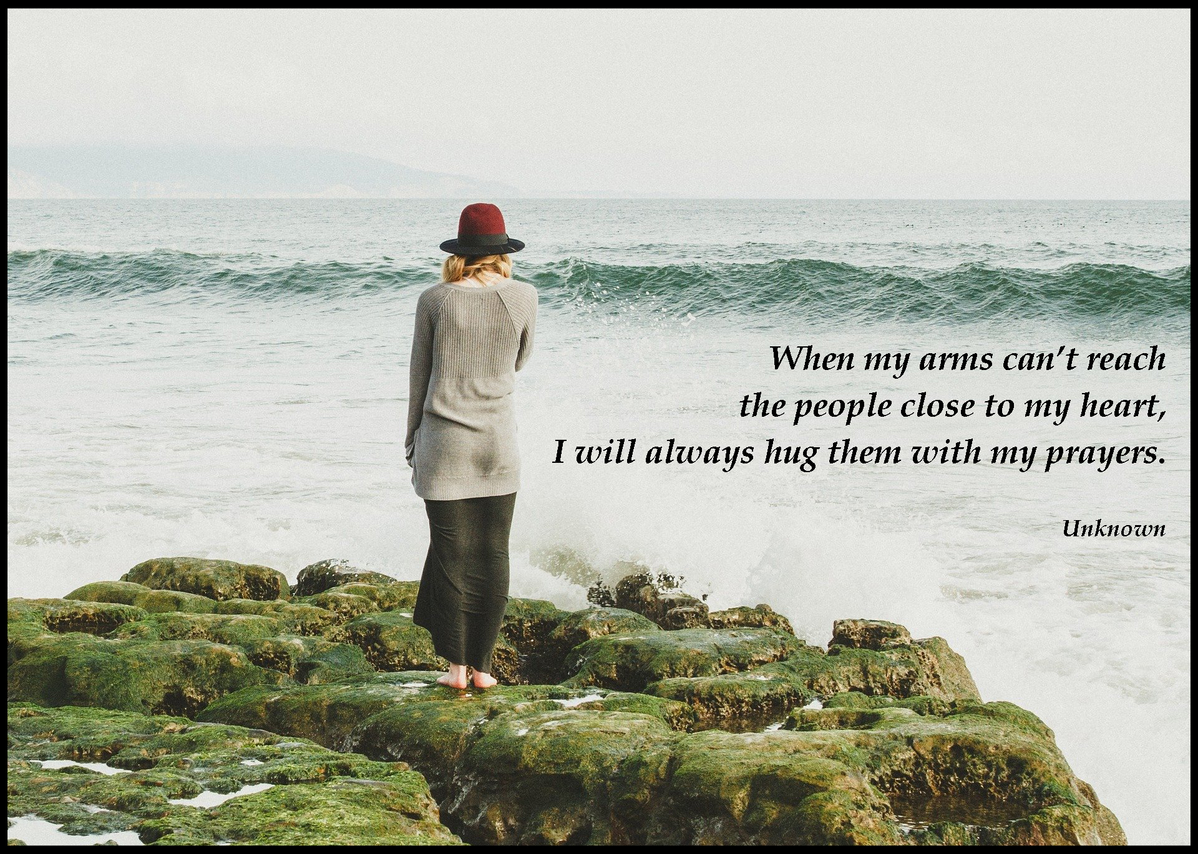
12. A Journey in Love
– Year 6 –

Slide 13

Physical
Learning intention
Explain how human life is conceived.
13. A Journey in Love
– Year 6 –

Slide 14
Questions
What are the key building blocks of a loving relationship?
How does conception take place?
14. A Journey in Love
– Year 6 –

Slide 15
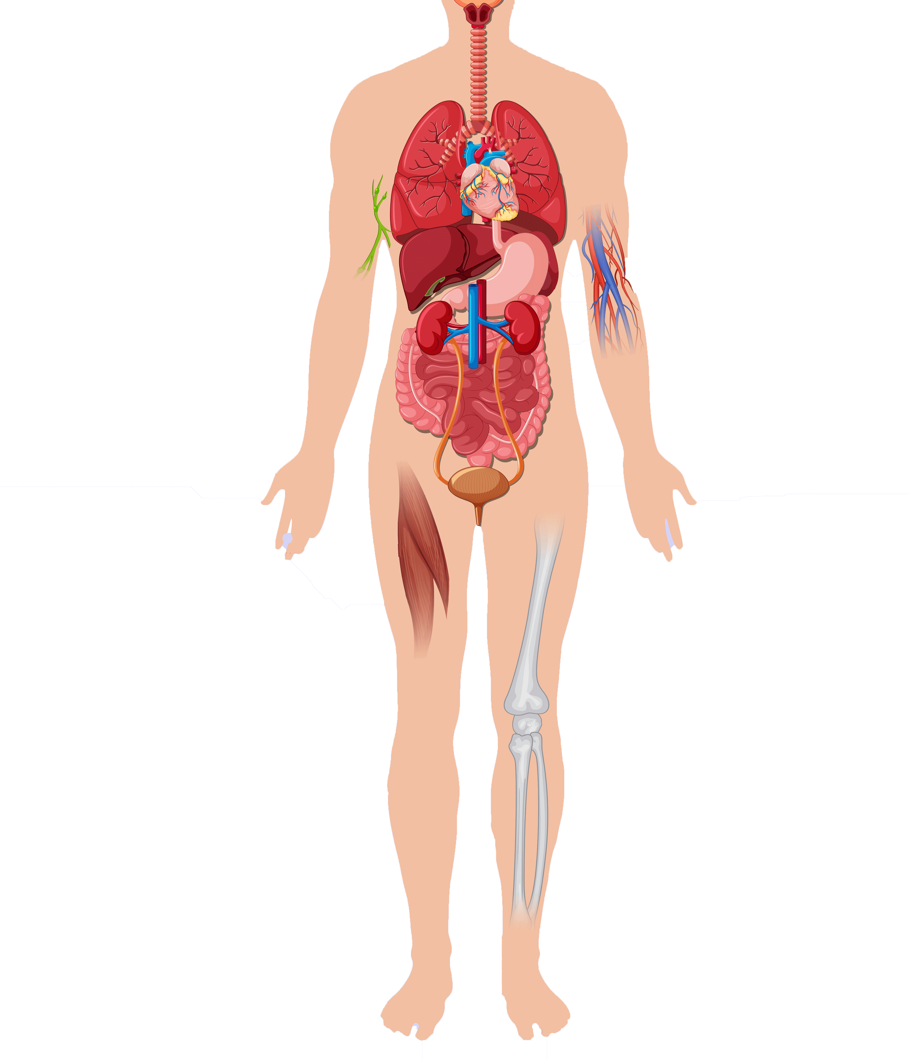
Anatomy
Voice box
Heart
Lungs
Liver
Stomach
Kidneys
Large intestine
Small intestine
Image source: www.vecteezy.com
15. A Journey in Love
– Year 6 –

Slide 16
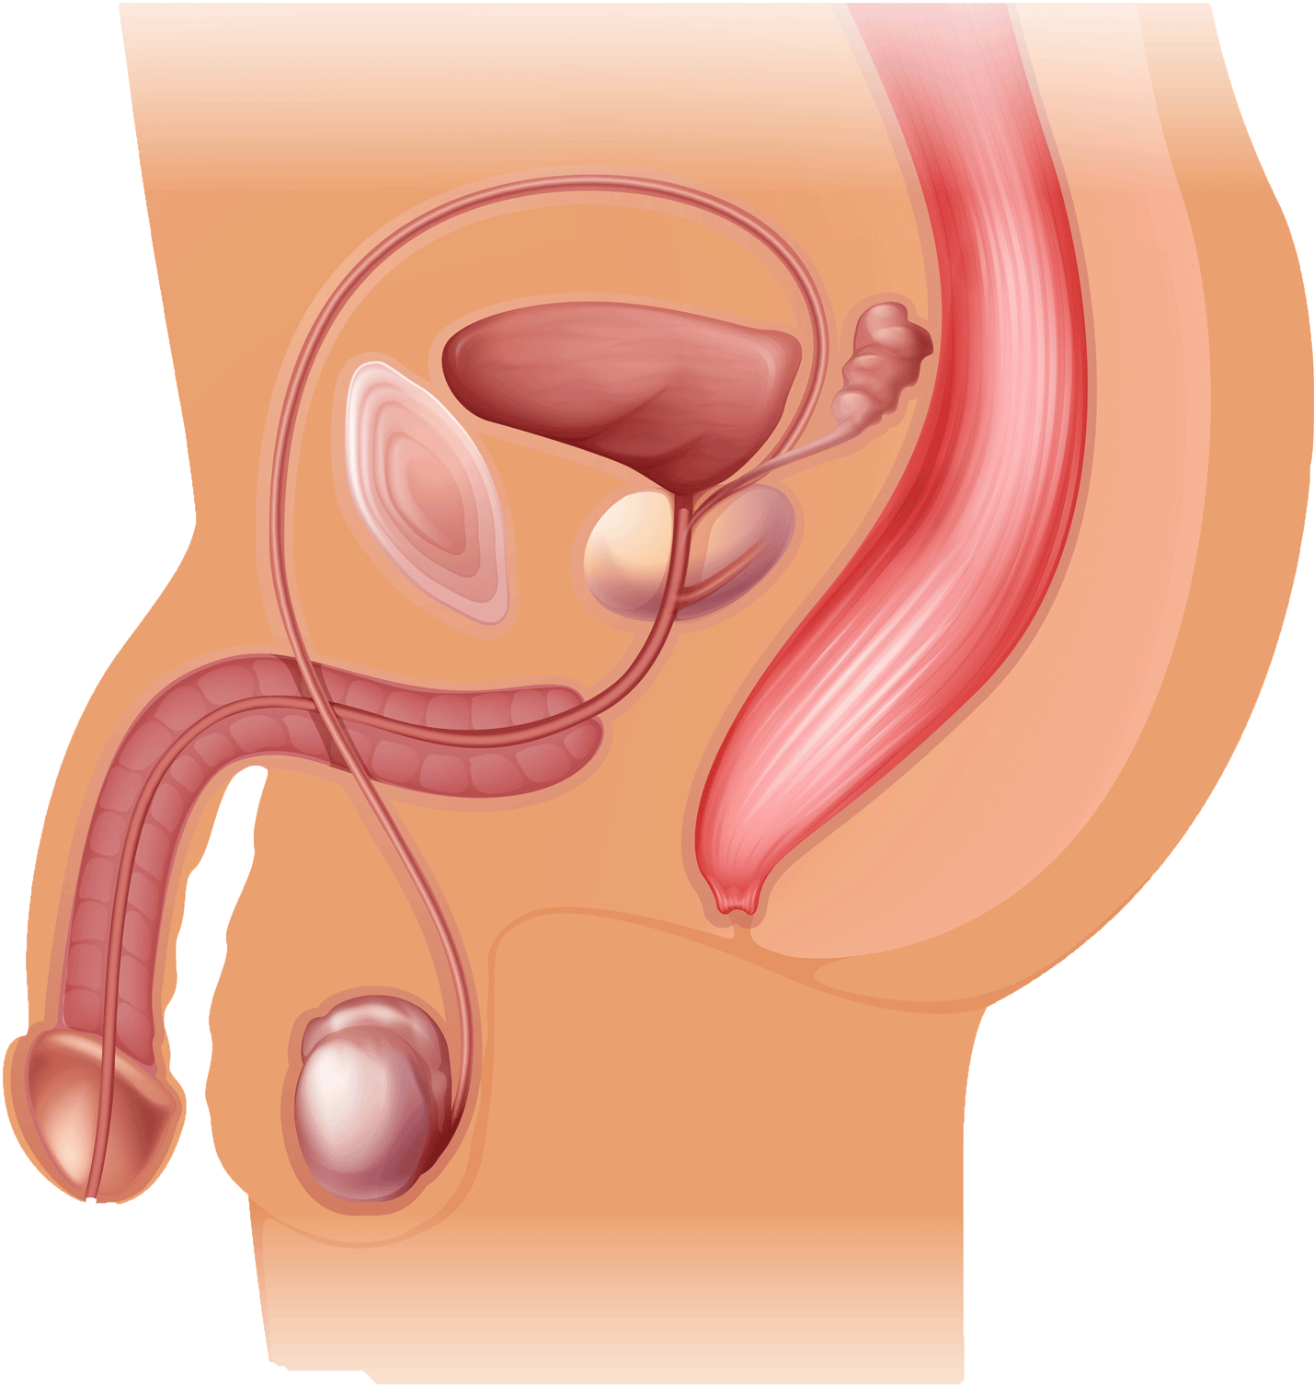
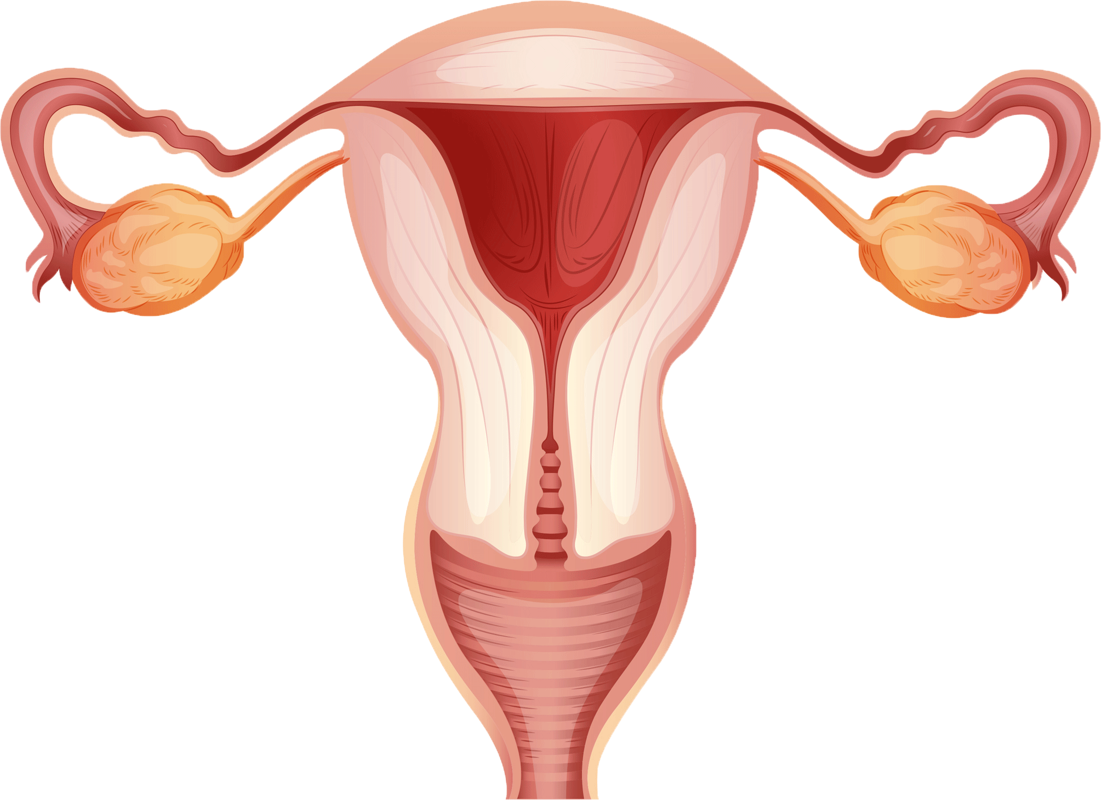
Male and female reproductive organs
Ovary
Sperm duct
Bladder
Prostate gland
Uterus
(womb)
Fallopian tube
Penis
Cervix
Vagina
Testicle
Scrotum
Male
Female
Image source: www.vecteezy.com
16. A Journey in Love
– Year 6 –

Slide 17
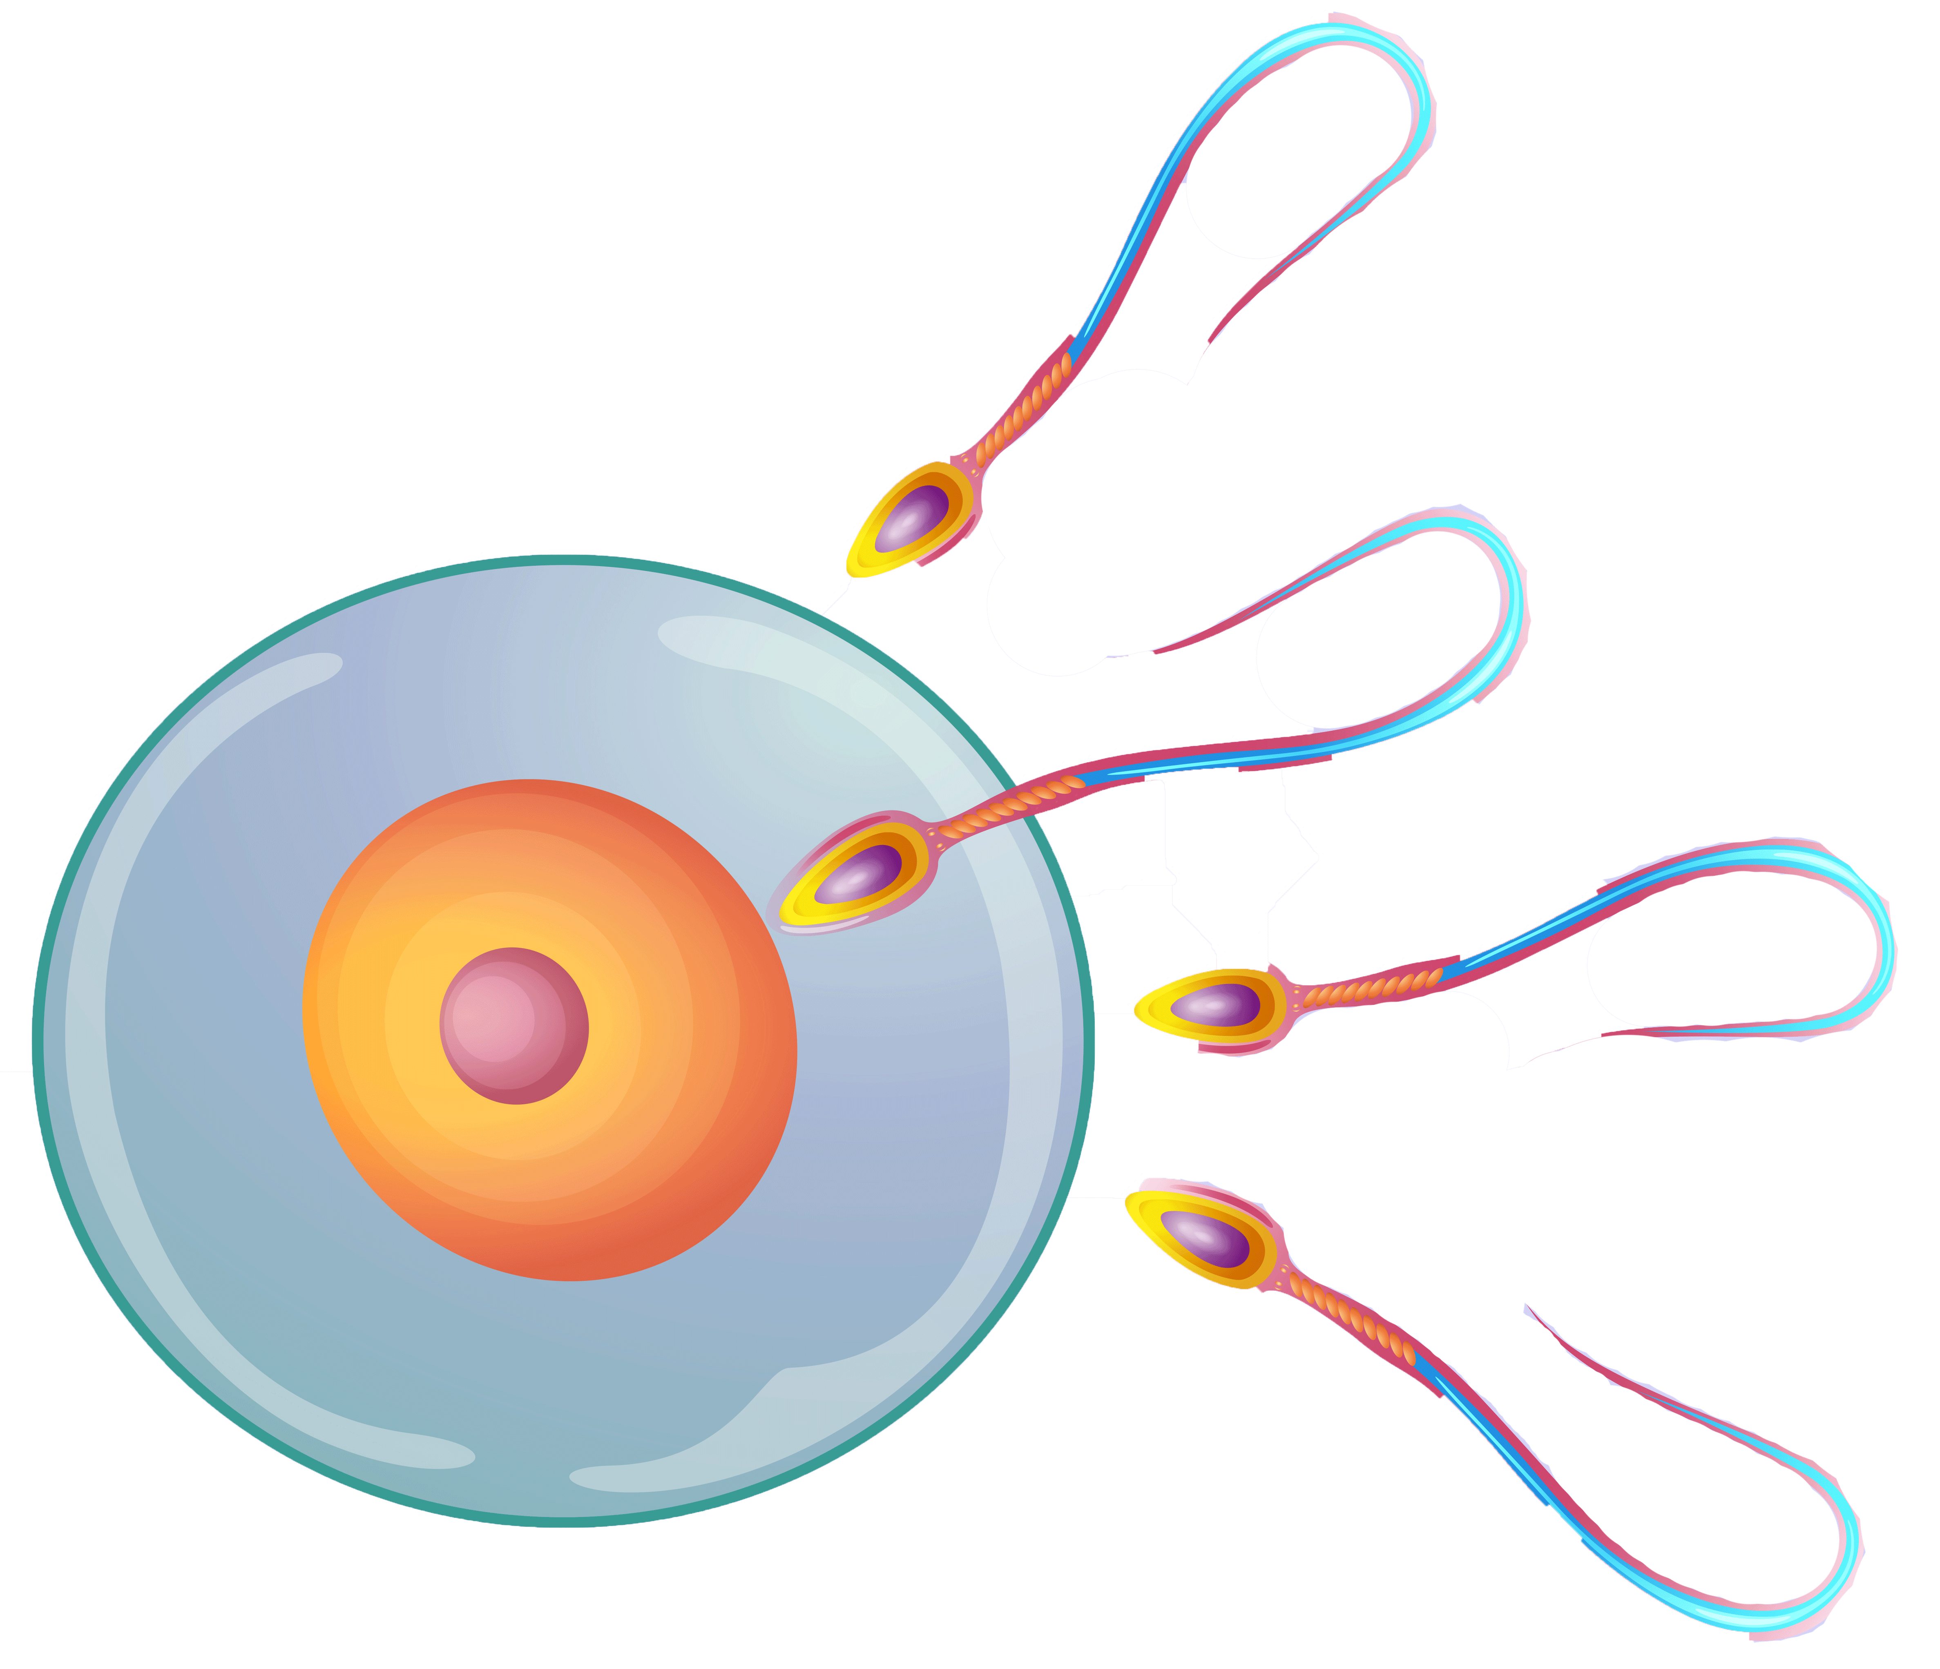
Sexual intercourse between husband and wife is a joyful expression of their love for each other.
It is an act of intimate self-giving, made by two people who want to give everything of themselves to the person they love and respect.
When a couple make love the husband’s penis becomes stiff and is placed inside his wife’s vagina. Millions of sperm cells are released when the man ejaculates at the peak moment of his sexual arousal. Each sperm cell has a long tail that it uses to swim through the cervix, into the uterus, and eventually into his wife’s fallopian tubes.
Although a hundred sperm cells may reach the egg cell only one sperm can enter the egg to fertilise it.
Relationships in Moral Education p.23
Image source: https://www.vecteezy.com
17. A Journey in Love
– Year 6 –

Slide 18
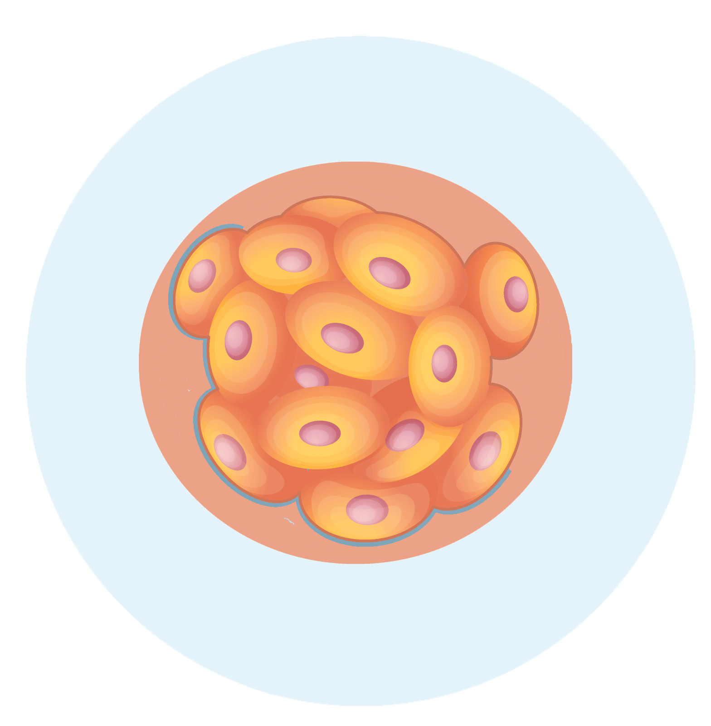
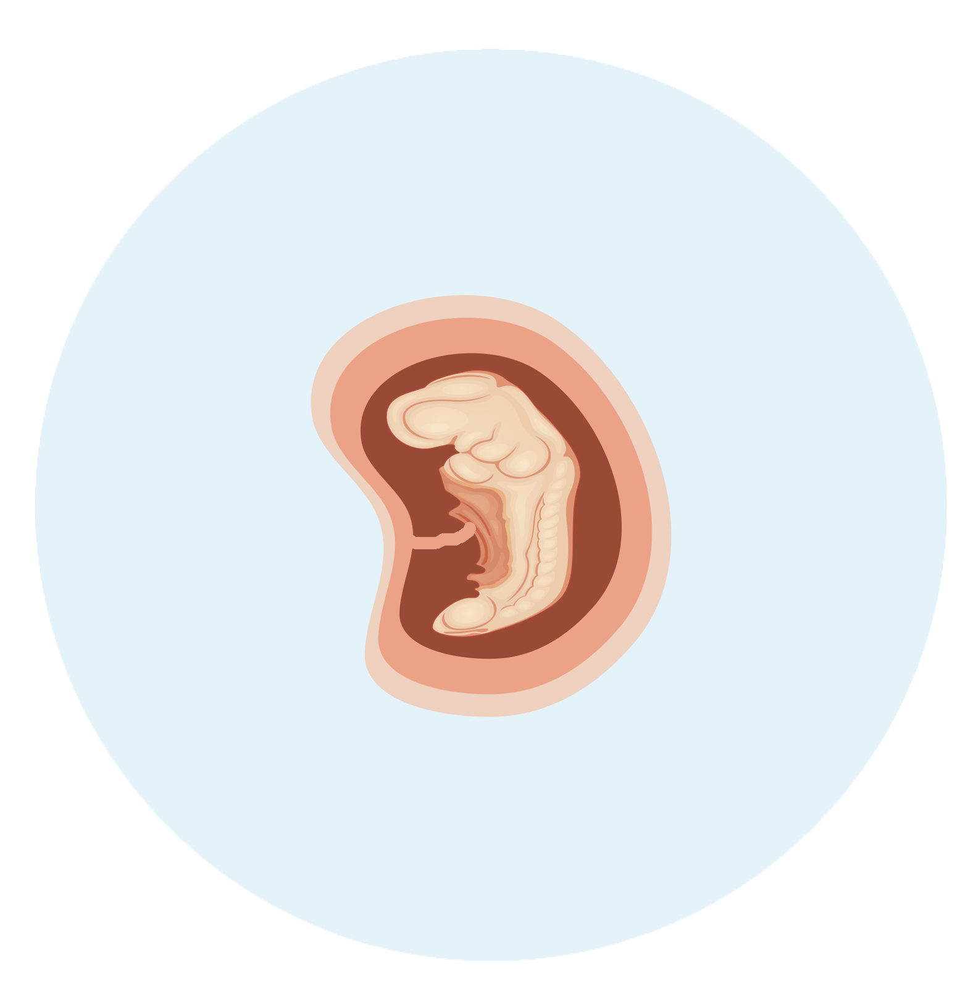
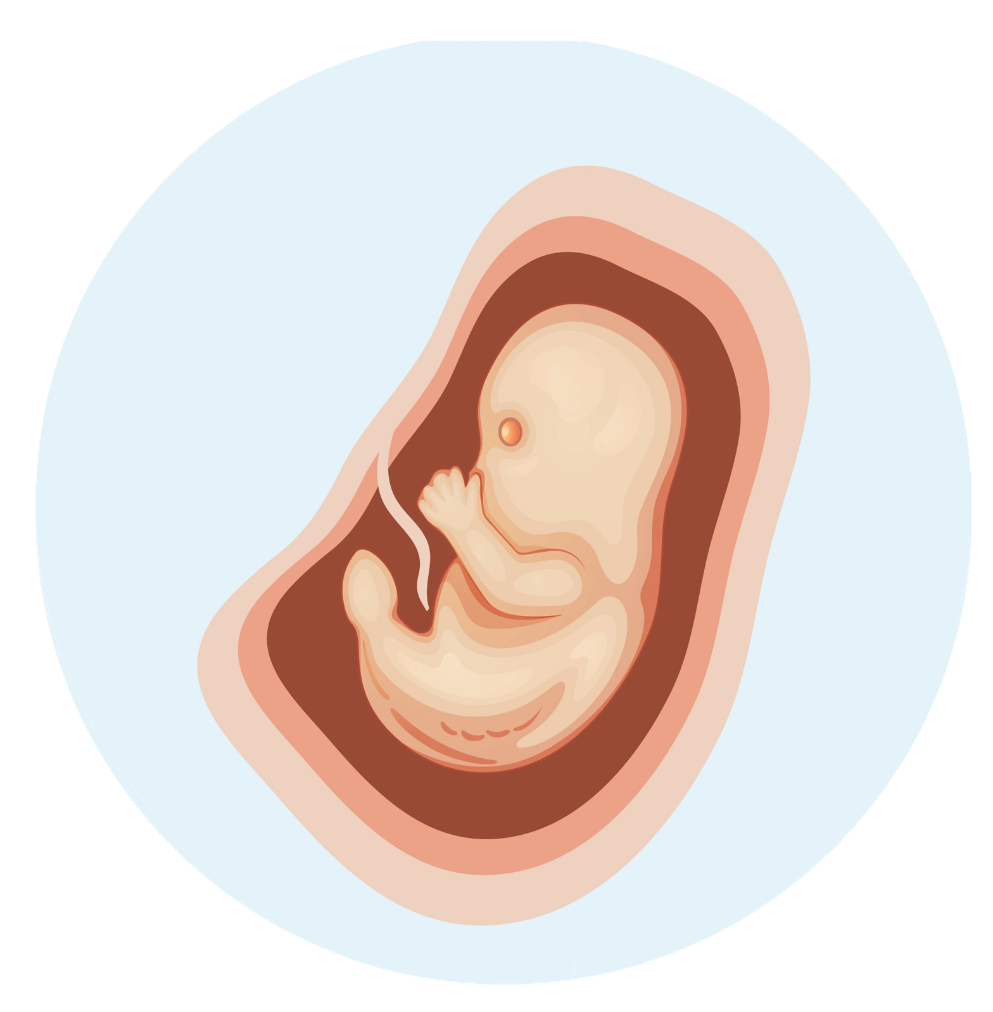
Understand how a child grows within the mother’s womb
After a few days,
the cell divides repeatedly
to form a ball of cells
After 8 weeks, the baby has eyes but no eyelids. It starts making its first tiny movements, but its mother cannot feel them yet
After 16 weeks, the baby begins to swallow and pass urine. It has fingers and toenails. At this stage its skin is bright red and transparent
Image source: www.vecteezy.com
18. A Journey in Love
– Year 6 –

Slide 19
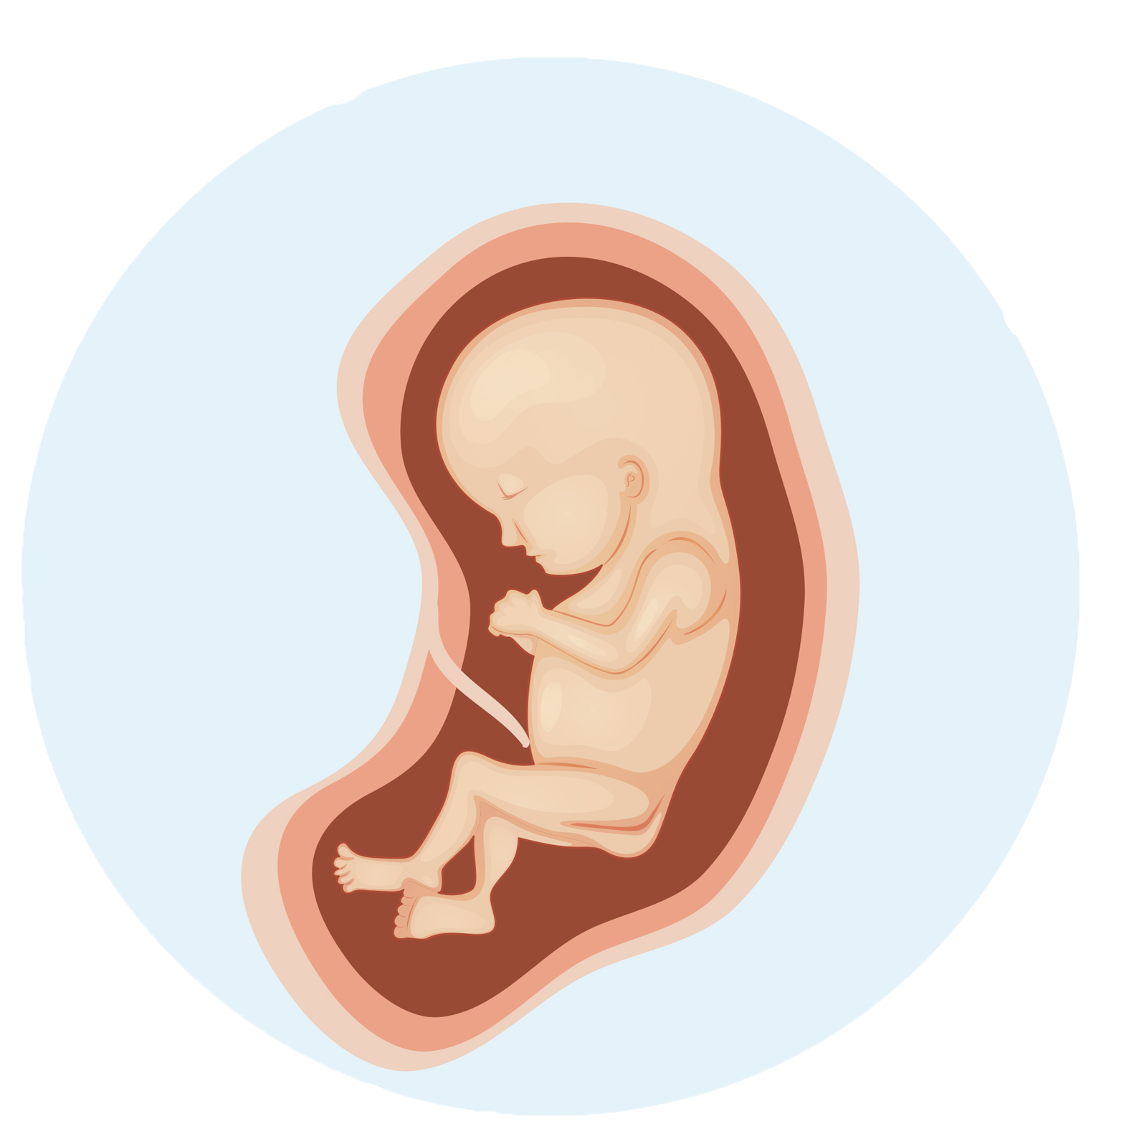
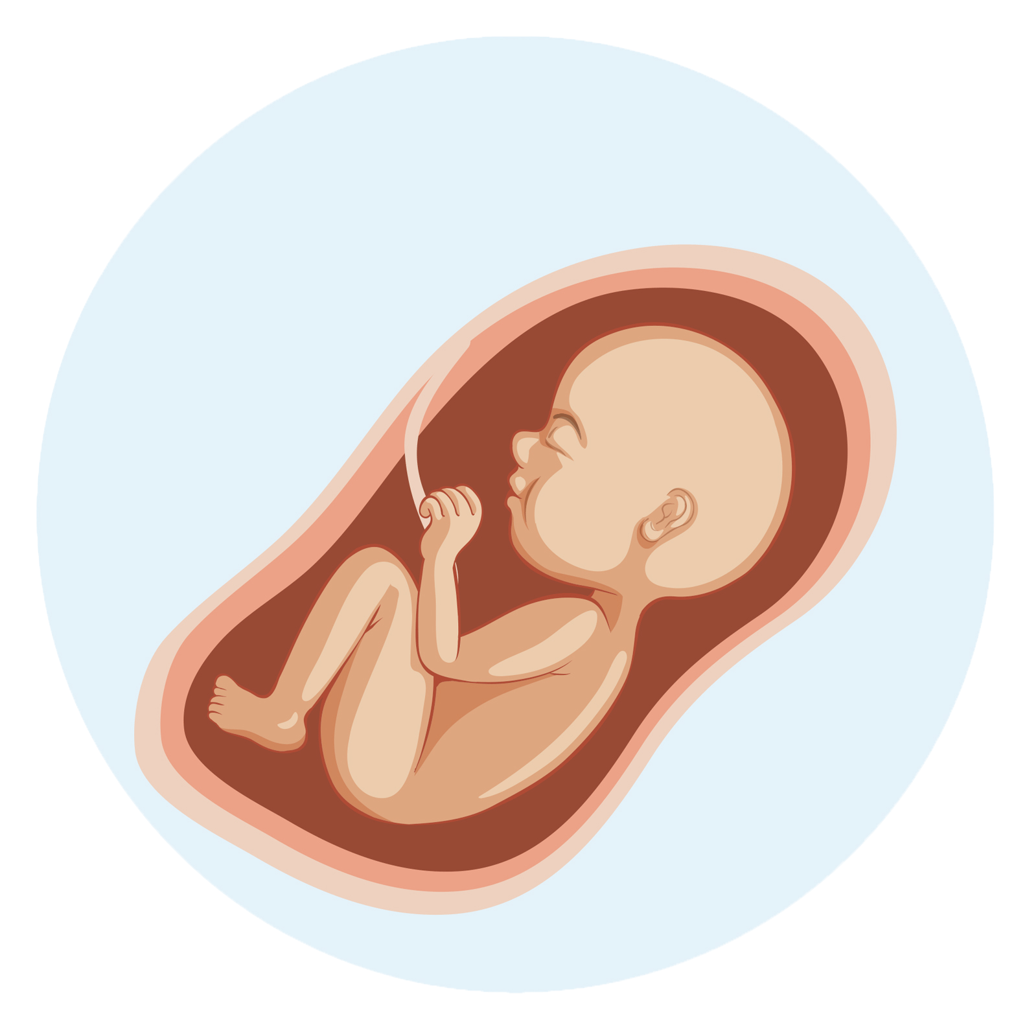
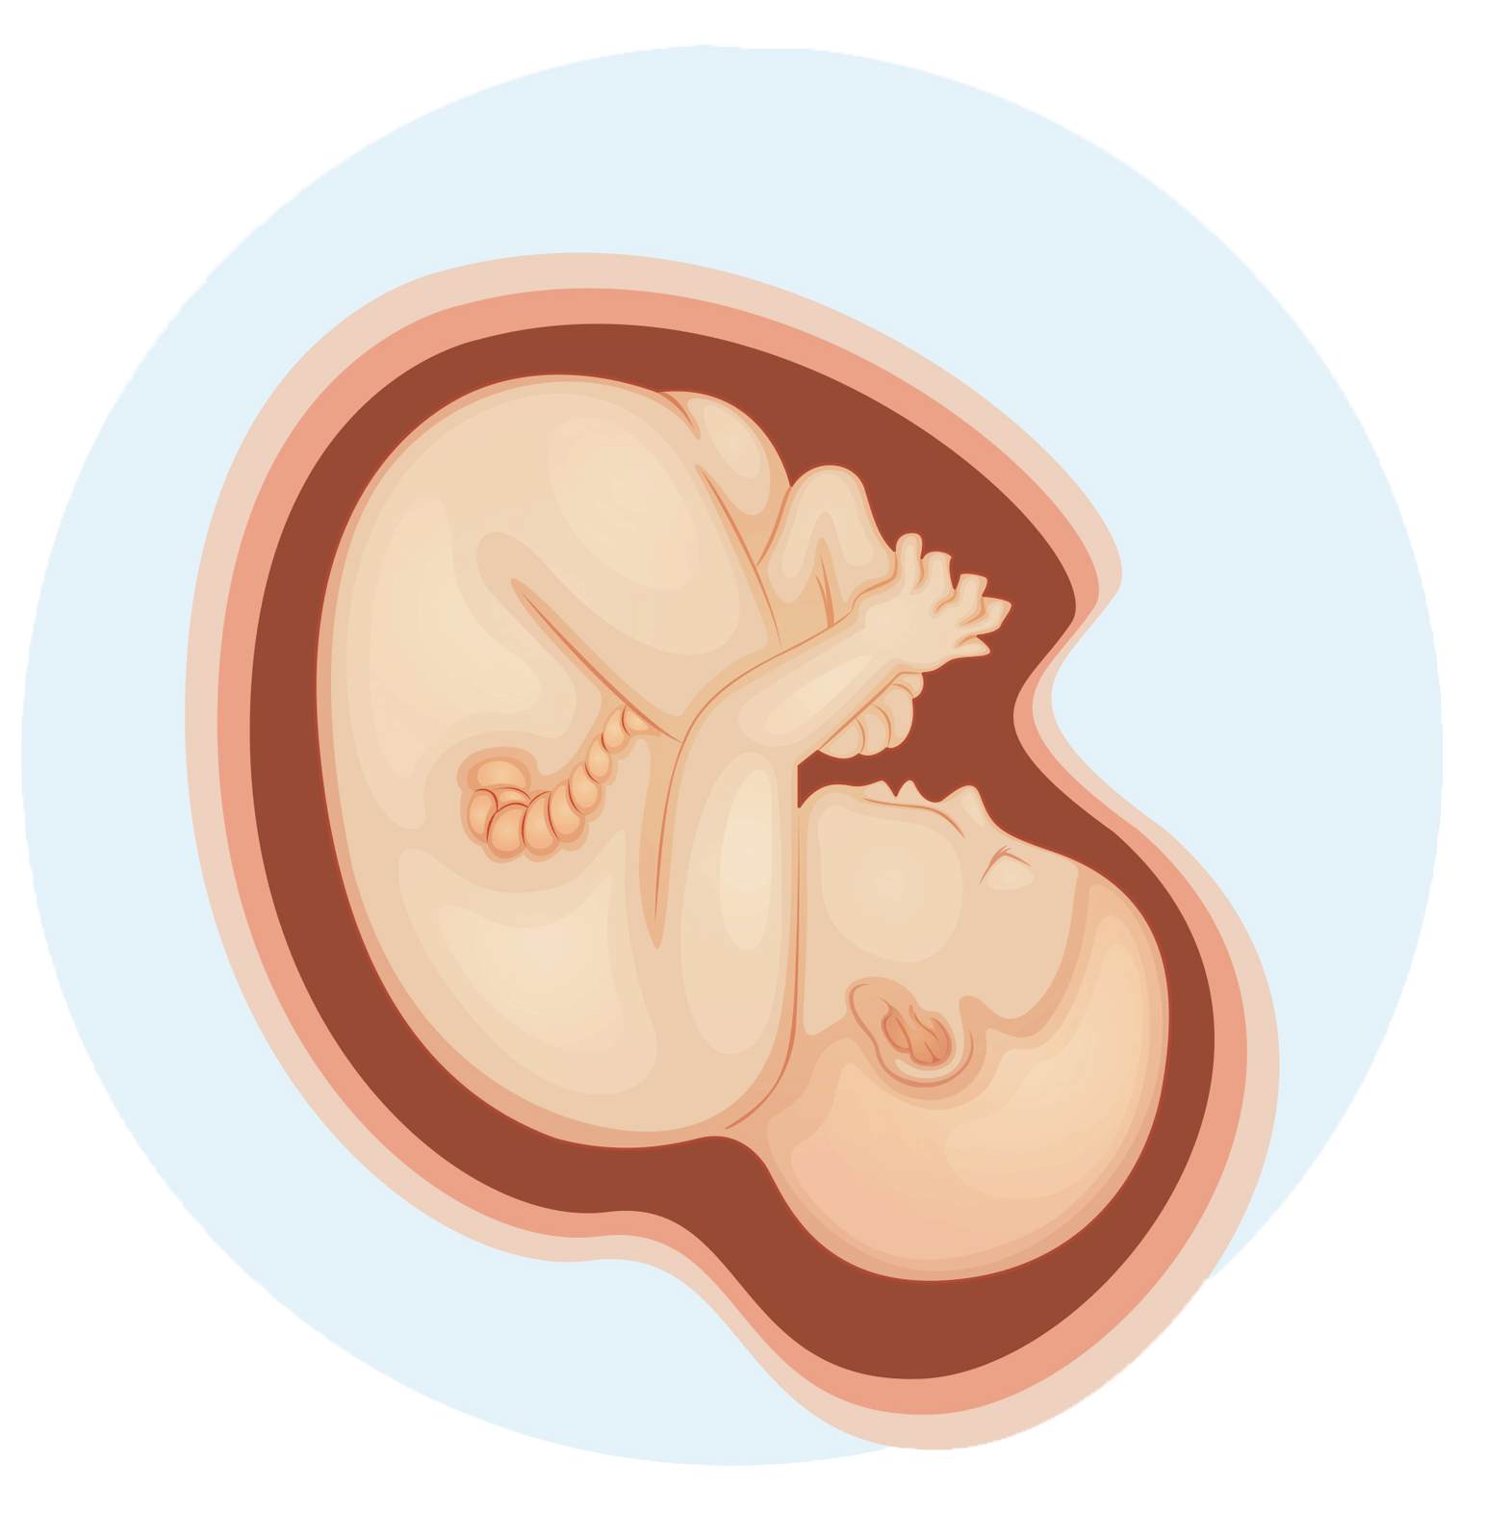
Understand how a child grows within the mother’s womb
After 24 weeks, the baby can hear voices and other sounds from outside its mother. It has some hair and eyebrows and eyelashes. The skin is very wrinkled
After 28 weeks, the baby’s kicks are quite strong and can be felt by putting a hand on the mother’s tummy.
After 36 weeks, the baby has taken up its final position in the uterus.
Its lungs are getting ready to take their first breath. The baby continues to get fatter. Sometime after 36 weeks, the baby’s head is now positioned ready for birth.
The baby could arrive any time between 38th and 42nd week of pregnancy
Image source: www.vecteezy.com
19. A Journey in Love
– Year 6 –

Slide 20
Pause and reflect
Psalm 139:16–17
You saw me before I was born.
Every day of my life was recorded in your book.
Every moment was laid out before
a single day had passed.
How precious are your thoughts
about me, O God.
They cannot be numbered!
It is God who gives life. Let us respect and love human life, especially vulnerable life in a mother’s womb.
Pope Francis

Slide 21
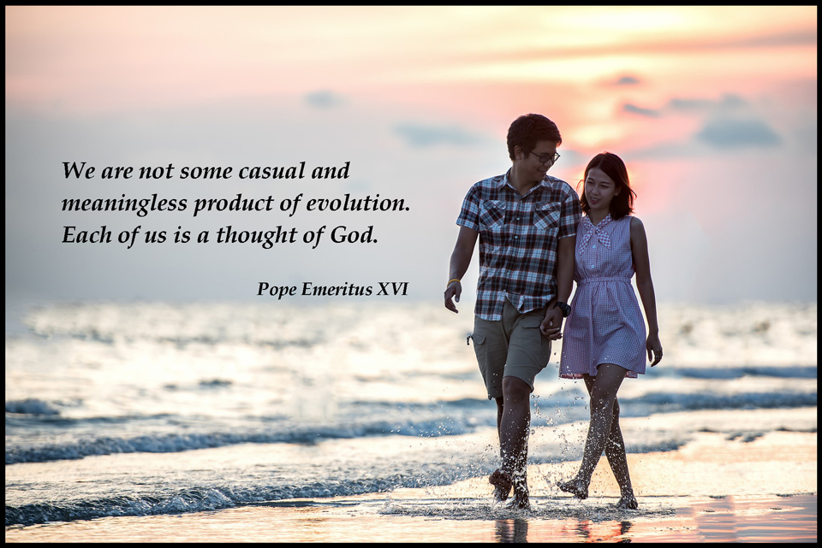
21. A Journey in Love
– Year 6 –

Slide 22
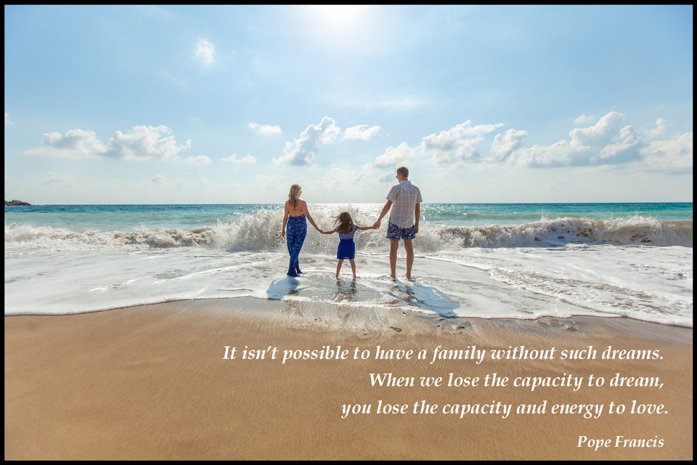
22. A Journey in Love
– Year 6 –

Slide 23
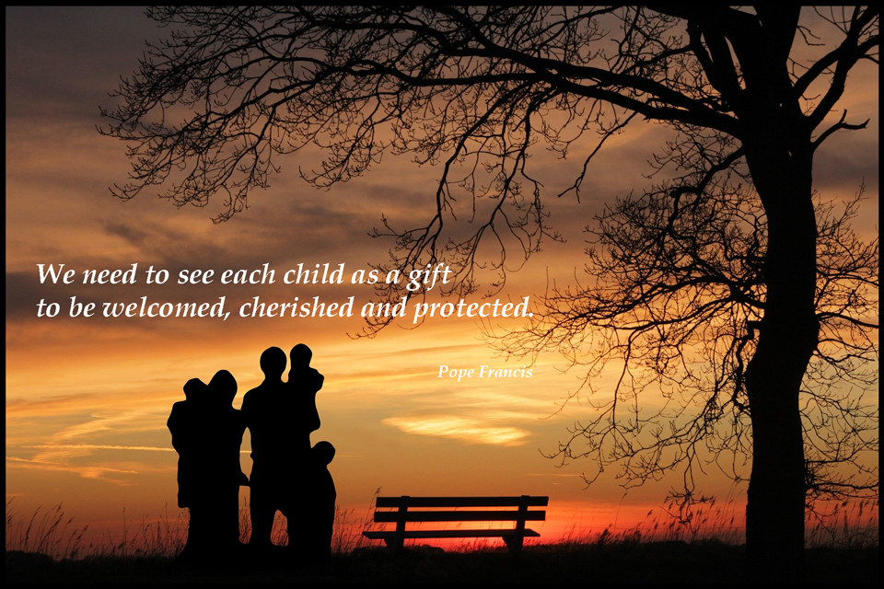
23. A Journey in Love
– Year 6 –

Slide 24
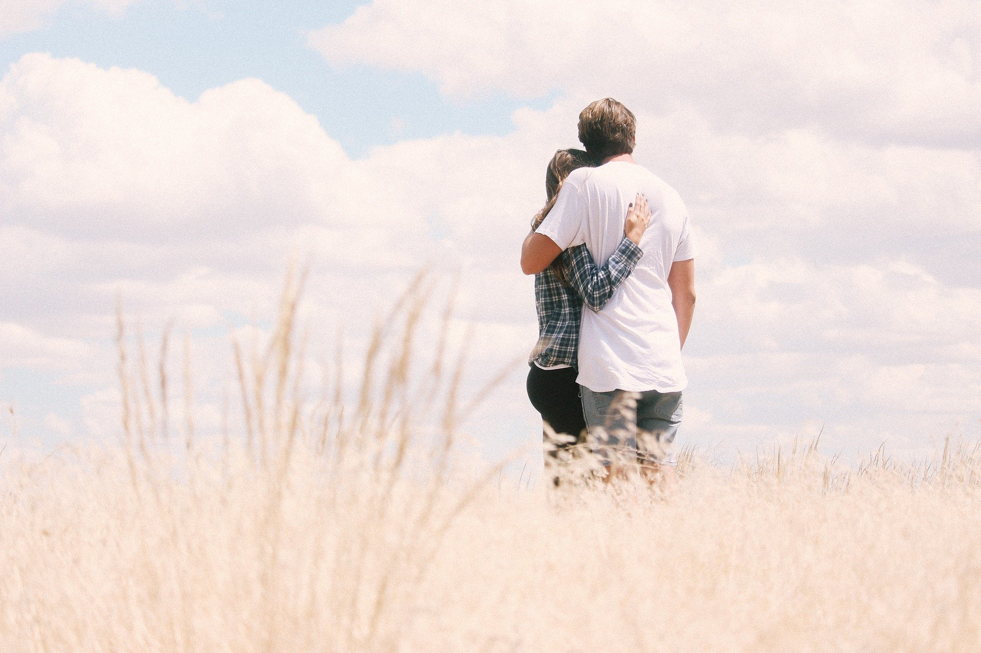
Spiritual
Learning intention
Show an understanding of how being made in the image and likeness of God informs decisions and actions when building relationships with others, including life-long relationships.
24. A Journey in Love
– Year 6 –

Slide 25
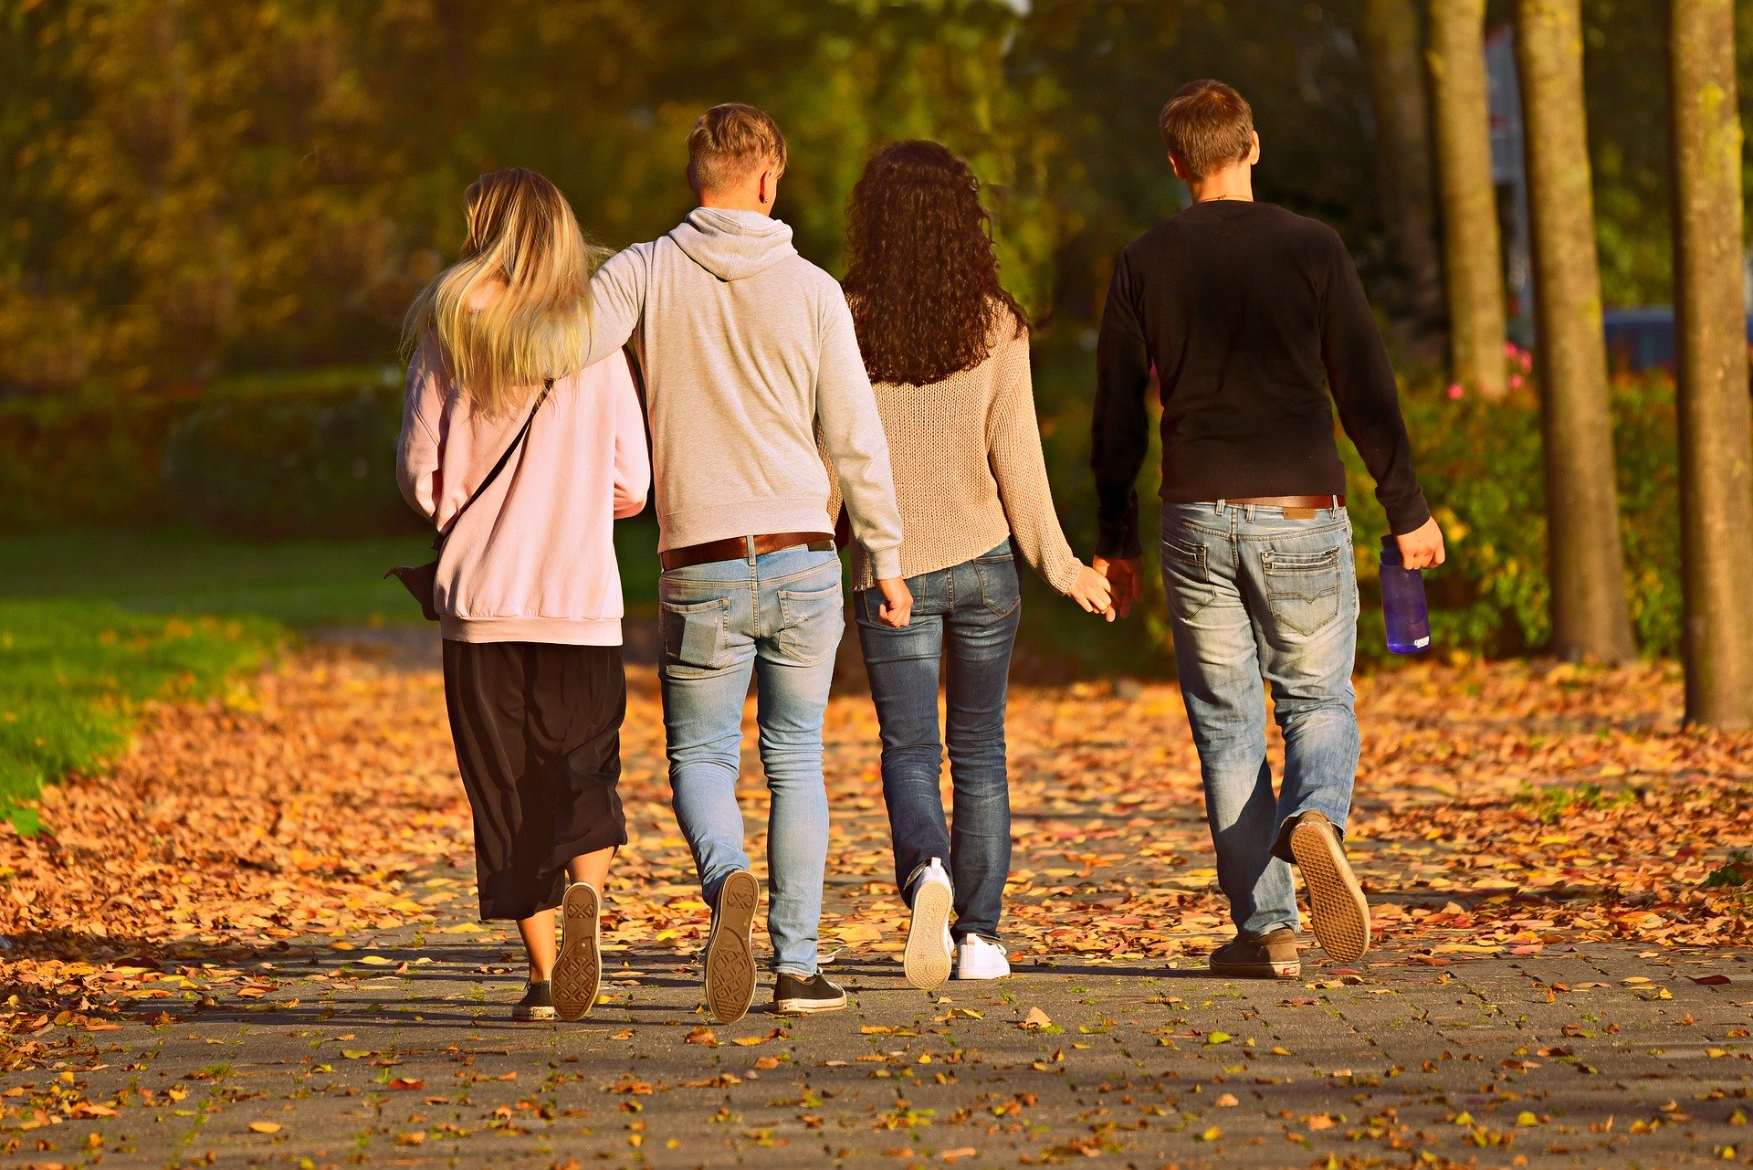
Questions
What are the characteristics of positive respectful relationships?
Include the different ways that we can make friends and relationships with others? e.g. social media platforms.
When making friends on-line we should be cautious of the information we share and how it could be used: positively or negatively.
When building relationships on-line, how can we recognise risks, such as inappropriate images, language and behaviour, and to who and how we would report these?
Continued on next slide >>
25. A Journey in Love
– Year 6 –

Slide 26
Questions (continued)
What sorts of boundaries are appropriate in friendships with peers and others, including in a digital context? If boundaries have been crossed; such as inappropriate or unsafe contact, how would we report this and where could we get advice?
How can we ensure that we are contributing to the wellbeing of others and are taking steps to avoid seeing negatives; how would this impact on building positive relationships?
How can we discover the presence of God in family and friends?
26. A Journey in Love
– Year 6 –

Slide 27
Pause and reflect
God of generous and abundant love,
be with us as we continue our Christian journey.
Help us to follow in the footsteps of Jesus and may it be said of us, as of the ‘first Christians’, “see how these Christians love one another.”
We begin by making the Sign of the Cross.
“In the name of the Father,
and of the Son
and of the Holy Spirit.
Amen.”

Slide 28

The Beatitudes in the Gospel of Matthew 5:3-10
1. “Blessed are the poor in spirit, for theirs is the kingdom of heaven.”
The poor include both literally poor people, in need of basic necessities, and figuratively poor people, who are aware of their spiritual poverty, people who acknowledge their need and utter dependence upon God. The reward mentioned here is nothing less than the kingdom of heaven.
What do we consider to be our family’s greatest riches?
2. “Blessed are they who mourn, for they will be comforted.”
Those who mourn could be anyone who is sad or experiencing a loss of any kind. Jesus promises comfort for those who suffer. When we suffer we have a choice to make: we can become bitter, or we can become more compassionate to others who are in pain.
How do we find comfort in our family?
28. A Journey in Love
– Year 6 –

Slide 29
The Beatitudes in the Gospel of Matthew 5:3-10
3. “Blessed are the meek, for they will inherit the land.”
The meek are people who are humble and patient. A person who chooses other ways to resolve conflicts without resorting to violence is meek. The reward is great wealth.
How do we resolve conflict in our families?
4. “Blessed are they who hunger and thirst for righteousness, for they will be satisfied.”
This blessing is for people who hunger for justice in our world. Children have a great capacity to see wrongs and often possess a simple view of complex issues.
Perhaps our children can use their creativity to solve some of the local injustices in schools and communities.
29. A Journey in Love
– Year 6 –

Slide 30
The Beatitudes in the Gospel of Matthew 5:3-10
5. “Blessed are the merciful, for they will be shown mercy.”
Mercy is a word that holds many meanings: forgiveness, kindness, compassion. It is easier to extend mercy to others when you begin with yourself. In our family, rather than keeping track of mistakes, we try to see God’s grace among us.
With mercy, you receive back the more you give.
How can you practise mercy at home?
6. “Blessed are the clean of heart, for they will see God.”
Who better to be clean or pure of heart then little ones? They lack malice and have such innocence, at least during the first few years. Of course, they see God, because there is nothing clouding their vision!
The clean of heart can also be people who single-mindedly see God first in all situations and people.
30. A Journey in Love
– Year 6 –

Slide 31
The Beatitudes in the Gospel of Matthew 5:3-10
7. “Blessed are the peacemakers, they will be called children of God.”
What risks do we take to make peace? Jesus asks us all to be peacemakers; we are, after all, children of God. As his children, we must continue to work for unity and understanding.
Our families are microcosms of the world in which we learn peace-making skills. Peace begins at home.
8.“Blessed are they who are persecuted for the sake of righteousness, for theirs is the kingdom of heaven.”
It can be difficult to do what is right, such as standing up to someone who is acting like a bully.
But we learn from Jesus, and, through practice in our family, we see that doing the right thing is what it really means to be a follower of Jesus.
www.teachingcatholickids.com
31. A Journey in Love
– Year 6 –

Slide 32
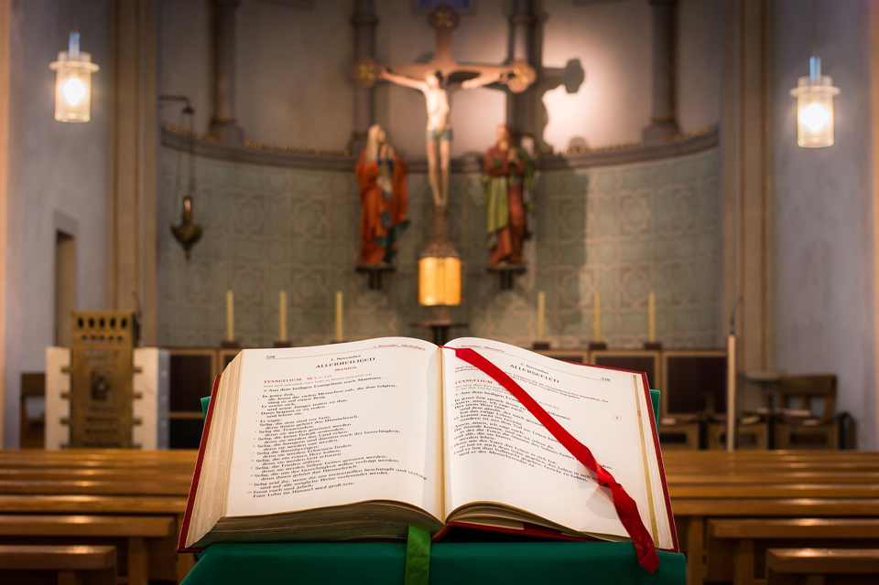
The smaller Beatitudes
Blessed are those who can laugh at themselves, they will have no end of fun.
Blessed are those who can tell a mountain from a molehill, they will be saved a lot of bother.
Blessed are those who know how to relax without looking for excuses, they are on the way to becoming wise.
Blessed are those who know when to be quiet and listen, they will learn a lot of new things.
Blessed are those who are sane enough not to take themselves too seriously, they will be valued by those about them.
Happy are you if you can take small things seriously and face serious things calmly, you will go far in life.
32. A Journey in Love
– Year 6 –

Slide 33
The smaller Beatitudes - continued
Happy are you if you can appreciate a smile and forget a frown, you will walk on the sunny side of the street.
Happy are you if you can be kind in understanding the attitudes of others, you may be taken for a fool, but this is the price of charity.
Happy are you if you know when to hold your tongue and smile, the Gospel has begun to seep into your heart.
Blessed are they who think before acting and pray before thinking, they avoid many blunders.
Above all blessed, are those who recognise the Lord is in all whom they meet, the light of truth shines in their lives. They have found true wisdom.
34. A Journey in Love
– Year 6 –

Slide 34

34. A Journey in Love
– Year 6 –

Slide 35
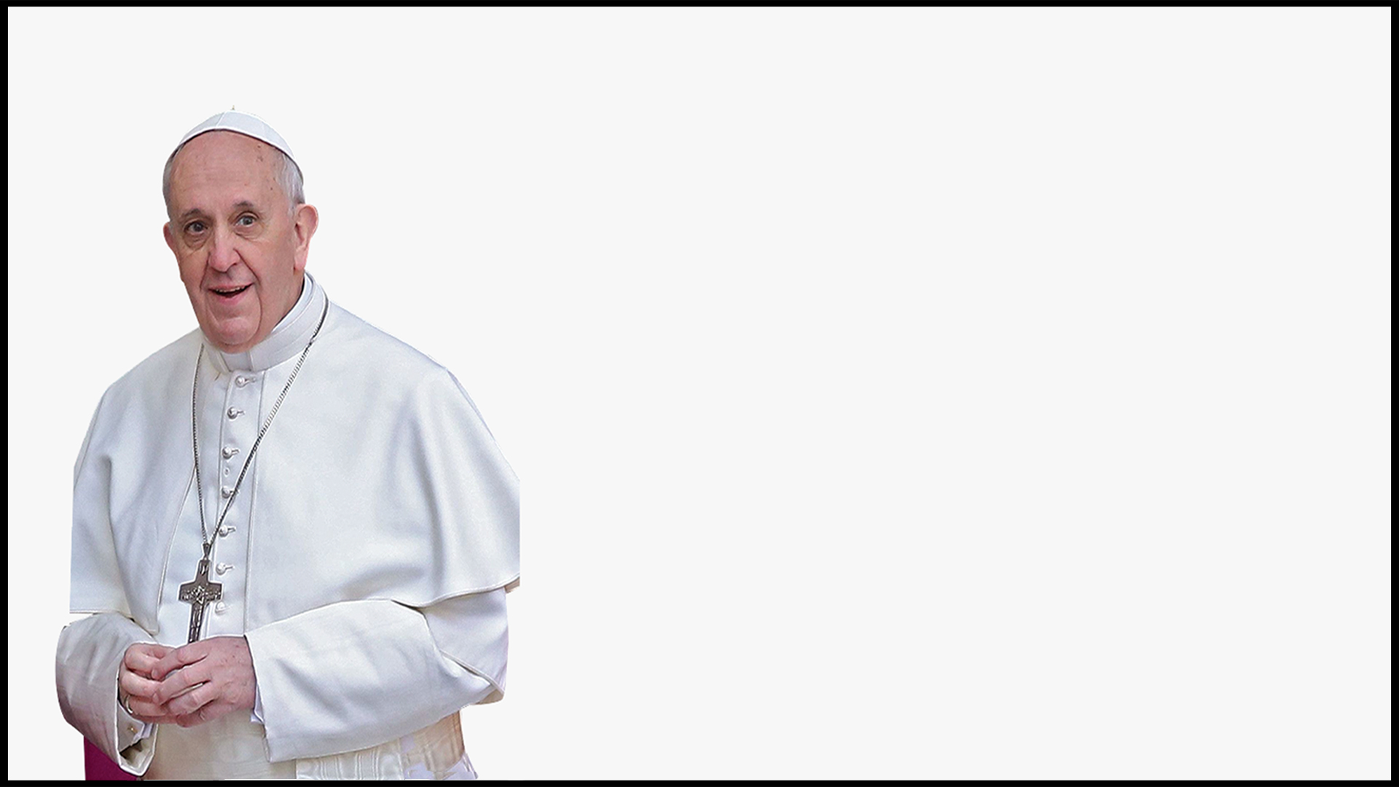





Pope Francis’ Beatitudes for Young People
Happy are the merciful.
Happy are those who embrace and forgive.
Happy are those who bring new life and opportunities.
Happy are those who see the good in other people.
Happy are those who help others when they make mistakes.
35. A Journey in Love
– Year 6 –

Slide 36
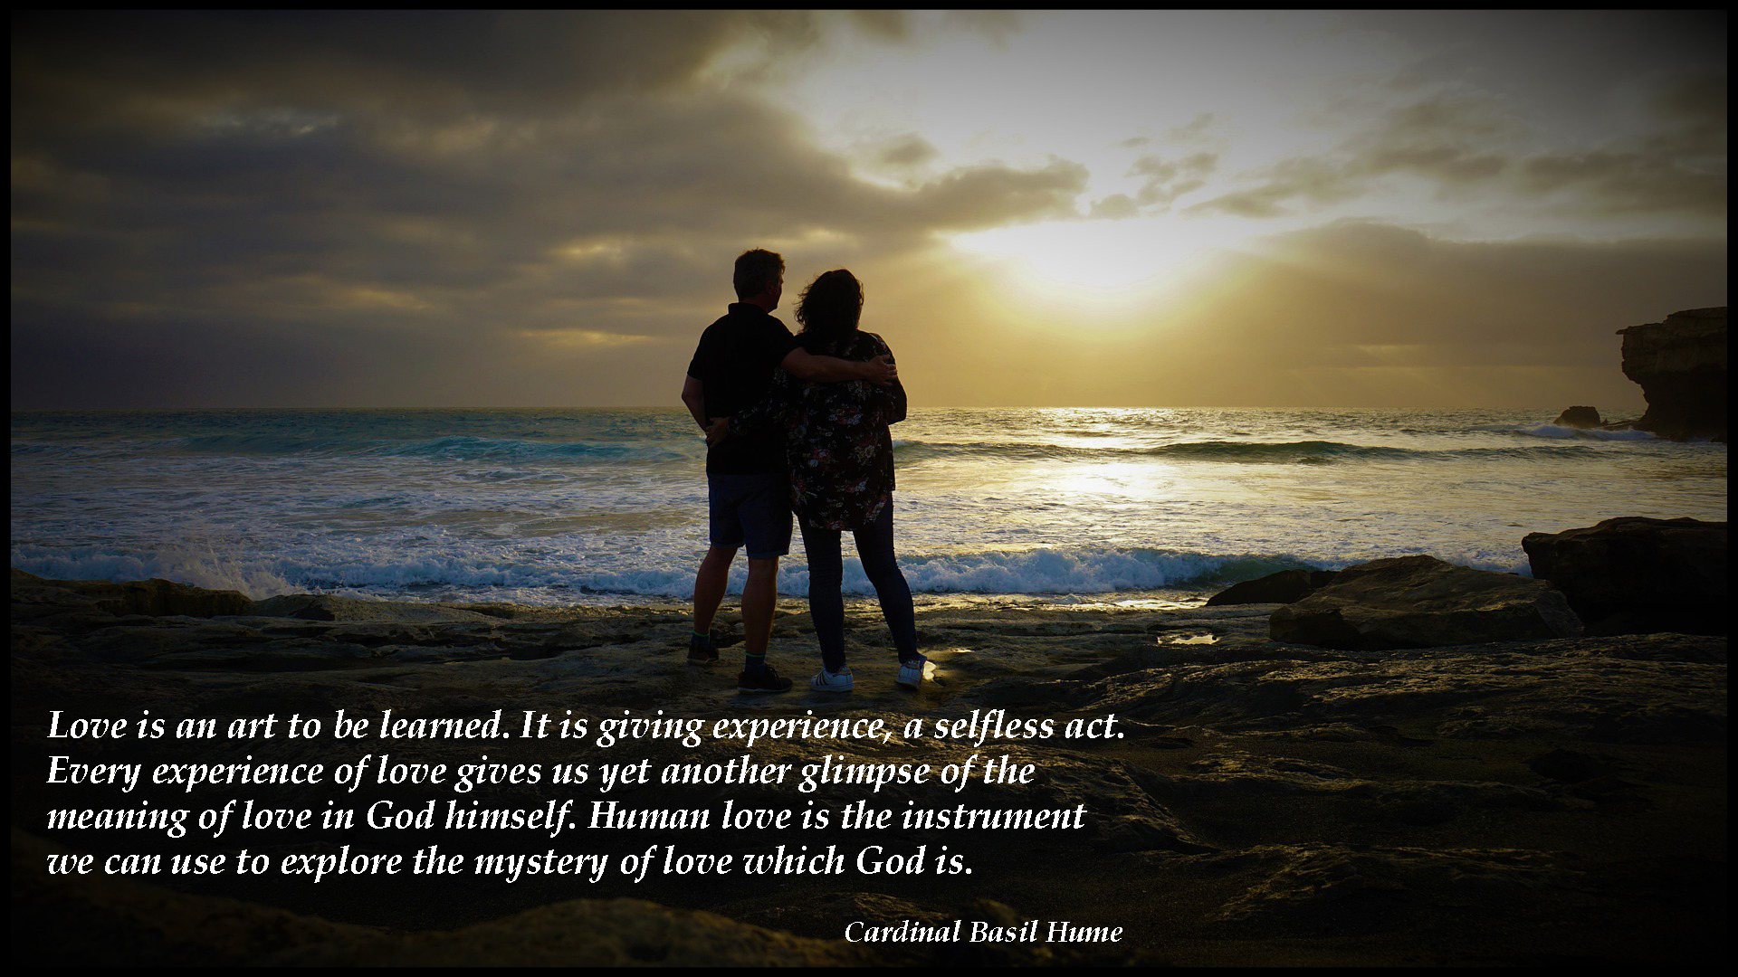

Slide 37

37. A Journey in Love
– Year 6 –

Slide 38
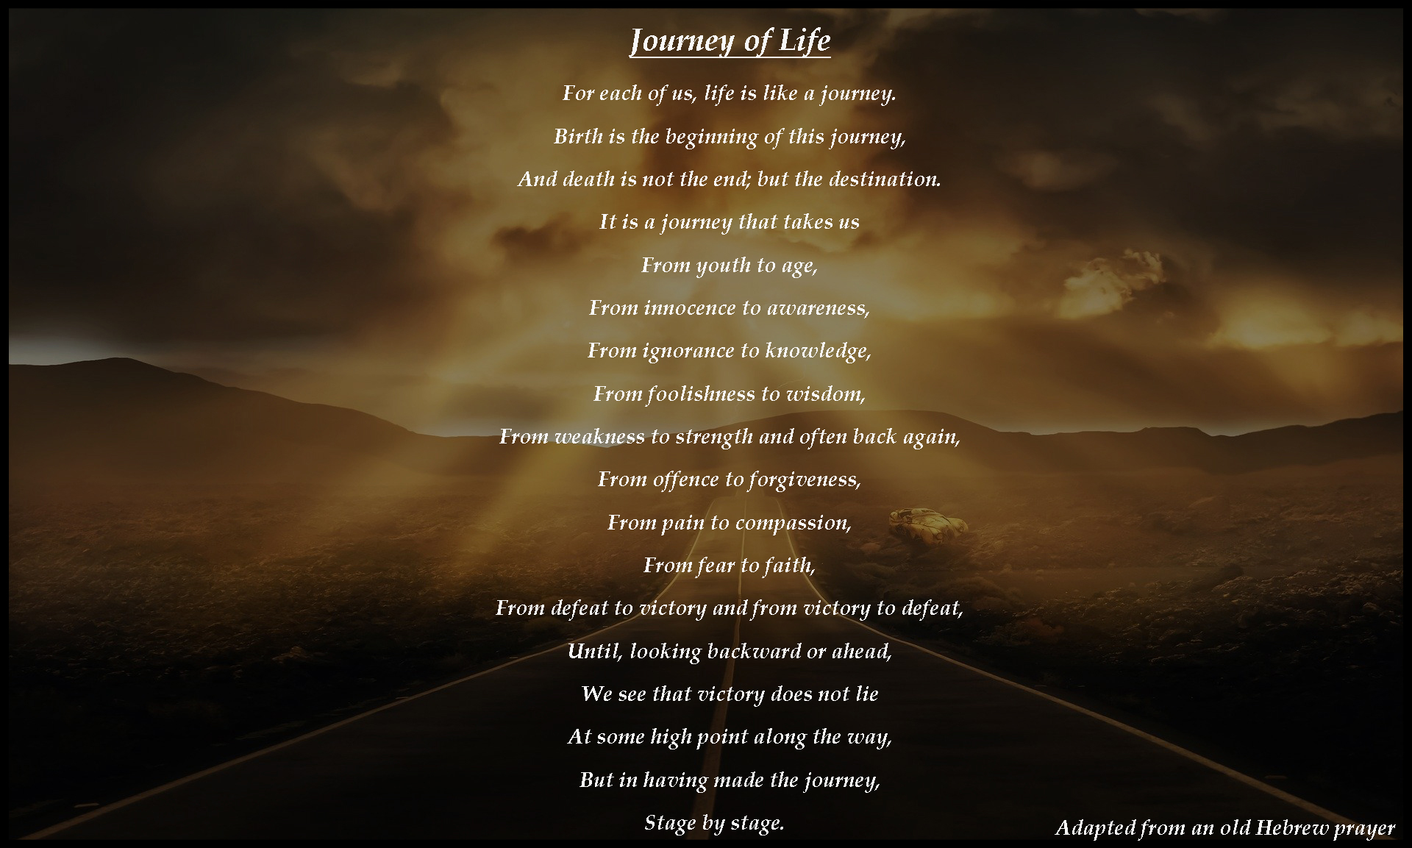

Slide 39
Be sanctuaries of respect for life, proclaiming the sacredness
of every human life
from conception to natural death.
Pope Francis
39. A Journey in Love
– Year 6 –

