Slide 1
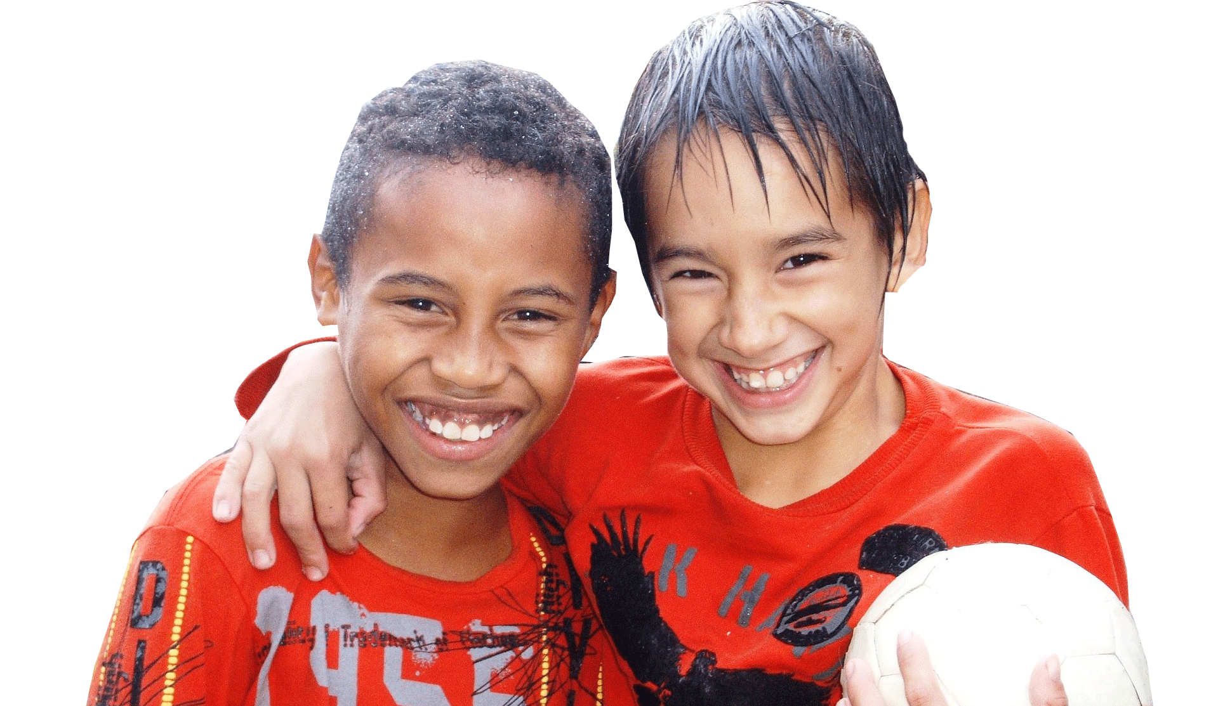

Year 5
God loves us in our changing and developing.
1. A Journey in Love
– Year 5 –

Slide 2

IMPORTANT
Copyright and Terms and Conditions of use
By using this Powerpoint CD presentation you are agreeing to the following terms and conditions.
All images and text are copyright to the respective owners and can only be used and shown as a presentation within a classroom or other room or area within an educational establishment.
– All the files and images contained within this PowerPoint presentation are subject to copyright restrictions and cannot be duplicated, copied or shared as detailed on the CD and CD packaging (Unlawful duplication is prohibited by law).
– You must NOT share this Powerpoint presentation or any of the text and images by uploading them to a website on the Internet.
If you have purchased a Network Licence you may store the Powerpoint presentation on your Intranet.
– You must not change/alter or recreate the files in any way or form.
– If you do not comply with the terms of this licence you could be liable to legal action against you by the copyright holder and/or the agency that acts on their behalf.
This Powerpoint presentation is a simplified form of the
A Journey in Love book and should be used in conjunction with
this publication.
The book is available from www.mccrimmons.com
Published in United Kingdom in 2020 by
McCrimmon Publishing Co. Ltd.
sales@mccrimmons.com / www.mccrimmons.com
McCrimmon order ref: MB7863CD
Text © 2005/2006/2020 Sr Jude Groden and the following contributors.
﻿Dr Sathi Aiya / Ilse Brockling / Fr David Clemens
Sarah Feist / Shaun Kelliher / Patrick Harrison.
Narrative text: Sr Jude Groden.
Powerpoint construction and design by Éanna McAteer
I have read the Terms and Conditions above…
Acknowledgements
Most of the mages used in this Powerpoint presentation are from www.pixabay.com Pixabay are an online (free to use for commercial use) image library.
Other image credits
Slide 7 (top) www.pexels.com
Slides 8 - 9 Emc
Slides 25 - 26 www.vecteezy.com
CONTINUE

Slide 3
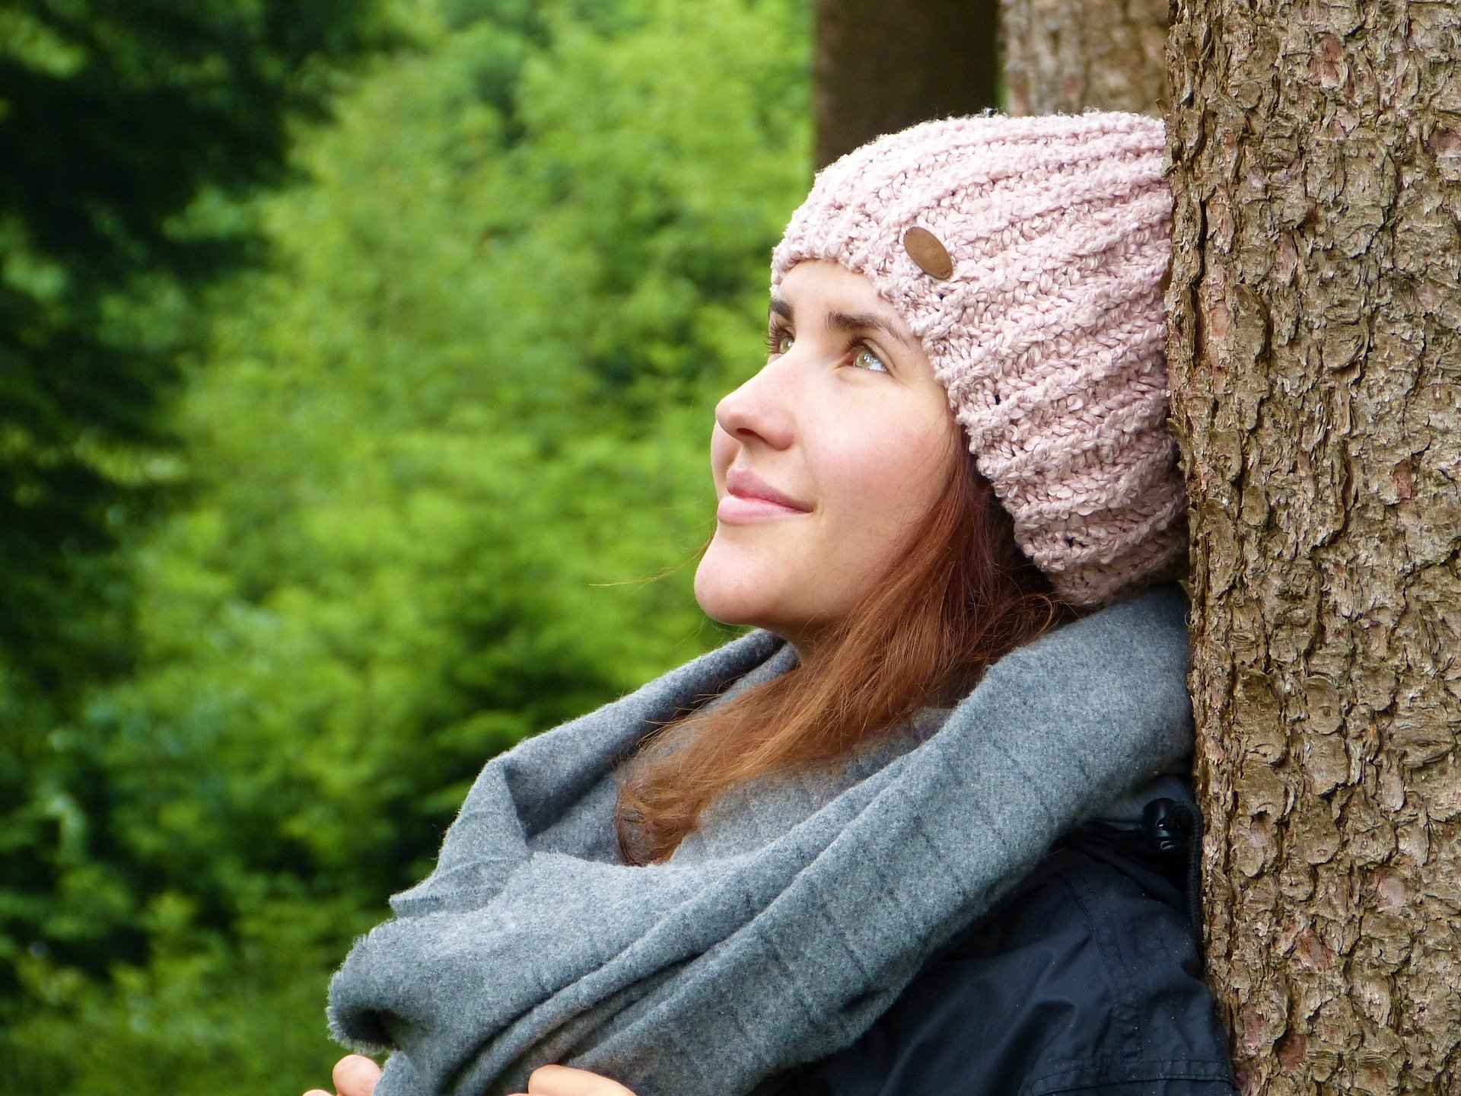
Aim
Show knowledge and understanding of how we grow in awareness of the physical and emotional changes that accompany puberty – sensitivity, mood swings, anger, boredom etc. and grow further in recognising God’s presence in our daily lives.
3. A Journey in Love
– Year 5 –

Slide 4


God
develop
uterus
sensitivity
ovulation
fertilised
ovum
puberty
biological
fallopian
tube
presence
respect
celebrate
reproduction
vagina
external
menstrual
cycle
cervix
internal
womb
hormones
change
period
pituitary gland
4. A Journey in Love
– Year 5 –

Slide 5

Respecting
Helping
Adapting
Skills
Accepting
Relating
Deciding
Developing
Supporting
Considering

Slide 6
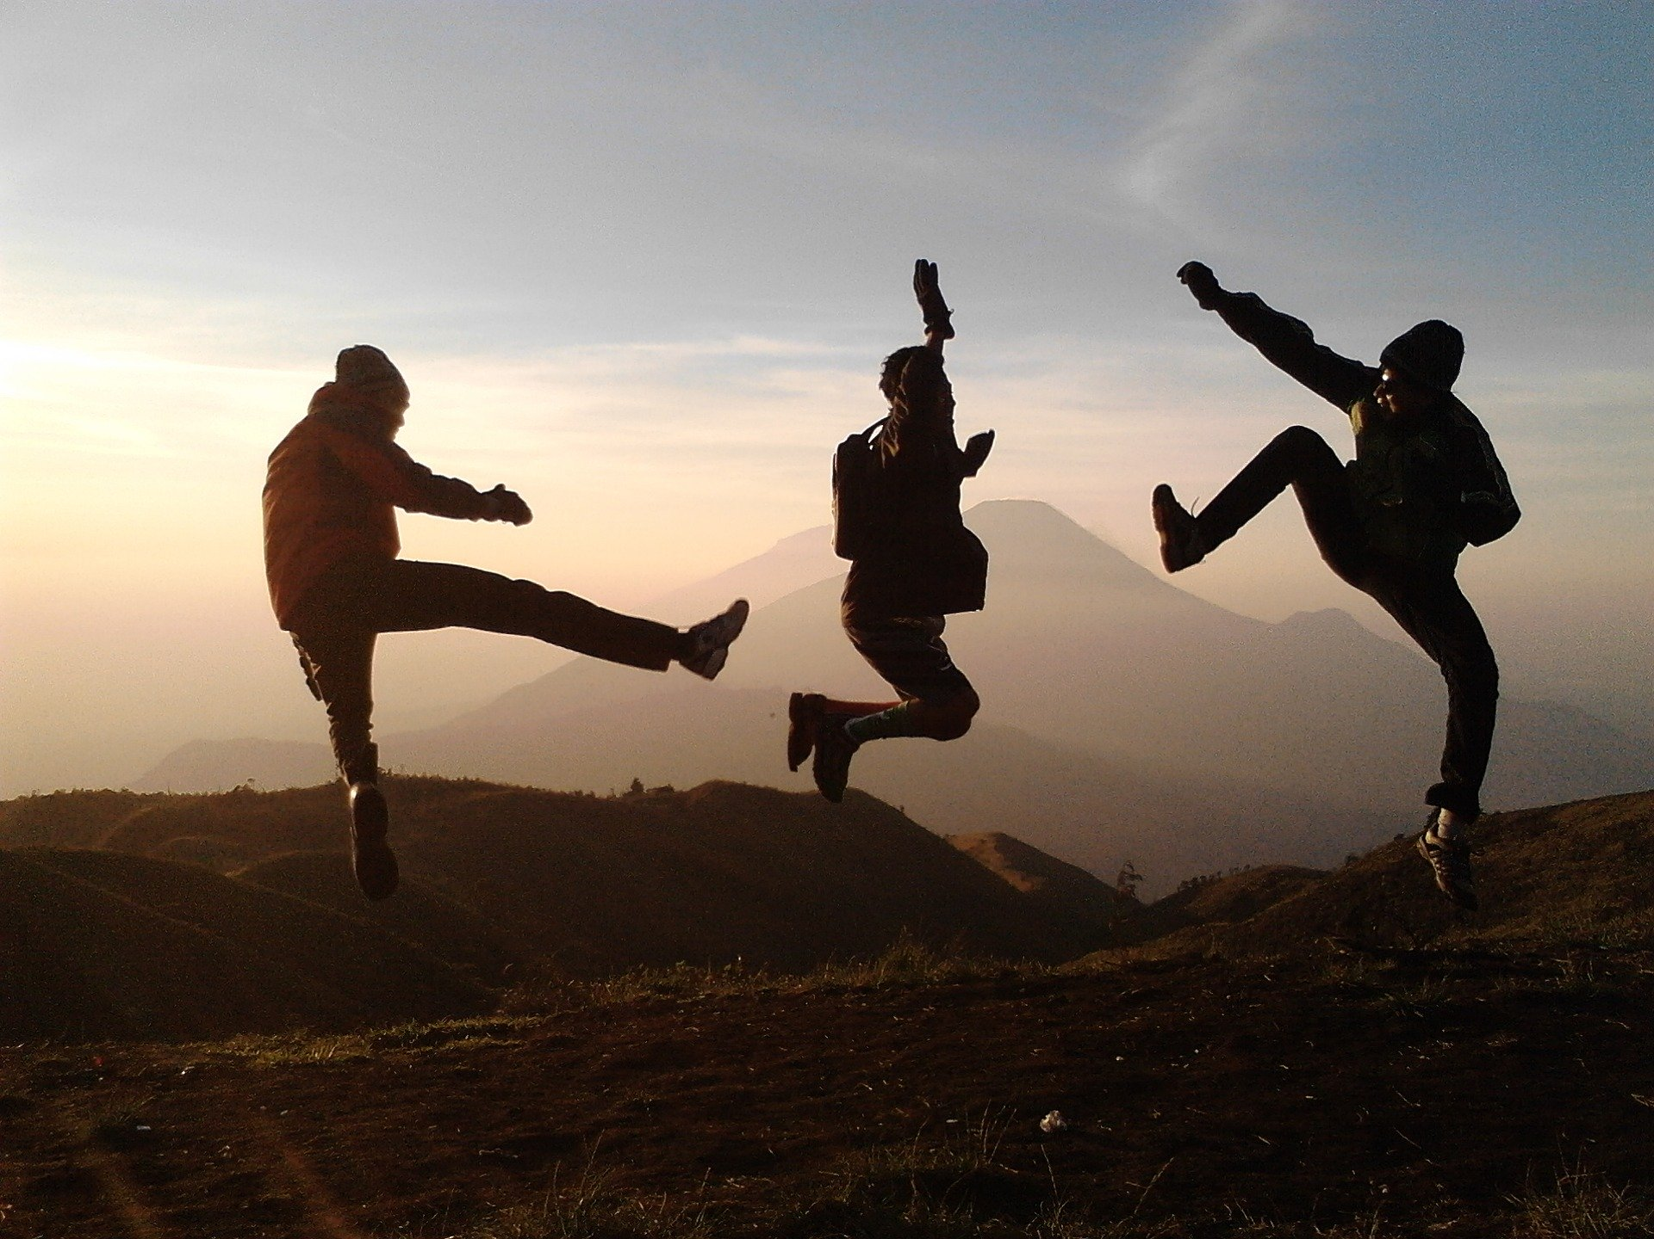
Social and Emotional
Learning intention
To show knowledge and understanding of emotional relationship changes as we grow and develop.
6. A Journey in Love
– Year 5 –

Slide 7
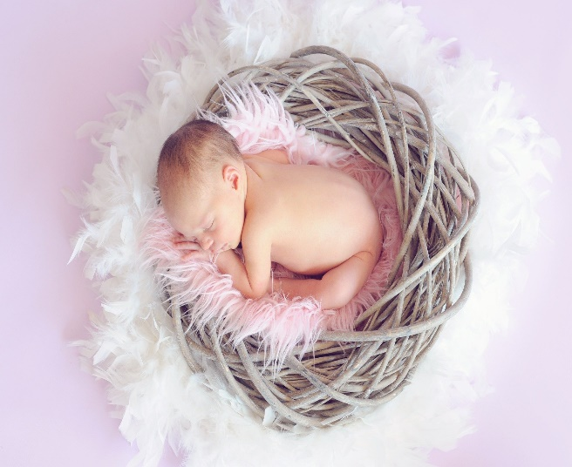
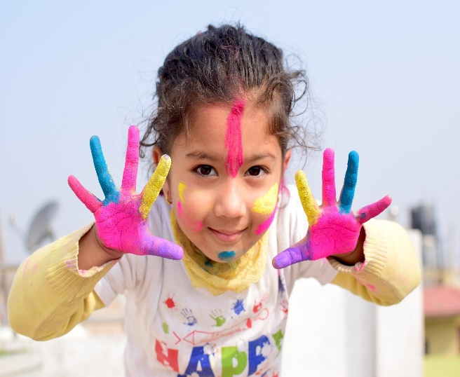
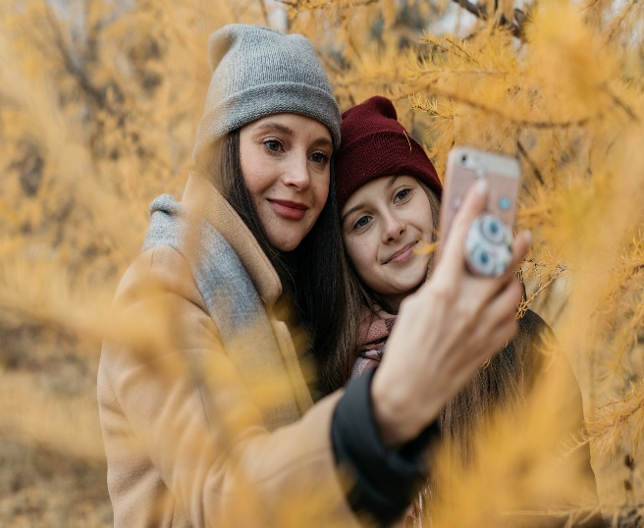
The basic stages of emotional childhood development
Infant or baby (Birth – 2 years old)
Toddler or pre-school age (3-5 years old)
School going age (6-12 years old)
Adolescent or teenager (13-18 years old)
7. A Journey in Love
– Year 5 –

Slide 8
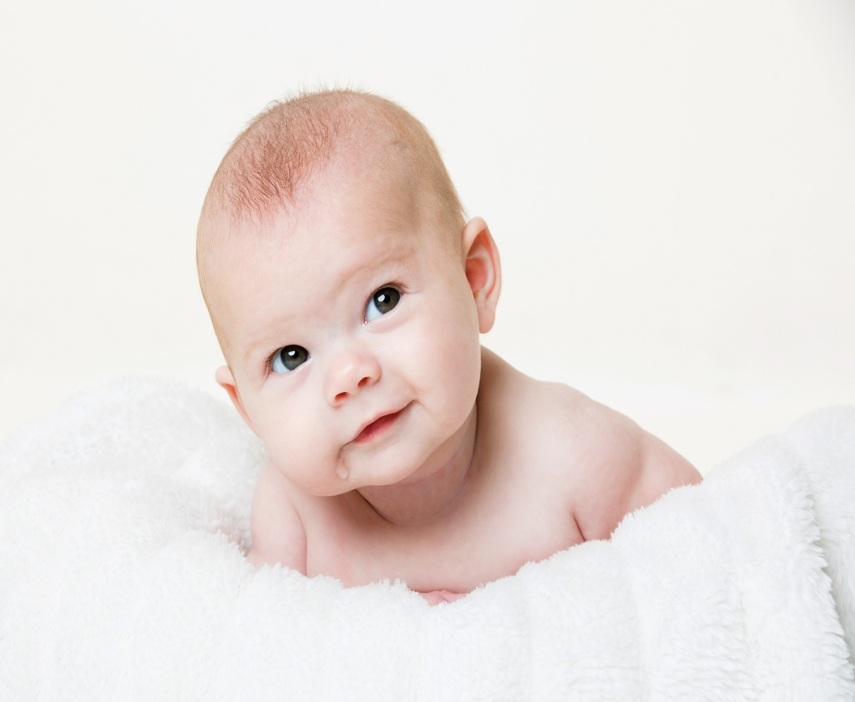
Infant or baby (birth – 2 years old)
A child goes through many changes in development.
Initially, the baby will be very sleepy and in a few weeks will become more alert, responsive and interactive with people they see on a daily basis.
The child develops a very close bond with their parents or caregivers and begins to smile.
8. A Journey in Love
– Year 5 –

Slide 9
Infant or baby (birth – 2 years old)
The child develops a sense of belonging in the family.
Once the child is fully aware of their surroundings, they could show signs of jealousy when a parent holds another baby – this is a normal sign of emotional development.
9. A Journey in Love
– Year 5 –

Slide 10
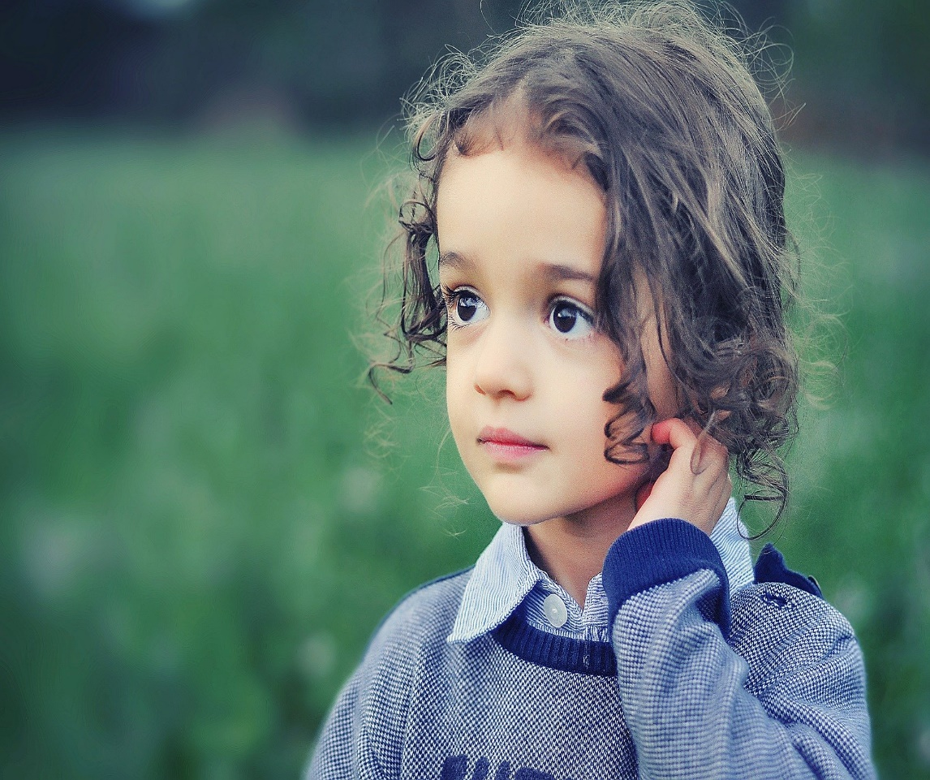
Toddler or preschool age (2-5 years old)
When the child starts walking, a whole new adventurous approach to life begins.
They will start exploring on their own and their language skills will develop significantly.
They will start naming objects and people and will start developing their own personality very quickly.
10. A Journey in Love
– Year 5 –

Slide 11
Toddler or preschool age (2-5 Years old)
They will start exploring their emotions and might even start throwing tantrums.
It is important, at this stage, that parents or caregivers learn to teach the child the value of delayed gratification – the child cannot get everything that they see.
Just as the child learns to say ‘no’, they need to learn to accepting ‘no’ from other people too.
11. A Journey in Love
– Year 5 –

Slide 12
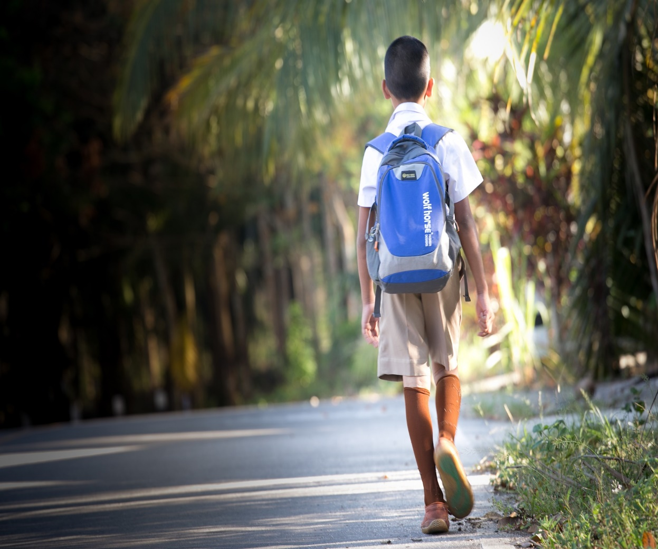
School going age (6-12 years old)
During this stage the child’s life becomes a lot more independent and social.
A parent or caregiver needs to instil a good set of morals and accepting behaviour.
Some children may struggle to adapt to schooling.
12. A Journey in Love
– Year 5 –

Slide 13
School going age (6-12 years old)
It is important that parents are able to provide praise and encouragement for achievement but parents must also be able to allow [children] to sometimes experience the natural consequences for their behaviour or provide logical consequences to help them learn from mistakes.
13. A Journey in Love
– Year 5 –

Slide 14
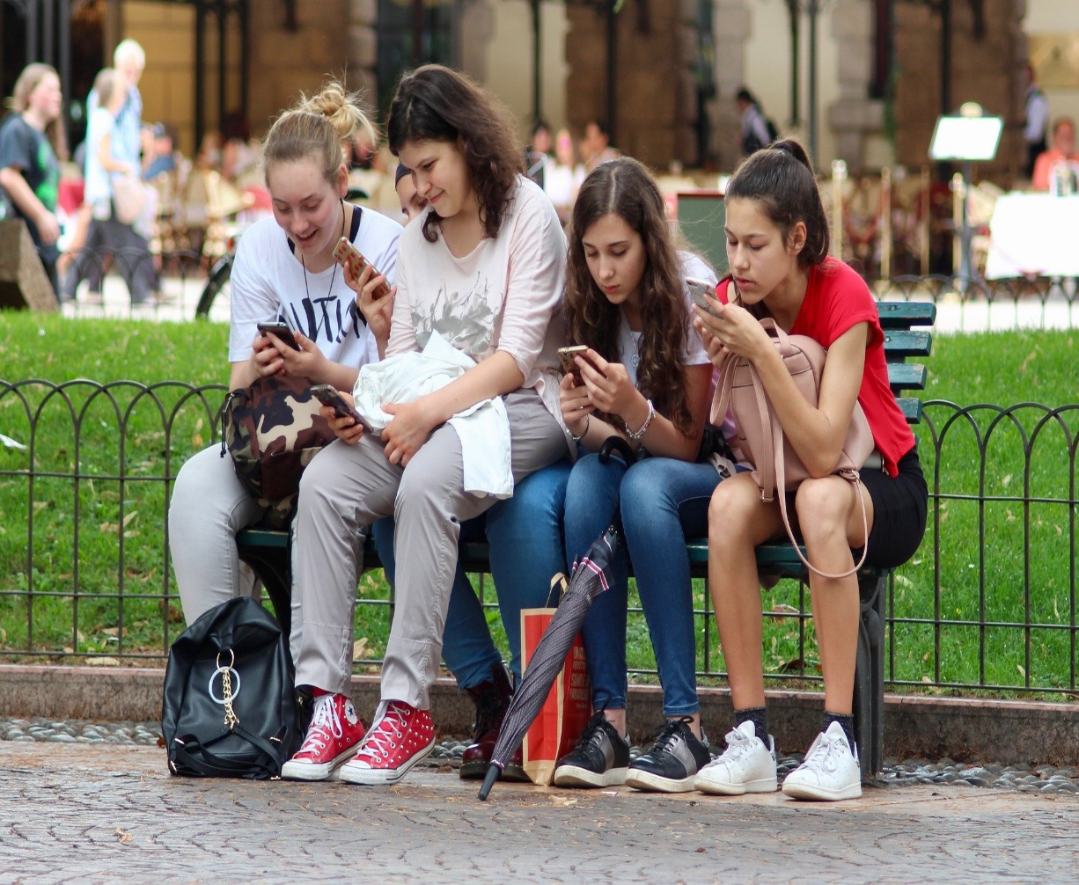
Adolescent or teenager (13-18 years old)
The teenage years often pose the biggest challenges when it comes to parenthood.
A child goes through many emotional and social changes.
Most 13-14 year olds are going through puberty, which means a slight change in mood, self sensitivity and self-consciousness can be expected.
14. A Journey in Love
– Year 5 –

Slide 15
Adolescent or teenager (13-18 years old)
At around 15, most children want to do things without their parents and want to be more social with friends.
Most teenagers at the age of 17 “are equipped to regulate their emotions. They’re less likely to lose their tempers and healthy teens know how to deal with uncomfortable feelings.”
During this time, they will develop and strengthen relationships with people they feel close to.
15. A Journey in Love
– Year 5 –

Slide 16
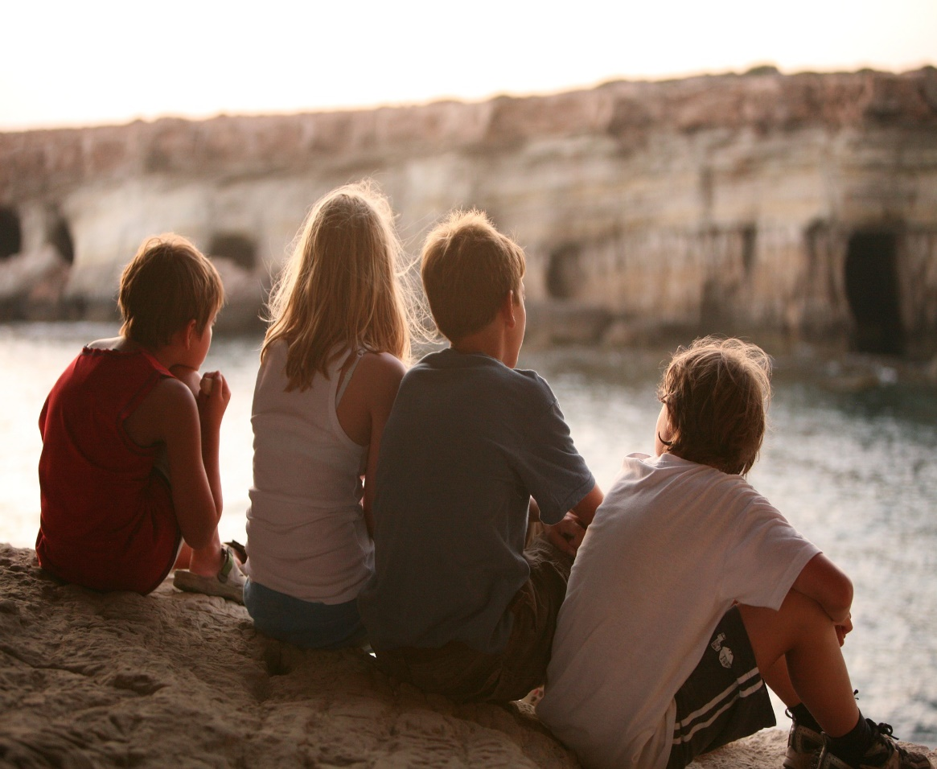
Questions
Can you recognise some behaviour changes as you have grown and developed.
Do you think these changes have affected any friendships, and how?
Are these determined by how others treat you?
Are there ways you are becoming more sensitive to your emotional development and that of others?
Questions continued on next page >>>
16. A Journey in Love
– Year 5 –

Slide 17
Questions (continued)
If a friend was struggling with their self-confidence and self-esteem, what would you advise them to do?
Where would you go and/or who would you go to for advice or to report concerns for yourself or on behalf of a friend because you are worried about being unsafe, feeling uncomfortable or concerned for your own or their mental health and wellbeing?
How can this translate to keeping safe on-line?
17. A Journey in Love
– Year 5 –

Slide 18
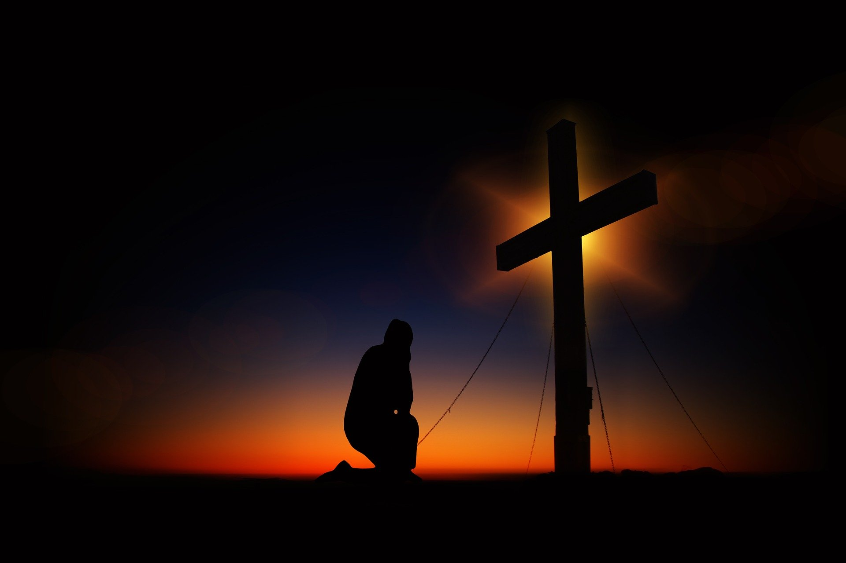
Pause and reflect
Lord, make me an instrument of your peace;
Where there is hatred, let me sow love;
Where there is doubt, faith;
Where there is despair, hope;
Where there is darkness, light;
Where there is sadness, joy.
O Divine Master, grant that I may not so much seek to be consoled as to console; to be understood as to understand; to be loved as to love.
For it is in giving that we receive;
it is in pardoning that we are pardoned;
and it is in dying that we are born to eternal life.

Slide 19
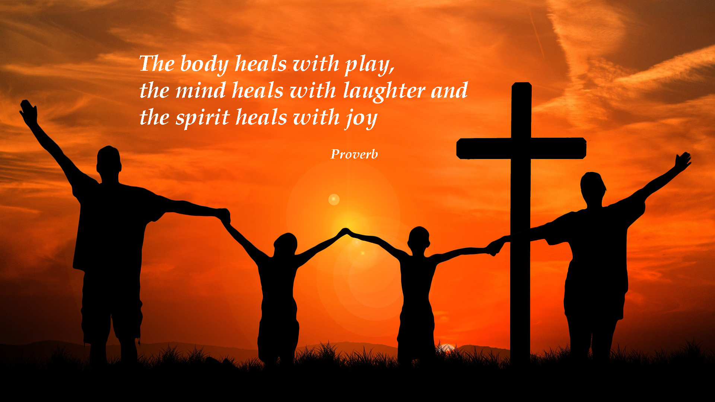
19. A Journey in Love
– Year 5 –

Slide 20

Physical
Learning intention
To show knowledge and understanding of all physical changes in puberty.
20. A Journey in Love
– Year 5 –

Slide 21
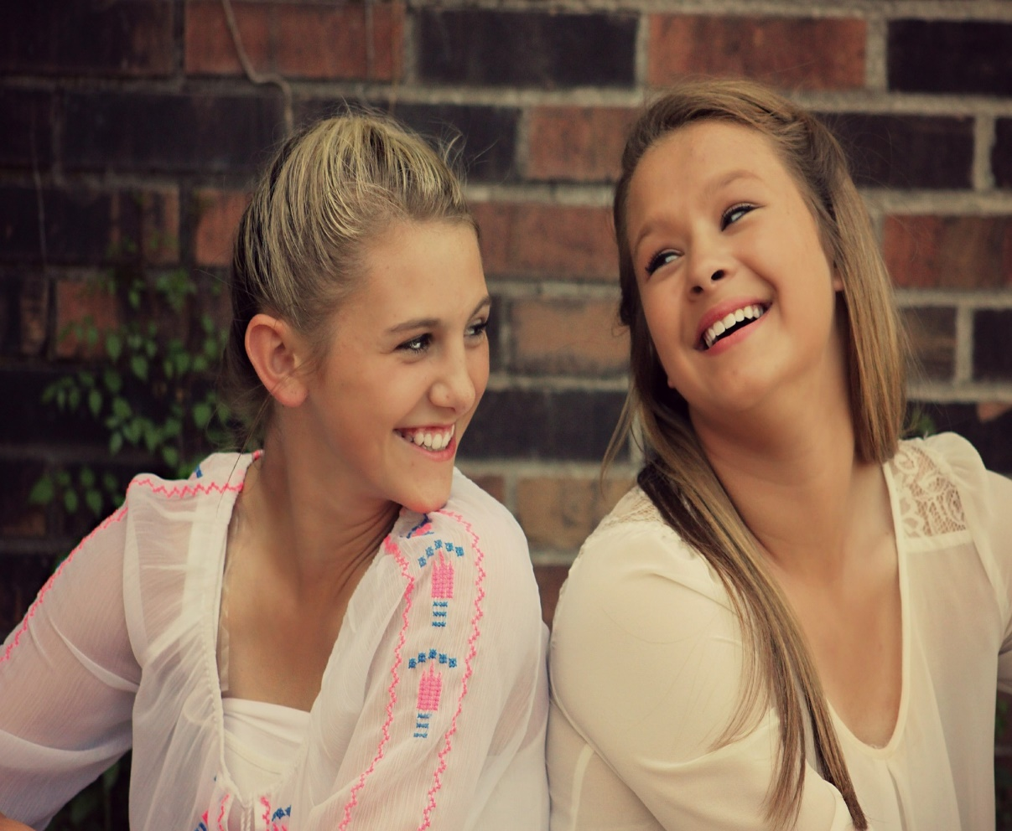
Questions
How do you we recognise the emotional,
internal and external changes that happen
during puberty?
Why do we think we might need to change
our hygiene routines during the time of
puberty; why is it important to keep clean and maintain a good personal hygiene?
How do we know what physical contact is appropriate, inappropriate or unsafe? Can this be extended to other forms of contact and what might these be?
As we grow and change how do we recognise the God of love who journeys with us?
21. A Journey in Love
– Year 5 –

Slide 22
Physical changes in girls
Breasts develop: they come in all shapes and sizes.
Hips broaden and waist slims, ovaries produce oestrogen in hormonal activity.
Menstruation begins and the uterus enlarges.
Vaginal lining thickens.
First menstruation occurs approximately 12 months after breasts have begun to develop.
Usually start to grow hair on underarm, pubic area and legs.

Slide 23
Physical changes in boys
Increased testosterone in the blood stream.
Muscles and bones develop.
Voice deepens.
Some boys get uneven breast changes in early puberty.
Waist thickens.
Longer limbs in proportion to body.
Continued >>>

Slide 24
Physical changes in boys
Shoulders broaden.
Wet dreams and erections.
Penis and scrotum enlarge.
Hair can grow on face, chest, back, arms as well as under arms and pubic area.
Production of sperm and discharge of seminal fluid during ejaculation.
Adam’s apple enlarges.

Slide 25
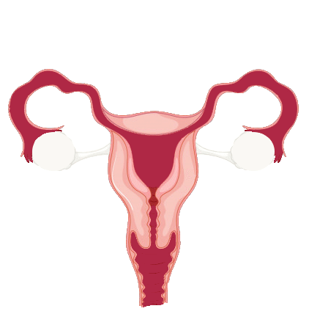
Menstruation and Ovulation
Menstruation (from the Latin for ‘month’)
The menstrual cycle is controlled by hormones released from the pituitary gland.
Most menstrual cycles last for about 28 days. The first day of the period marks the start of the cycle and is counted as day 1.
If the uterus does not receive a fertilised ovum, the Lining of the uterus breaks down and is shed over the next number of days.
This is called menstruation. The lining of the uterus begins to thicken and an ovum begins to develop.
Womb (Uterus)
Fallopian Tube
Cervix
Vagina
Image: www.vecteezy.com
25. A Journey in Love
– Year 5 –

Slide 26
Menstruation and Ovulation
Ovulation
On approximately the 14th day of the cycle an ovum is released in the fallopian tube.
This is called ovulation.
The ovum travels towards the uterus.
The lining of the uterus continues to thicken and gets full of blood in case a fertilised ovum arrives. If the ovum is not fertilised it will dissolve and a period will occur.
Then the cycle starts again.
Womb (Uterus)
Fallopian Tube
Cervix
Vagina
Image: www.vecteezy.com
26. A Journey in Love
– Year 5 –

Slide 27
Pause and reflect
Loving Father and Creator of all,
we thank you for the beauty, dignity and gift of human life.
Help us to respect and treasure its sacredness from the moment of conception until its natural end.
Amen

Slide 28
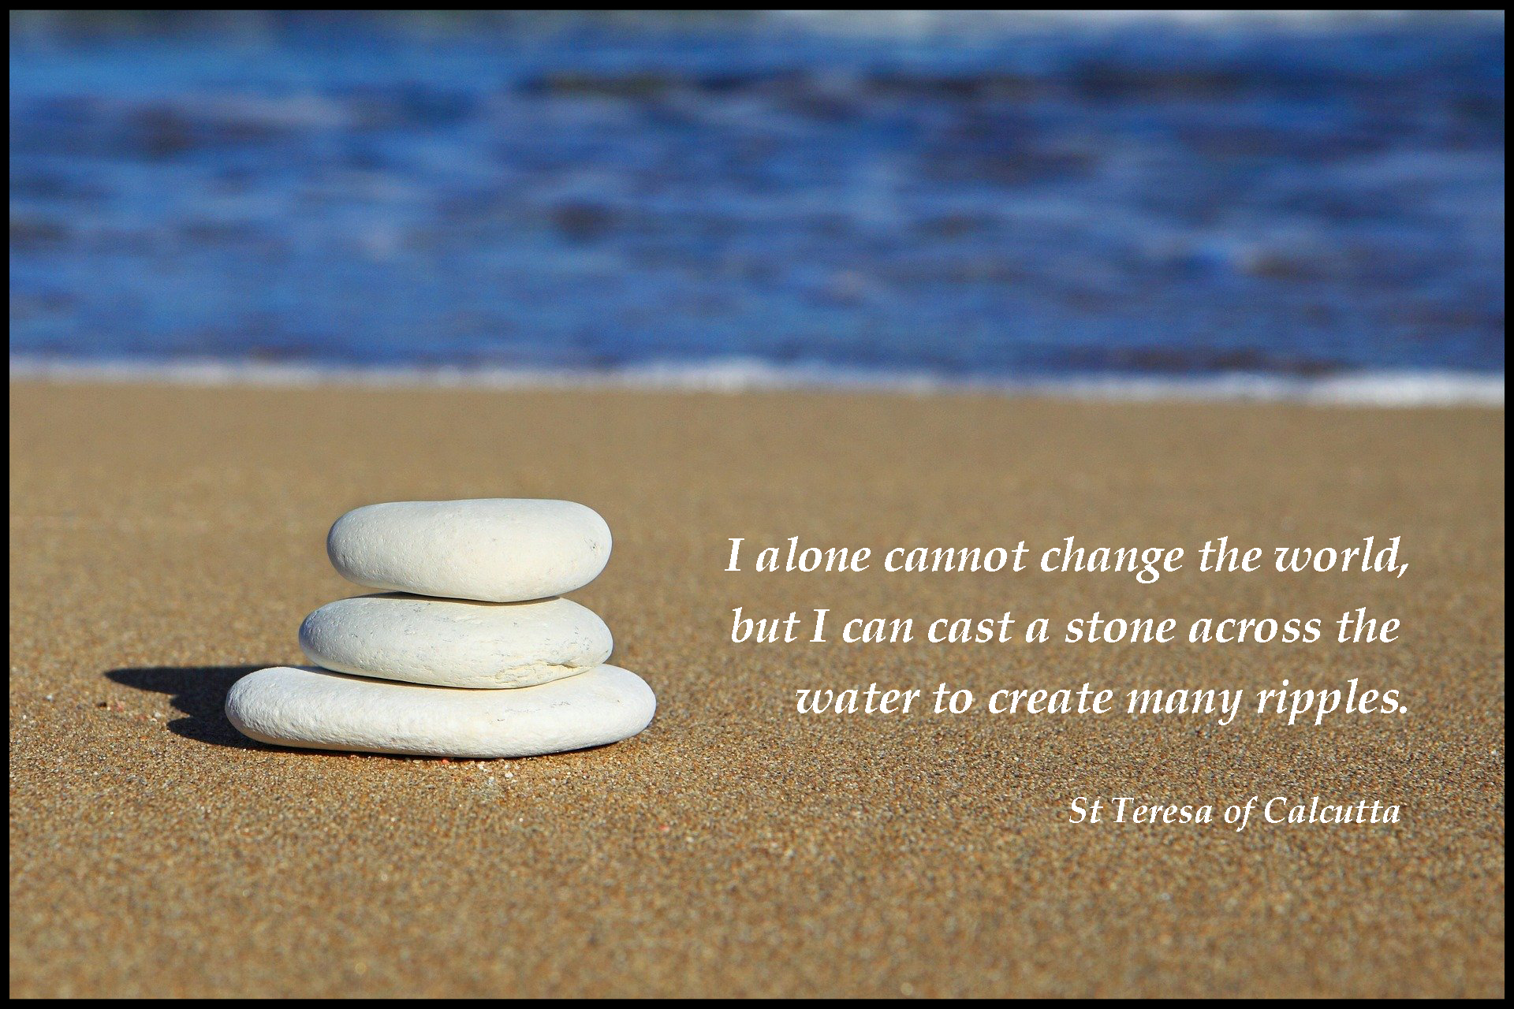
28. A Journey in Love
– Year 5 –

Slide 29
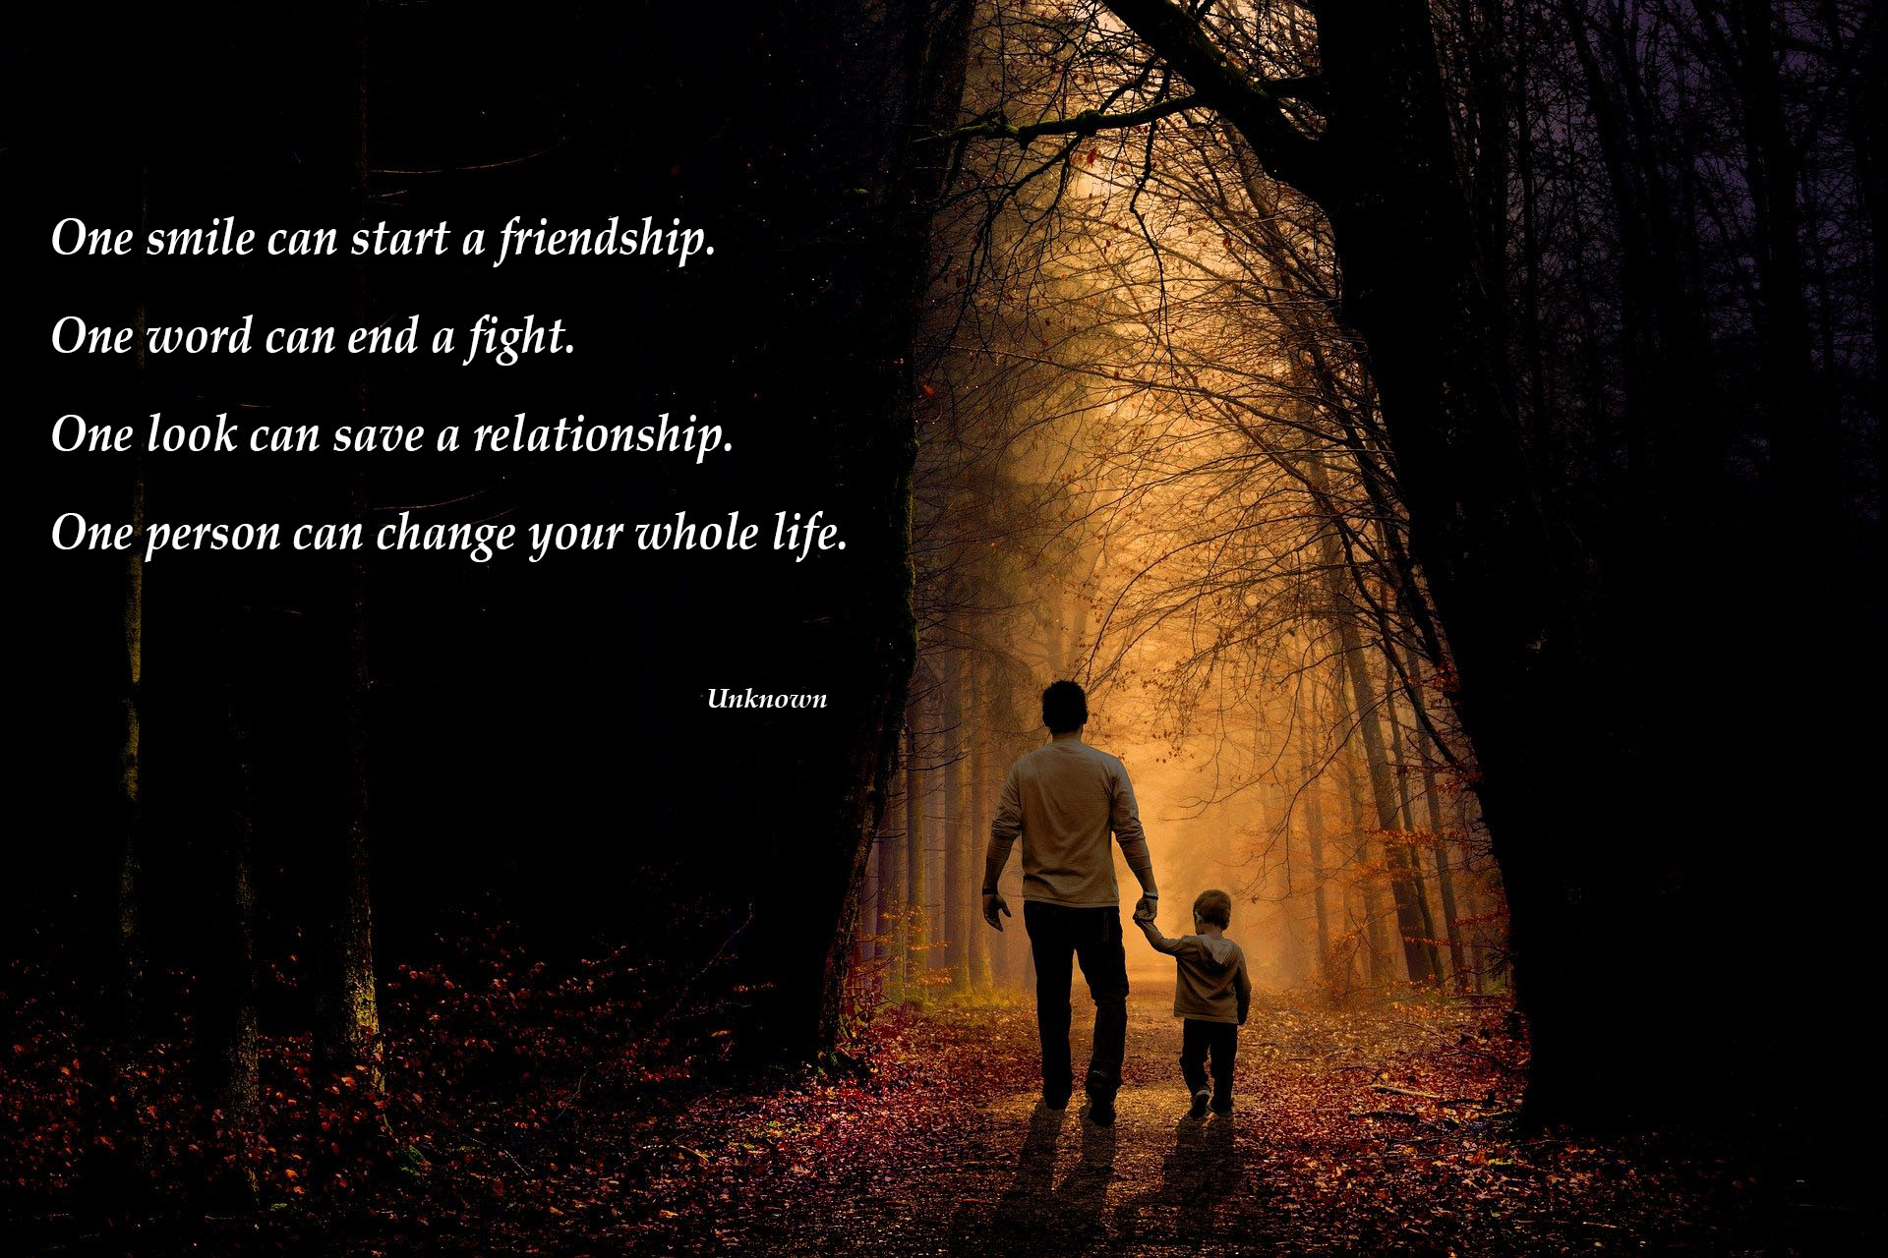
29. A Journey in Love
– Year 5 –

Slide 30

30. A Journey in Love
– Year 5 –

Slide 31
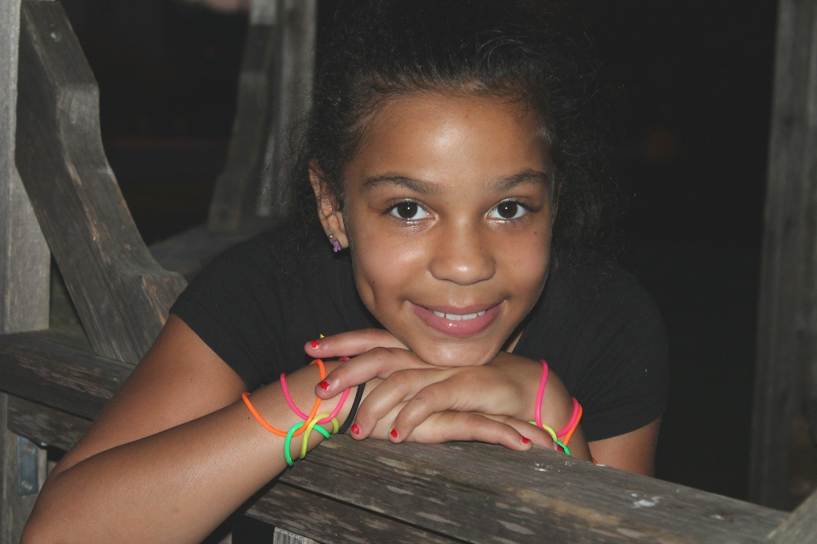
Spiritual
Learning intention
To celebrate the joy of growing physically and spiritually.
31. A Journey in Love
– Year 5 –

Slide 32
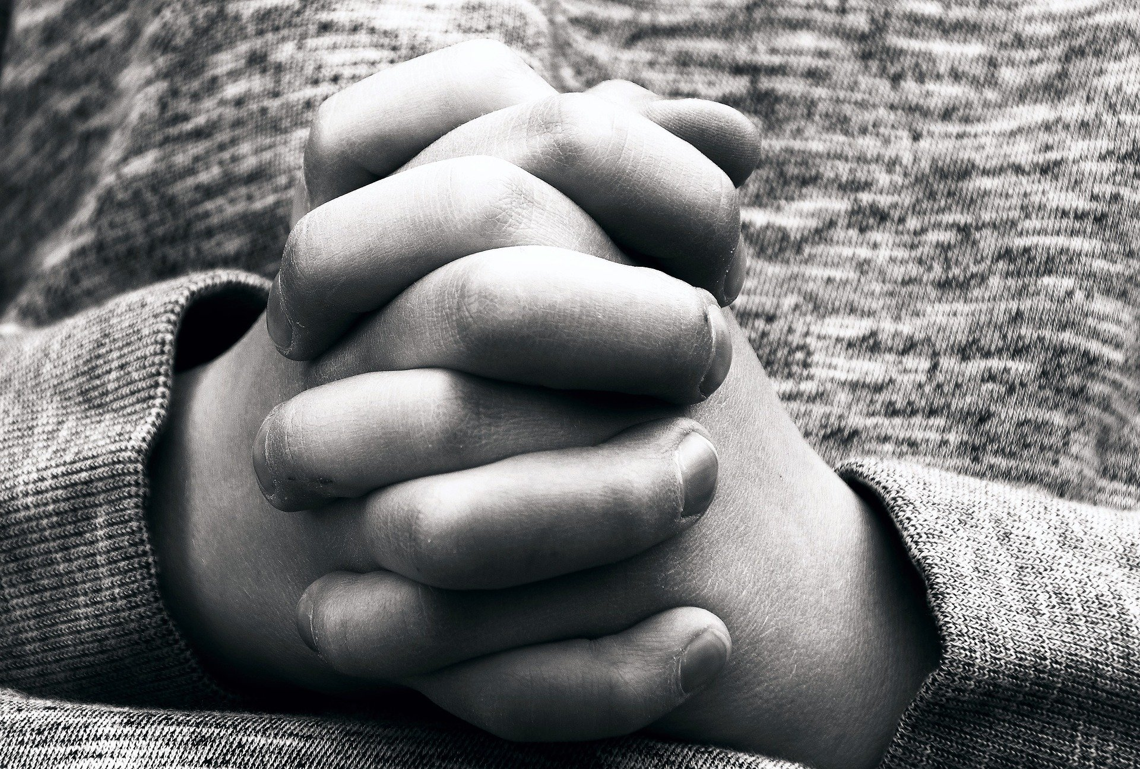
Questions
What does it mean to grow holistically,
e.g. physically, socially, emotionally, intellectually and spiritually?
Are there ways and means we can ensure each aspect happens healthily?
What difficulties might you face as your body changes and grows?
God’s love surrounds you always and His Holy Spirit guides and protects you.
How will this help you to be respectful of your own body and help you to be courageous in the face of changes?
32. A Journey in Love
– Year 5 –

Slide 33
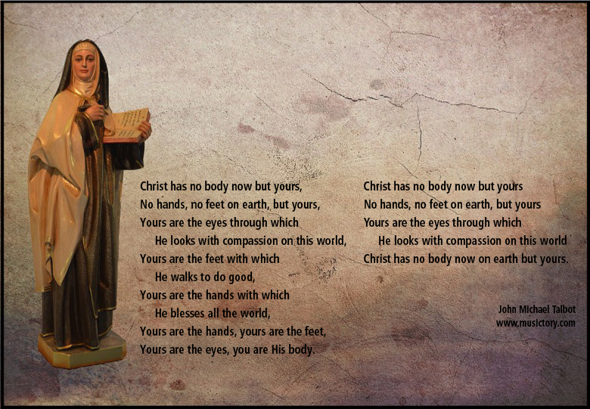
Pause and reflect
St Teresa’s Prayer
Saint Teresa of Avila

Slide 34

The Christian family is missionary:
it announces the love of God to the world.
The most beautiful thing God made,
so the Bible tells us, was the family.
He created man and woman
and He gave them everything.
He entrusted the world to them:
‘Grow, multiply, cultivate the earth,
make it bear fruit, let it grow.’
All the love he put into that marvellous creation he entrusted to a family.
Pope Francis
34. A Journey in Love
– Year 5 –

