Slide 1
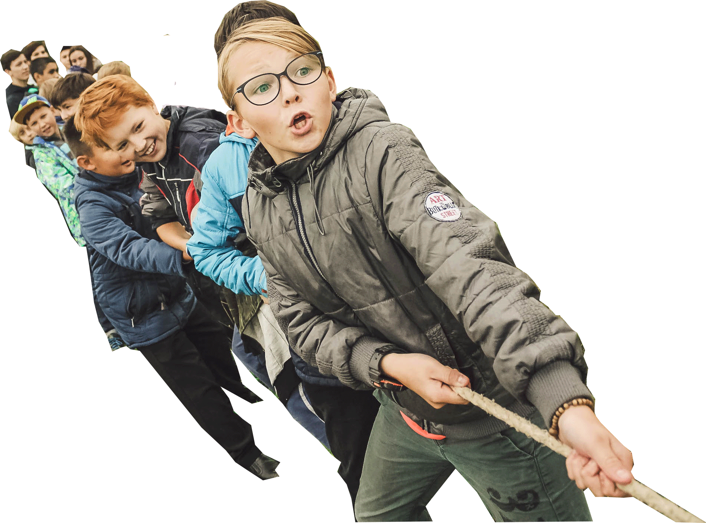

Year 4
God loves us in our differences

Slide 2

IMPORTANT
Copyright and Terms and Conditions of use
By using this Powerpoint CD presentation you are agreeing to the following terms and conditions.
All images and text are copyright to the respective owners and can only be used and shown as a presentation within a classroom or other room or area within an educational establishment.
– All the files and images contained within this PowerPoint presentation are subject to copyright restrictions and cannot be duplicated, copied or shared as detailed on the CD and CD packaging (Unlawful duplication is prohibited by law).
– You must NOT share this Powerpoint presentation or any of the text and images by uploading them to a website on the Internet.
If you have purchased a Network Licence you may store the Powerpoint presentation on your Intranet.
– You must not change/alter or recreate the files in any way or form.
– If you do not comply with the terms of this licence you could be liable to legal action against you by the copyright holder and/or the agency that acts on their behalf.
This Powerpoint presentation is a simplified form of the
A Journey in Love book and should be used in conjunction with
this publication.
The book is available from www.mccrimmons.com
Published in United Kingdom in 2020 by
McCrimmon Publishing Co. Ltd.
sales@mccrimmons.com / www.mccrimmons.com
McCrimmon order ref: MB7863CD
Text © 2005/2006/2020 Sr Jude Groden and the following contributors.
﻿Dr Sathi Aiya / Ilse Brockling / Fr David Clemens
Sarah Feist / Shaun Kelliher / Patrick Harrison.
Narrative text: Sr Jude Groden.
Powerpoint construction and design by Éanna McAteer
I have read the Terms and Conditions above…
Acknowledgements
Most of the mages used in this Powerpoint presentation are from www.pixabay.com Pixabay are an online (free to use for commercial use) image library.
Other image credits
13 & 14 Pexels (Fauxels)
16 Pexels (Agung Pandit Wiguna)
17 Pexels (Jorge Barreto)
18 Pexels (Porapak Apichodilok)
CONTINUE

Slide 3
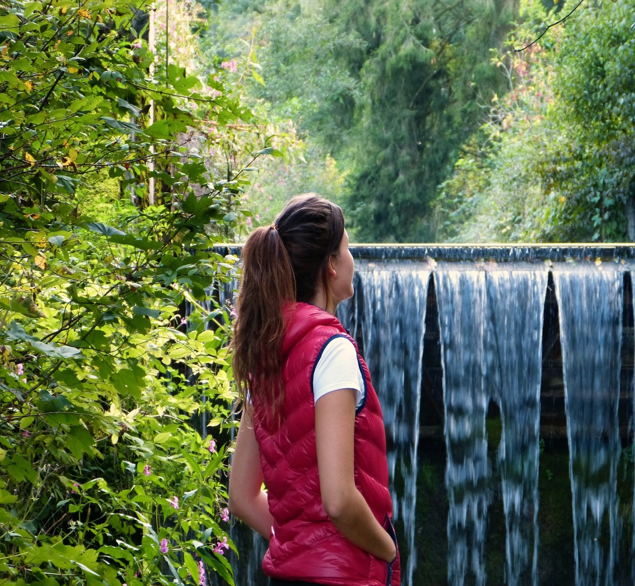
Aim
To make links and connections to show that we are all different.
To celebrate these differences as we appreciate that God’s love accepts us as we are now and as we change.
3. A Journey in Love
– Year 4 –

Slide 4


God
cultural
bullying
gifts
biological
polite
talents
respect
uniqueness
difference
courtesy
innate
development
manners
beauty
change
sensitivity
dignity
stereotype
religious
acceptance
belief
4. A Journey in Love
– Year 4 –

Slide 5

Respecting
Encouraging
Skills
Recognising
Appreciating
Celebrating
Relating

Slide 6
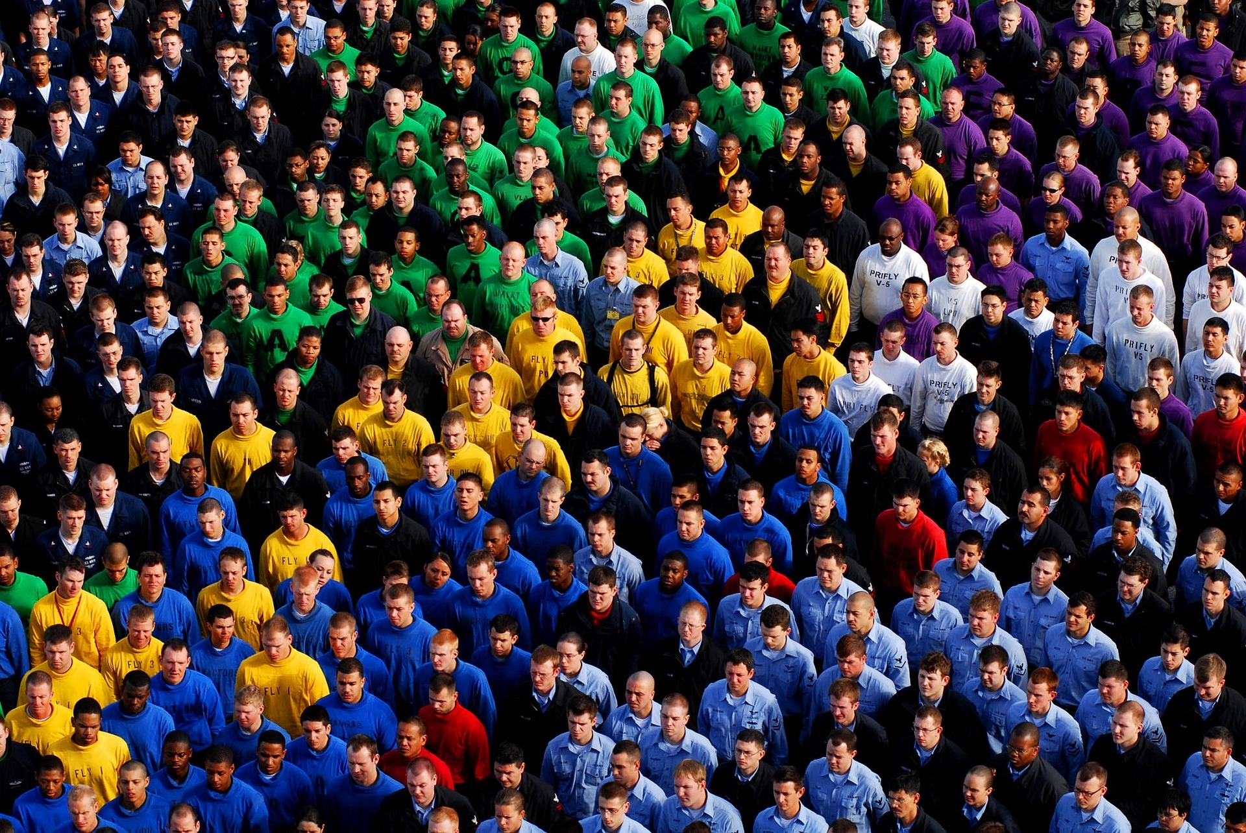
Social and Emotional
Learning intention
To describe how we all should be accepted and respected.
6. A Journey in Love
– Year 4 –

Slide 7
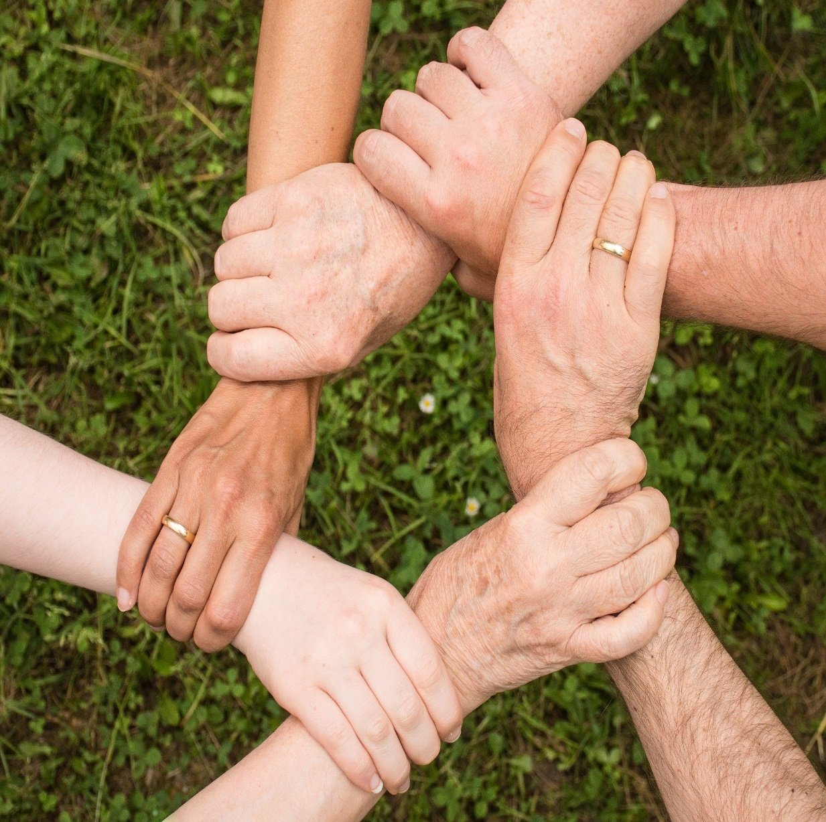
Questions
Is there more to courtesy and manners than saying ‘please’ and ‘thank you’?
In what ways is being polite and courteous helping to make a better world to live in?
How would you ensure that you have a part to play in keeping yourself and others in your family and community safe?
How do authority figures help communities and societies work together better?
How should we include everyone and celebrate each others’ differences in school, home and in communities?
7. A Journey in Love
– Year 4 –

Slide 8
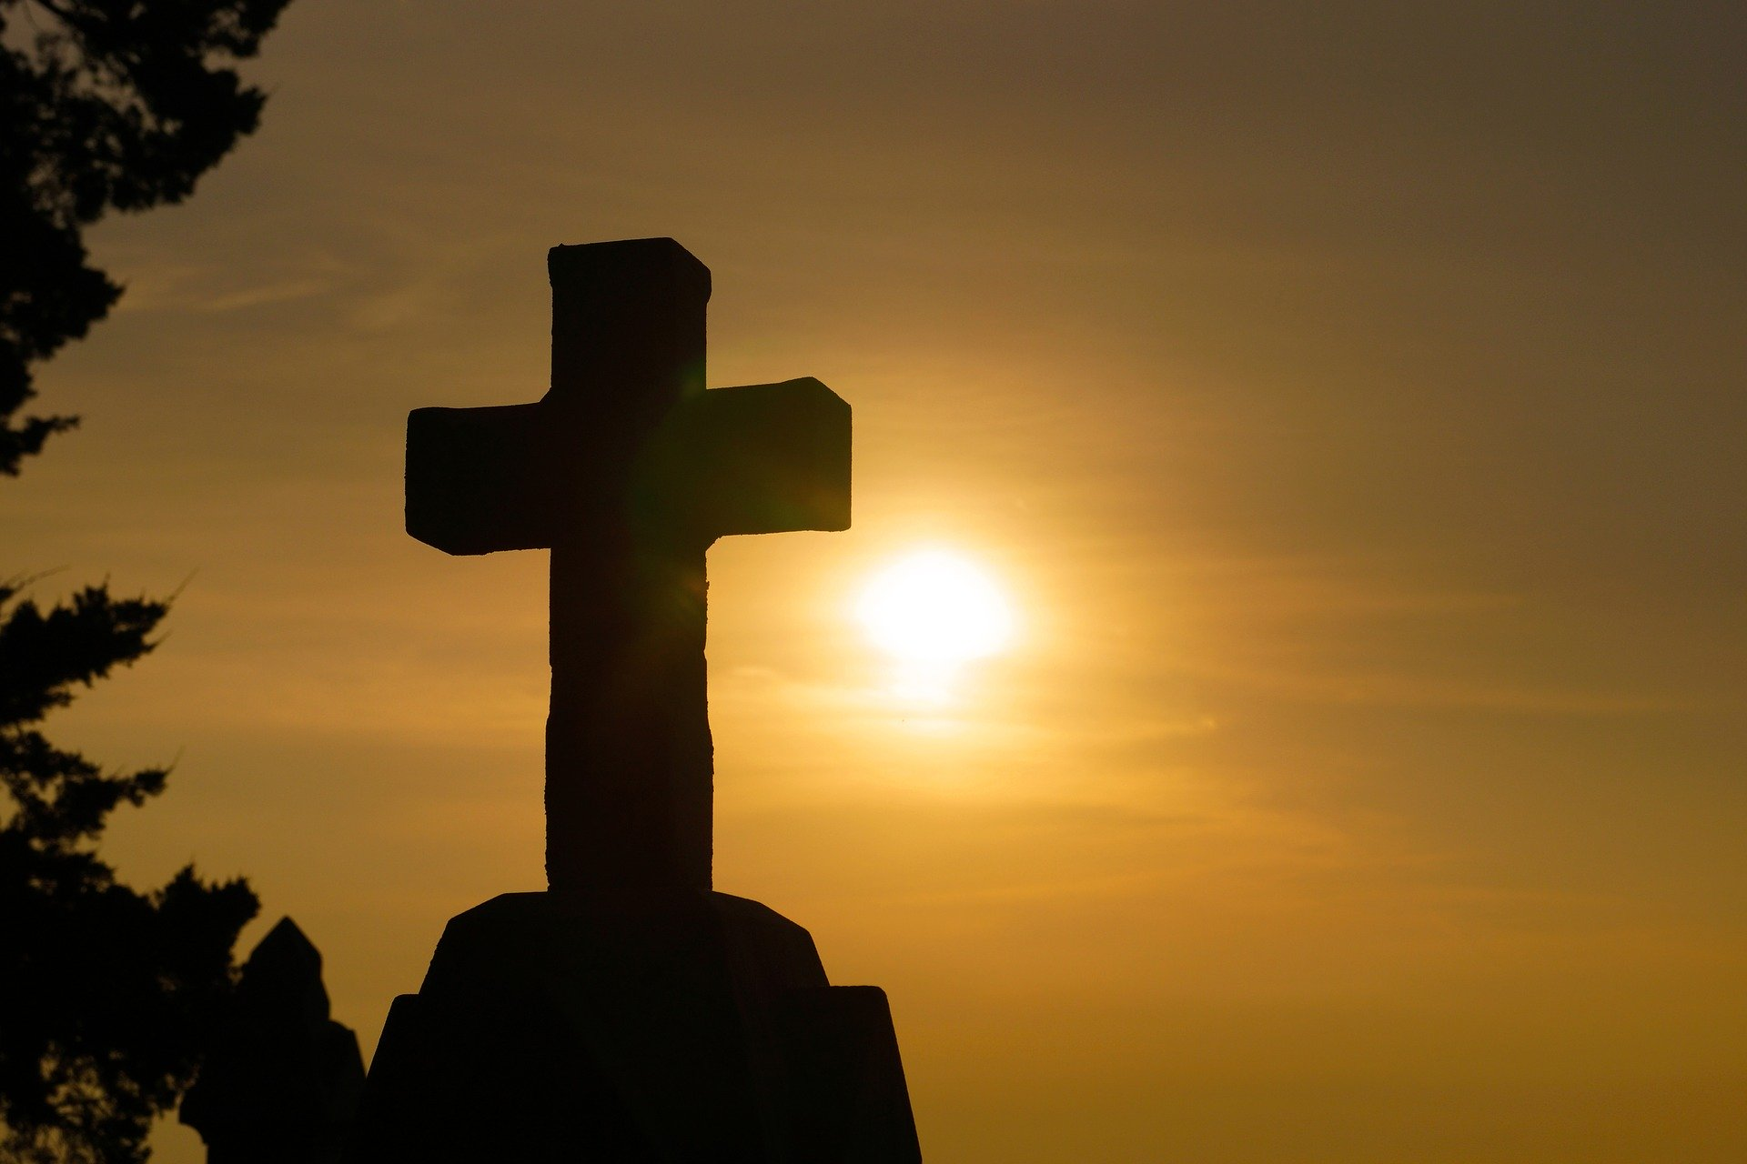
Pause and reflect
God,
Grant me the serenity to accept the things
I cannot change, courage to change the things I can
and wisdom to know the difference.
Amen

Slide 9
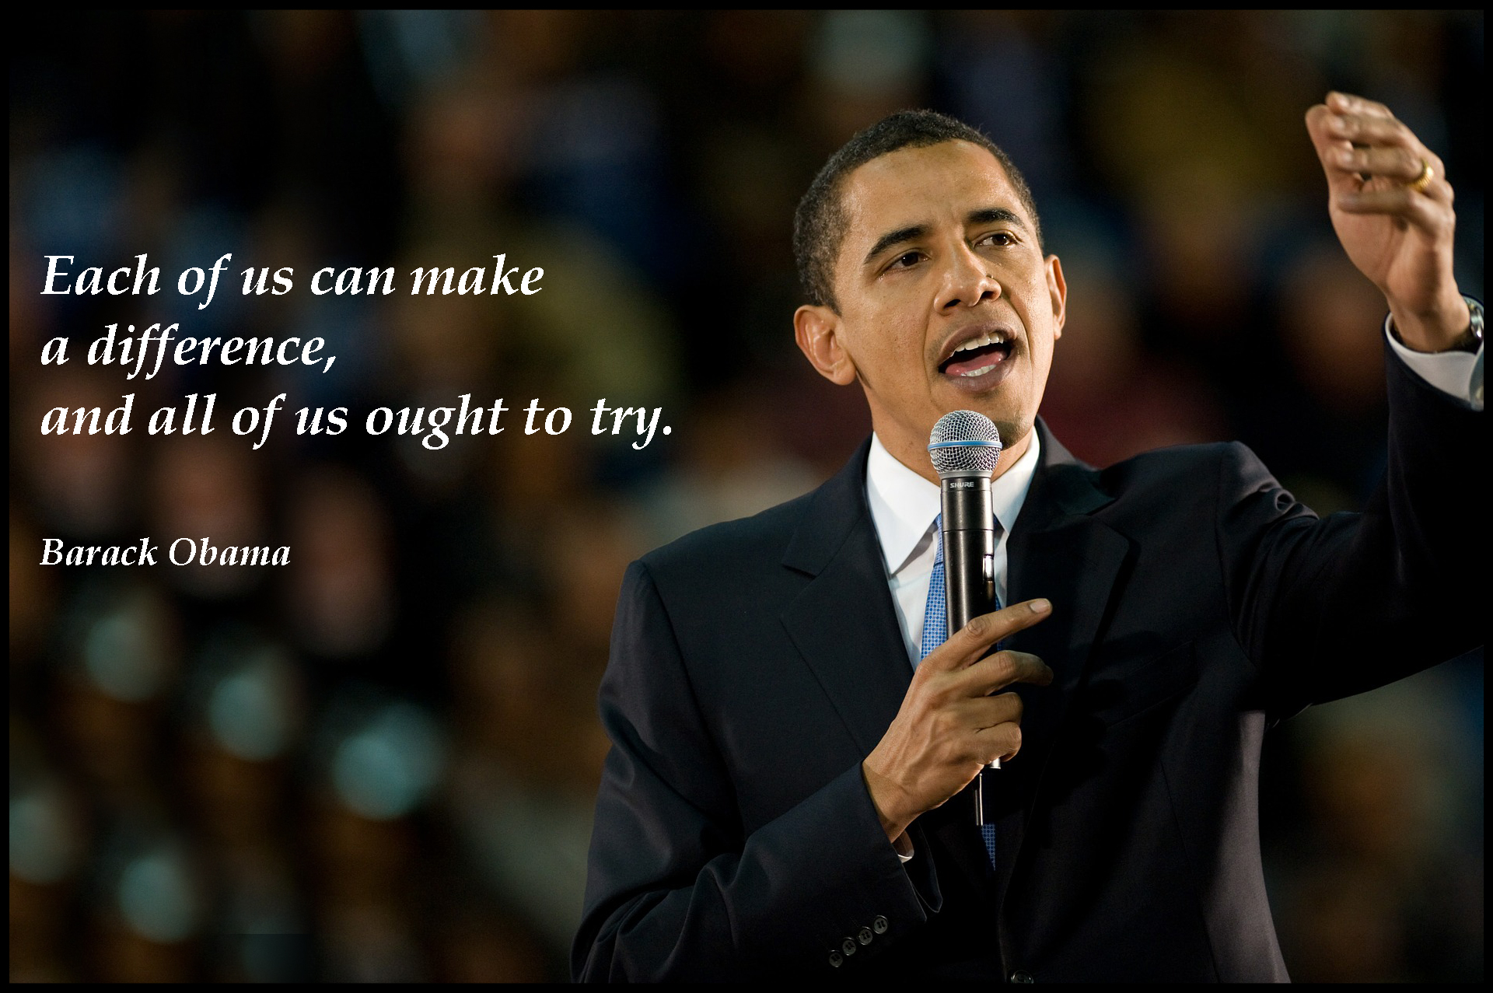
9. A Journey in Love
– Year 4 –

Slide 10
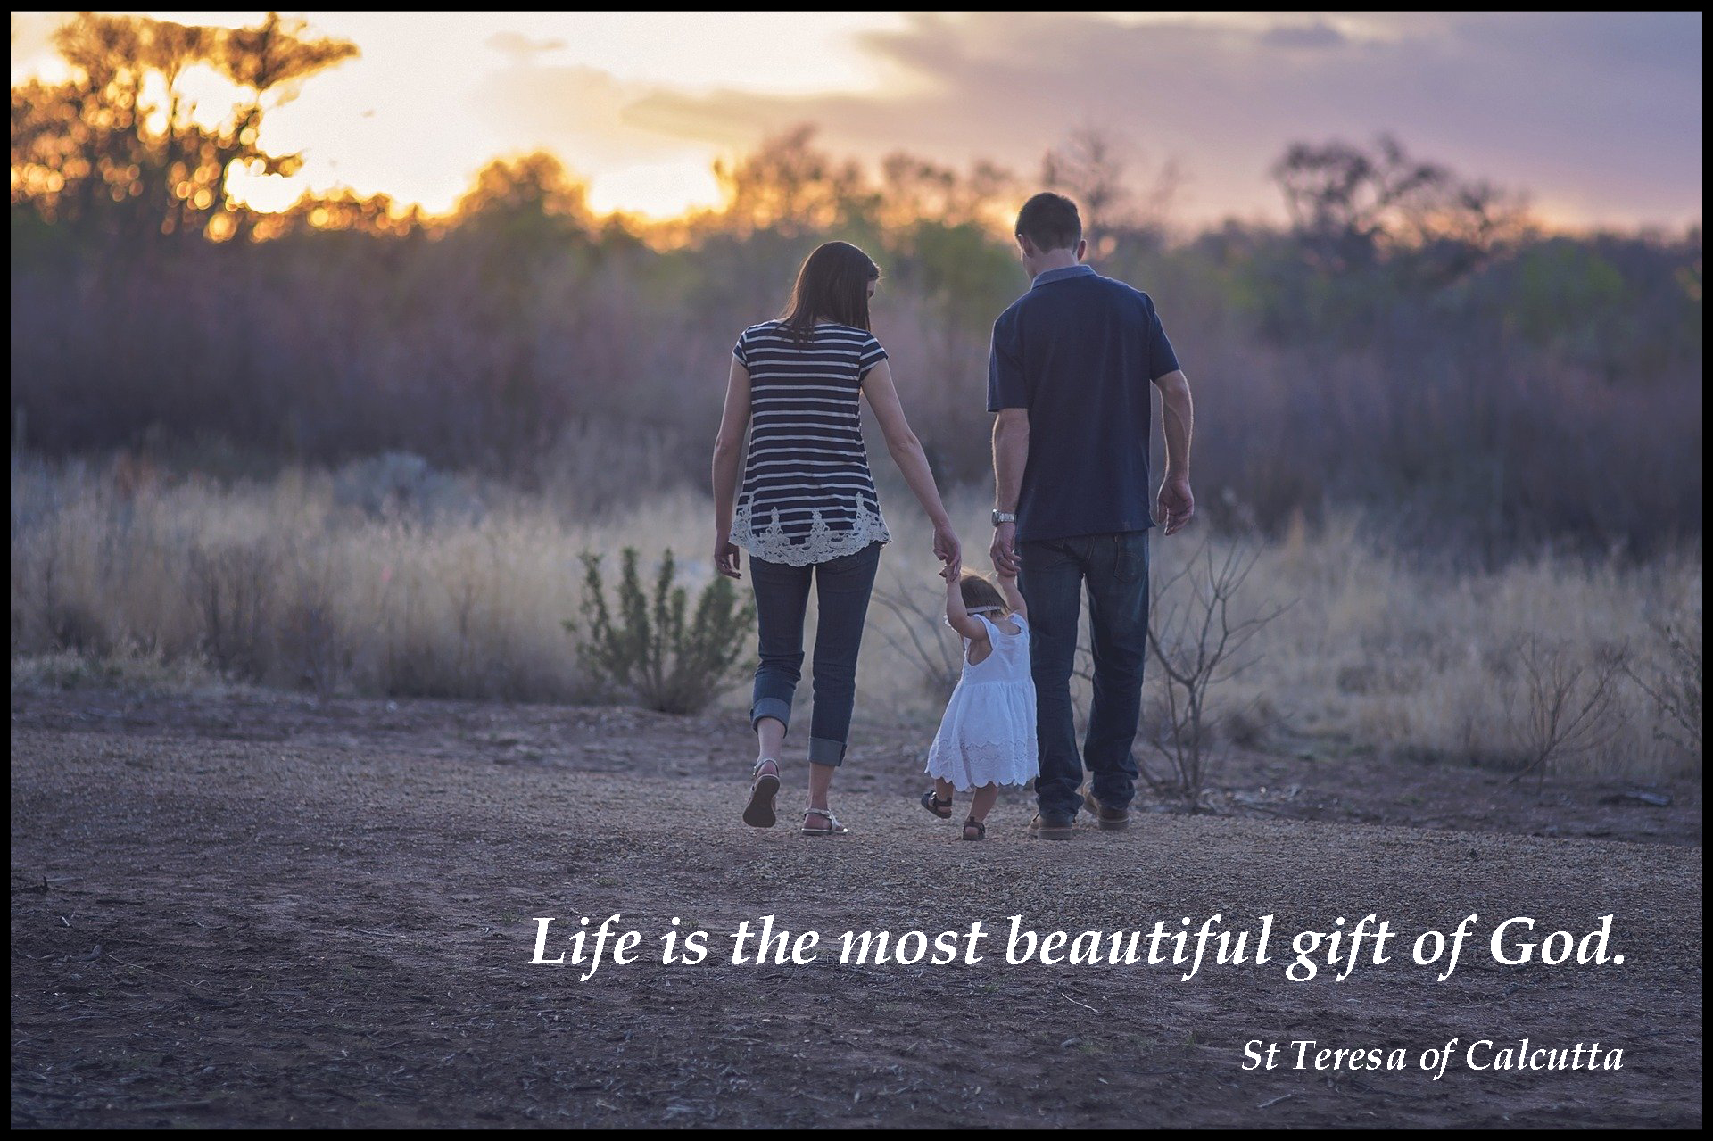
10. A Journey in Love
– Year 4 –

Slide 11
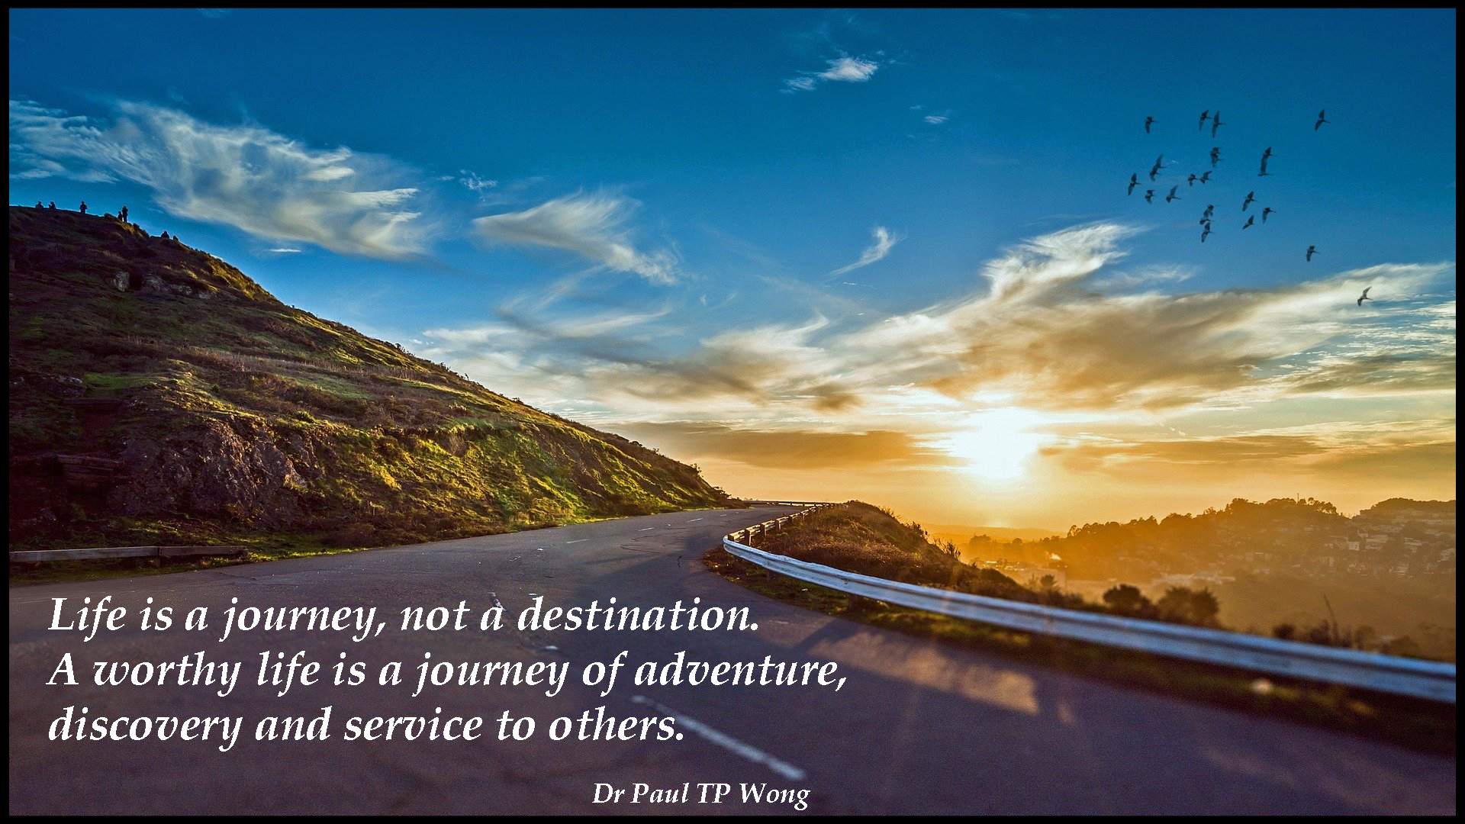
11. A Journey in Love
– Year 4 –

Slide 12
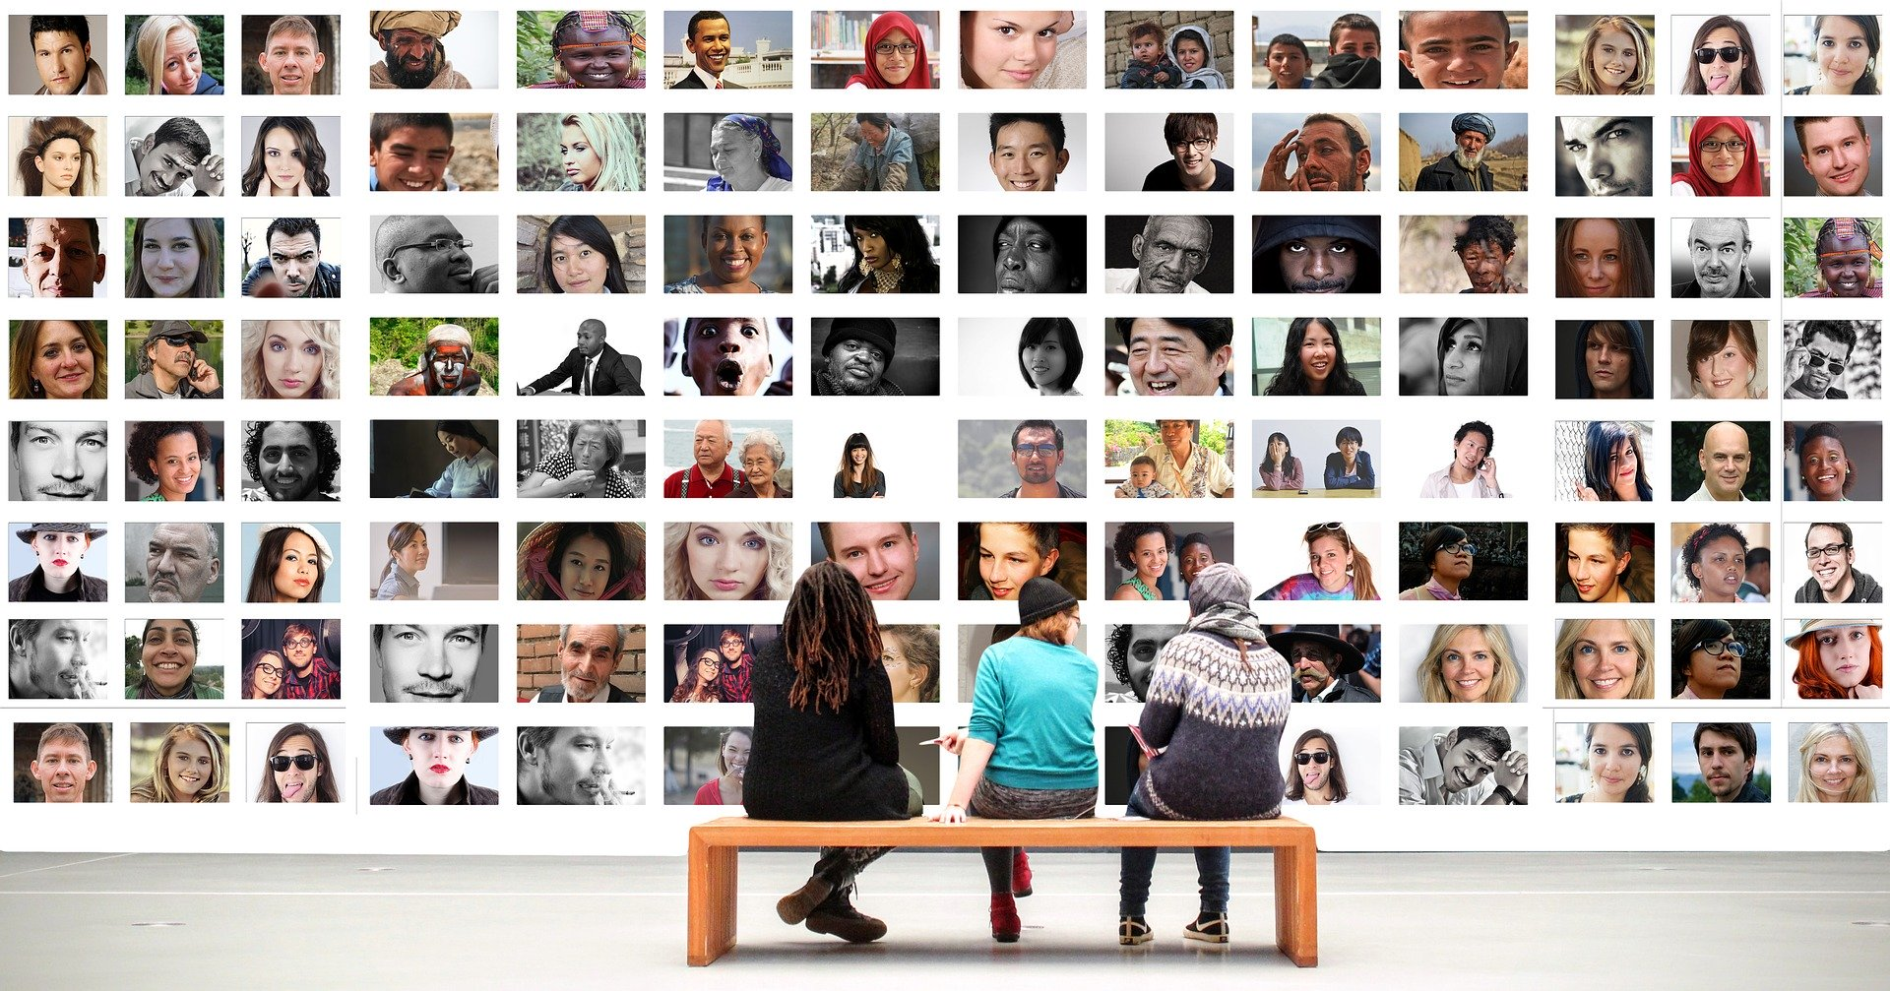
Physical
Learning intention
To describe how we should treat others making links with the diverse modern society we live in.
12. A Journey in Love
– Year 4 –

Slide 13
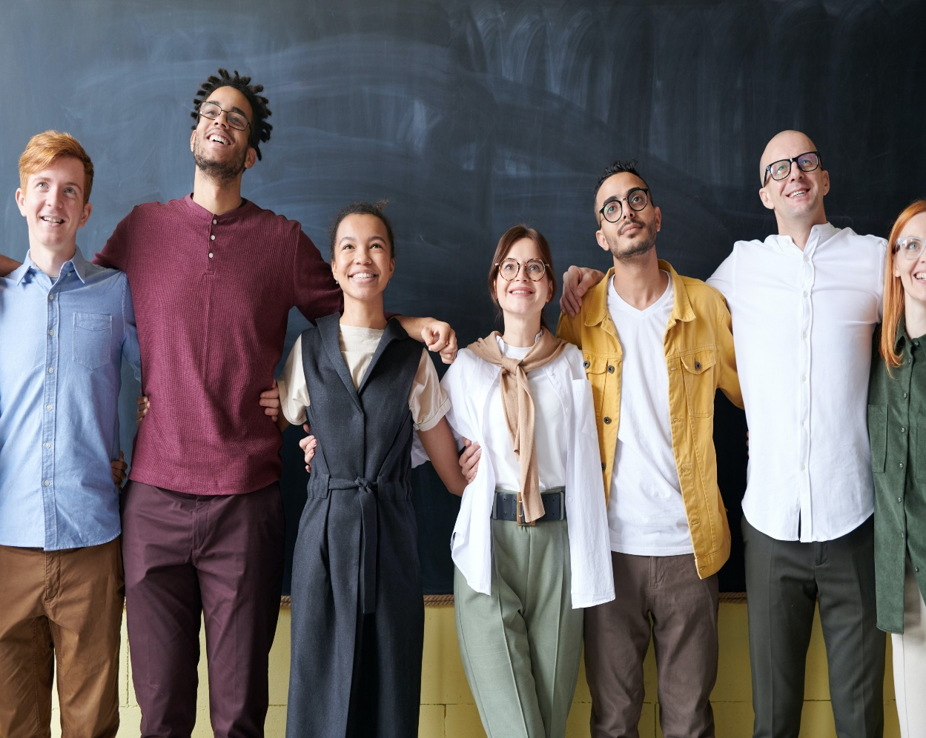
Questions
How do we respect others, even when they are different from ourselves: physically, ethnically, culturally or in religious beliefs?
How might these differences change over time as we grow?
In what ways can we expect to be treated with respect by others and in turn show them the same respect?
How can we challenge the stereotypes that encourage bullying of all kinds?
How can we recognise the innate dignity of every person and ask God to help us see it?
13. A Journey in Love
– Year 4 –

Slide 14
Questions (continued)
How could daring a friend to do something you would not like to do challenge the golden rule ‘treat others as you would like them to treat you’?
Is it the right thing to pressurise someone into doing something they would not be comfortable doing? E.g. keeping a secret that is not right to keep.
How can we recognise the innate dignity of every person and ask God to help us to see it?
14. A Journey in Love
– Year 4 –

Slide 15
Pause and reflect
Loving Father,
We thank you for the wonder and gift of each person made in your image and likeness.
Help us to be courageous in loving all despite our uniqueness and difference.
Amen

Slide 16
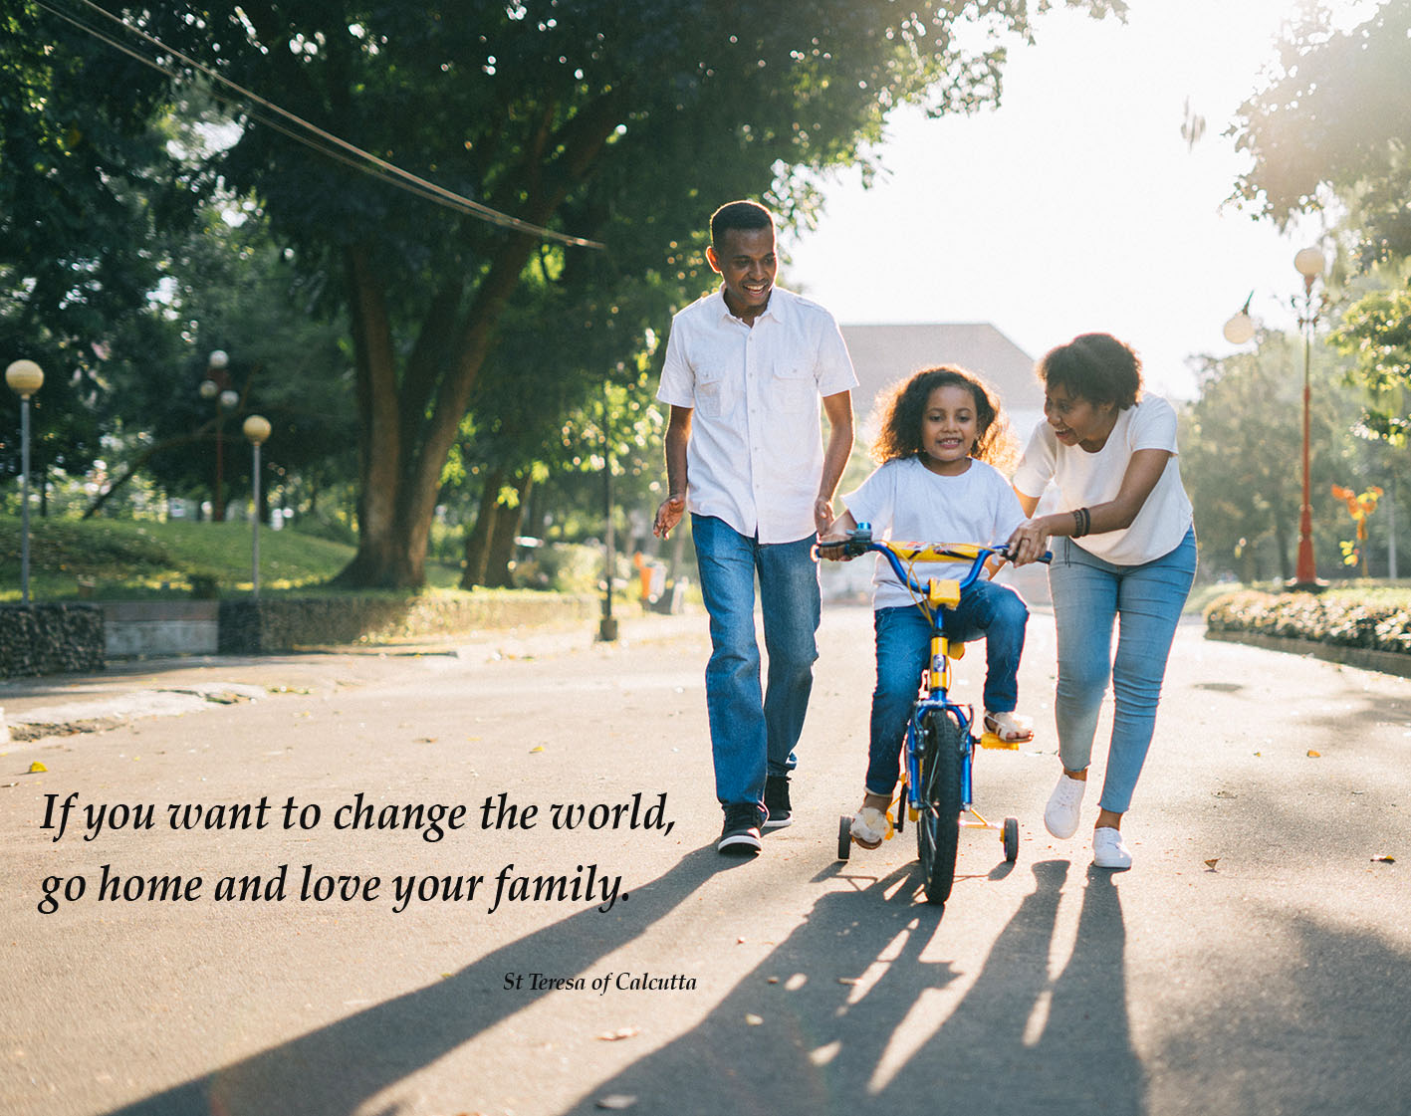
16. A Journey in Love
– Year 4 –

Slide 17
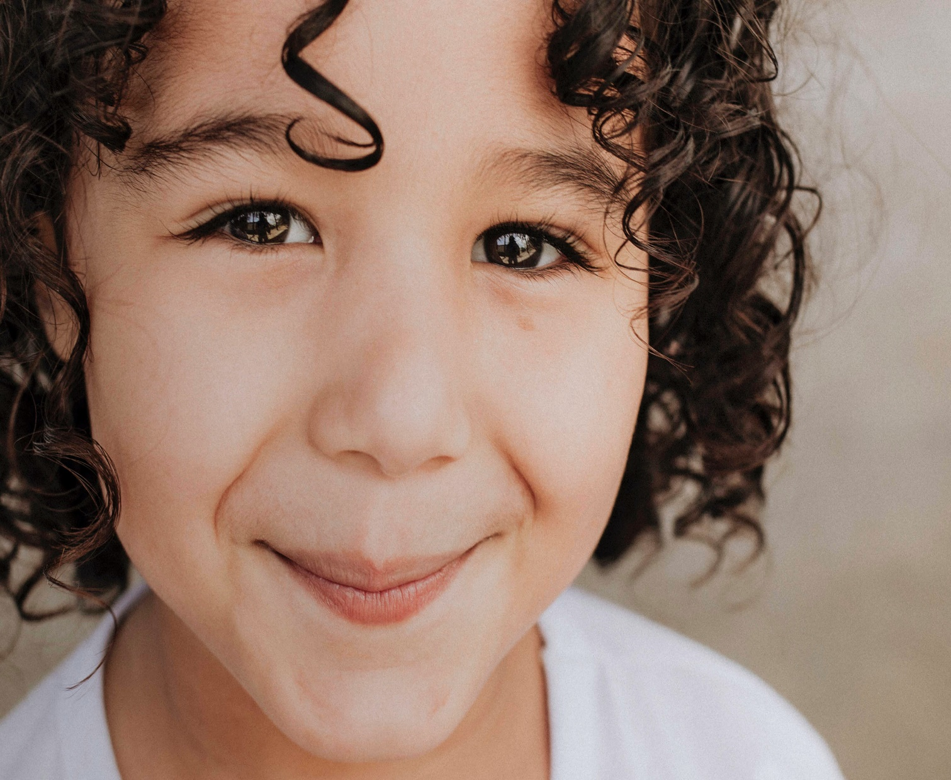
Spiritual
Learning intention
To celebrate the uniqueness and innate beauty of each of us.
17. A Journey in Love
– Year 4 –

Slide 18
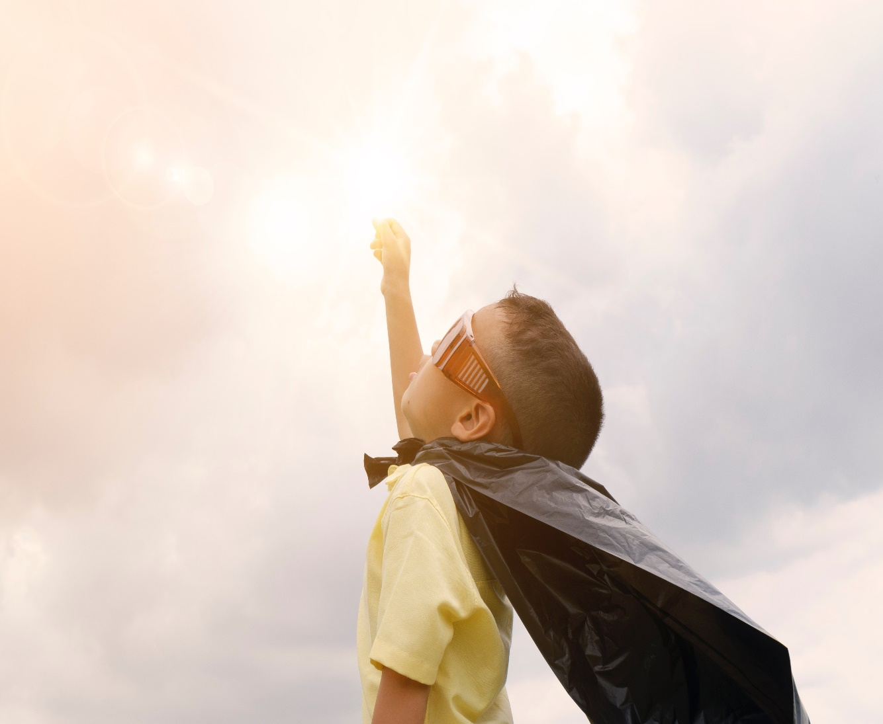
Questions
What makes you unique?
What are your special qualities, gifts,
and talents?
What attributes do others recognise
in you?
Why are being honest, truthful and having integrity positive attributes?
How can your gifts be used for the common good?
What is it that we can do for each other to support each other’s mental health and wellbeing, recognising the importance of expressing feelings.
18. A Journey in Love
– Year 4 –

Slide 19
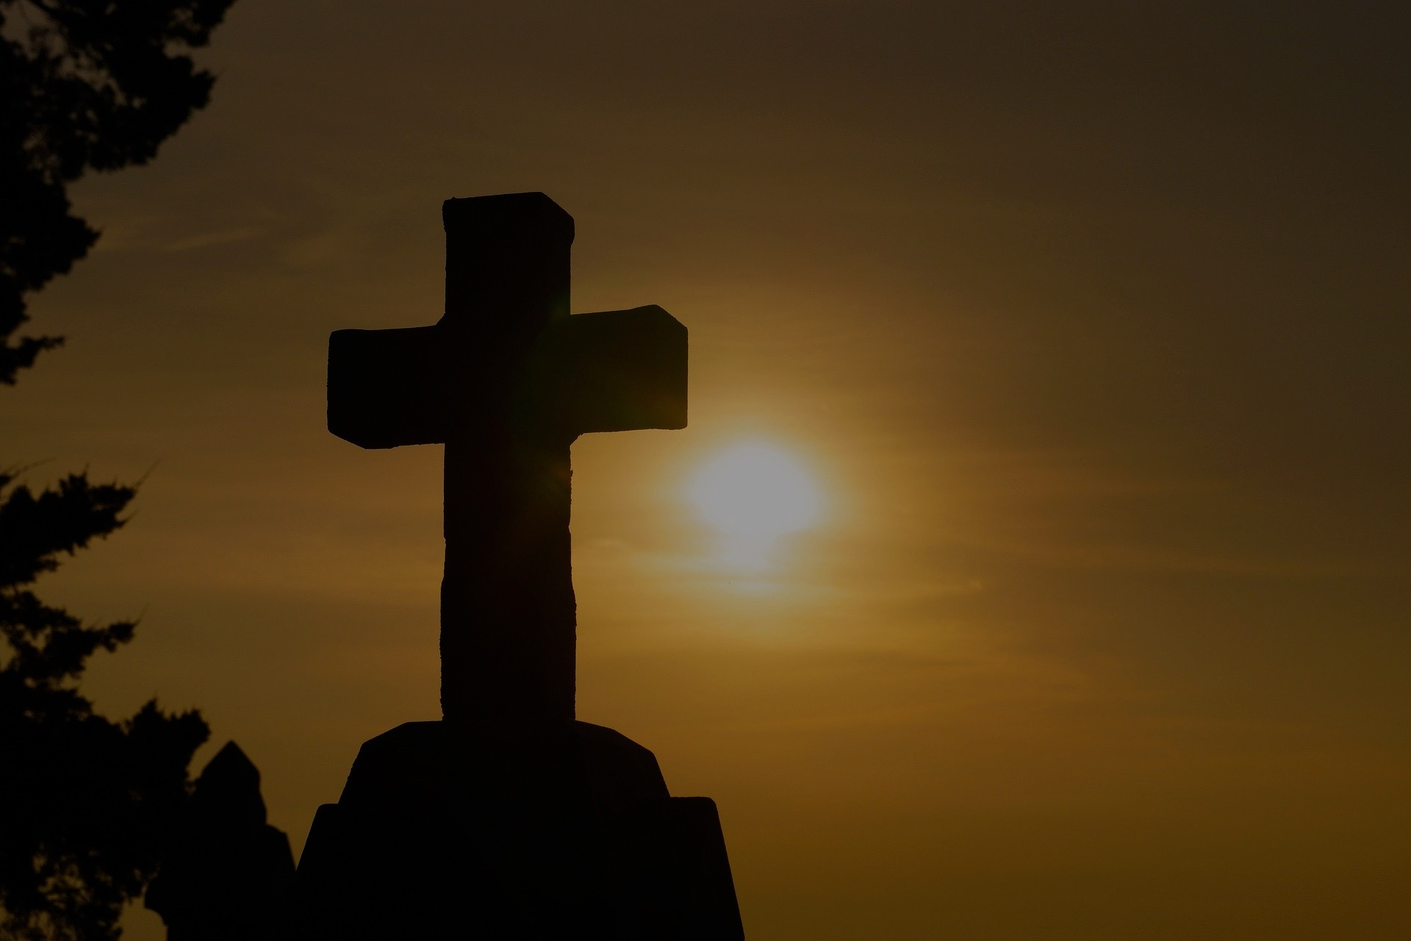
Pause and reflect
Lord God,
I give you all the members of our family.
You know them all so well and love them all.
I ask that you would cover us with a rainbow of hope.
Hope that draws us together to work out our differences.
Hope that helps us to celebrate together and care for one another.
Hope that rides like a banner in our lives and watches over us wherever we go.
Hope that overcomes adversity and gathers strength to overcome.
Hope that guides us and gives us vision for our future alone and together.
Hope filled with love.
Hope that breathes peace.
Amen

Slide 20
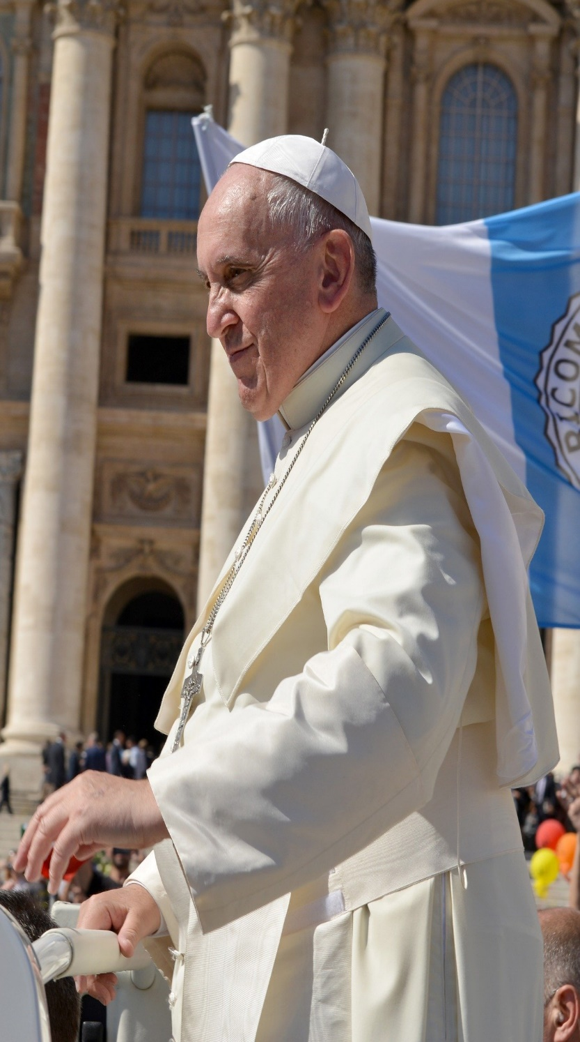
No family drops down from heaven;
perfectly formed.
Families need constantly to grow and mature in the ability to love
Pope Francis
20. A Journey in Love
– Year 4 –

