Slide 1
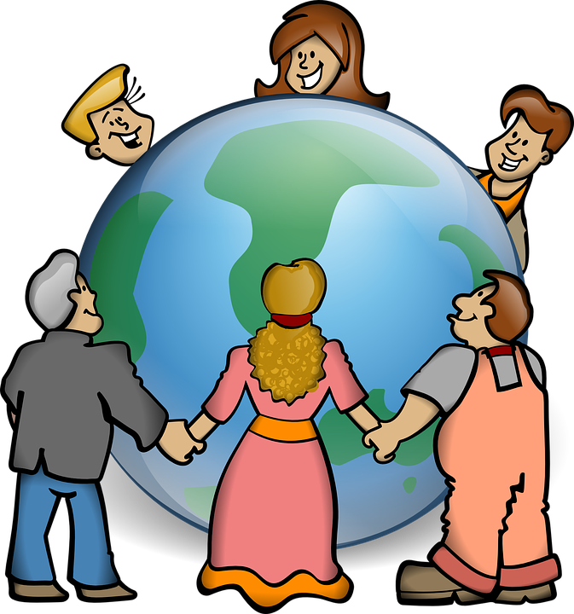

Year 3
How we live in love
1. A Journey in Love
– Year 3 –

Slide 2

IMPORTANT
Copyright and Terms and Conditions of use
By using this Powerpoint CD presentation you are agreeing to the following terms and conditions.
All images and text are copyright to the respective owners and can only be used and shown as a presentation within a classroom or other room or area within an educational establishment.
– All the files and images contained within this PowerPoint presentation are subject to copyright restrictions and cannot be duplicated, copied or shared as detailed on the CD and CD packaging (Unlawful duplication is prohibited by law).
– You must NOT share this Powerpoint presentation or any of the text and images by uploading them to a website on the Internet.
If you have purchased a Network Licence you may store the Powerpoint presentation on your Intranet.
– You must not change/alter or recreate the files in any way or form.
– If you do not comply with the terms of this licence you could be liable to legal action against you by the copyright holder and/or the agency that acts on their behalf.
This Powerpoint presentation is a simplified form of the
A Journey in Love book and should be used in conjunction with
this publication.
The book is available from www.mccrimmons.com
Published in United Kingdom in 2020 by
McCrimmon Publishing Co. Ltd.
sales@mccrimmons.com / www.mccrimmons.com
McCrimmon order ref: MB7863CD
Text © 2005/2006/2020 Sr Jude Groden and the following contributors.
﻿Dr Sathi Aiya / Ilse Brockling / Fr David Clemens
Sarah Feist / Shaun Kelliher / Patrick Harrison.
Narrative text: Sr Jude Groden.
Powerpoint construction and design by Éanna McAteer
I have read the Terms and Conditions above…
Acknowledgements
Most of the mages used in this Powerpoint presentation are from www.pixabay.com Pixabay are an online (free to use for commercial use) image library.
Other image credits
Slide 4 netclipart.com
Slide 5 maxpixel.net
CONTINUE

Slide 3
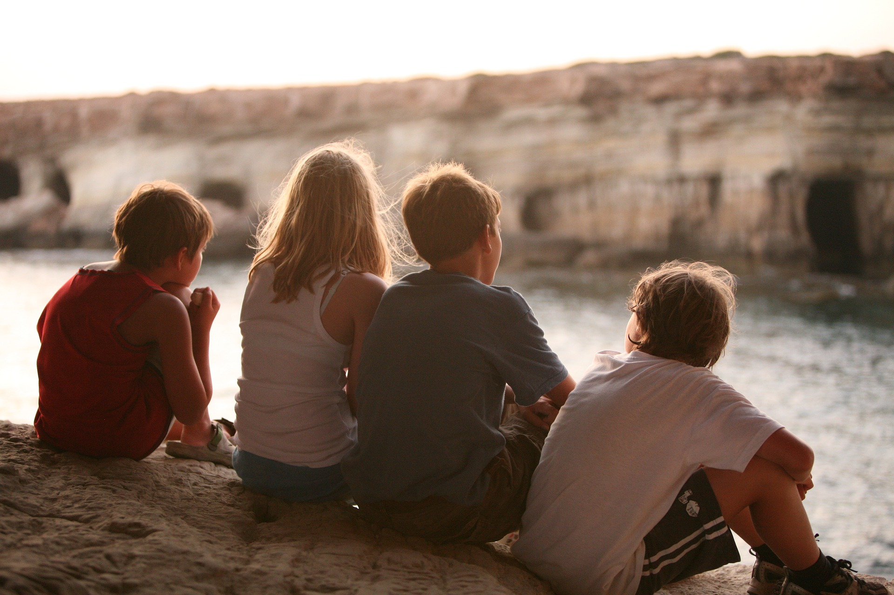
Aim
To describe and give reasons for how we grow in love in caring and happy friendships where we are secure and safe.
3. A Journey in Love
– Year 3 –

Slide 4


community
carer
trust
God-given
guardian
selfless
belonging
feelings
generous
family
emotions
reasons
diverse
friends
difficulties
father
loyalty
positive
mother
kindness
respectful
4. A Journey in Love
– Year 3 –

Slide 5

Listening
Reflecting
Observing
Understanding
Skills
Relating
Describing
Speaking
Articulating
Respecting
Choosing wisely
Praying
5. A Journey in Love
– Year 3 –

Slide 6
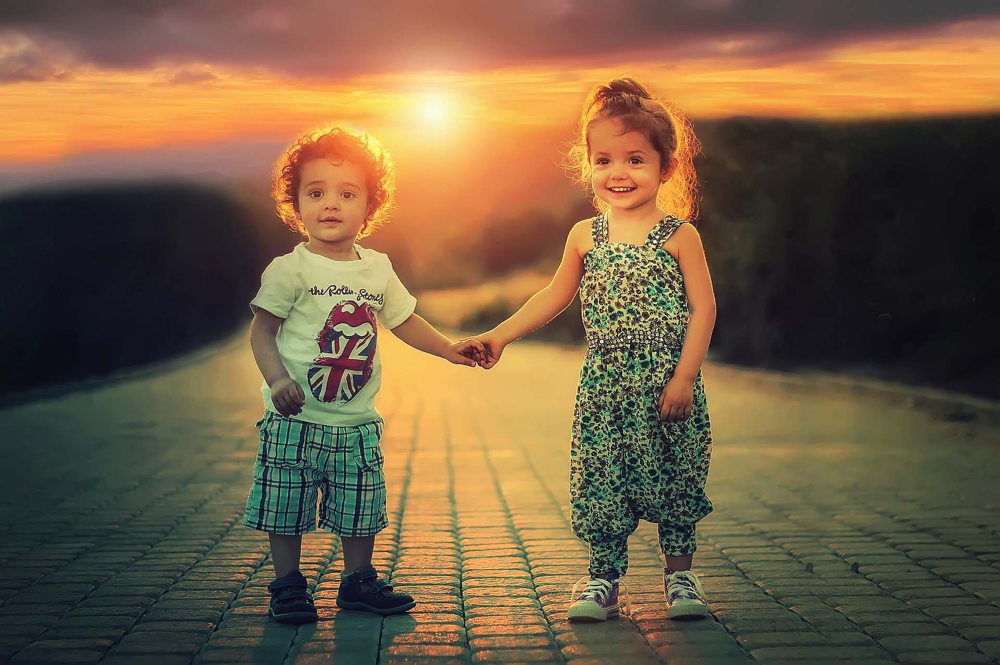
Social and Emotional
Learning intention
To describe and give reasons how friendships make us feel happy and safe.
6. A Journey in Love
– Year 3 –

Slide 7
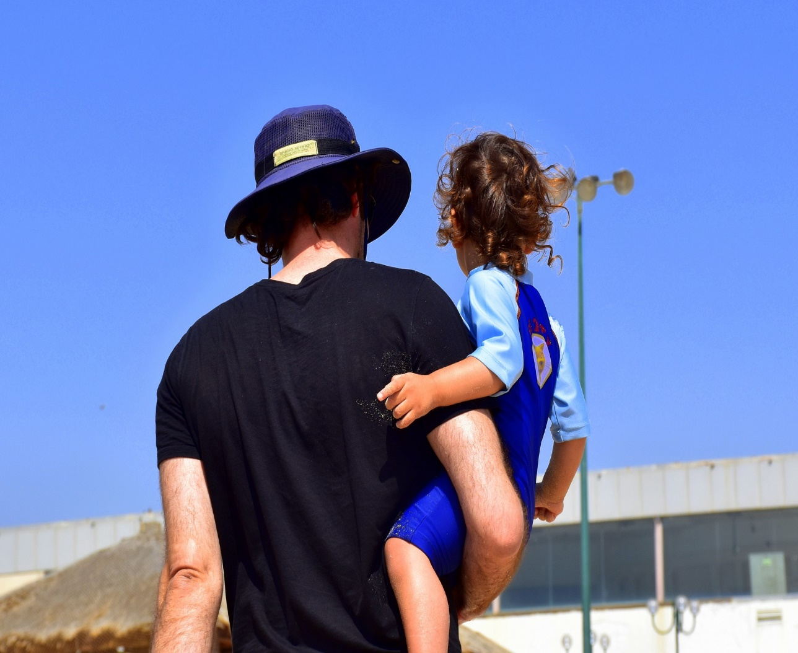
Questions
How do friendships make us feel happy and
secure?
Who could you turn to if you didn’t feel safe in
a friendship?
What is the difference between a relative,
a friend and an acquaintance?
How would you respond to an adult you do not know who makes you feel uncomfortable or unsafe?
What are the qualities, characteristics of a true friend?
Sometimes people behave differently online, even our friends.
How can we make sure these friendships are positive and safe?
How can friendships change?
7. A Journey in Love
– Year 3 –

Slide 8

Pause and reflect
Thank you, Jesus,
for the gift of friendship.
Thank you for giving me good friends
and help me to be a true friend to others.

Slide 9
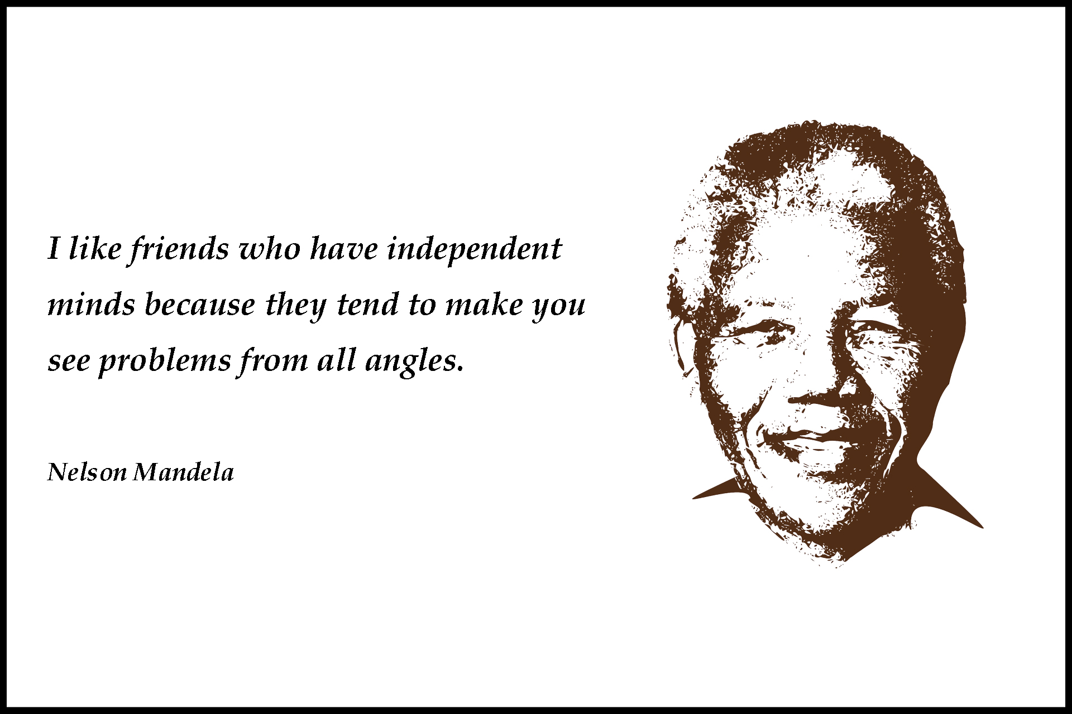
9. A Journey in Love
– Year 3 –

Slide 10
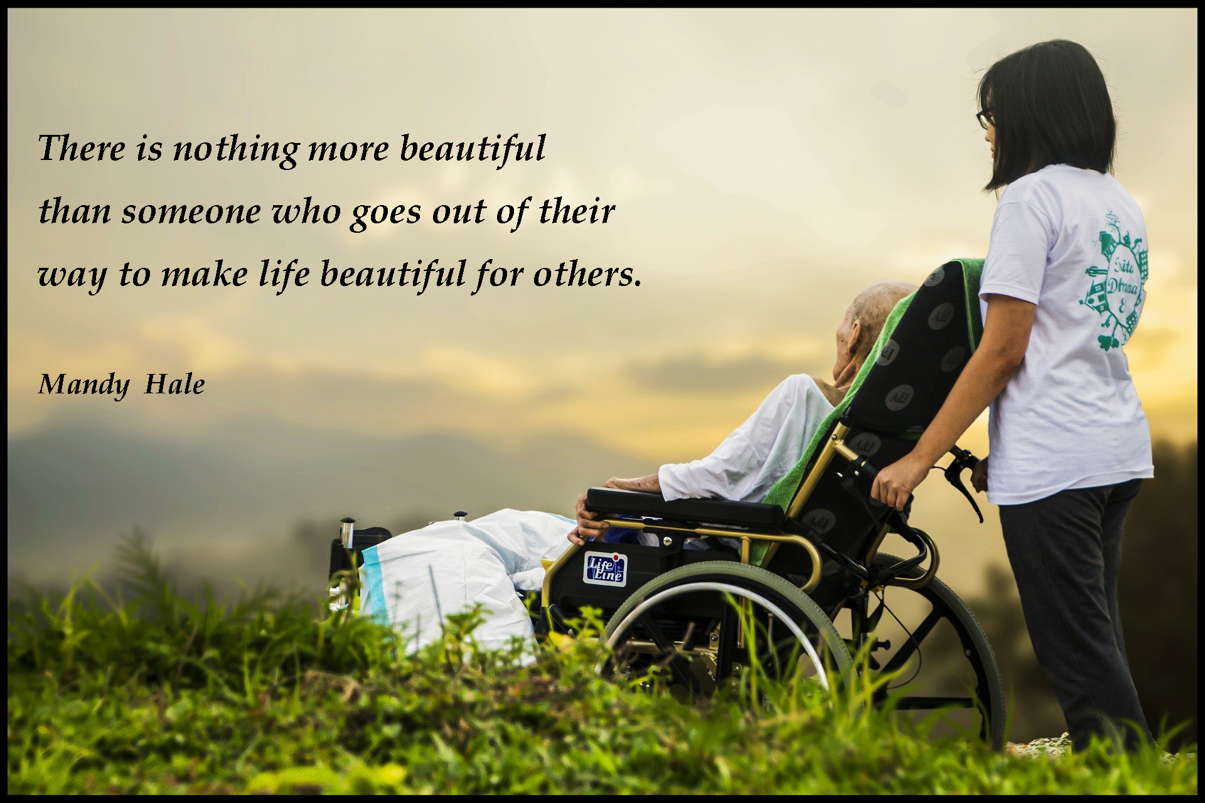
10. A Journey in Love
– Year 3 –

Slide 11
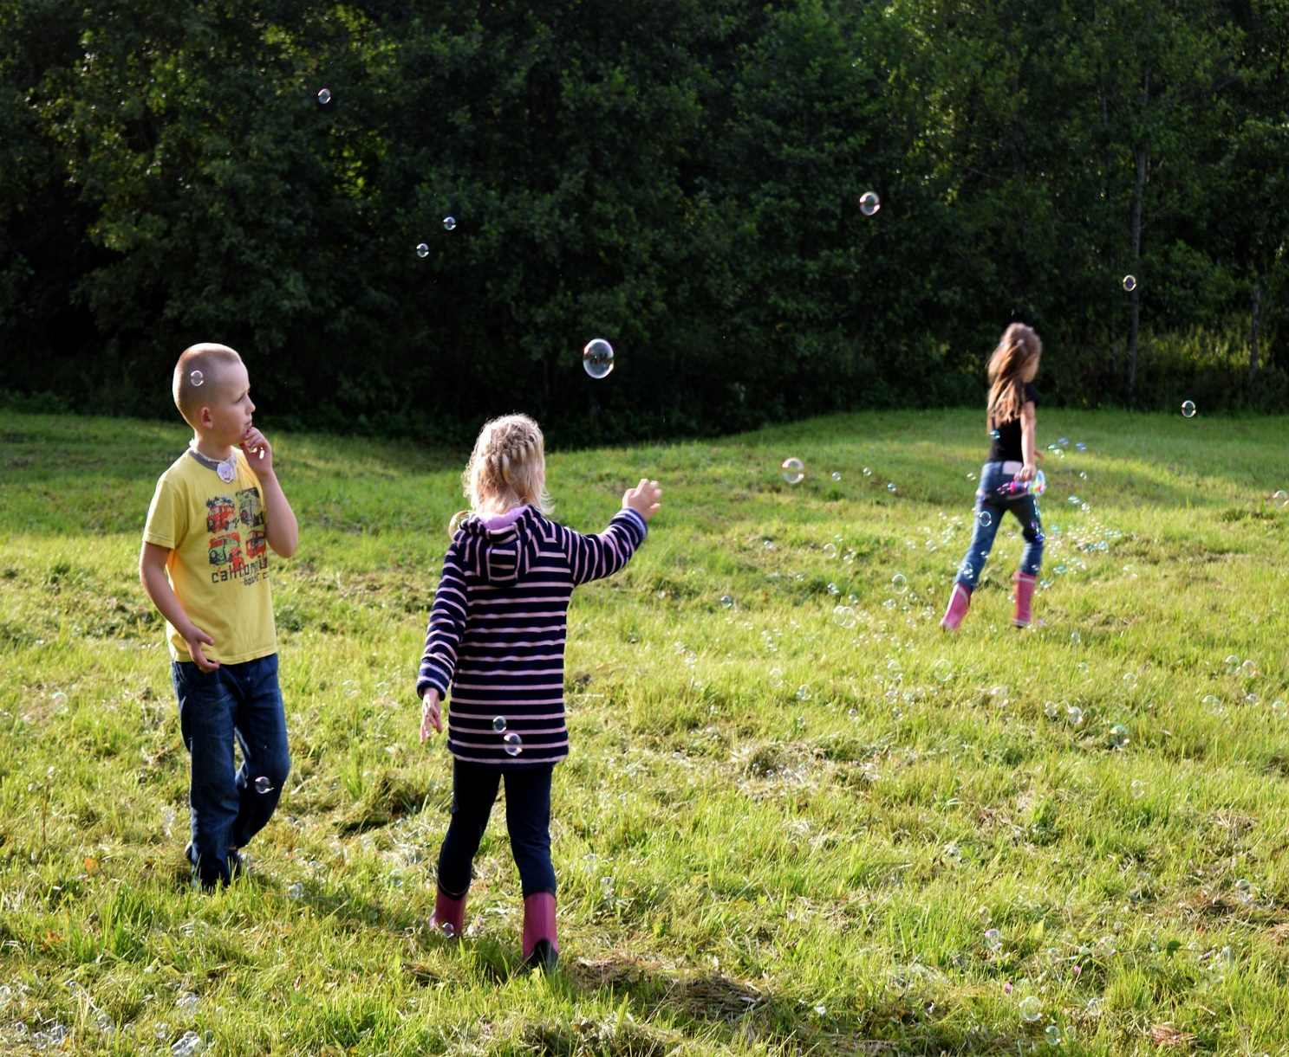
Physical
Learning intention
To describe and give reasons why friendships can break down,
how they can be repaired and strengthened.
11. A Journey in Love
– Year 3 –

Slide 12
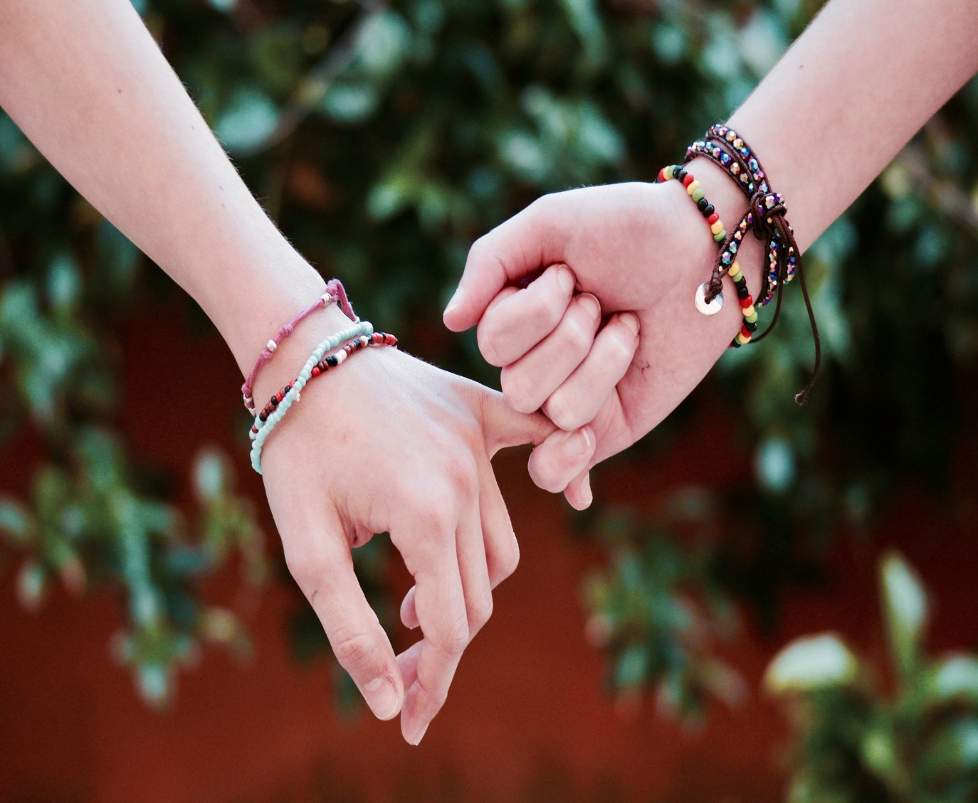
Questions
What things trigger disagreements between friends and within friendship groups?
How do these make people feel?
What might be the best way to resolve conflict in friendships?
Healthy friendships make people feel included; how should we react if we or others feel lonely or excluded?
What strategies could be used to ensure that they are included?
Why is violence never the answer?
12. A Journey in Love
– Year 3 –

Slide 13
Pause and reflect
God of generous love,
we thank you for forgiving us endlessly.
Give us grateful and forgiving hearts always
and at all times.
May it be said of us, as of the ‘first Christians’
“see how they love one another.”
We ask this through Christ our Lord.
Amen.

Slide 14
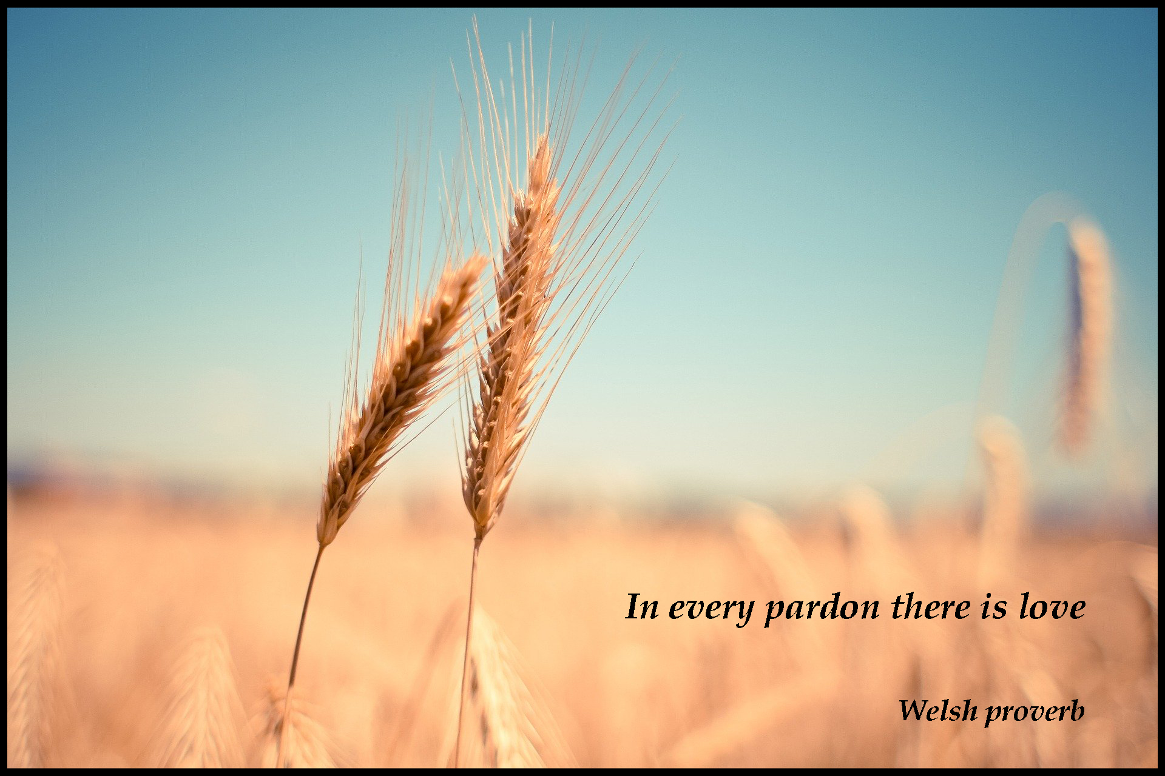
14. A Journey in Love
– Year 3 –

Slide 15
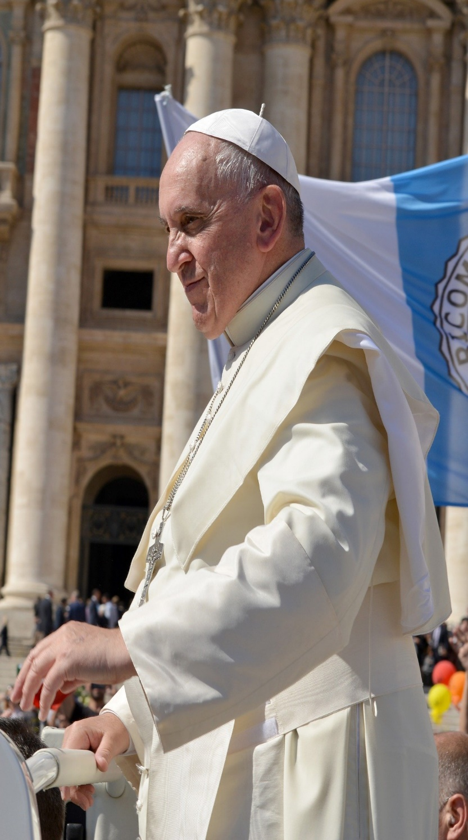
The basis of deep joy
is the presence of God.
The presence of God in the family
and his love, which is welcoming,
merciful and respectful towards all.
Pope Francis
15. A Journey in Love
– Year 3 –

Slide 16
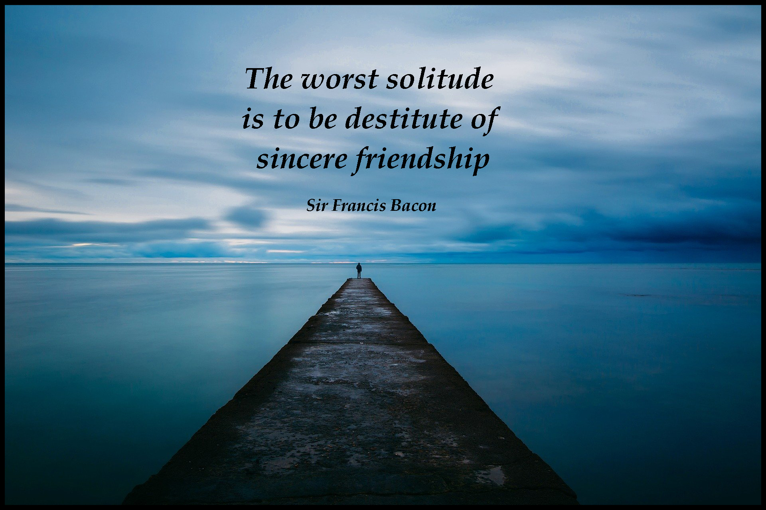
16. A Journey in Love
– Year 3 –

Slide 17
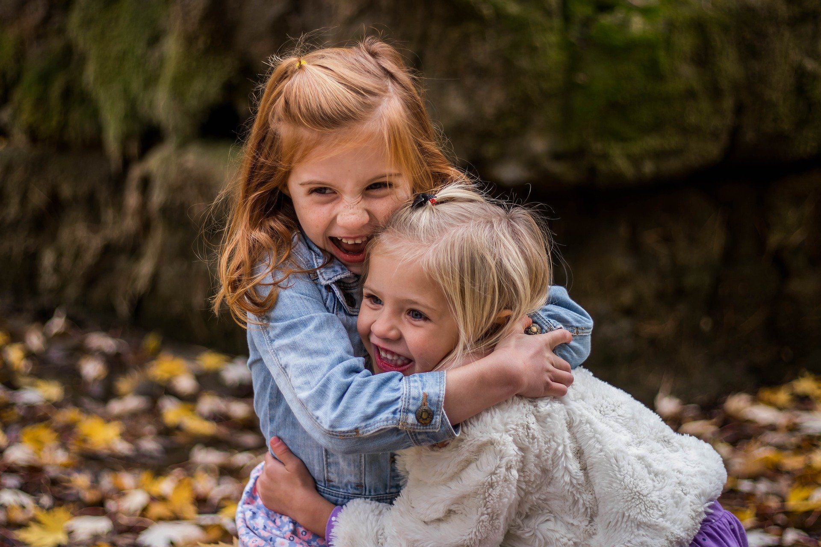
Spiritual
Learning intention
To celebrate the joy and happiness of living in friendship with God and others.
17. A Journey in Love
– Year 3 –

Slide 18
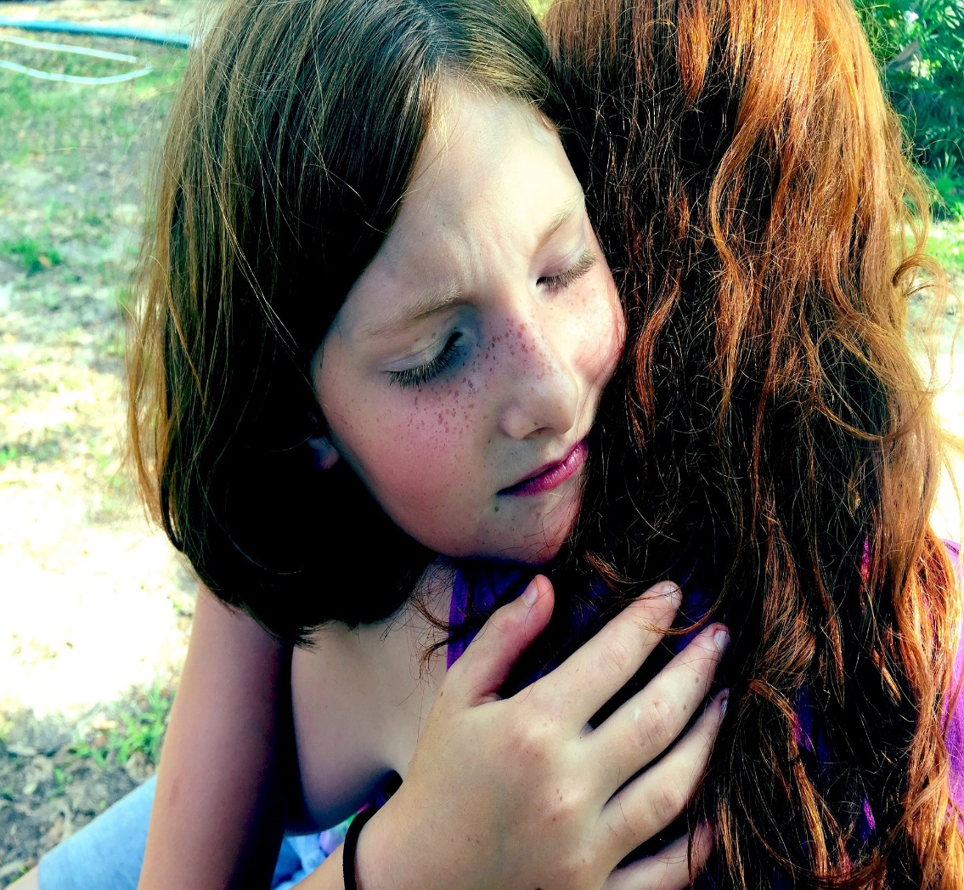
Questions
How does the gift of the Sacrament of Reconciliation help restore friendship with God and others?
Forgive us our trespasses as we forgive those who trespass against us.’ How can these words inspire, help and guide us to improve our friendships?
What Bible stories teach us about the beauty of forgiveness?
Luke 15:11-22, Luke 15:4-7, Luke 17:3-4, Luke 7:47-49, Luke 19: 1-10.
What does the phrase: “To err is human to forgive is divine” mean to you?
St Francis de Sales said: A quarrel between friends when made up, adds a new tie to friendship.” How would you explain the following quote to your friends and others.
18. A Journey in Love
– Year 3 –

Slide 19
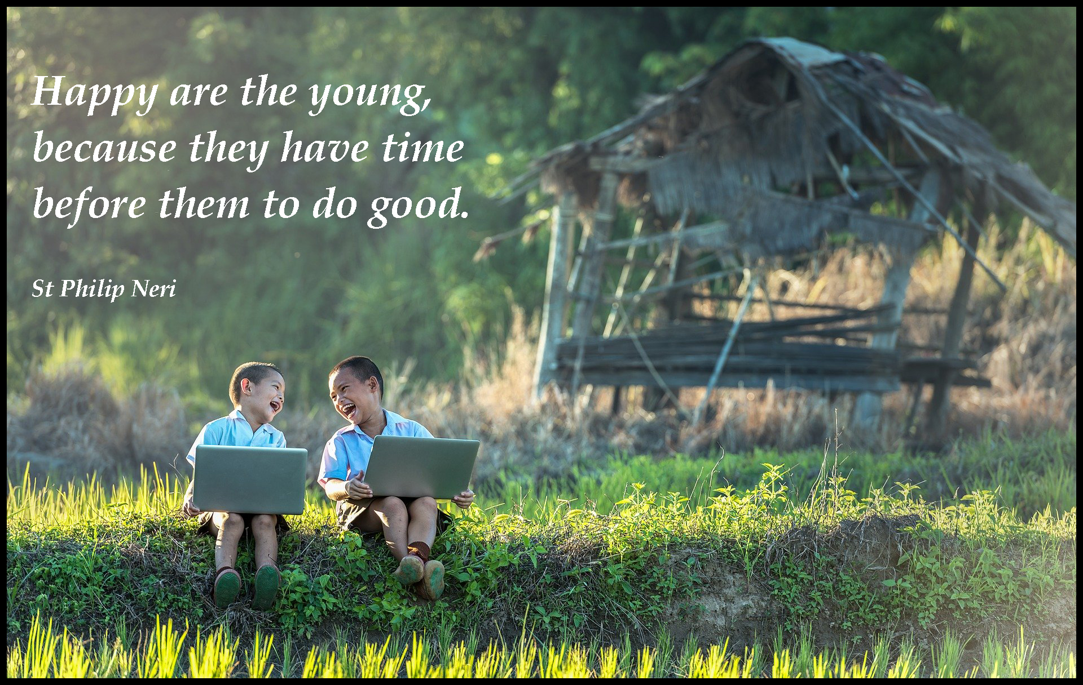
19. A Journey in Love
– Year 3 –

Slide 20
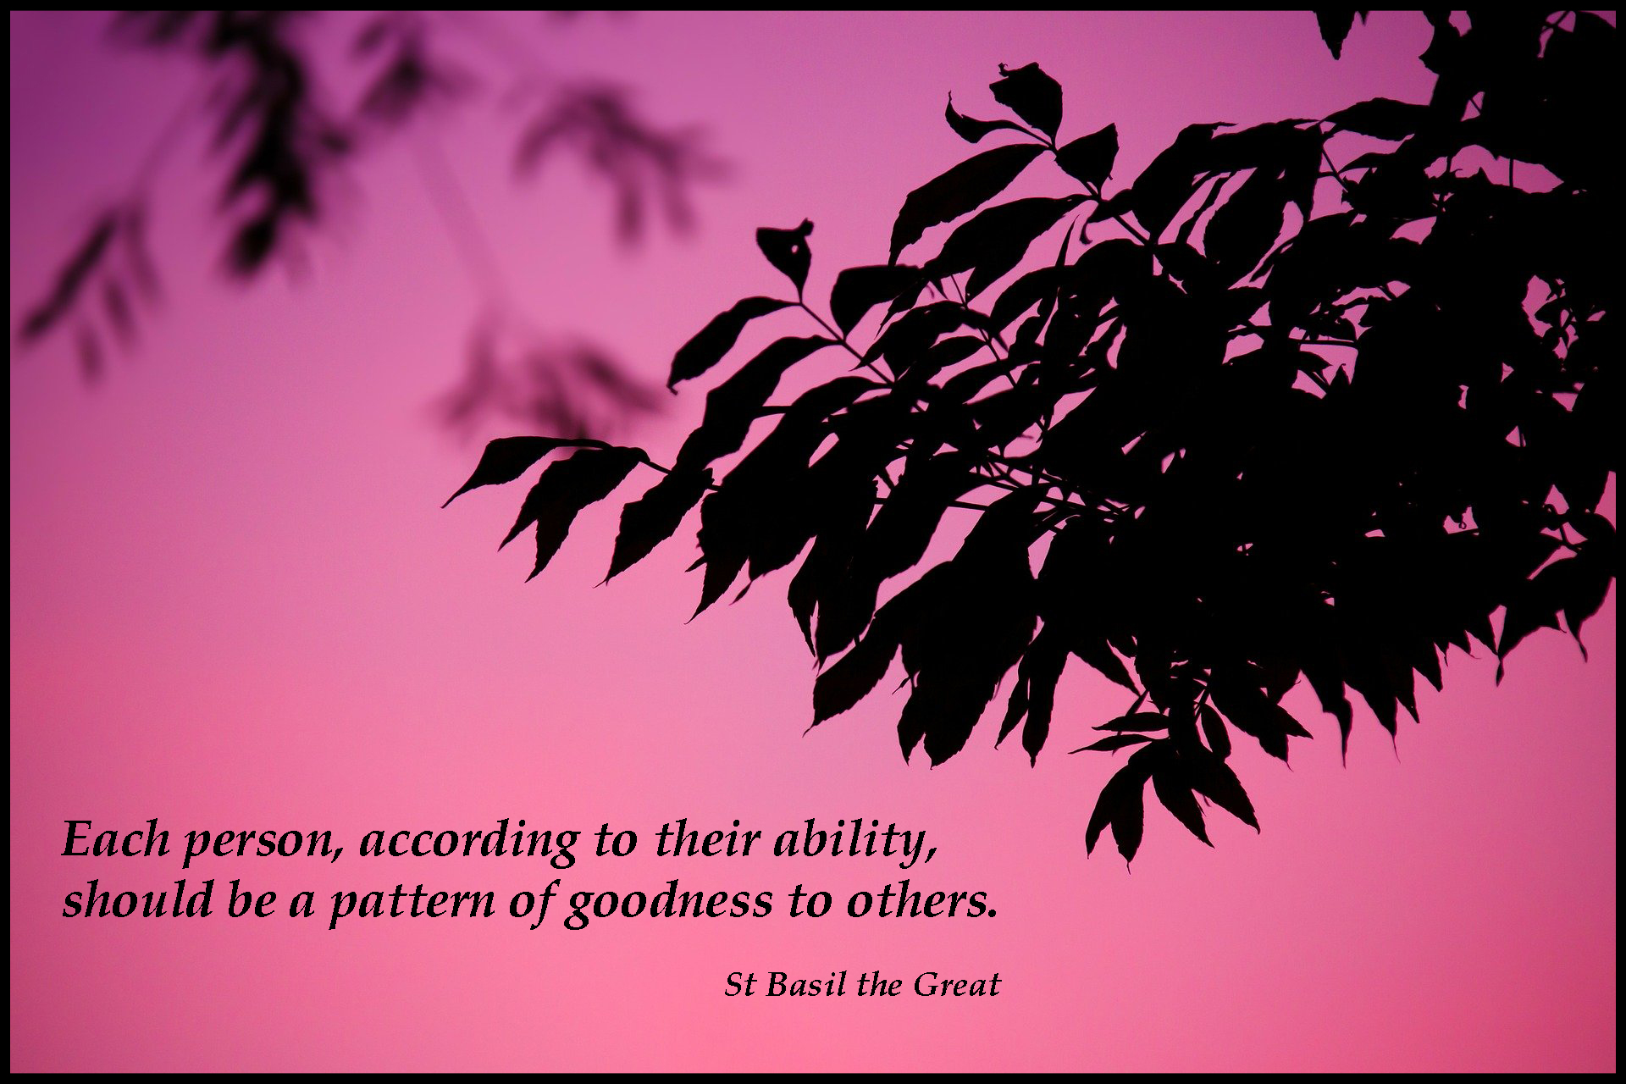
20. A Journey in Love
– Year 3 –

Slide 21
Pause and reflect
Scripture reading: Ephesians 4:32
Be kind and tender-hearted
to one another, and forgive one another, as God has forgiven you in Christ.
A thought from Pope Francis:
‘God treats us as his children,
he forgives us, embraces us, loves us
even when we make mistakes.’

Slide 22
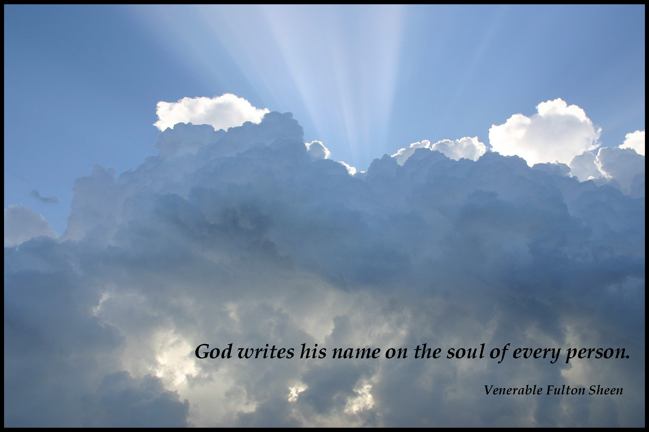
22. A Journey in Love
– Year 3 –

Slide 23
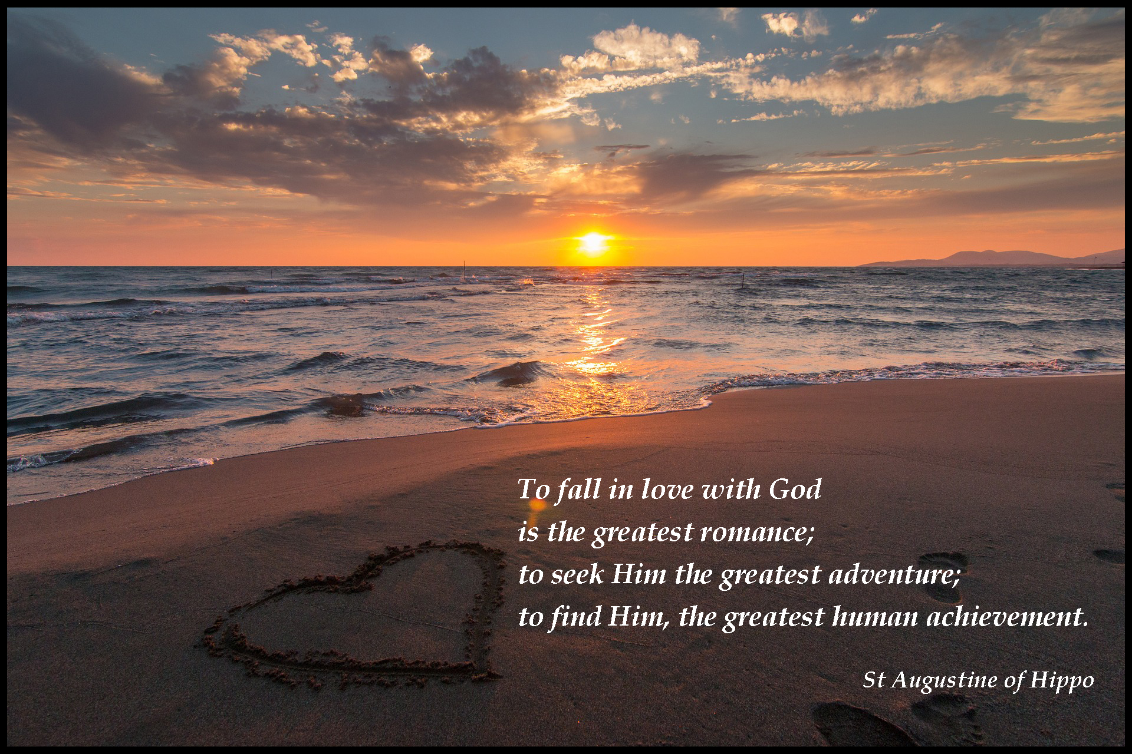
23. A Journey in Love
– Year 3 –

Slide 24
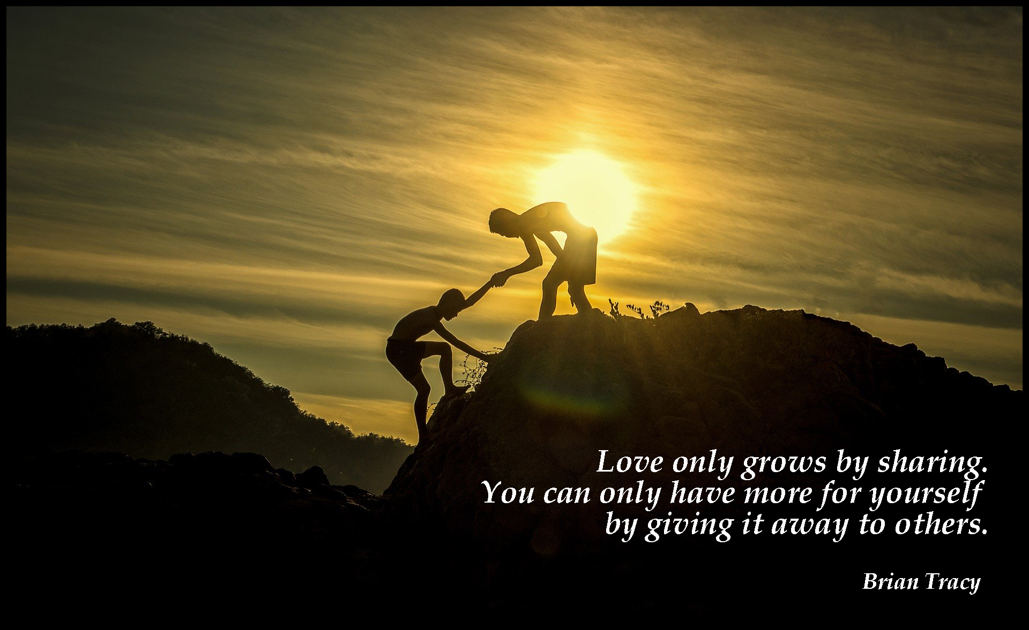
24. A Journey in Love
– Year 3 –

Slide 25

God loves us as we are:
no sin, fault or mistake
can make Him change
His mind.
Pope Francis
25. A Journey in Love
– Year 3 –

