Slide 1


Year 2
We meet God’s love in the community
1. A Journey in Love
– Year 2 –

Slide 2

IMPORTANT
Copyright and Terms and Conditions of use
By using this Powerpoint CD presentation you are agreeing to the following terms and conditions.
All images and text are copyright to the respective owners and can only be used and shown as a presentation within a classroom or other room or area within an educational establishment.
– All the files and images contained within this PowerPoint presentation are subject to copyright restrictions and cannot be duplicated, copied or shared as detailed on the CD and CD packaging (Unlawful duplication is prohibited by law).
– You must NOT share this Powerpoint presentation or any of the text and images by uploading them to a website on the Internet.
If you have purchased a Network Licence you may store the Powerpoint presentation on your Intranet.
– You must not change/alter or recreate the files in any way or form.
– If you do not comply with the terms of this licence you could be liable to legal action against you by the copyright holder and/or the agency that acts on their behalf.
This Powerpoint presentation is a simplified form of the
A Journey in Love book and should be used in conjunction with
this publication.
The book is available from www.mccrimmons.com
Published in United Kingdom in 2020 by
McCrimmon Publishing Co. Ltd.
sales@mccrimmons.com / www.mccrimmons.com
McCrimmon order ref: MB7863CD
Text © 2005/2006/2020 Sr Jude Groden and the following contributors.
﻿Dr Sathi Aiya / Ilse Brockling / Fr David Clemens
Sarah Feist / Shaun Kelliher / Patrick Harrison.
Narrative text: Sr Jude Groden.
Powerpoint construction and design by Éanna McAteer
I have read the Terms and Conditions above…
Acknowledgements
Most of the mages used in this Powerpoint presentation are from www.pixabay.com Pixabay are an online (free to use for commercial use) image library.
Other image credits
Slide 4 Hand, writing netclipart.com
Slide 5 (as Year 1, 5) maxpixel.net
CONTINUE

Slide 3
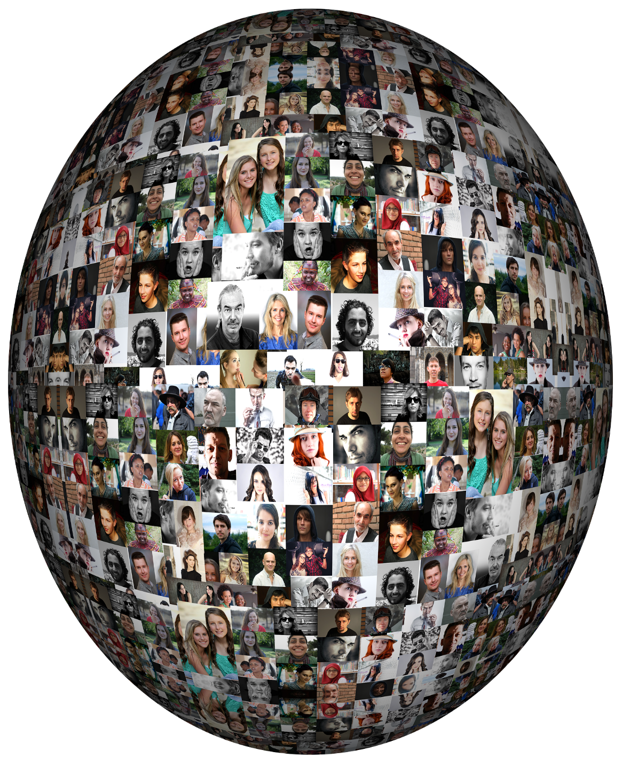
Aim
To describe how we are growing and developing in diverse communities that are God-given.
3. A Journey in Love
– Year 2 –

Slide 4


community
belonging
secrets
local
family
recognise
global
diverse
emotions
impact
father
friendships
responsibility
mother
relationships
harm
carer
stereotypes
improve
guardian
respect
God-given
feelings
equal
4. A Journey in Love
– Year 2 –

Slide 5

listening
observing
relating
speaking
Skills
respecting
praying
reflecting
describing
understanding
informing
recognising
5. A Journey in Love
– Year 2 –

Slide 6
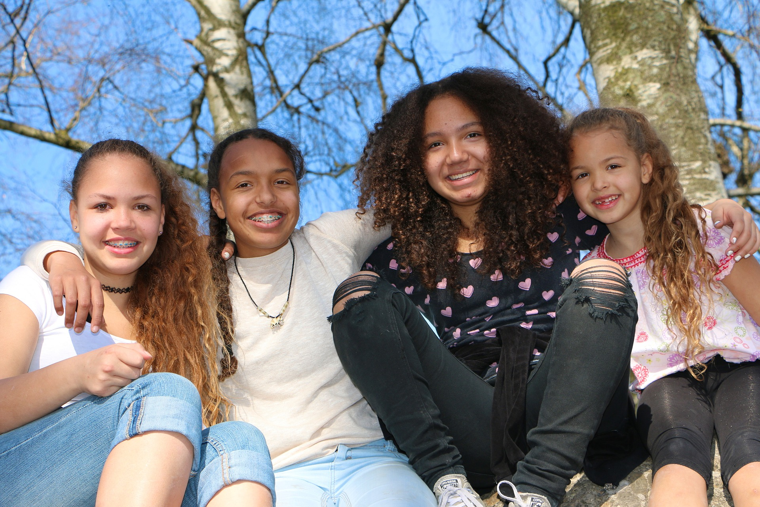
Social and Emotional
Learning intention
to recognise the joy and friendship of belonging to a diverse community.
6. A Journey in Love
– Year 2 –

Slide 7
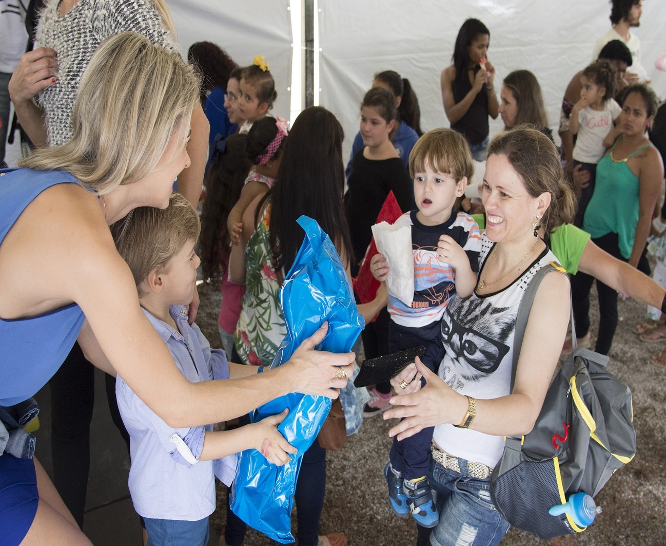
Questions
How would you describe a community?
What are the joys of belonging to a community?
How do different individuals enrich our communities?
How do we learn from each other and show an understanding of the different roles and responsibilities people have in their communities? Look at some key figures that children will be able to make connections with e.g. Teachers, police, swimming instructors, sports coaches etc.
What do you bring to the communities you belong to? (Respect, love, care, generosity of spirit, loyalty and forgiveness).
7. A Journey in Love
– Year 2 –

Slide 8
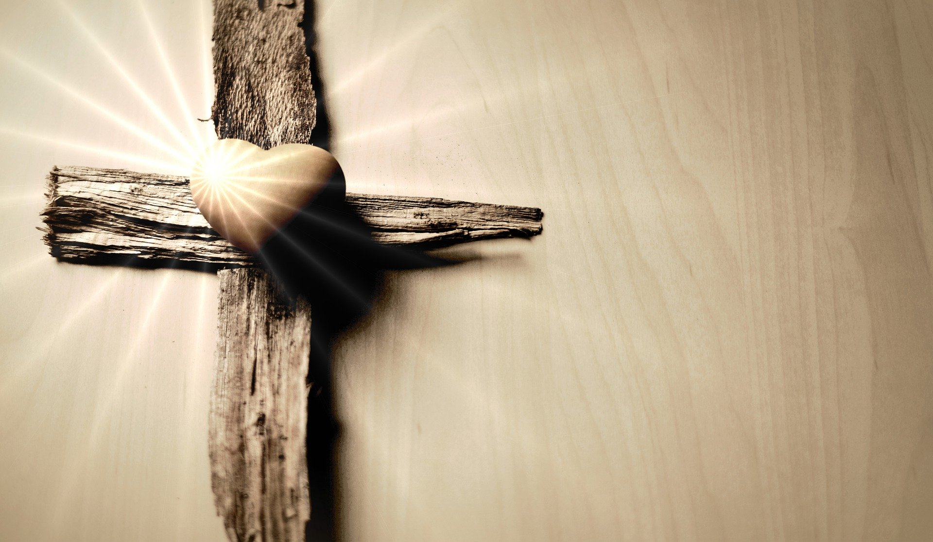
Pause and reflect
Why is my community good for me?
Home, school, parish etc.
What do I bring to my community and what do I receive in return?
What joys do I experience in my community?

Slide 9
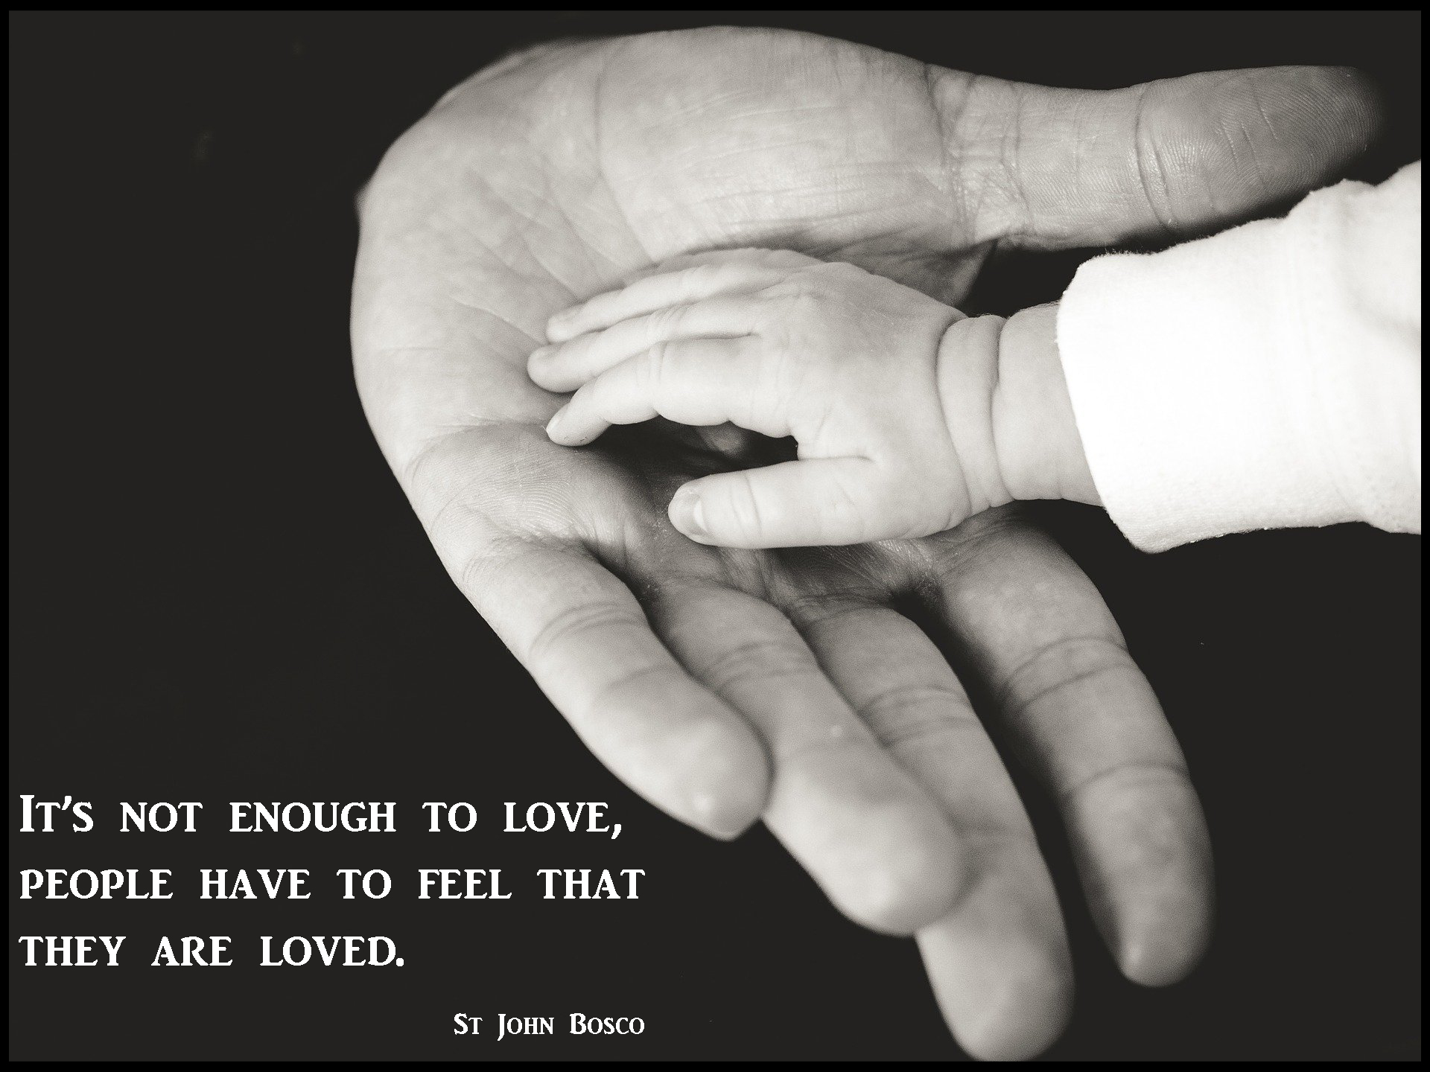
9. A Journey in Love
– Year 2 –

Slide 10
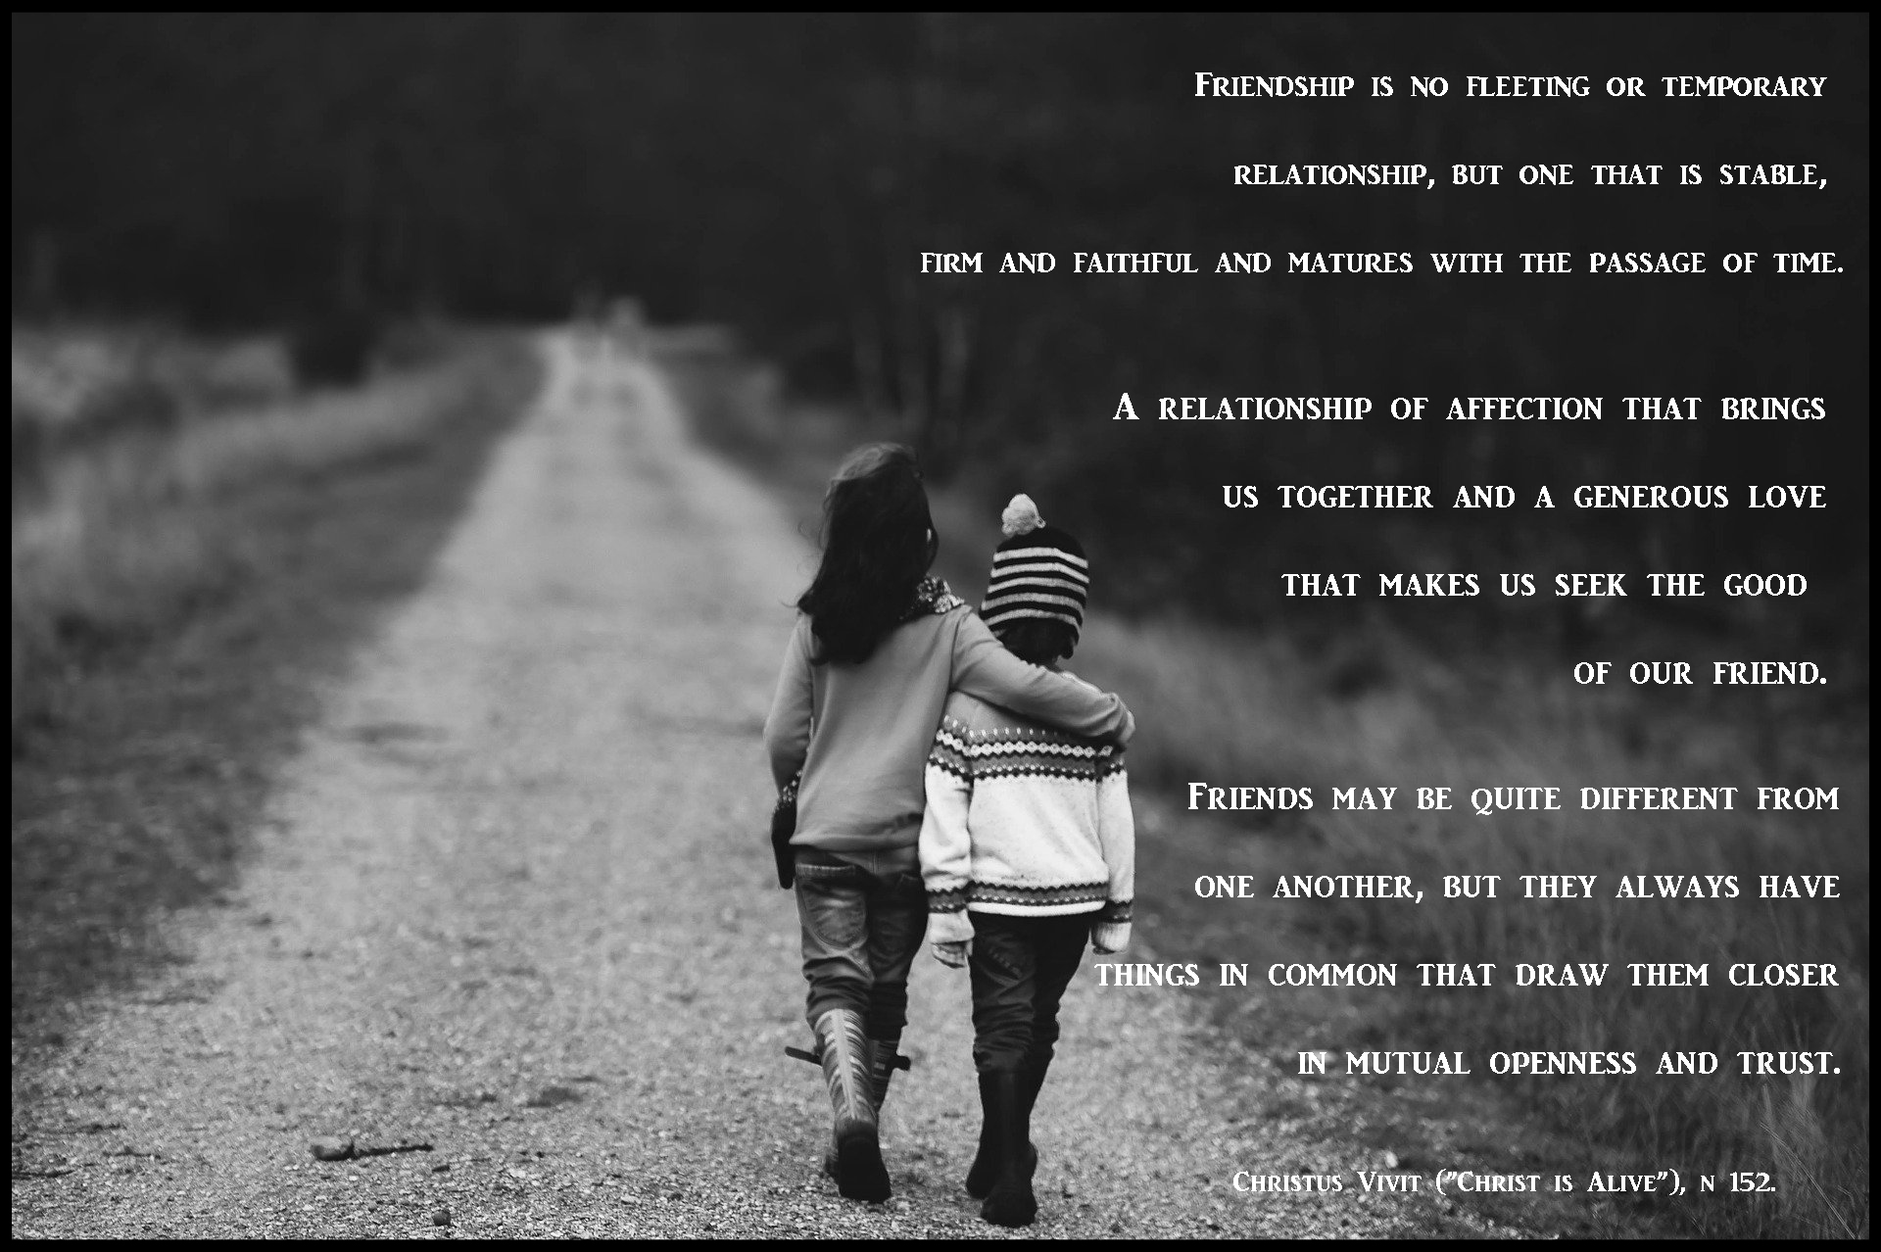
10. A Journey in Love
– Year 2 –

Slide 11
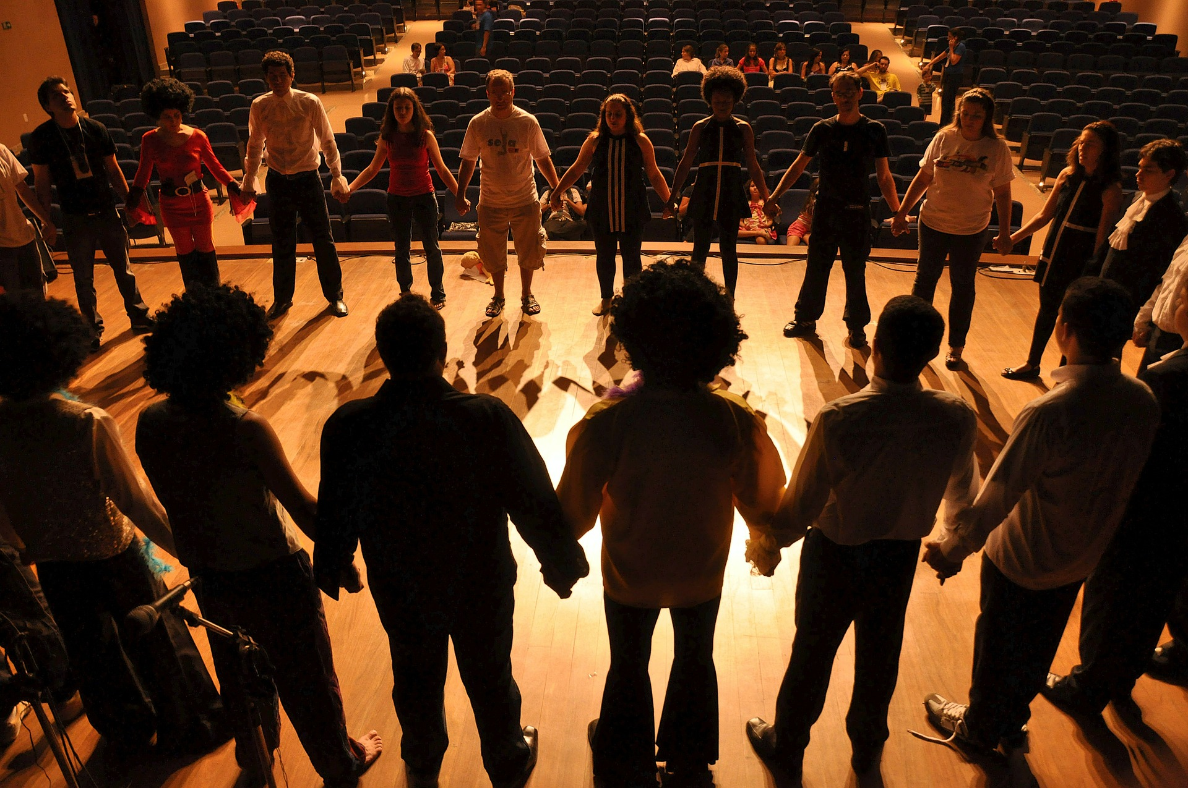
Physical
Learning intention
to describe ways of being safe in communities.
11. A Journey in Love
– Year 2 –

Slide 12
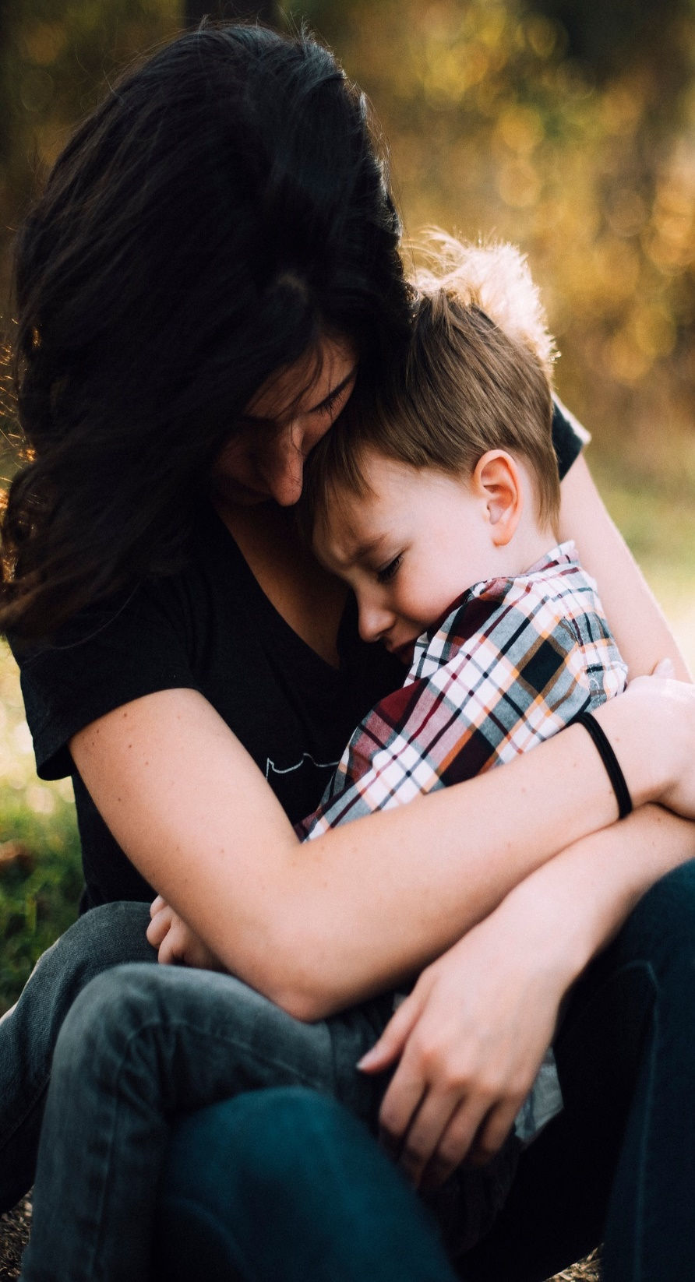
Questions
What makes us feel safe in families, in our friendships and in our wider communities?
In what ways might you feel unsafe, and when is it not right to keep a secret?
Who would you go to if you were worried or felt unsafe?
What would you do if you were worried about another person whom you considered being unsafe?
Do you know how to ask for help and the appropriate people you can talk to?
12. A Journey in Love
– Year 2 –

Slide 13
Pause and reflect
Loving Father,
Creator of all people and all of creation, help us to see others as you see them as brothers and sisters in Jesus to be loved and respected at all times.
Amen

Slide 14
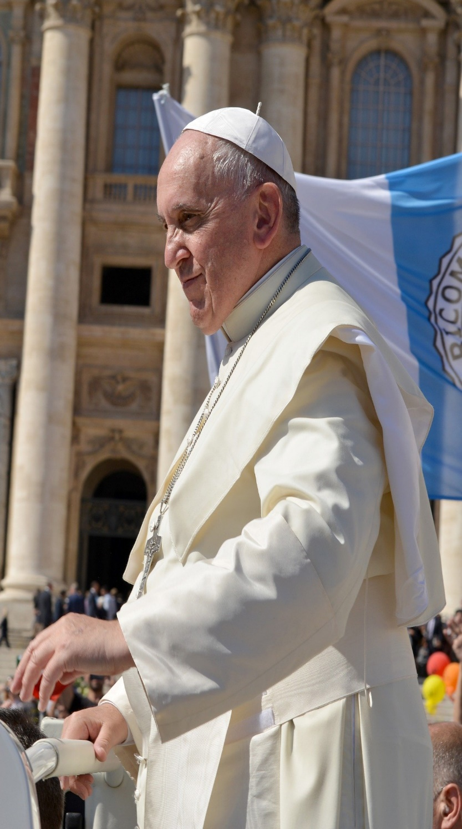
Let us learn to live with kindness,
love everyone,
even when they do not love us.
Pope Francis
14. A Journey in Love
– Year 2 –

Slide 15
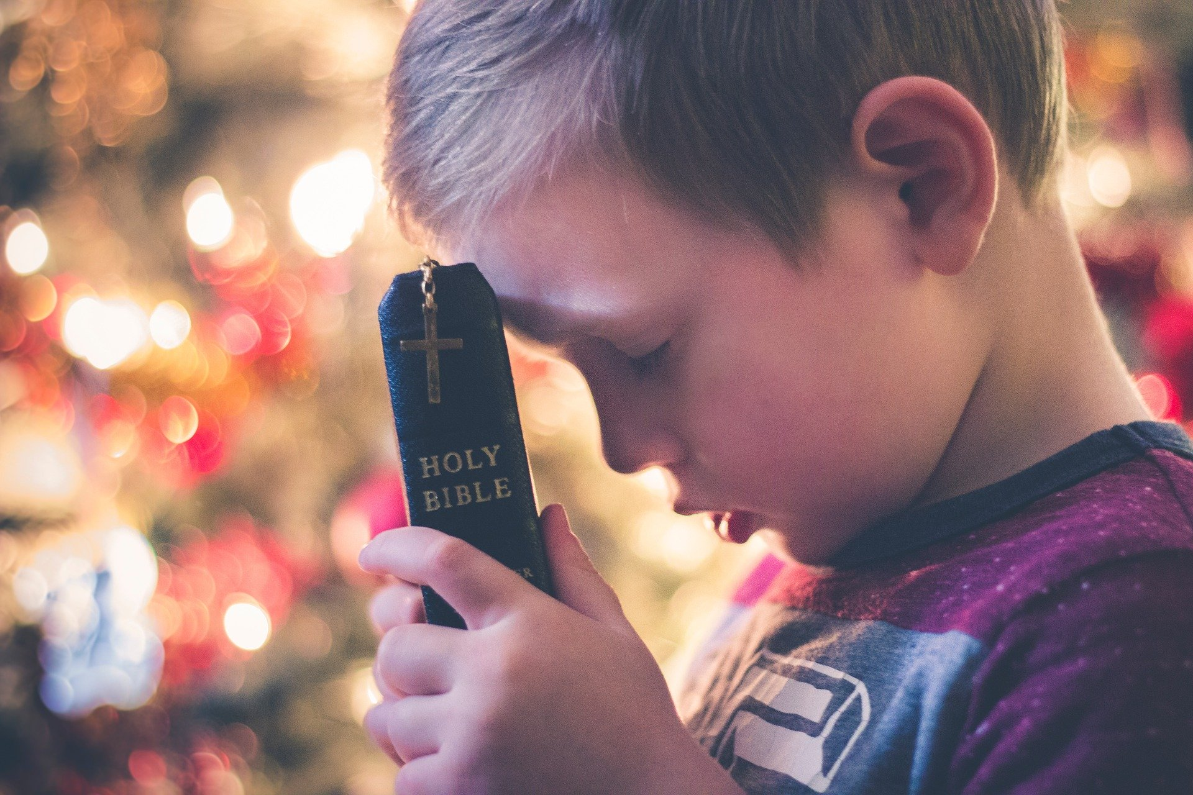
Spiritual
Learning intention
To celebrate ways of meeting God in our communities.
15. A Journey in Love
– Year 2 –

Slide 16
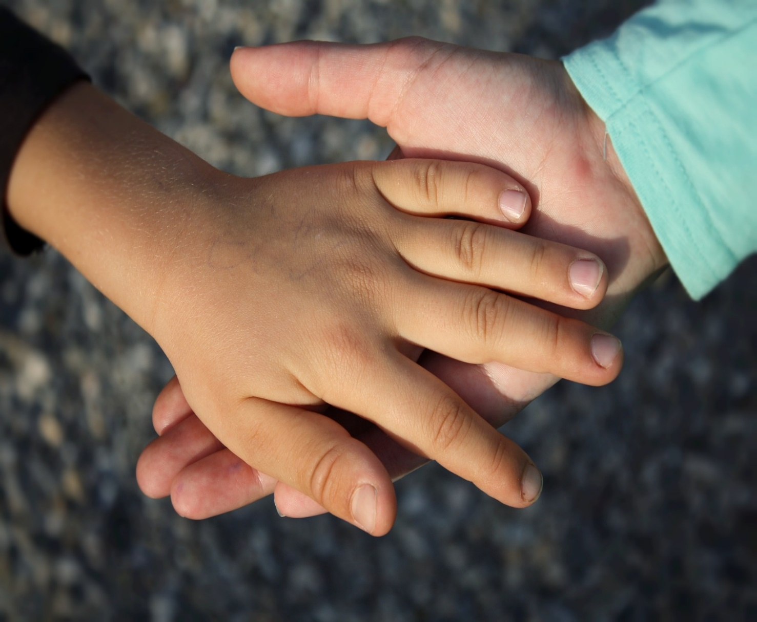
Questions
How does the school motto or mission statement celebrate this community?
How do we, as a community, reach out to others in their time of need?
How and where do we meet God in the community?
How do we show respect, love and care for all God has created and strive to keep each other safe?
16. A Journey in Love
– Year 2 –

Slide 17
Pause and reflect
Loving God,
We praise and thank you for the great generosity of so many people who volunteer their time, talents and skills to various communities in order to spread joy, hope, love, and improve the lives of others.
Amen

Slide 18
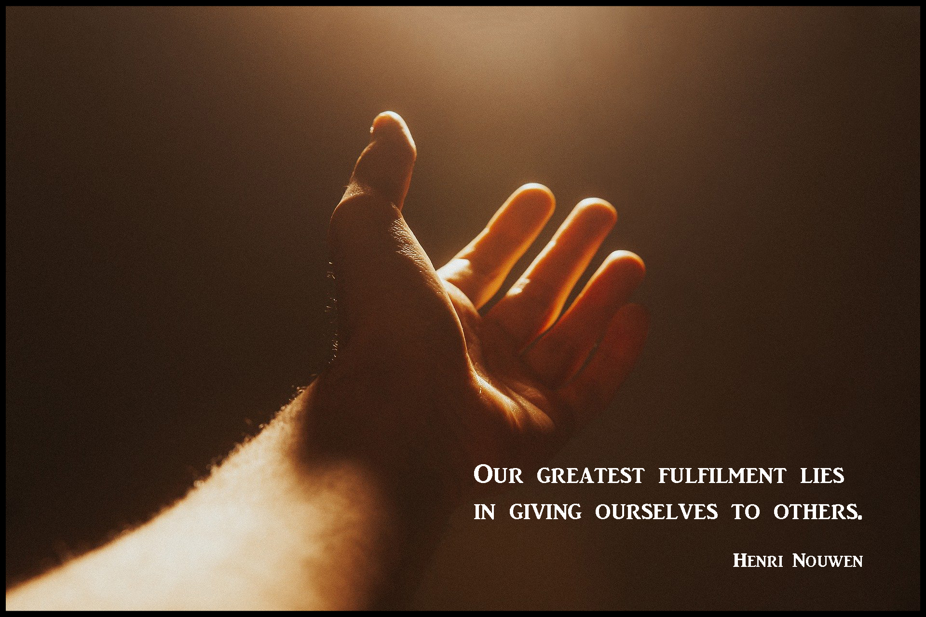
18. A Journey in Love
– Year 2 –

Slide 19
The love of God is always sowing love and making people grow.
Pope Francis
19. A Journey in Love
– Year 2 –

Slide 20
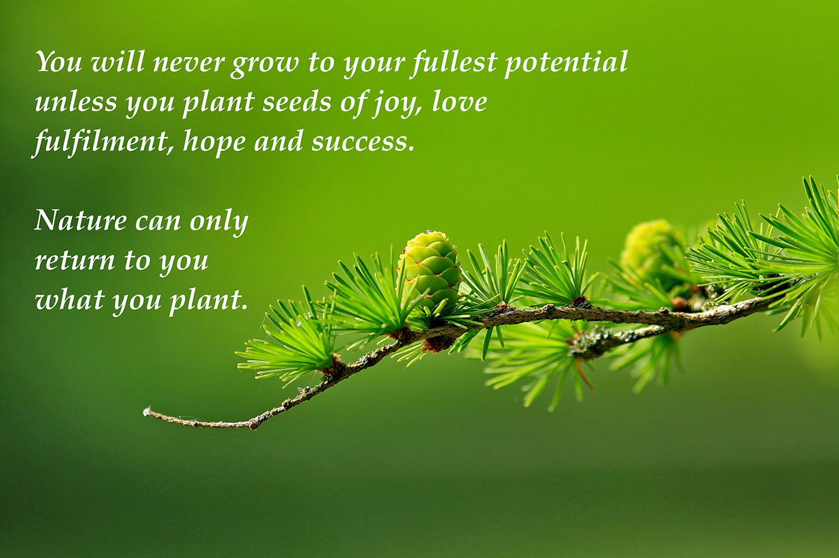
20. A Journey in Love
– Year 2 –

Slide 21
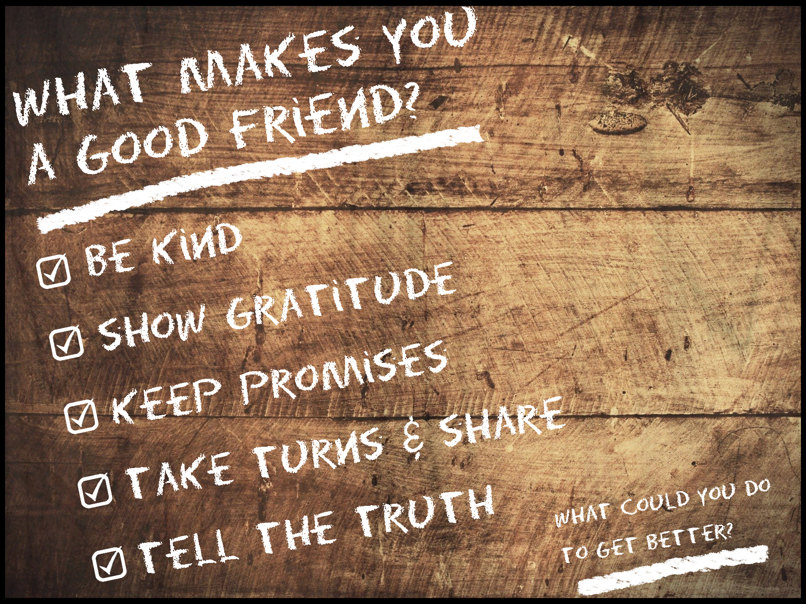
21. A Journey in Love
– Year 2 –

