Slide 1


Year 1
We meet God’s love in our family
1. A Journey in Love
– Year 1 –

Slide 2

IMPORTANT
Copyright and Terms and Conditions of use
By using this Powerpoint CD presentation you are agreeing to the following terms and conditions.
All images and text are copyright to the respective owners and can only be used and shown as a presentation within a classroom or other room or area within an educational establishment.
– All the files and images contained within this PowerPoint presentation are subject to copyright restrictions and cannot be duplicated, copied or shared as detailed on the CD and CD packaging (Unlawful duplication is prohibited by law).
– You must NOT share this Powerpoint presentation or any of the text and images by uploading them to a website on the Internet.
If you have purchased a Network Licence you may store the Powerpoint presentation on your Intranet.
– You must not change/alter or recreate the files in any way or form.
– If you do not comply with the terms of this licence you could be liable to legal action against you by the copyright holder and/or the agency that acts on their behalf.
This Powerpoint presentation is a simplified form of the
A Journey in Love book and should be used in conjunction with
this publication.
The book is available from www.mccrimmons.com
Published in United Kingdom in 2020 by
McCrimmon Publishing Co. Ltd.
sales@mccrimmons.com / www.mccrimmons.com
McCrimmon order ref: MB7863CD
Text © 2005/2006/2020 Sr Jude Groden and the following contributors.
﻿Dr Sathi Aiya / Ilse Brockling / Fr David Clemens
Sarah Feist / Shaun Kelliher / Patrick Harrison.
Narrative text: Sr Jude Groden.
Powerpoint construction and design by Éanna McAteer
I have read the Terms and Conditions above…
Acknowledgements
Most of the mages used in this Powerpoint presentation are from www.pixabay.com Pixabay are an online (free to use for commercial use) image library.
Other image credits
Slide 5 & 6 netclipart.com
Slide 7 maxpixel.net
Slide 23 EMcMedia
CONTINUE

Slide 3

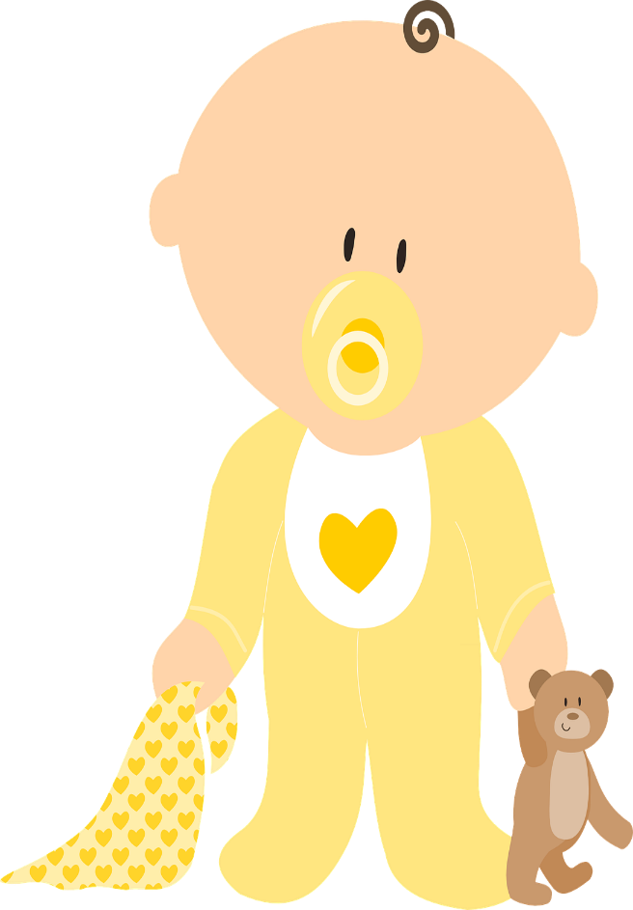
Aim
To focus on families and specially growing up in a loving, secure and stable home.
3. A Journey in Love
– Year 1 –

Slide 4


Year One
unique
stable
boundaries
friend
important
kindness
respect
different
teasing
secure
special
bullying
truth
God
signs
positive
lies
love
healthy
negative
care
safe
wrong
Key words continued…
commitment
unacceptable
4. A Journey in Love
– Year 1 –

Slide 5
Year One
head
shoulders
penis
eyes
arms
bottom
nose
breasts
anus
mouth
nipple
legs
teeth
waist
knees
tongue
elbows
ankles
throat
vagina
feet
neck
vulva
toes
5. A Journey in Love
– Year 1 –

Slide 6

Year One
respecting
listening
celebrating
observing
deciding
Skills
relating
supporting
speaking
understanding
recognising
reflecting
praying
6. A Journey in Love
– Year 1 –

Slide 7
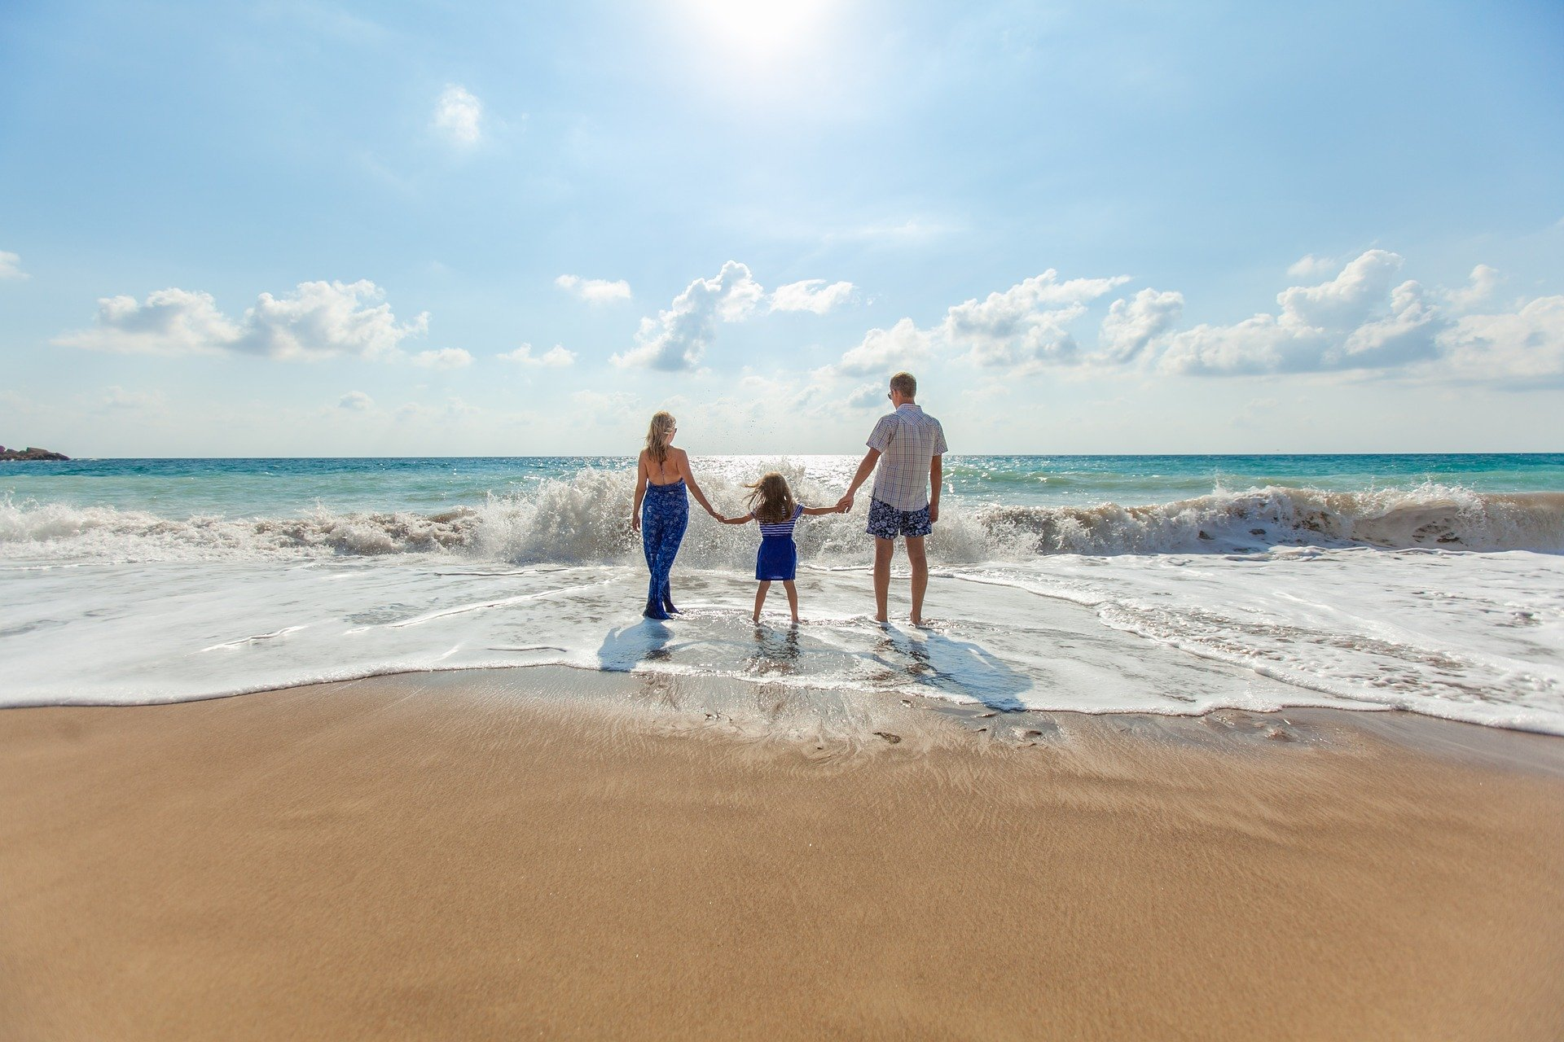
Social and Emotional
Year One
Learning intention
To recognise signs that I am loved in my family.
7. A Journey in Love
– Year 1 –

Slide 8
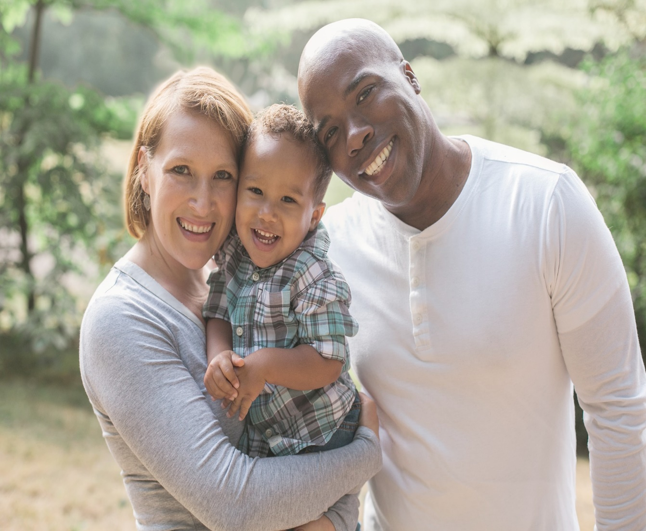
Questions [1]
How is love shown in your family?
Why are the words ‘please’, ‘thank you’, and ‘sorry’ important to create a happy family?
How does saying ‘please’ show care and consideration for members of your family?
Questions Continued on next page >>>
8. A Journey in Love
– Year 1 –

Slide 9
Questions [2]
How does saying ‘thank you’ show love for each other?
How does saying ‘sorry’ show respect, build bridges, keep us safe and help us to build a happy family and mend broken friendships?
Why is teasing and bullying wrong and unacceptable within families and friendships?
Why should we always tell the truth?
9. A Journey in Love
– Year 1 –

Slide 10
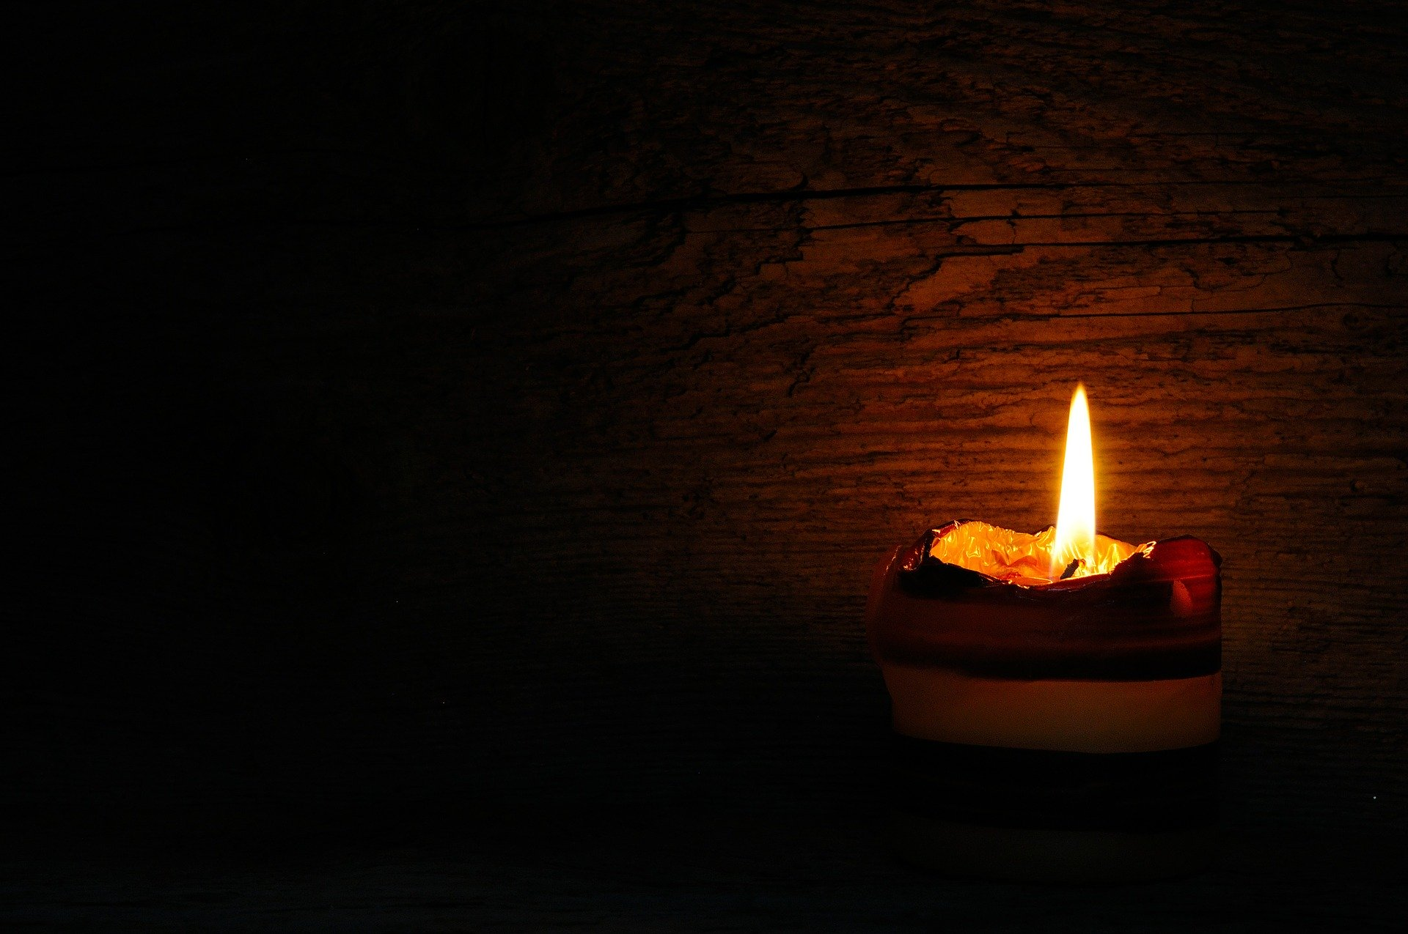
Pause and reflect
﻿We praise God as we make the Sign of the Cross.
“In the name of the Father,
and of the Son and of the Holy Spirit.
Amen”
Light a candle to remind us that Jesus is with us and loves us.
Each one shares some signs of love experienced.

Slide 11
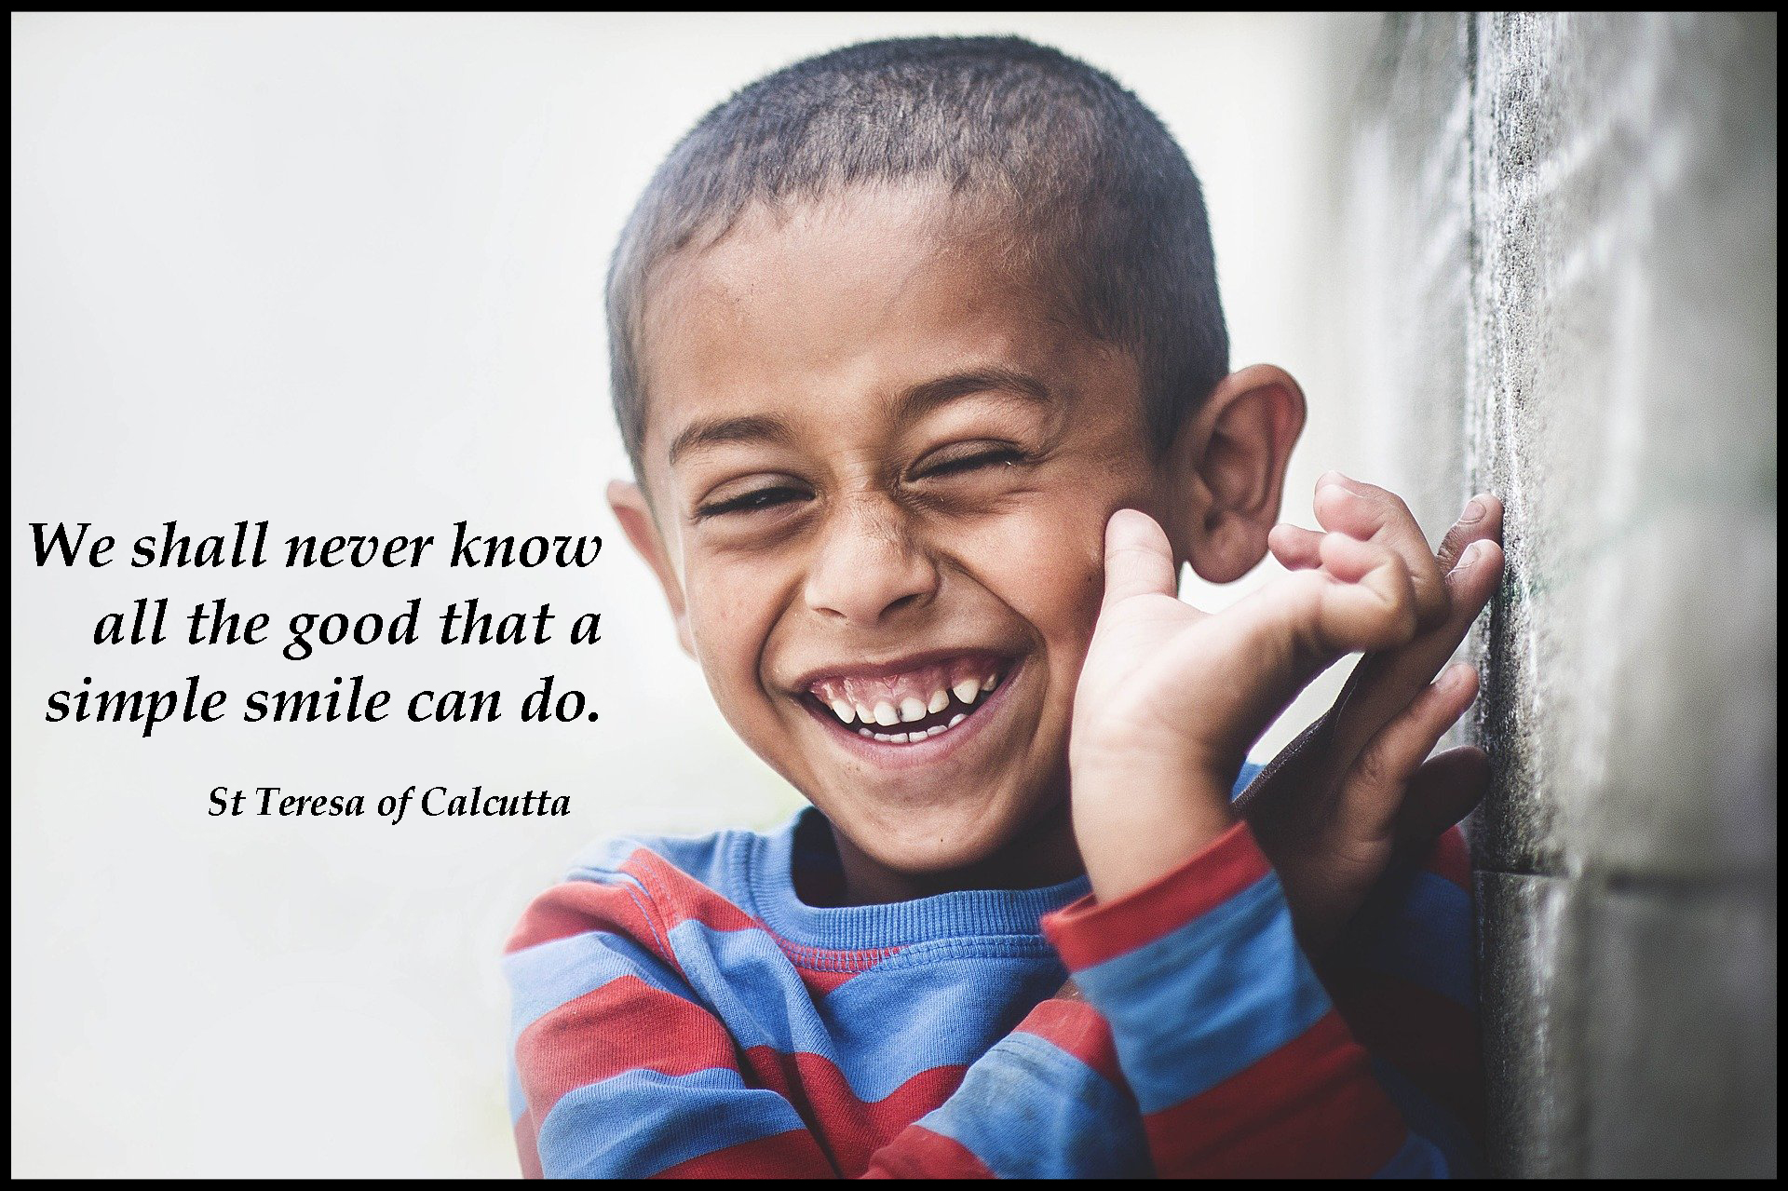
11. A Journey in Love
– Year 1 –

Slide 12
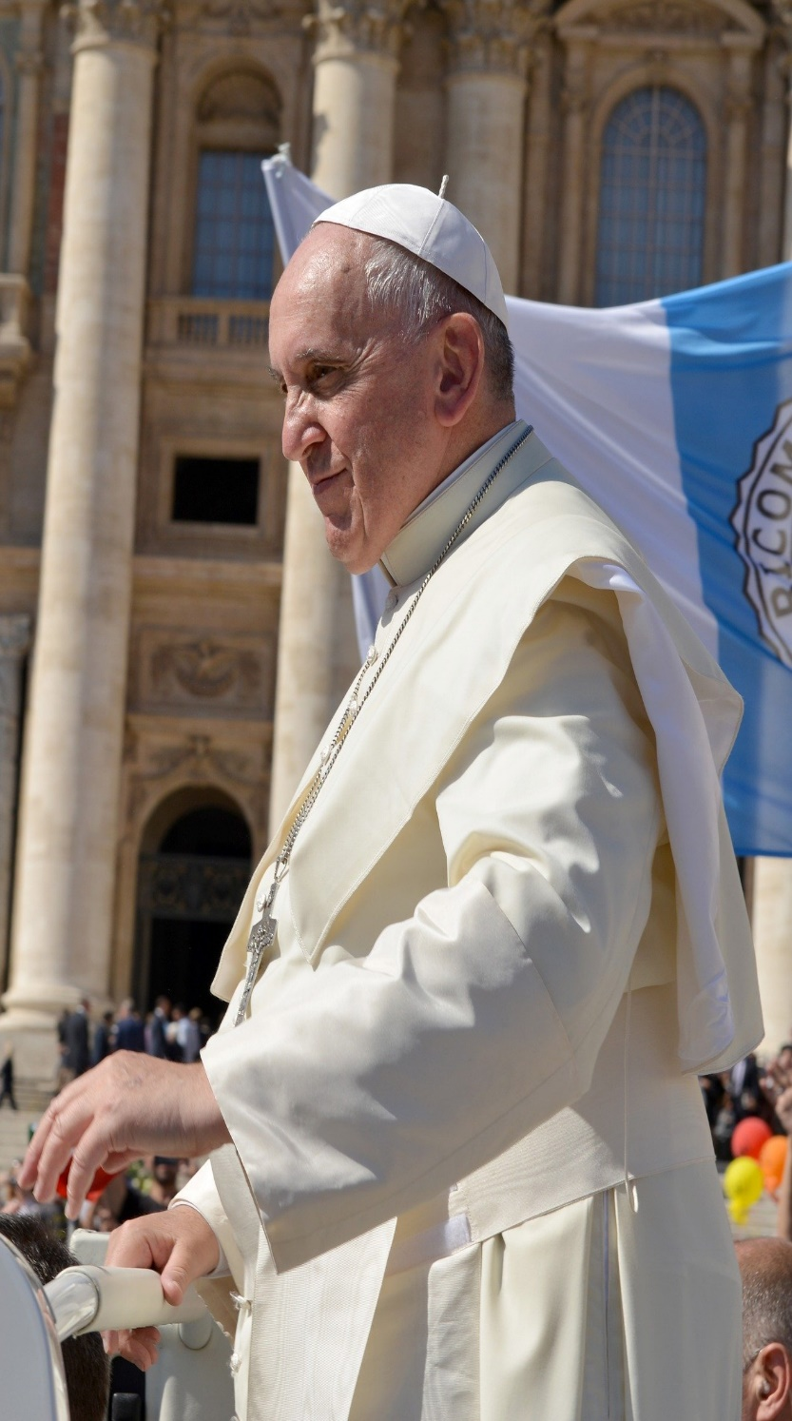
“There is no such thing as the perfect family.
Only by the daily exercise of forgiveness can the family grow.”
Pope Francis
12. A Journey in Love
– Year 1 –

Slide 13
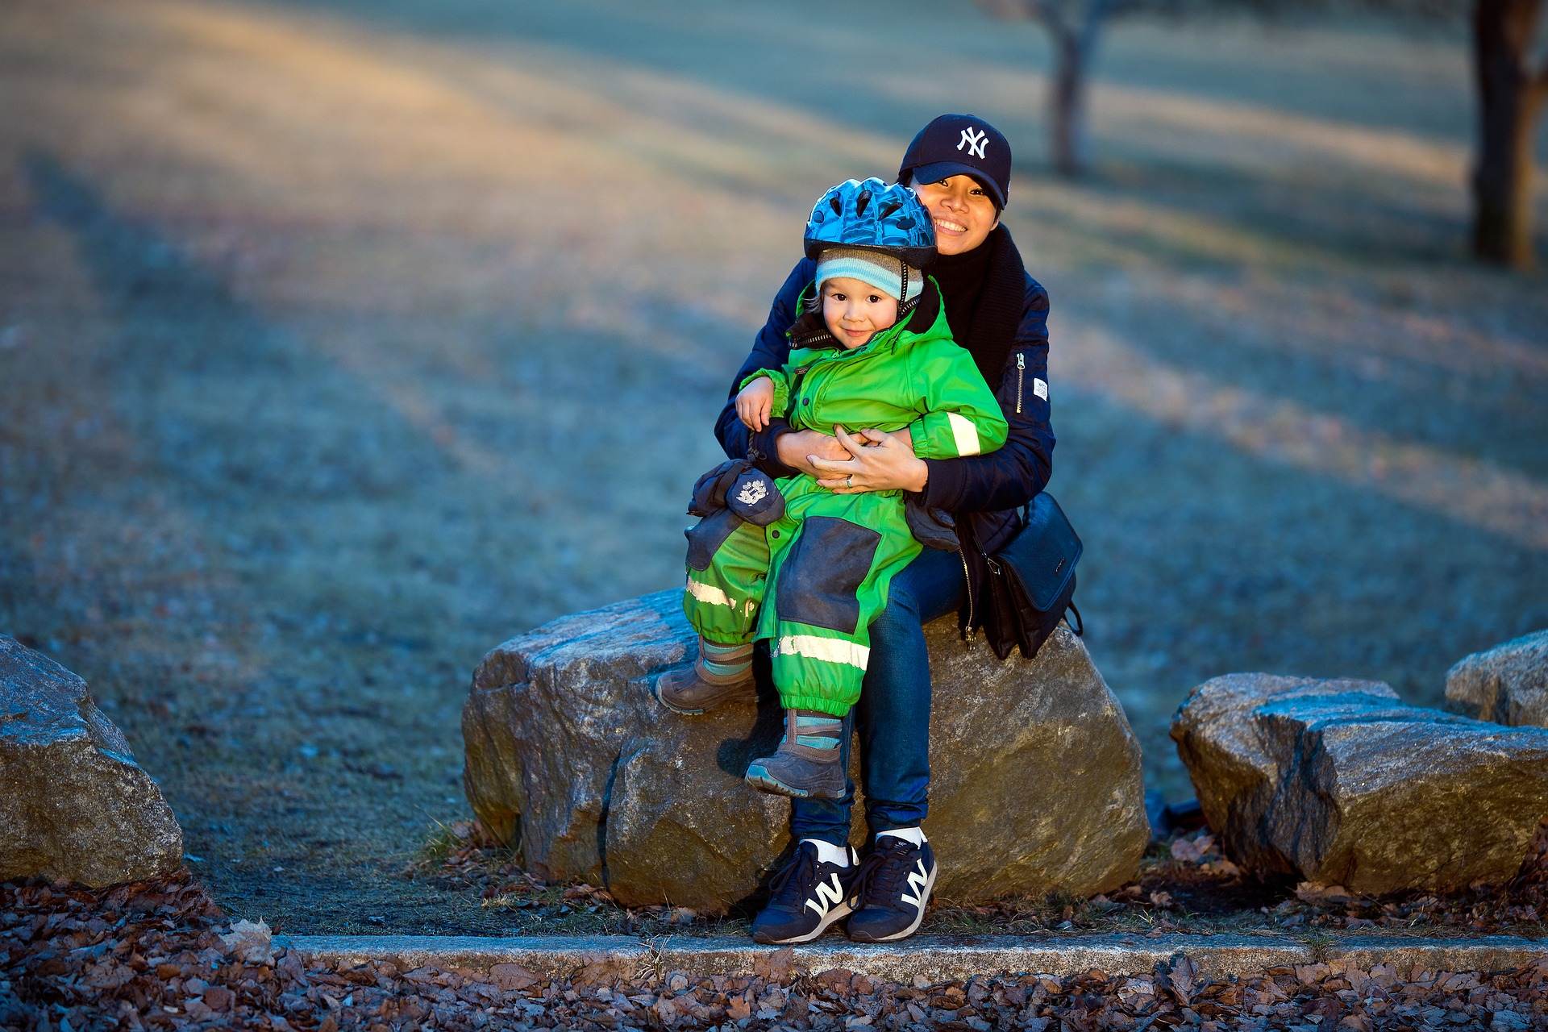
Physical
Learning intention
To rec
ognise how I am cared for and kept safe in my family.
13. A Journey in Love
– Year 1 –

Slide 14
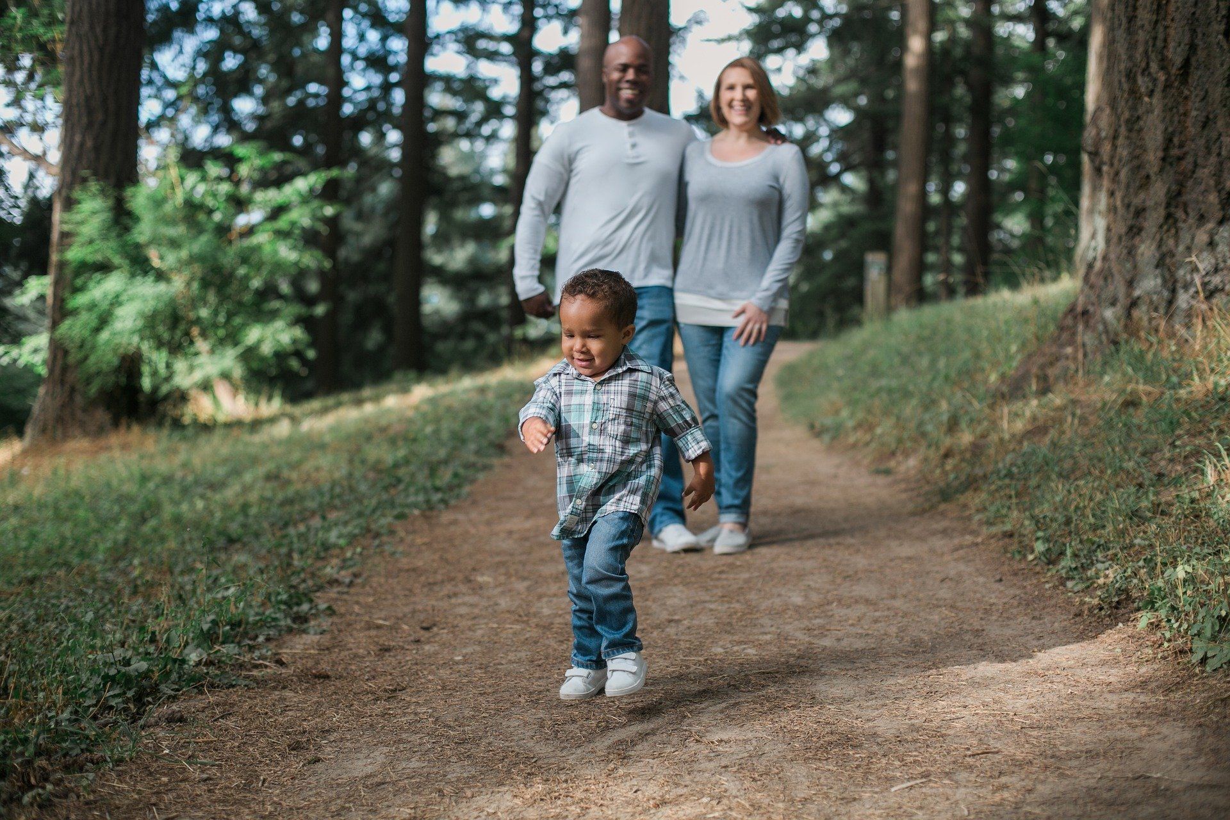
Questions
Who is in my family?
How do families show love and care for one another ?
What are some of the characteristics of a happy family?
How do we act with adults that are not in our family or those we do not know?
In what ways are we made in the image and likeness of God?
How does your family help you to keep healthy?
Include physical, mental and spiritual health.
Include taking care not to spread diseases e.g. washing hands, coughs and sneezing etc.
14. A Journey in Love
– Year 1 –

Slide 15
Pause and reflect
Loving Father,
thank you for my mum, dad, brothers and sisters and all who love and care for me. You love me so much that you have my name carved on the palm of your hand.
Amen
Isaiah 49:16

Slide 16
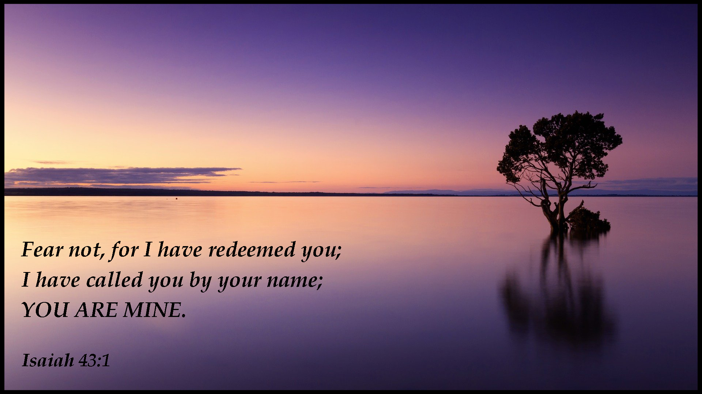
16. A Journey in Love
– Year 1 –

Slide 17
“Protect your families.
Be sanctuaries of respect
for life.”
Pope Francis
17. A Journey in Love
– Year 1 –

Slide 18
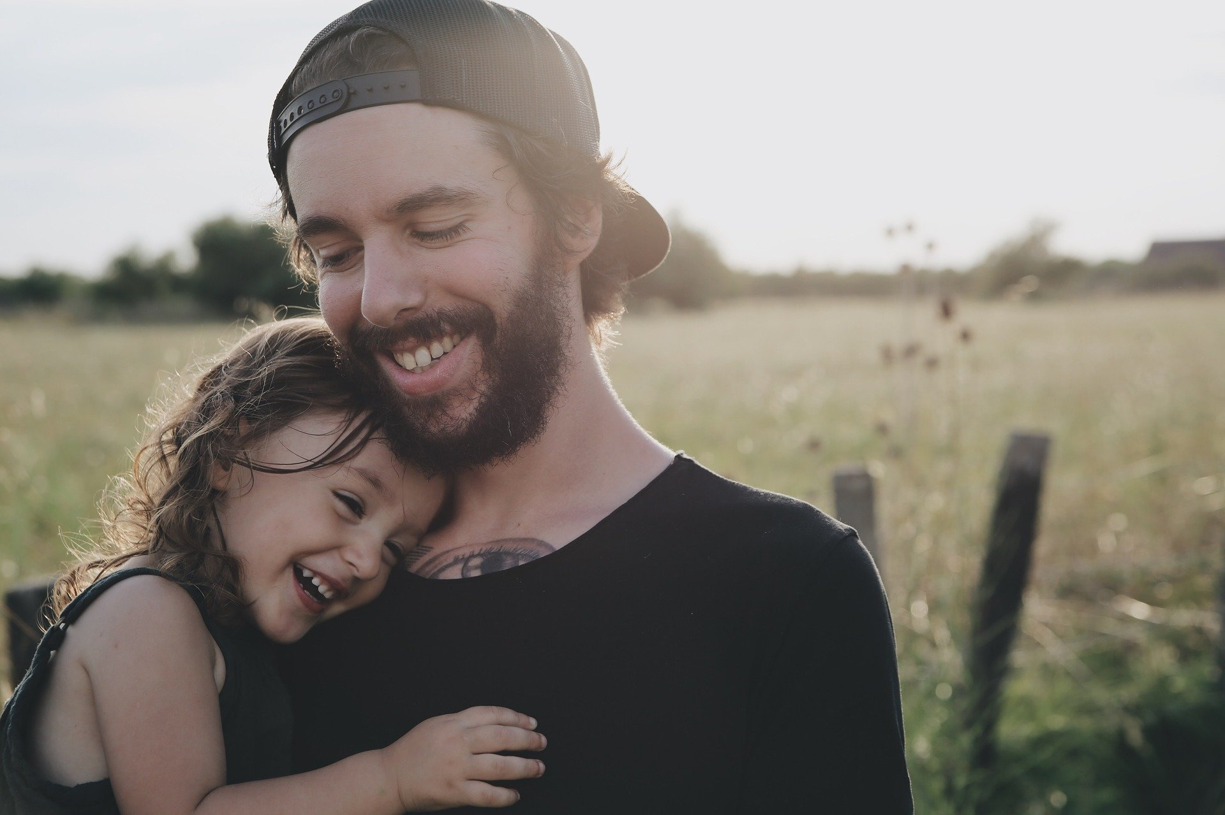
Spiritual
Learning intention
To celebrate ways the God loves and cares for us.
18. A Journey in Love
– Year 1 –

Slide 19

Questions
What ways have we grown in love and security in our families?
How have we shown love to our families this year?
How do we know that we are loved and cared for by God?
In the story of the Lost Sheep how does God show he loves and cares for each and all of us, in our families and school community?
How shall we thank God for his unconditional love?
19. A Journey in Love
– Year 1 –

Slide 20
Pause and reflect
﻿“In the name of the Father,
and of the Son
and of the Holy Spirit.
Amen”
Assemble in a circle around a focus with a candle and a cross.
When all are quiet, light the candle to welcome ‘Jesus the Light of the World’.
Pray each ‘litany of thanksgiving’ and at the end of each all say:
“Bless (Name) and his/her family.”

Slide 21
“ ‘Please,’
‘thank you,’
and ‘sorry’
are words that open up
the
road
to a good
family
life.”
Pope Francis
21. A Journey in Love
– Year 1 –

Slide 22
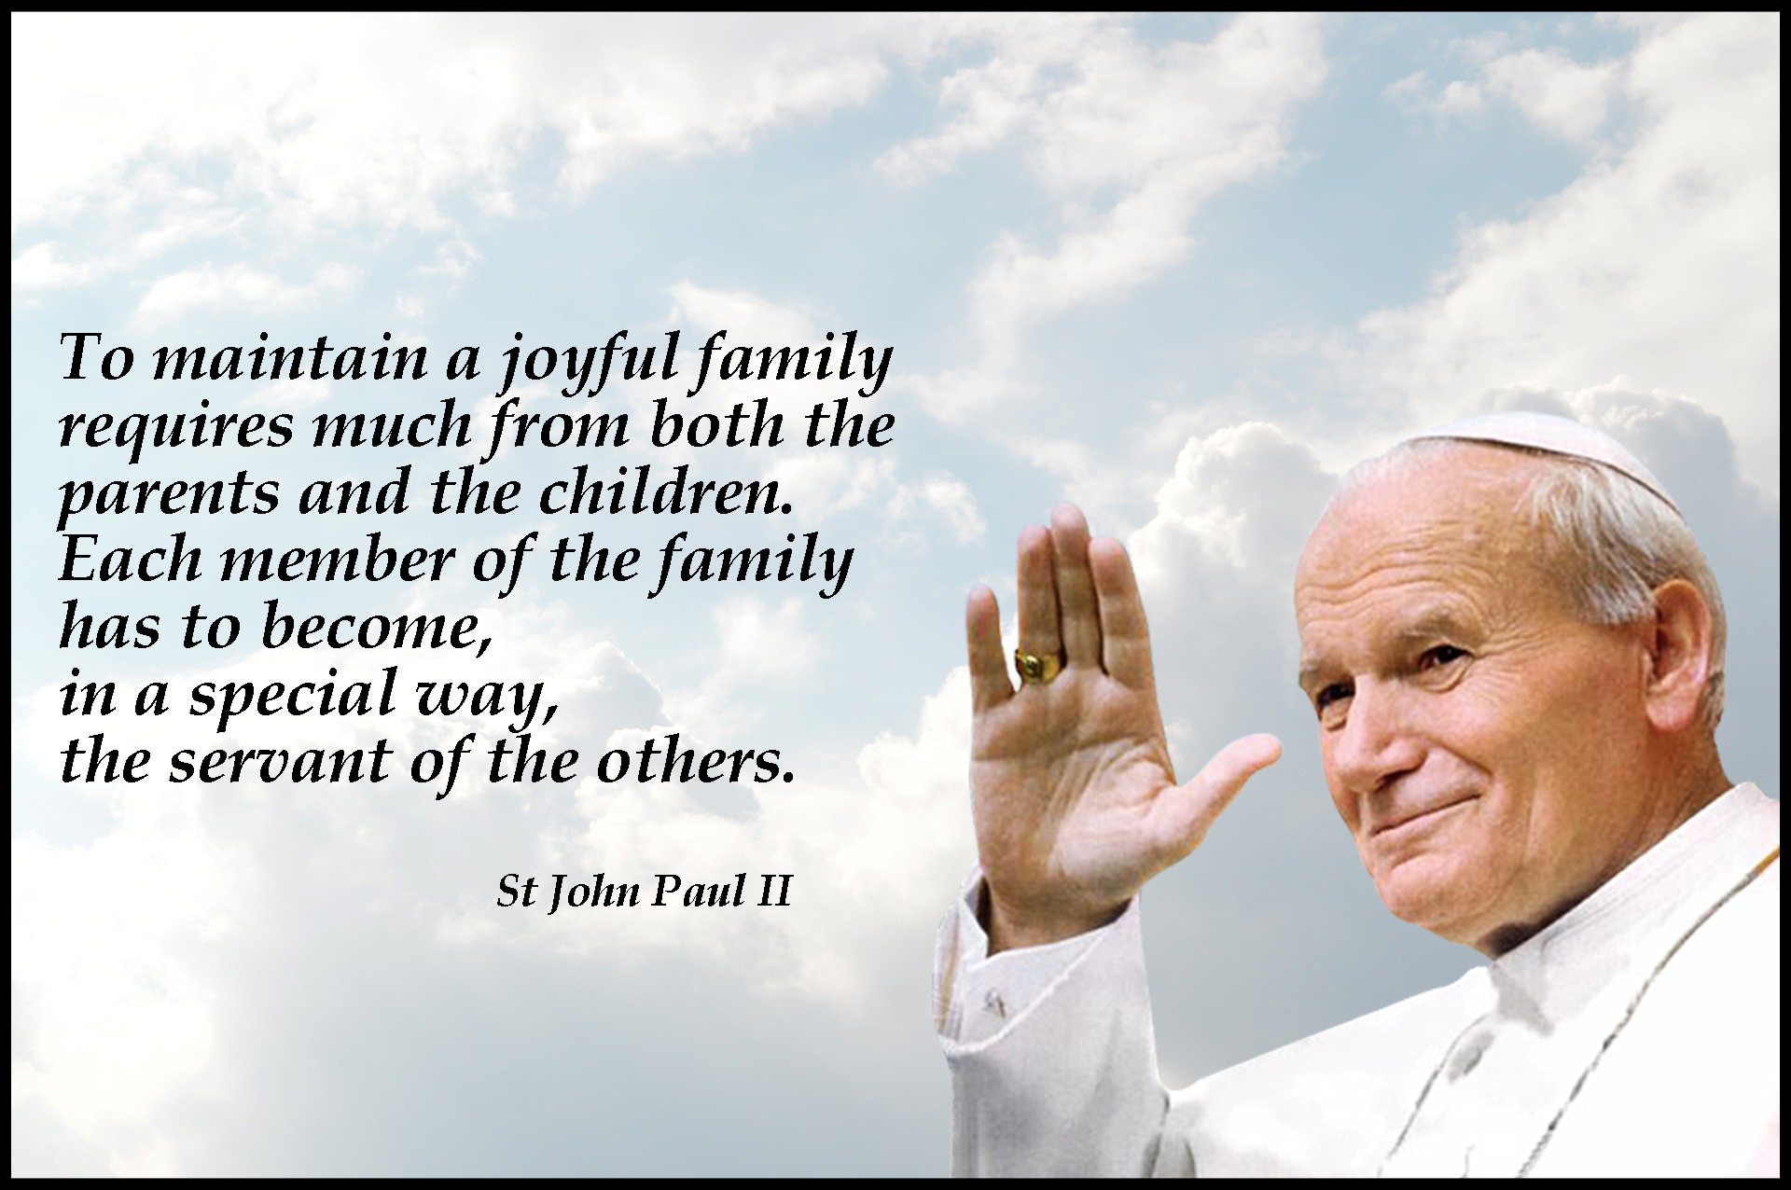
22. A Journey in Love
– Year 1 –

Slide 23
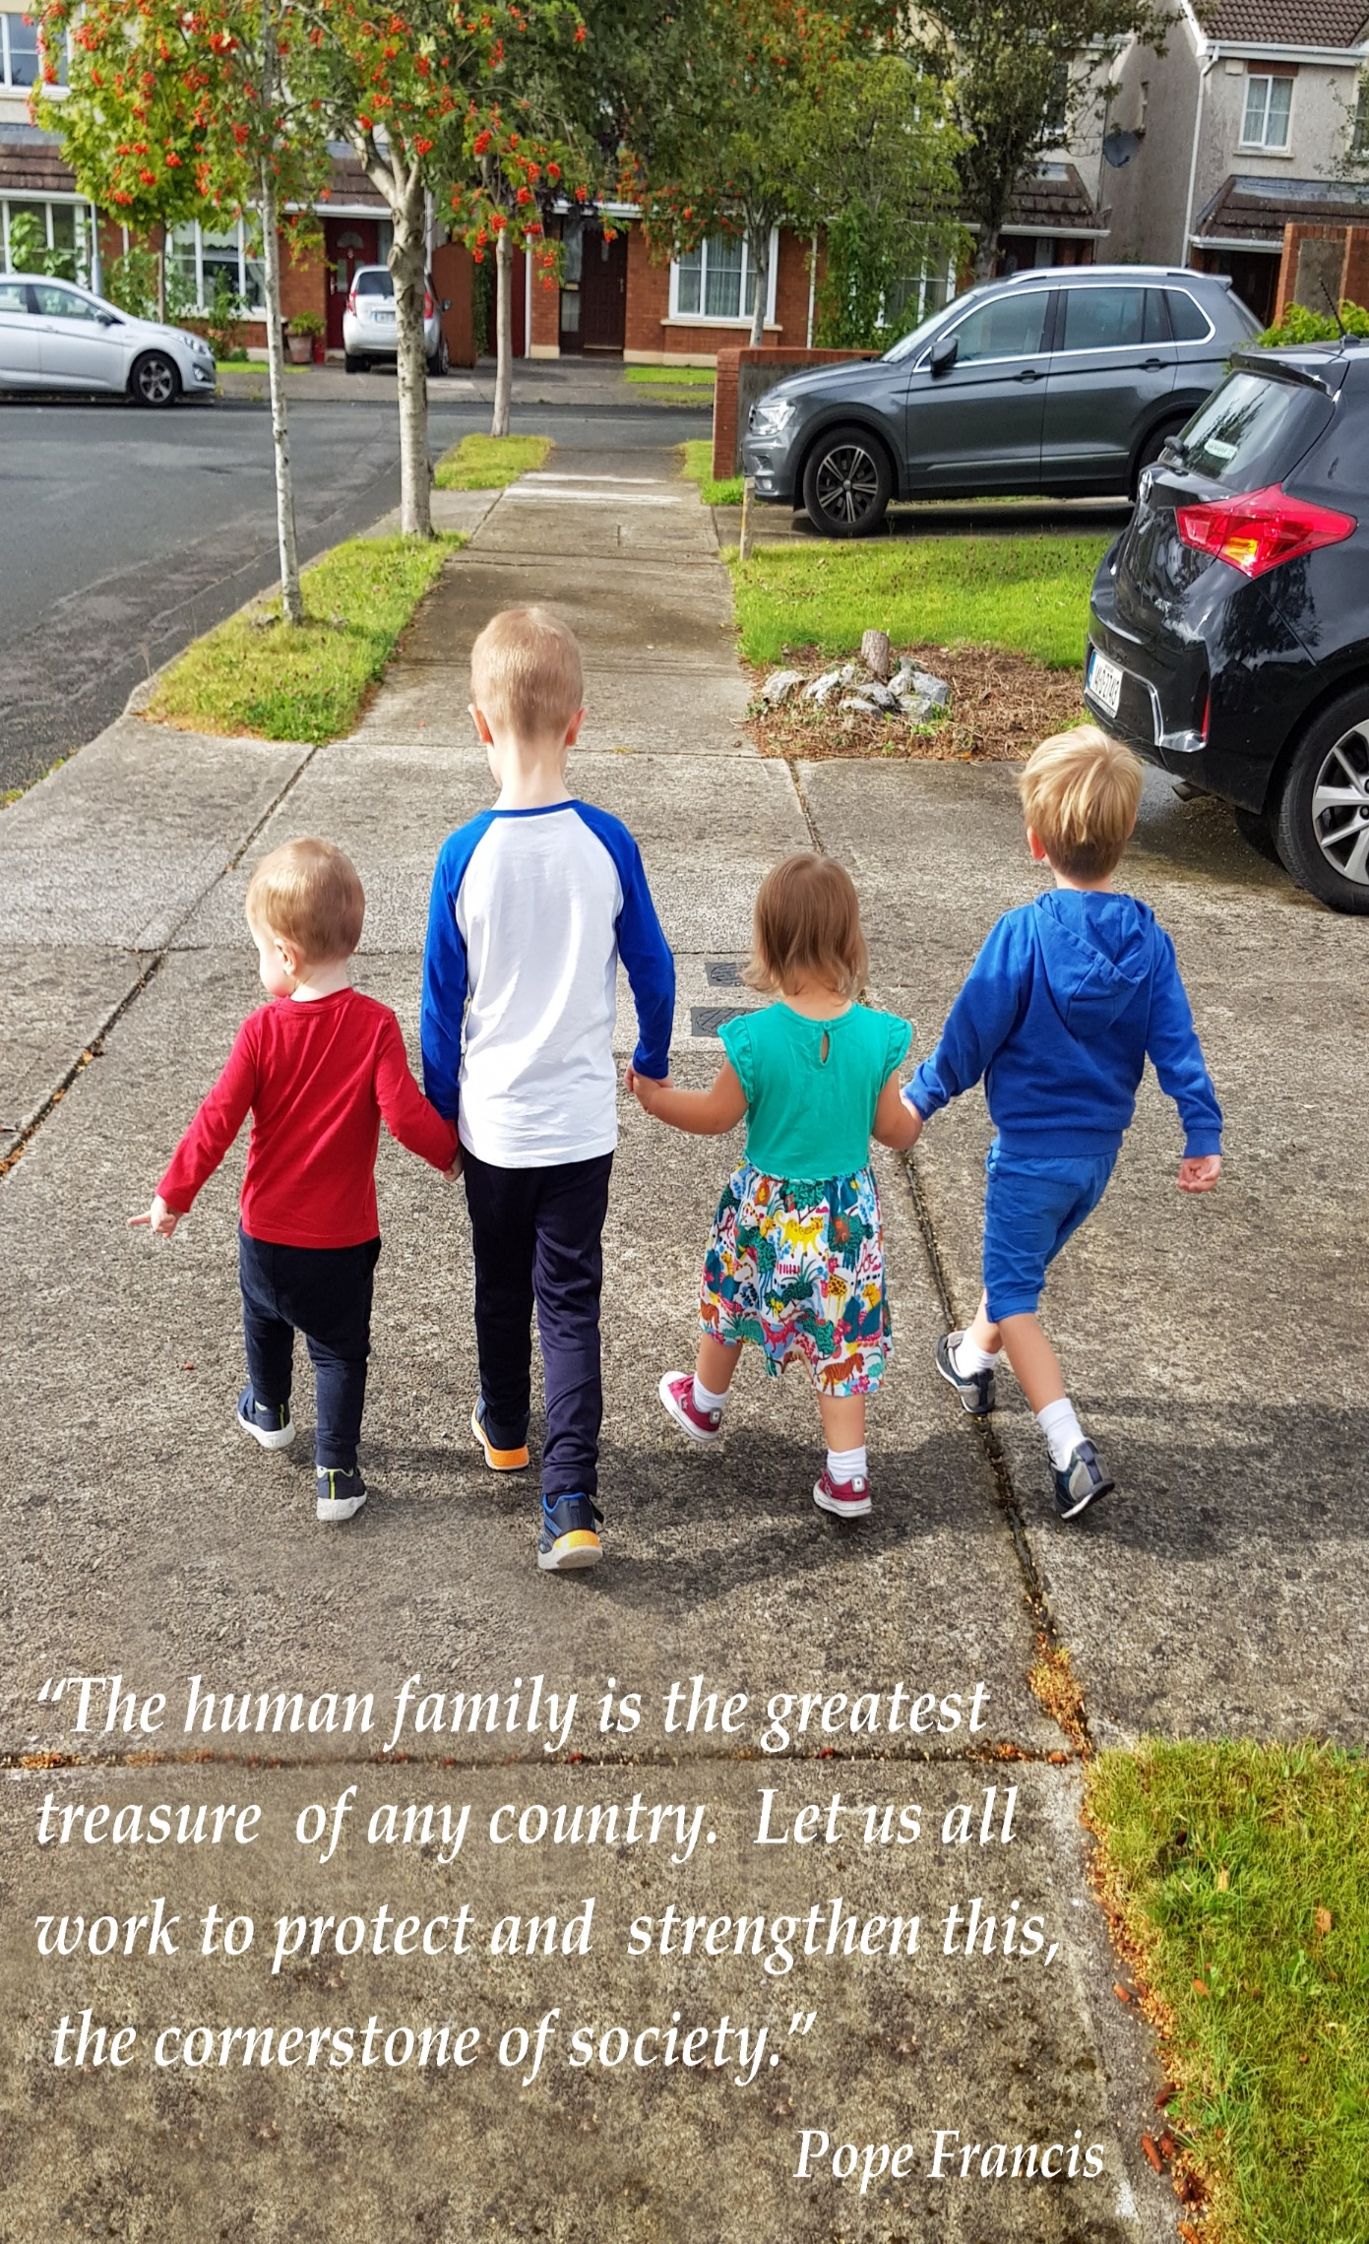
23. A Journey in Love
– Year 1 –

