Slide 1




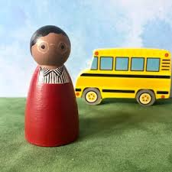
Year 5 Parks

Slide 2

Class Teacher
Miss Owens
Teaching Assistants
Mrs French (mornings)
Ms Brown (Y5 shared)

Slide 3

My background
Teacher for 16 years
Previous SENCo role
Art specialist
Loves all things purple and/or sparkly
Mummy to Edith and Noodle the cat
Positive, fair and reflective ☺

Slide 4
Vision for the year ☺
For EVERYONE to:
Be the best learners that they can be with increasing independence
Secure key skills within a broad and rich curriculum
Grow spiritually, physically, morally and intellectually.
Notes:
Introduction – my background and current role

Slide 5
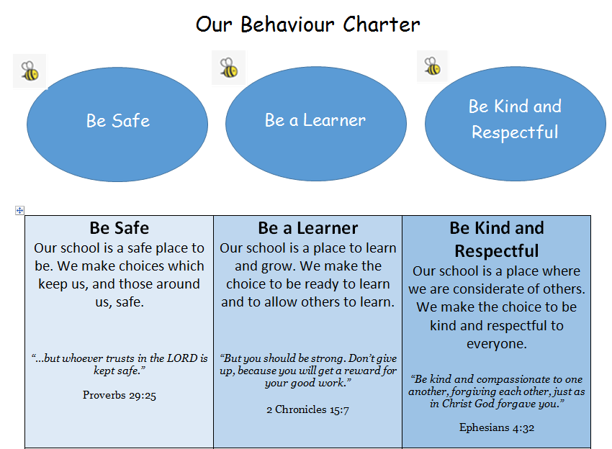


Behaviour charter
Notes:
Introduction – my background and current role

Slide 6
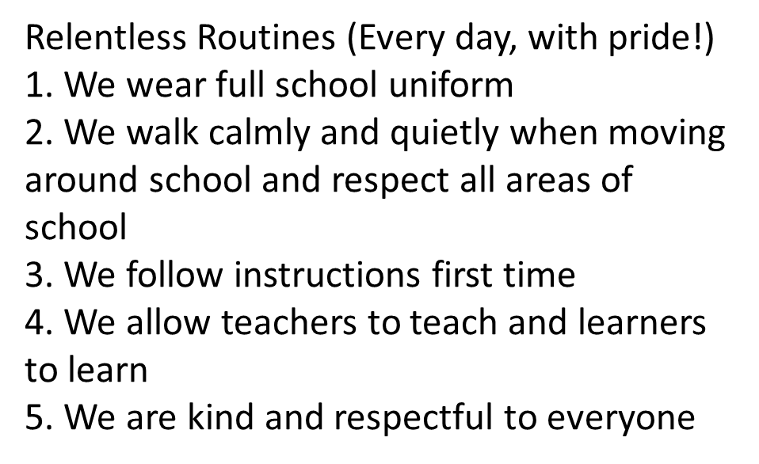
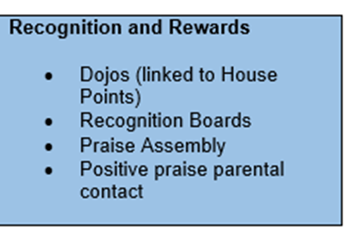

Slide 7
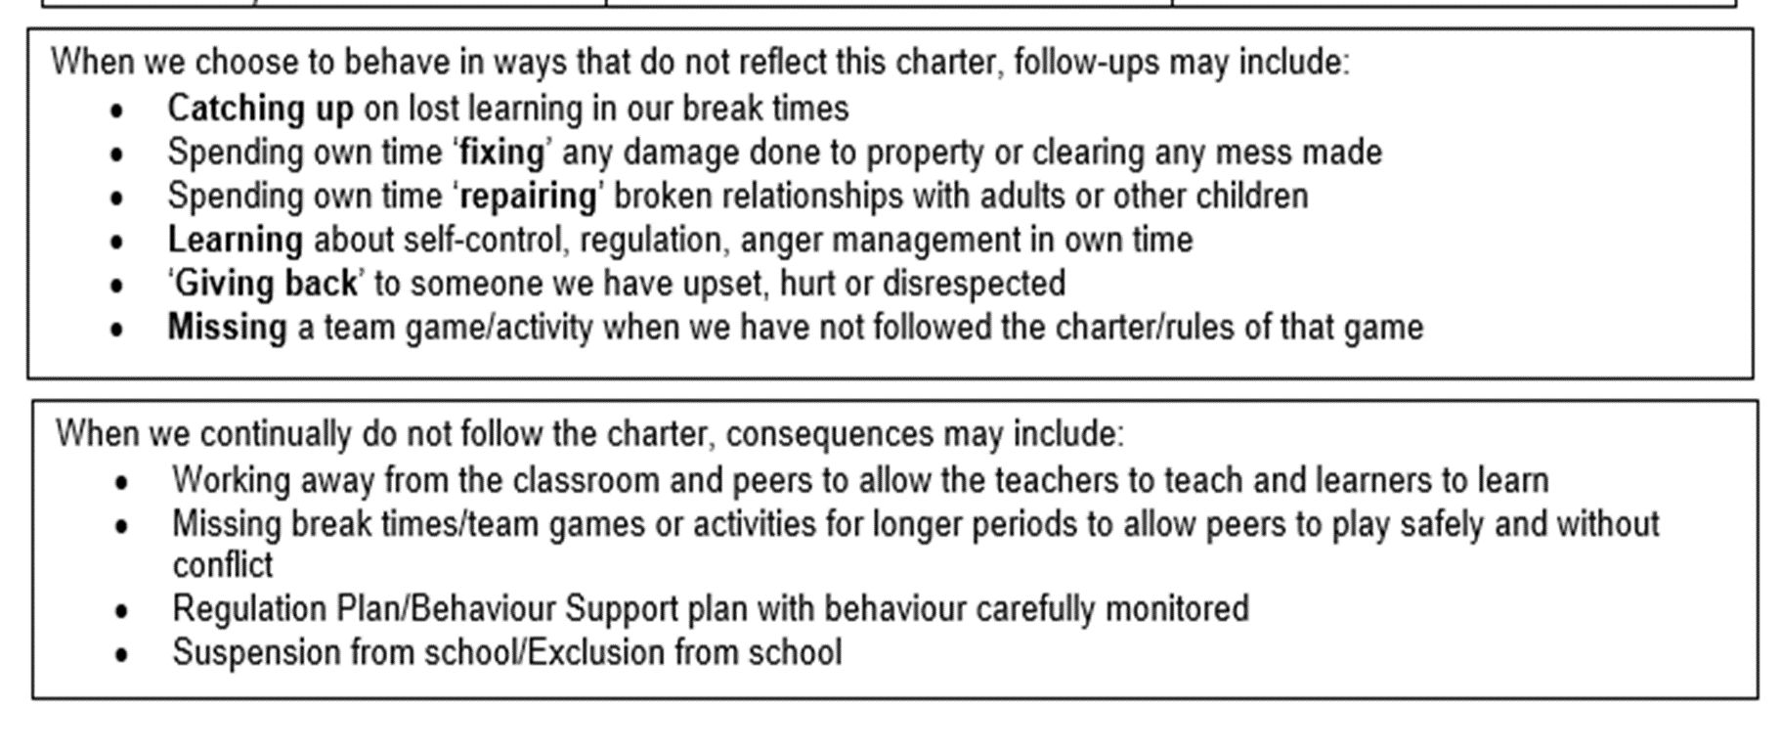

Slide 8
Earrings
Safe Practice in PE states that, ‘The Association for Physical Education strongly recommends the practice of removing all personal effects at the commencement of every lesson to establish a safe working environment. This applies to all ear and body piercings.’
The teacher has duty of care for the safety of children.
Staff can not remove or tape (cover) earrings.
Many children can not remove earrings themselves.
Children can only participate in parts of the lesson if earrings are worn.
School can not be held responsible for losses of removed earrings.
The earrings worn in the past were becoming more and more unsuitable and unsafe as people deviated away from the single plain stud.
For these reasons, earrings are not allowed in school.

Slide 9
Timetable in brief
English / Maths – Daily, Monday to Friday
Science x 1 a week
Computing x 1 a week
P.E x 2 lessons a week
Geography/History half termly
Art /Design Technology half termly
French x1 a week
Religious Education – timetabled for two and half hours every week.
Physical Education – children must have their correct P.E kit in school every day. PE is on a Friday this half term and may change throughout the year. Swimming is our 2nd PE lesson.

Slide 10
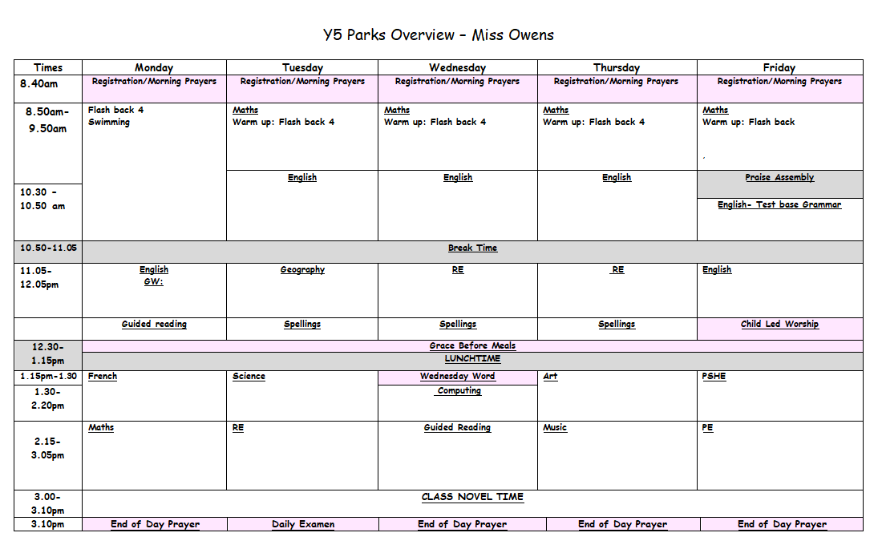

Slide 11
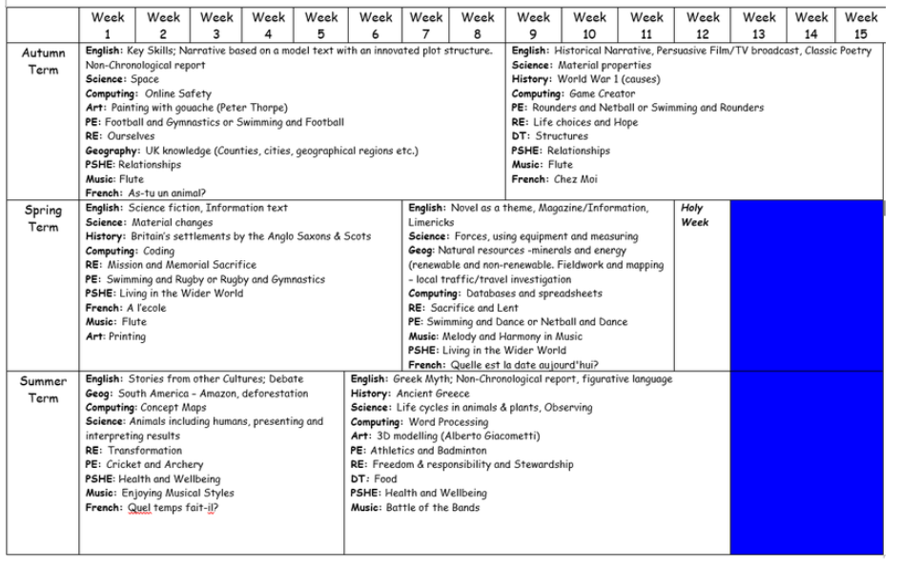

Slide 12
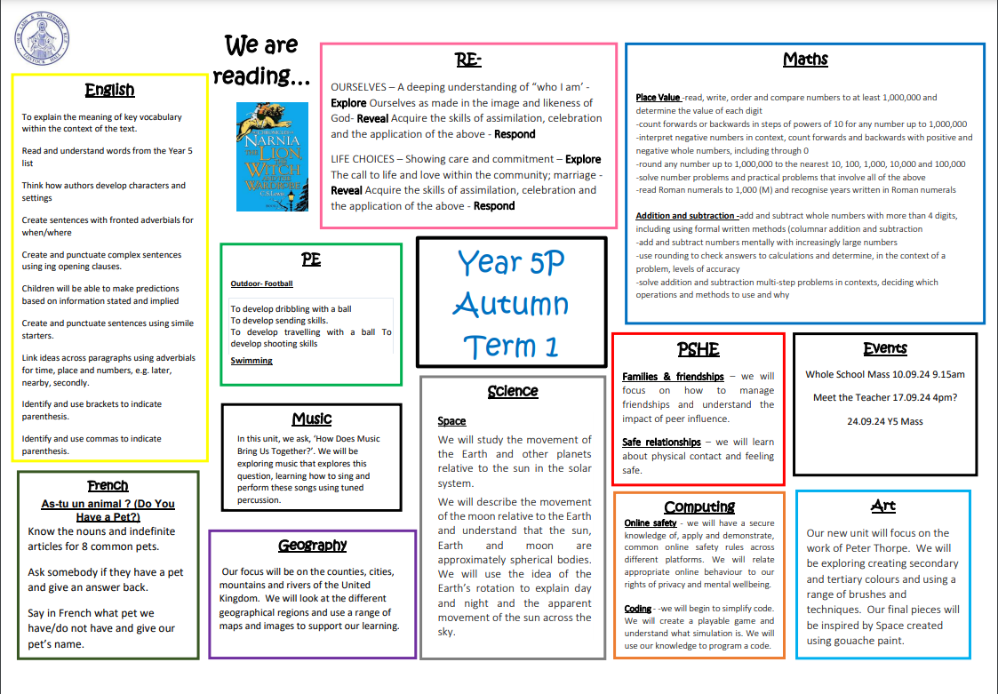

Slide 13




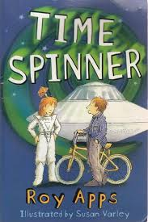

English Curriculum
We are really proud of our English curriculum. We use a range of texts, both fiction, non-fiction and poetry within our units. Our chosen texts are age-appropriate, exciting and diverse.
More information about the key skills that we cover within our lessons can be found on our curriculum map each half term.

Slide 14

Reading
There are many reading opportunities every day in Year 5 which include:
  Home reading
  Reading for pleasure
  Guided reading
  Class novel (Daily)
  In Year 5 we are developing stamina as a reader and accessing a wide range of authors and texts.
  Regular reading helps to develop vocabulary, improve spellings and the ability to read at pace and with understanding.

Slide 15
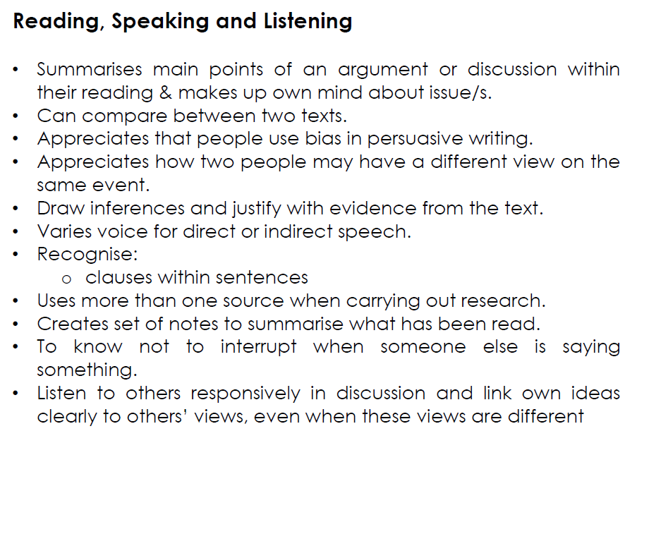
End of year expectations Y5
Reading, speaking and listening

Slide 16
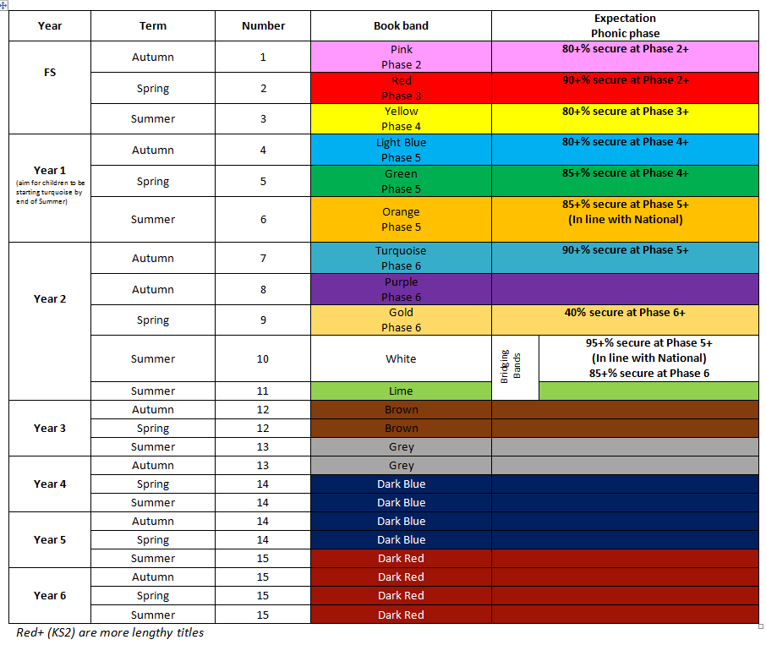

Slide 17

Writing
In Year 5, we write every day :
In English, we teach:
    A range of genres (fiction / non-fiction/poetry)
    Grammar, punctuation, spelling (GPS)
    Handwriting
  Writing across the curriculum
    Science, Geography, RE, History
  Handwriting – all handwriting should be joined and legible

Slide 18
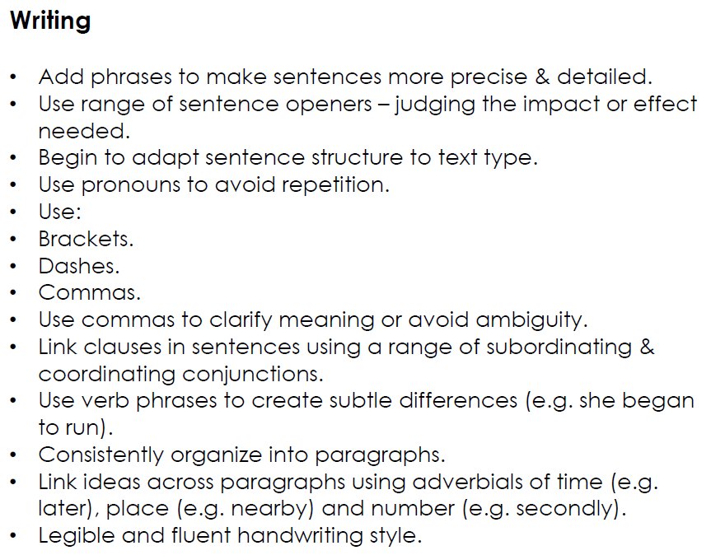
End of year expectations Y5

Slide 19
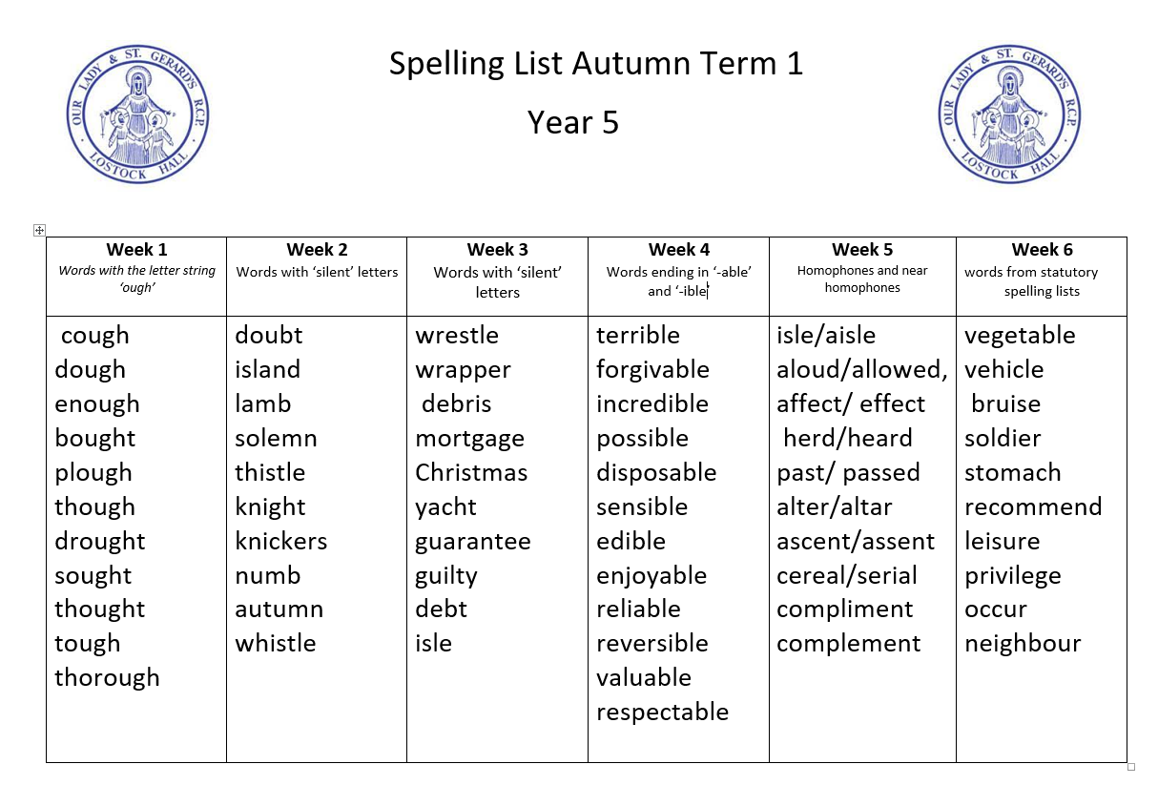
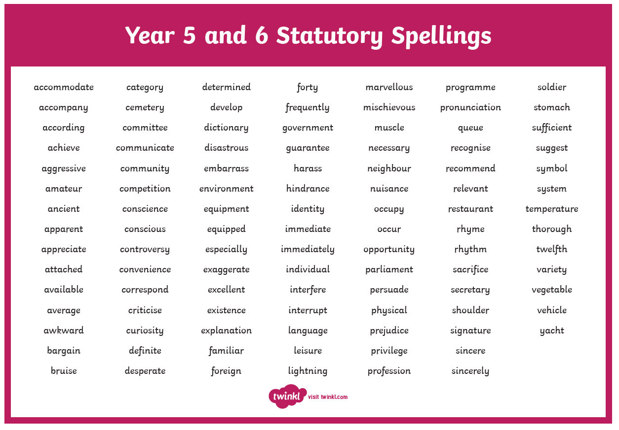
Spelling
We focus on a different spelling rule each week, following the No Nonsense Spelling scheme
Children should learn the Year 5/6 spelling list at home.
Spellings lists will be shared on class dojo at the beginning of each term. This is for your reference and the children will NOT be tested weekly.

Slide 20
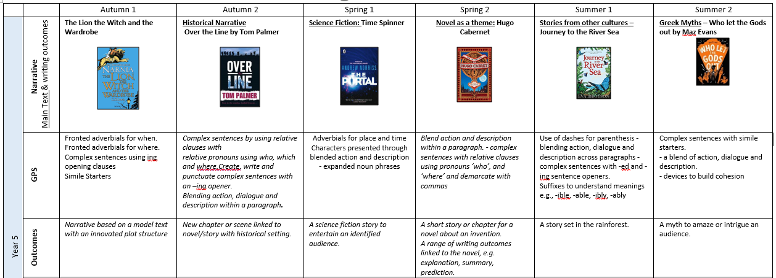

Slide 21
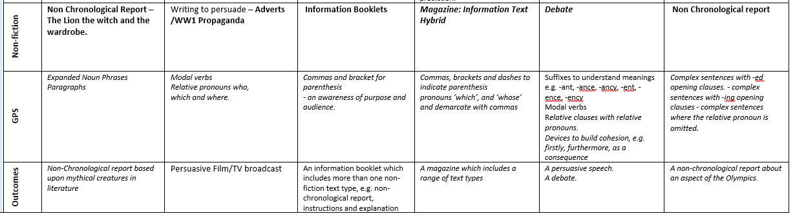

Slide 22

Maths
We follow the White Rose scheme of work which uses a range of strategies in Year 5:
  Mental methods – the ability to recall and calculate at pace
  Written methods – we practise the formal written methods followed in our Calculations Policy
  Problem solving / Reasoning – the children will be challenged in every lesson to use their Maths skills and apply them to a range of contexts
Times tables facts- It is important that everyone knows their times table facts up to 12 x 12. (Please note that by the end of year 4, children should know their multiplication and associated division facts up to 12x12. )
  The children have the White Rose work books in school and use jotters alongside these for any working out or extra calculations.

Slide 23
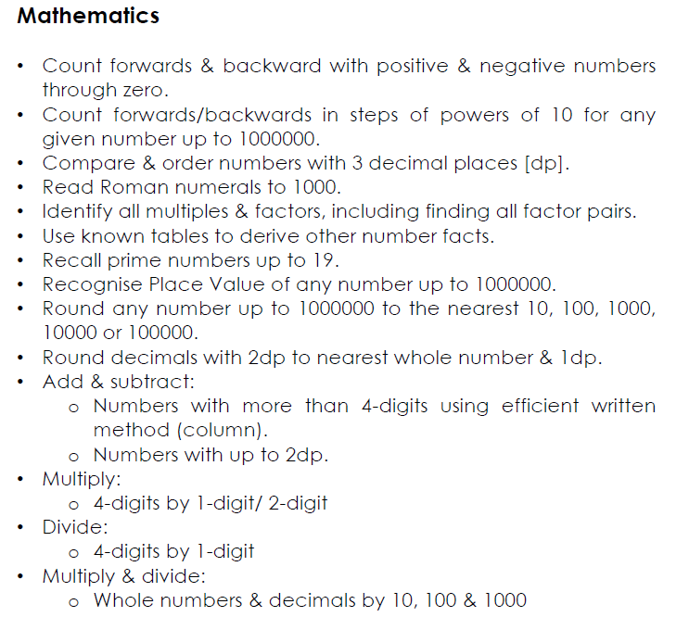
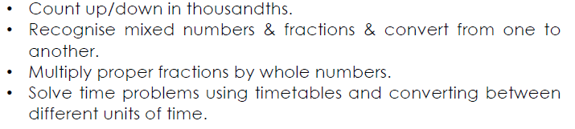
Maths
End of year expectations Y5

Slide 24

White Rose have also produced Practice Journals which are fully aligned to the curriculum we follow in school. These may be useful as an additional resource to use at home – these are not compulsory but are great for extra consolidation. They can be purchased from Amazon for £4.99

Slide 25

RE
Autumn Term
    Ourselves
    Life choices
    Hope
Spring Term
    Mission
    Memorial sacrifice
    Sacrifice
Summer Term
    Transformation
    Freedom and responsibility
    Stewardship

Slide 26
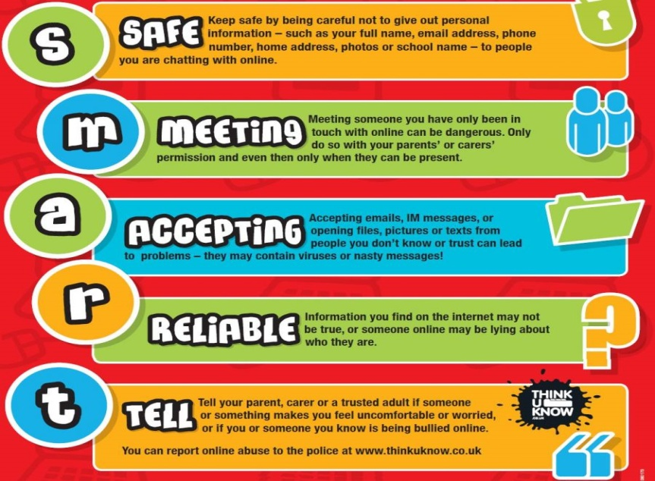
Online Safety
Taught in the Autumn term and revisited regularly
throughout the year.
We follow the SMART e-safety rules.
In Year 5, our focus is on:
the use of age appropriate websites including social media;
not sharing personal information online;
knowing what to do if something worries or upsets them online.
As a school, we teach our children how to use the internet responsibly.

Slide 27
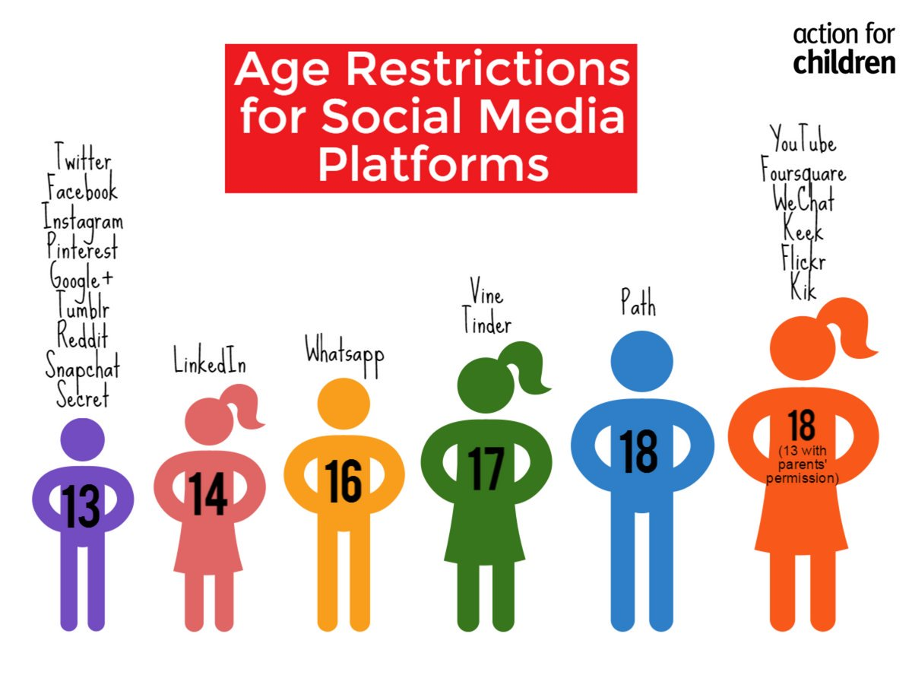

Slide 28

Homework
Reading daily but at least 3 times a week with their school book. Ticked to say when read and a comment/signature when finished.
Maths and/or English set weekly on purple mash.
Occasionally, class teachers may ask children to complete a research piece of homework or a creative activity linked to the wider curriculum.

Slide 29

Year 5 residential
On Tuesday 12th November at 5pm there will be a parents meeting about the upcoming residential.
Our residential is booked for Monday 25th November- Wednesday 27th November.

Slide 30


Working together
  We would like to thank you for your continued support.
  If you have any queries regarding your child, please do not hesitate to contact us on class dojo or make an appointment through the office.

